Slide 1

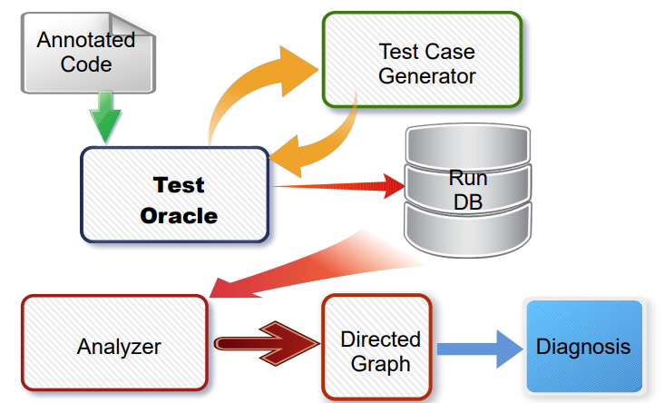
Augmenting Automated Black Box
Testing with Abductive Reasoning
Doha Ara, Ross Rannells and Dr. James Hill
Indiana University School of CSCI
Indiana University-Purdue University Indianapolis
Automate black-box testing by integrating an abductive reasoning artificial intelligent (AI) engine into the testing process to identify and locate errors during the testing process.
Apply our approach to software and models used for design and implement autonomous vehicles.
Introduction
Objectives
Modern software systems, e.g., large scale web sites, autonomous vehicles, are large collections of software must be thoroughly tested.
Testing is a painstaking process that results in limited application of valid techniques, e.g., black box testing
Limited application produces gaps and/or bias in software validation & verification
e.g., how do we know we wrote the correct code we are testing?
Data and Research Methodology
1. Load Annotated
Code to Oracle
2. Get Test Cases from
Test Case Generator
3. Store Test Results
to Database
4. Load Test Data Into
Analyzer
5. Generate Directed
Graph
6. Abduce Diagnosis
Created test case generator for numerical values; extending to other built-in types and abstract data types
Created engine that can auto-generate black box test oracles for Java code without any human intervention
Implemented Parsimonious Covering Reasoning engine that can find primary cause of error(s) in test applications
Conclusions
Results
Our approach will produce unbiased test results that validate systems requirements.
Our approach can easily integrate into a CI/CD pipeline allowing for earlier error detection.
Next steps, apply our approach on real-world software applications

