Slide 1
Database and Invoicing Application for Small Business - Implementation
David K. Hwang
Kansas State University
CIS598 – Fall 2019

Slide 2
Overview
Application Flow and GUI Design
Database Structure
Current Progress
Current Issues
Timeline

Slide 3
Application Flow
Simple Application States:
Initialization ➔ Wait for user input ➔ Update Model/View based on given input

Slide 4

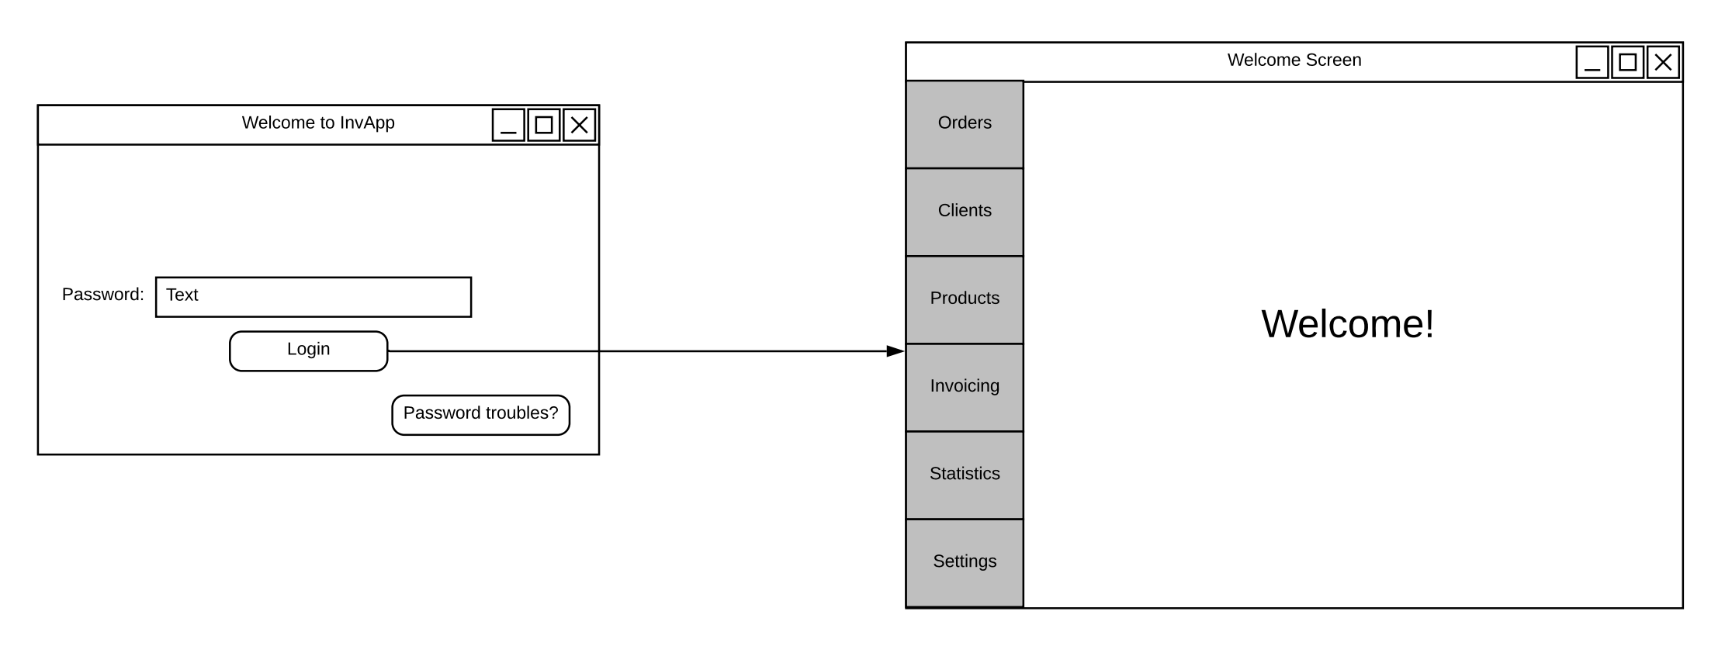
Login

Slide 5
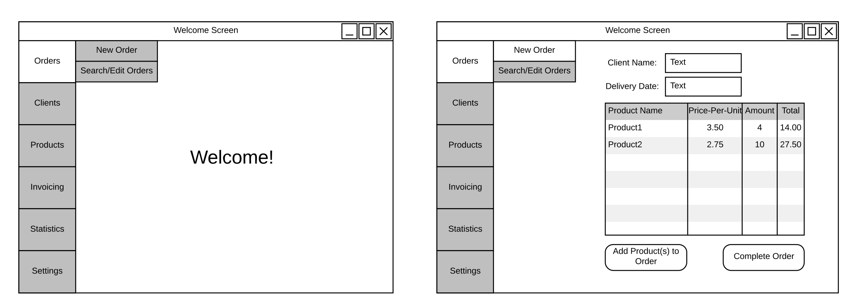
New Orders

Slide 6
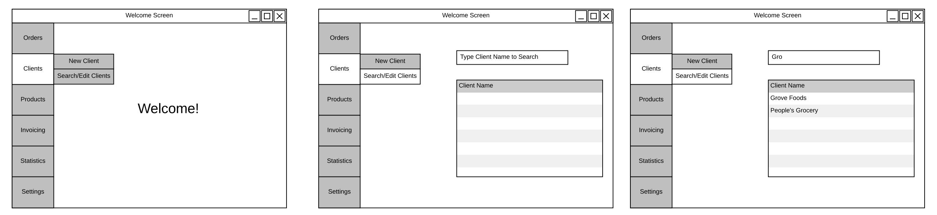
Searching for Client Info

Slide 7
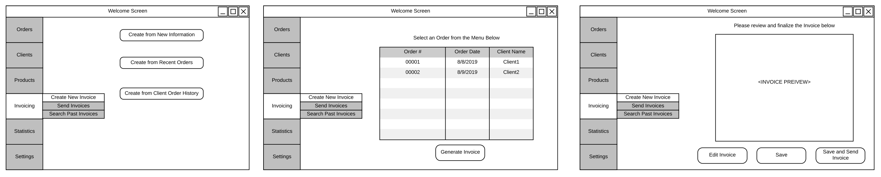
Creating Invoices

Slide 8
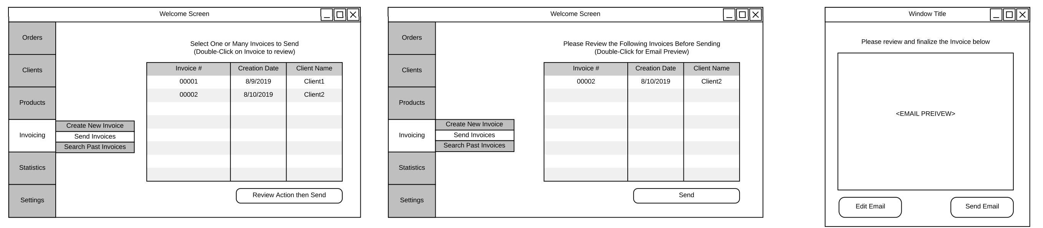
Sending Invoices

Slide 9
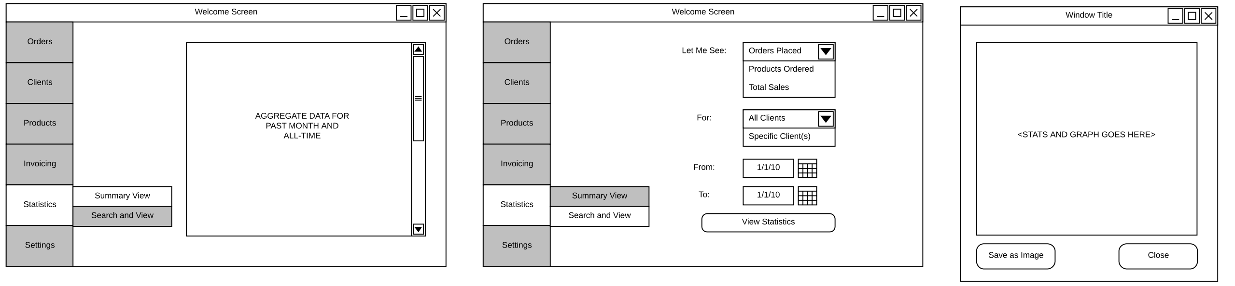
Viewing Statistical Information

Slide 10
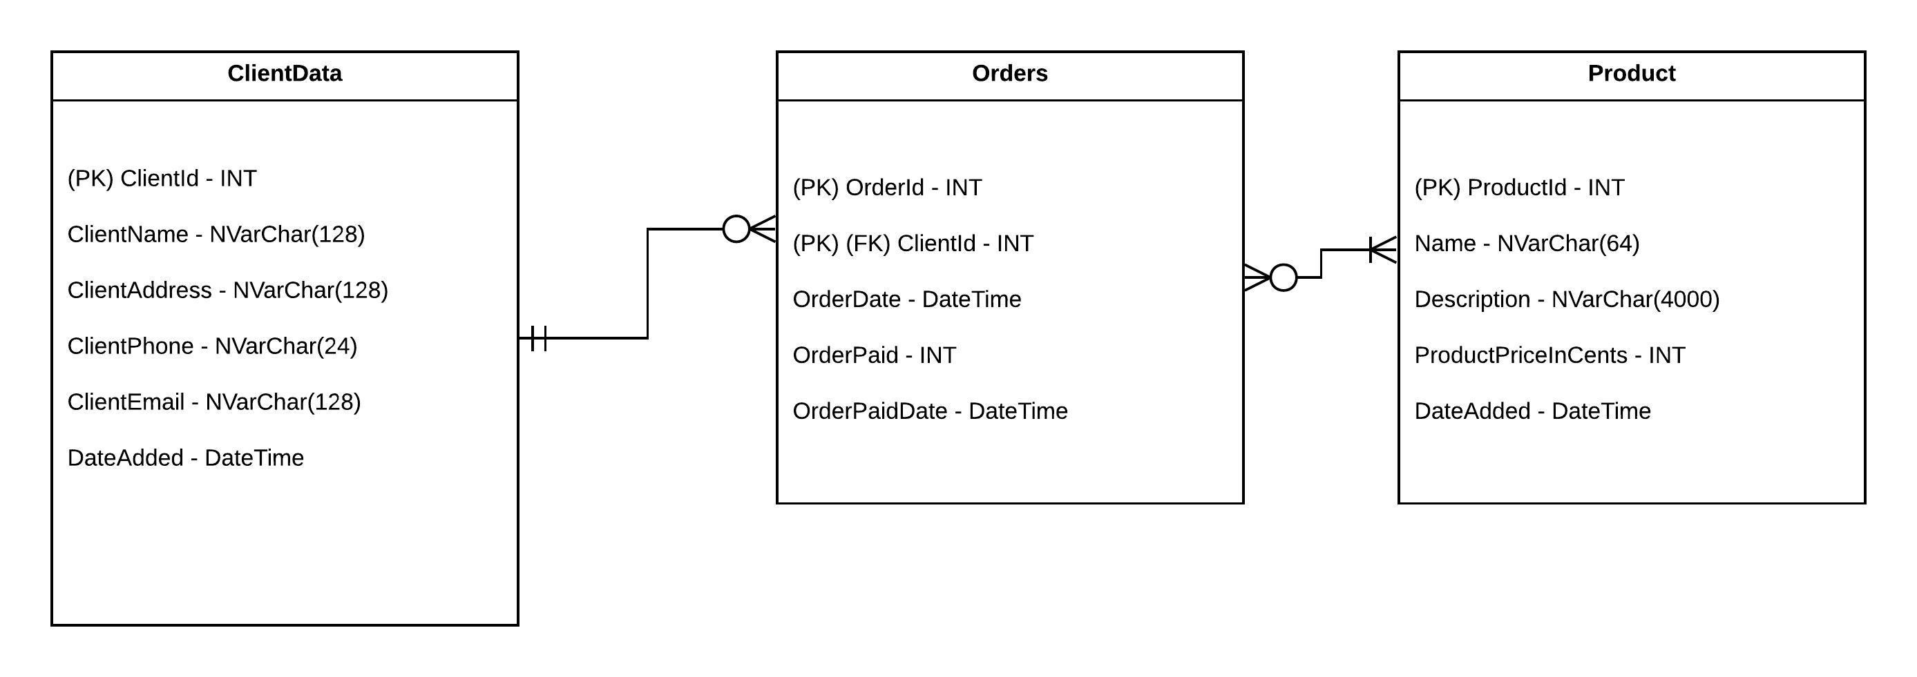
Database Structure

Slide 11
Current Progress
Lots of time dedicated to learning the LGPL version of Qt
Less features and no updated Qt designer == GUI coding w/o designer interface
MVC framework in python/pyqt5 has been created and properly connected
Basic GUI created

Slide 12
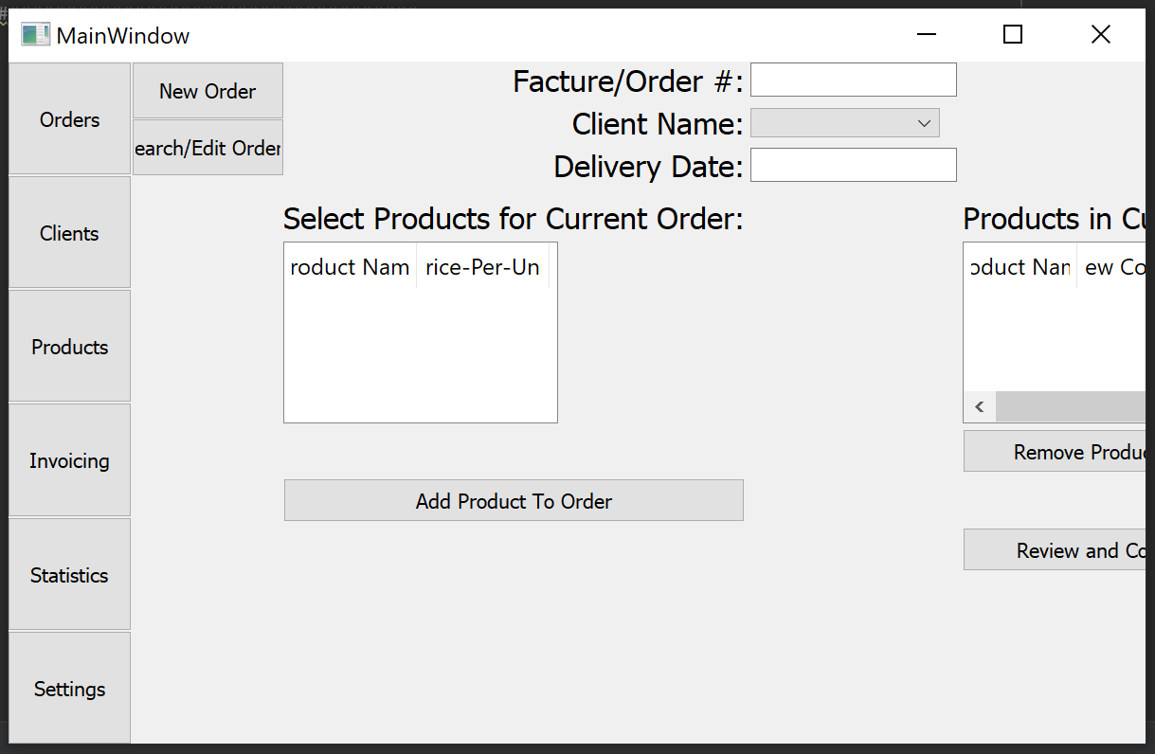

Slide 13
Current Issues
GUI sizing/resizing by user
Need more time to figure out Qt parameters to account for this
Portability
Program will need to include a complete installer so that user can instantly start using the program
Pysqlcipher3 has a few levels of dependencies (i.e. pysqlcipher => SQL cipher => OpenSSL library)
May need to switch to alternative security method of encrypting the database when not in use and decrypting upon user input of the password

Slide 14
Questions?

