Slide 1
ACGO Alcohol and Gaming Commission of Ontario
Senior Data Scientist Technical Assessment
Derya Kici
deryakici@gmail.com
June 1, 2023

Slide 2
Objective
Develop a predictive model using the given dataset on Chicago restaurant inspections. The aim is to identify establishments at a higher risk of violations.

Slide 3
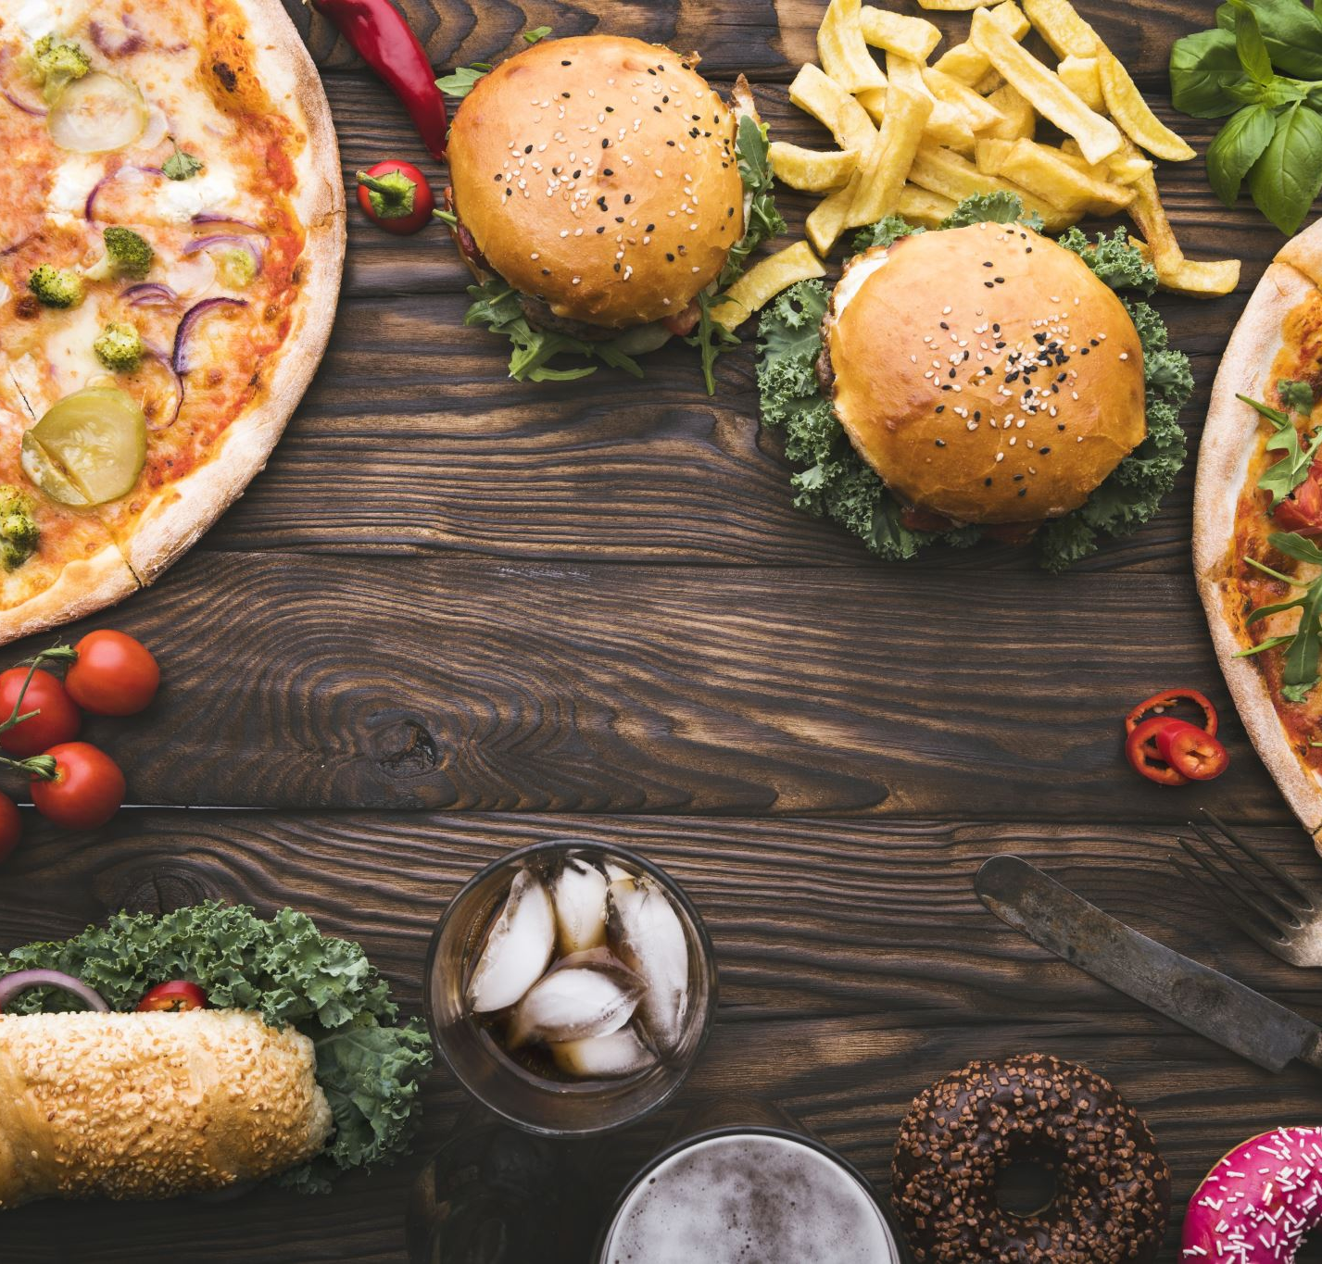
Dataset
Food Inspections and Violations dataset that contains information about food safety inspections performed by the Chicago Department of Public Health at various food establishments located in the city of Chicago.

Slide 4
Understanding Data
135,742 observations and 17 features
All features are either nominal or categorical
Inspection Id is the unique numbers for each inspection
30,792 Licence #. Each includes several different inspections with different dates and different inspection type
There are 33 inspection types (e.g. Complaint, Licence, Canvass etc.)
DBA Name and AKA name refers to the name of the establishments.
Each establishments has a facility type. There are 331 different facility type such as Restaurant, Grocery Store, School and so on

Slide 5
Understanding Data cont’d
There are 7 features related to the address and geographical location of the establishment: Address, City, State, Zip, Latitude, Longitude, and Location
Inspection Date
Violations refers to the specific violation id and description of the violations in addition to the comments.
Results might also be used as a target variable to predict if the establishment pass or failed the inspection. It has 7 categories: Pass', 'Not Ready', 'Fail', 'Out of Business', 'No Entry', 'Pass w/ Conditions', 'Business Not Located'
Target Variable: Risk
Risk 1 (High)
Risk 2 (Medium)
Risk 3 (Low)

Slide 6
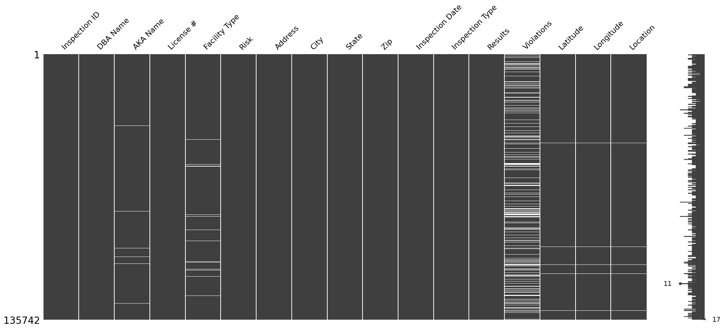
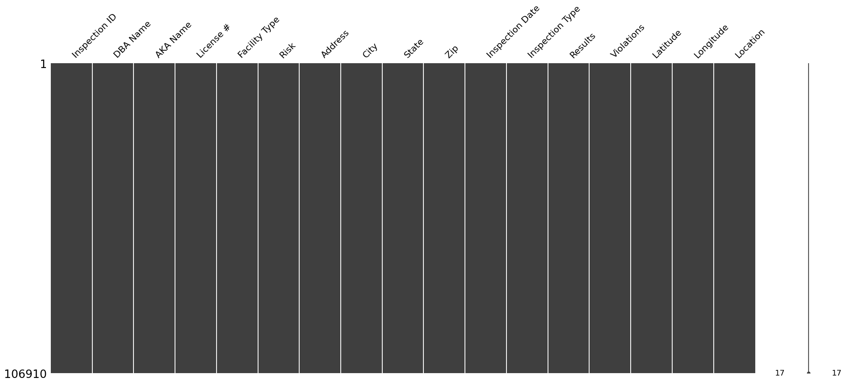
Missing and Duplicated Data
22% of the data is missing
When we remove the missing values, we still have over 100K data
There is no duplicated observations

Slide 7
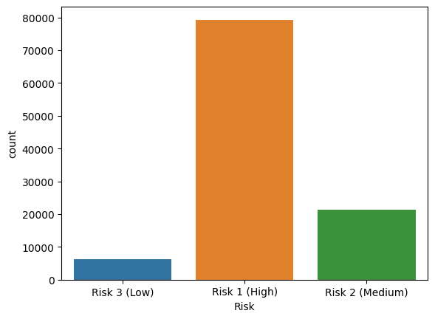
Target Variable - Risk
Imbalanced data
Risk2/Risk1: 0.27
Risk3/Risk1: 0.28
Risk3/Risk1:0.77
I will implement sampling strategy to balance dataset

Slide 8
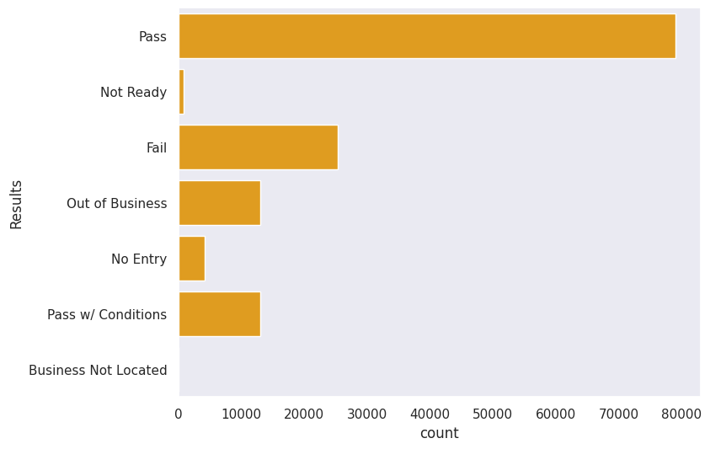
Alternative Target Variable - Results
It is also imbalanced.
If I will decide to predict result for the establishments, I will need to balance this variable too.

Slide 9
The feature(s) for prediction
Some of these features are redundant
It cause high volume of data
It requires too much memory, GPU, and time
Therefore, I eliminated some features:
Inspection Id, DBA Name, AKA Name, and Licence # do not affect the risk level
Address, City, State, Zip, Latitude, Longitude, and Location
Results: we aim to predict risk level not the result
Features selected:
Inspection Type
Facility Type
Violations
Inspection Date (Date component might have an effect on the risk level)
P.S. My initial analysis revealed that there is not a significant impact of date component on the model, then I removed that feature.

Slide 10
Exploratory Data Analysis
Predictor variables
Inspection Type – 57 categories
Facility Type – 412 categories
Violations - 46 categories
Inspection Date– 3 components (month -12, day: 31, year – 3 categories)
Target variable
Risk

Slide 11
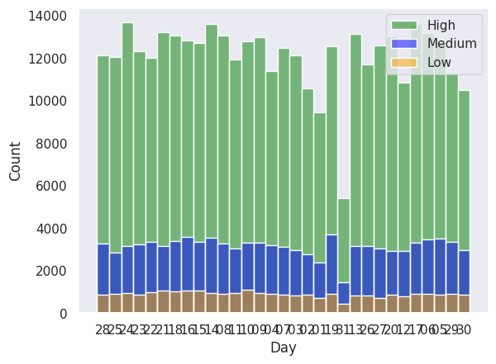
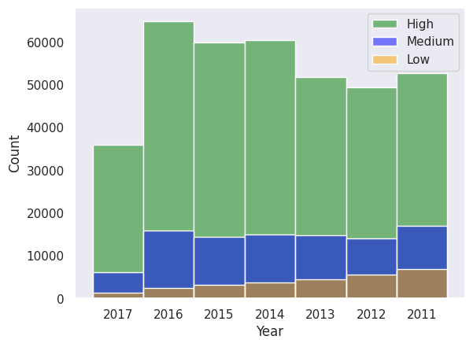
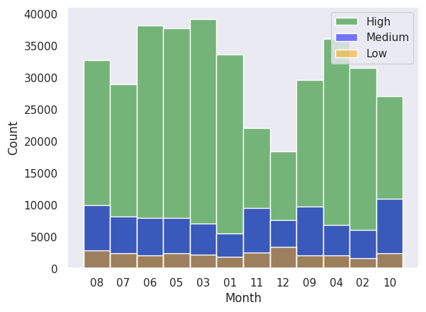
Risk Levels by Year, Month, and Day

Slide 12
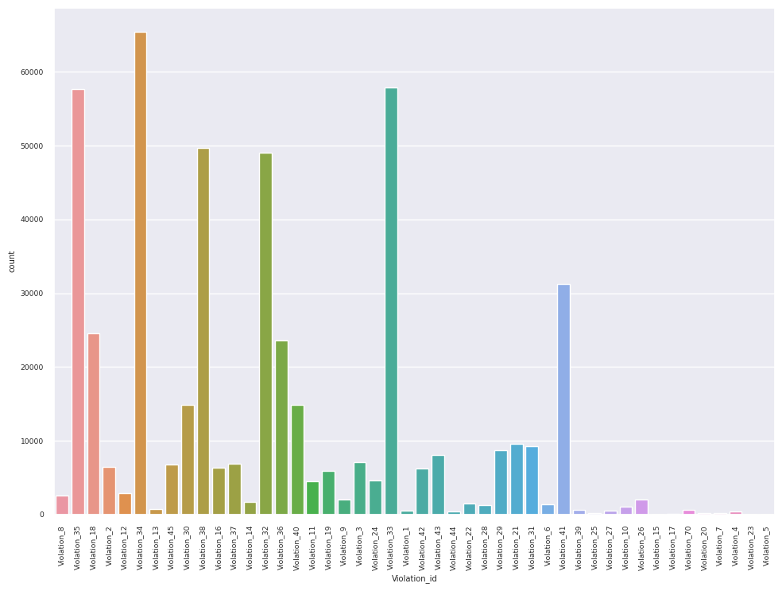
Violations
Violations feature required an important data preprocessing due to
the data is in text
Includes more multiple violation in the same data field
The format of the data
violation id,
violation description, and
Comments
for each violation
For details, please see Appendix A

Slide 13
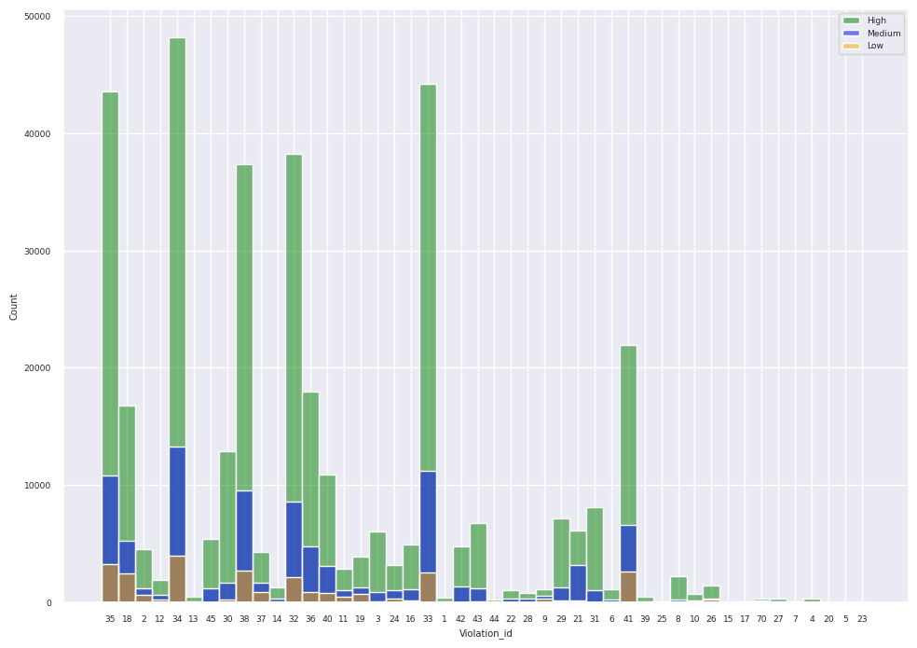
Risk Level by Violations
Some violations are listed more frequently in high level risk situation rather than some others.
For example,
Violation 35 are listed 57,658 in total and 43, 556 are in high risk level (75%)
Violation 18 are listed 24,588 in total and 16,782 are in high risk level (68%)

Slide 14
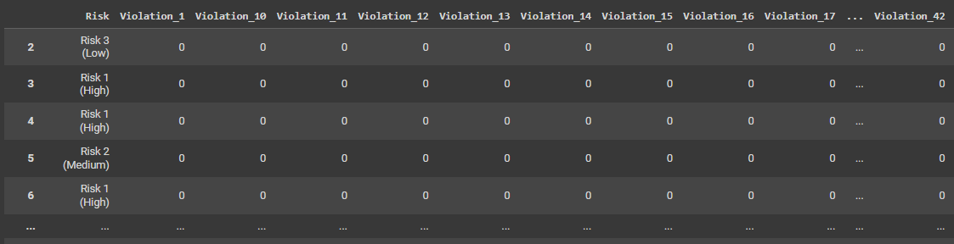
Data after preprocessing
460 features including the target feature
(categories for Inspection Type + categories for Facility Type + categories for Violations + 12 columns for month + 31 column for days + 3 columns for year)

Slide 15
MODELS
3 models are conducted
Base Model (Gaussian Naïve Bayes
Machine Learning Model (Decision Tree)
Deep Learning Model (Deep Neural Network)
Imbalanced Data
Without sampling
Over sampling
Random Over Sampler
SMOTE Over Sampler
Under sampling
Random Under Sampler
Near Miss Under Sampler
Train – Test Split: 70/30

Slide 16
Sampling Techniques
Random Undersampling
reduces the number of majority class randomly down to the desired ratio against the minority class.
NearMiss
selects samples from the majority class for which the average distance of the k nearest samples of the minority class is the smallest.
SMOTE
the minority class is over-sampled by creating “synthetic” examples rather than by over-sampling with replacement
Random Oversampling
balances the data by replicating the minority class samples.

Slide 17
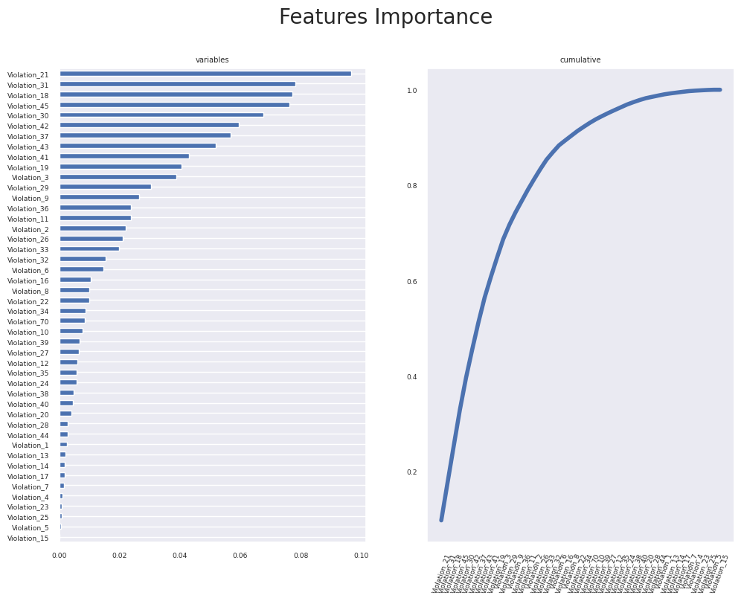
Feature Selection
As it is shown in the graphs, half of the violations have very little effect.
Then, we can either remove them or combine them in one feature called “Other”

Slide 18
Most Effective Features 50 out of 410 features
Violations
3, 16, 18, 19, 21, 30, 31, 32, 33, 34, 35, 36, 37, 38,, 41, 42,43.
Facility Type
Liquor, Bakery, Grocery Store, Restaurant, School, Daycare (2 - 6 Years), TAVERN, Mobile Food Dispenser, Children's Services Facility, Daycare Above and Under 2 Years, Mobile Food Preparer', Wholesale, Long Term Care, Catering, Daycare Combo 1586, GAS STATION', Hospital, Daycare (Under 2 Years), STADIUM, Golden Diner, CONVENIENCE, LIVE POULTRY'
Inspection Type
License, Canvass, Canvass Re-Inspection, License Re-Inspection, Complaint , Short Form Complaint, Complaint Re-Inspection, Task Force Liquor 1475, License-Task Force, Suspected Food Poisoning

Slide 19
Examples of Violations
Violation 18
NO EVIDENCE OF RODENT OR INSECT OUTER OPENINGS PROTECTED/RODENT PROOFED, A WRITTEN LOG SHALL BE MAINTAINED AVAILABLE TO THE INSPECTORS
Violation 16
FOOD PROTECTED DURING STORAGE, PREPARATION, DISPLAY, SERVICE AND TRANSPORTATION.
Violation 33
FOOD AND NON-FOOD CONTACT EQUIPMENT UTENSILS CLEAN, FREE OF ABRASIVE DETERGENTS

Slide 20
EVALUATION
According to the results of the analysis,
For the baseline model, the best results obtained from SMOTE and Random Under Sampling data with approximately 76% accuracy
For the Decision Tree model, the best results are provided on the imbalanced dataset with 79% accuracy.
For the DNN model, results are almost the same with the Decision Tree model on all dataset.
Considering both the evaluation metrics and run time, I selected Decision Tree model for prediction model.

Slide 21
CONCLUSION
I implemented 3 different models on 5 version of the data to find the best model:
Base Model: Naïve Bayes
Machine Learning Model: Decision Tree
Neural Network Model: DNN
Comparison of the results from 15 models, Decision Tree model is selected as the classification model.
These results can be improved by DNN model with more layers and hyperparameter tuning however due time restriction, I did not prefer to implement it in this assignment,
As classification on test data showed that 10,562 of the establishments out of 17,590 have higher risk of violations.
A few examples of those establishments are
"GRECIA'S PIZZA", "FLACO'S TACOS", 'BLANCO & NEGRO RESTAURANT', 'PITA EXPRESS', 'JARVIS GYROS', "JOE'S SEAFOOD, PRIME STEAK", 'REGGAE ISLAND JERK CHICKEN, INC', 'ANMOL RESTAURANT', 'PIZZERIA CALZONE', "BACINO'S OF LINCOLN PARK LTD"

Slide 22

References
https://towardsdatascience.com/how-to-deal-with-imbalanced-data-in-python-f9b71aba53eb
https://hersanyagci.medium.com/under-sampling-methods-for-imbalanced-data-clustercentroids-randomundersampler-nearmiss-eae0eadcc145

Slide 23

APPENDICES

Slide 24
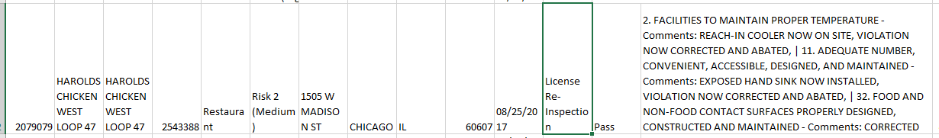
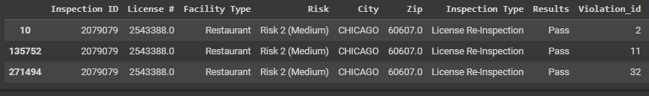
Appendix A: Data preprocessing for Violations
Example Inspection ID 2079079
There are 3 violations in this field:
Violation 2
Violation 11
Violation 32

Slide 25
Appendix B: Evaulation Metrics
Data | metrics | Naïve Bayes | Decision Tree | DNN
Imbalanced | accuracy | 0.27 | 0.79 | 0.79
 | precision | 0.8 | 0.75 | 0.75
 | recall | 0.27 | 0.79 | 0.79
 | f1-score | 0.21 | 0.75 | 0.75
Random Under Sampling | accuracy | 0.76 | 0.65
 | precision | 0.73 | 0.74
 | recall | 0.76 | 0.68
 | f1-score | 0.68 | 0.69
Near Miss Under Sampling | accuracy | 0.67 | 0.52
 | precision | 0.62 | 0.71
 | recall | 0.67 | 0.52
 | f1-score | 0.64 | 0.58
Random Over Sampling | accuracy | 0.26 | 0.67
 | precision | 0.8 | 0.74
 | recall | 0.26 | 0.67
 | f1-score | 0.2 | 0.69
SMOTE | accuracy | 0.76 | 0.66
 | precision | 0.7 | 0.74
 | recall | 0.76 | 0.66
 | f1-score | 0.67 | 0.69
Note: Deep Neural Network model is only conducted on the imbalanced dataset since this model
has capability to cope with imbalance data.

Slide 26
Thank You
Questions & Comments

