Slide 1
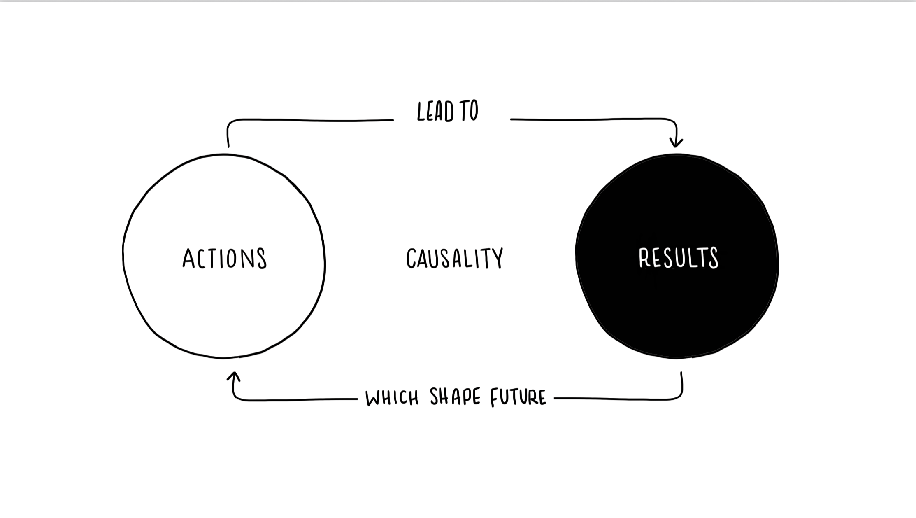
Test Slide
TestImage

