Slide 1
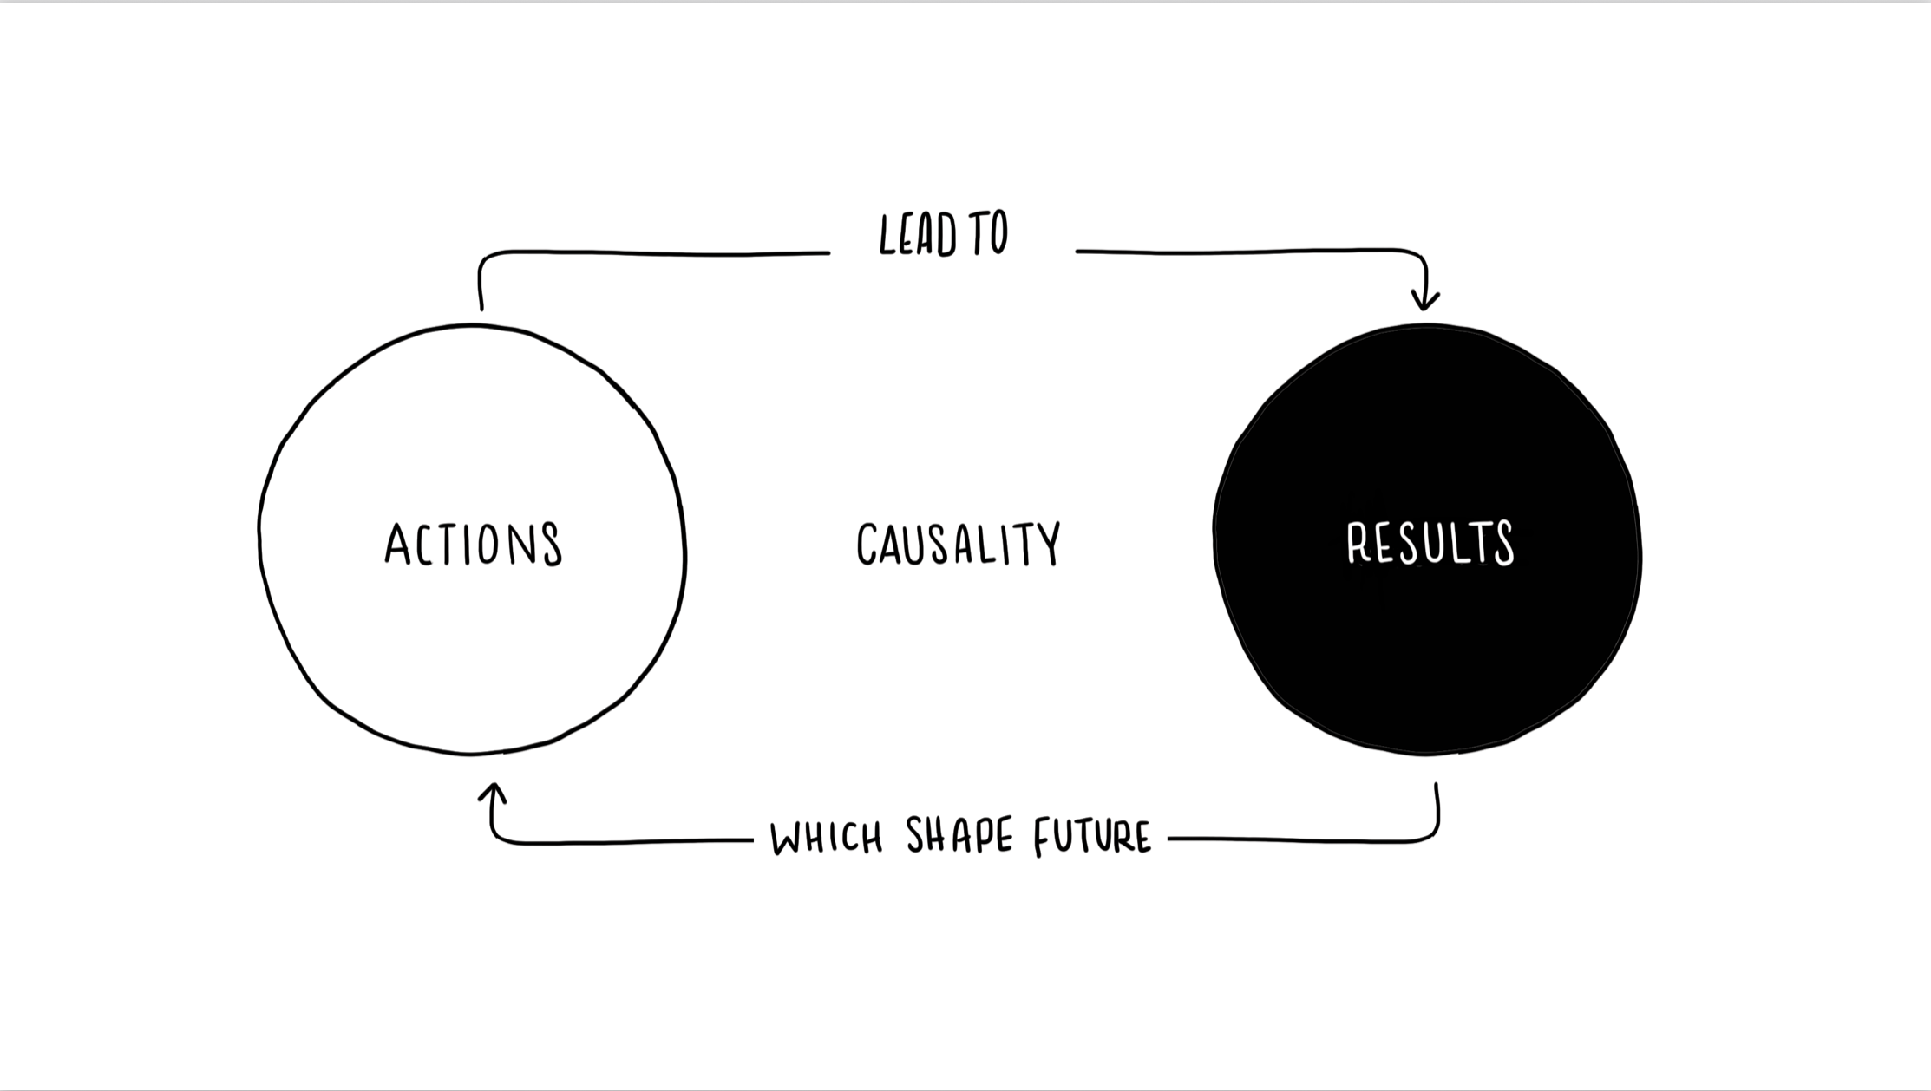
Test Slide with Image Outside Div
Content inside the div
TestImage

