Slide 1
Sandboxing in Operating Systems
Austin Kim
CPSC 351-04

Slide 2
What is Sandboxing?
The practice of placing immutable restrictions on a process's access to system resources
“Horizontal” slice of the access matrix
  Each process belonging to a row (domain) has only a limited set of capabilities (permissions)
Allow access to a limited subset of system calls

Slide 3
But… Why?
Any call to fork() → child process inherits all of parent’s permissions!
  NEED to restrict and control each process’s access to system resources
Defense in depth
  Even if malicious code gets through, its ability to do damage should be limited

Slide 4
Sandboxing Examples
Plan 9 from Bell Labs – namespaces
  Every system resource is a file, every file gets a pathname, every pathname need not be the same for all processes
Linux inherits this idea
  Linux namespaces
Idea also expanded upon by other tools:
  chroot
  systemd-nspawn

Slide 5
Sandboxing Examples: chroot
Largely limited to file access sandboxing
  The Good: Everything* is a file anyway
  The Bad: Can’t do anything about non-file resources (e.g. network sockets)
  The Ugly: Well-documented and trivial ways to break out of chroot
Easy to use, lightweight “VM”
Much more secure alt. in FreeBSD jail

Slide 6
Sandboxing Examples: chroot
Using chroot:
  Create a new “root” directory & copy over essential files
    Usually automated by other programs (e.g. debootstrap)
  Create symlinks to other resources the process should have access to
  Done!
  Run ‘chroot DIR CMD’ to run CMD with DIR as root.

Slide 7
Sandboxing Examples
chroot isn’t exactly satisfactory
  Can’t isolate non-file resources
  Have to explicitly execute programs under chroot at runtime
Need a way to tie groups of processes to access matrix slices
  Linux namespaces
  cgroups
  POSIX process grouping

Slide 8
Sandboxing Examples: cgroups
Short for “control groups”
Group processes under controllers (also called resource controllers or subsystems)
  Each controller is allowed only a subset of resources
Defined as a virtual filesystem (cgroupfs)
Two versions
  v1: Written in 2008
  v2: Attempt to consolidate dir hierarchy into a single standard
Adding process to a cgroup:
  Simply write PID to cgroups.procs file under the subsystem directory!

Slide 9
Sandboxing Examples: cgroups
Adding a new process subgroup under the cpu group in cgroups v1:
  Create a new directory under the cpu group:
    /sys/fs/cgroup/cpu/mygroup
  Create a new cgroups.procs file under that directory:
    /sys/fs/cgroup/cpu/mygroup/cgroups.procs
  Write the PID of process to that file
  Done.

Slide 10
Sandboxing Examples: cgroups
A short selection of cgroups controllers:
  cpu/
    All processes under this group are guaranteed to be assigned at least some CPU cycles even when the system is busy
  devices/
    This controller group allows its processes to read and write to devices, such as disks
  freezer/
    These processes are allowed to be frozen at-will depending on the need of the system
  pids/
    this controller group is has a hard limit on how many child processes they may spawn

Slide 11
Sandboxing Examples
What if process X doesn’t fit well in any controller groups in cgroups?
  A readonly process that can also write to the printer spool
OS needs some sort of mechanism for placing hard limits on system calls
  Some kind of a secure computing mode...
seccomp

Slide 12
Sandboxing Examples: seccomp
Short for “secure computing mode”
Enabled at kernel compile time
  Flag: CONFIG_SECCOMP=y
Two main modes:
  SECCOMP_SET_MODE_STRICT
    Only allows read(), write(), exit(), sigreturn()
  SECCOMP_SET_MODE_FILTER
    Allowed list of system calls are passed as a pointer to a Berkeley Packet Filter (BPF)
Any system calls outside the allowed list results in process being terminated

Slide 13
Sandboxing Examples: seccomp
Seccomp is seems easy at a glance
  Invoke prctl() to escalate the process to seccomp mode:
    prctl(PR_SET_SECCOMP, SECCOMP_MODE_STRICT);
      Strict mode
    prctl(PR_SET_SECCOMP, SECCOMP_MODE_FILTER, filter);
      Filter mode, only allow syscalls listed under filter variable
Now… the Berkeley Packet Filter
  BPF has its own assembly-like syntax
  BPF rules have to be defined as a structure at compile time

Slide 14
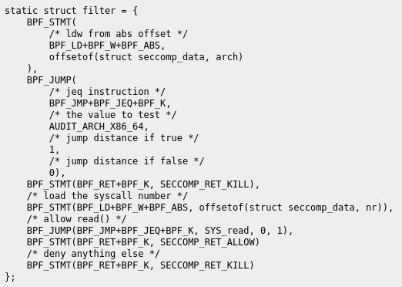
Sandboxing Examples: seccomp
BPF structure example:
Source: “Denying syscalls with seccomp.” Eigenstate. https://eigenstate.org/notes/seccomp. Accessed 19 Apr. 2020.

Slide 15
Conclusions
Sandboxing as a concept is simple enough
  Get a horizontal slice of the access matrix, or manually partition resources depending on the process needs
The devil is in the details
  Filesystem based sandboxing? (chroot)
  Process grouping? (cgroups)
  Hard-coded separate computing mode? (seccomp)
  Among countless others
Sandboxing is critical
  Defense in depth
  Safeguarding data

