Slide 1
Code Signing
Chris Nutter, Austin Kim | CPSC 351-91

Slide 2
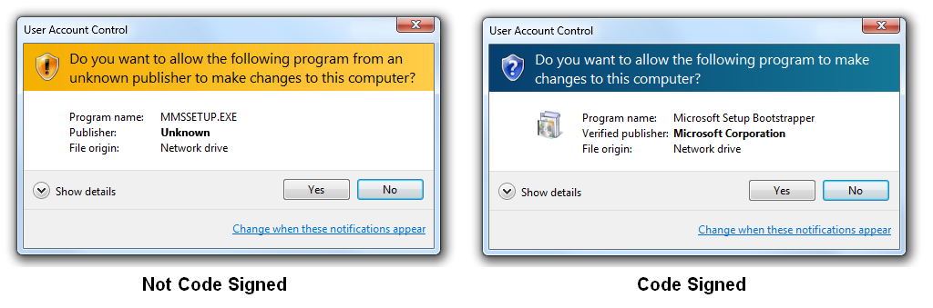
What is it and why is it important?
  Security and Protection
  Ensuring safety for consumers
  Verified through authorized CAs
https://www.ssl2buy.com/wiki/wp-content/uploads/2015/01/code-signing-certificates-warning-massage.png

Slide 3
Authentication and Integrity
  Authentication: Allows consumer to verify author
  Integrity: Verification of untampered code

Slide 4
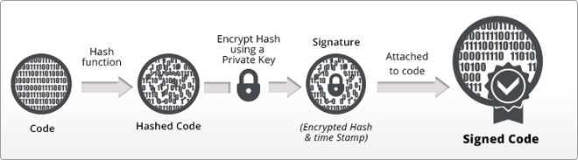
https://www.ssl2buy.com/wiki/wp-content/uploads/2015/01/code-signing-certificate.jpg

Slide 5
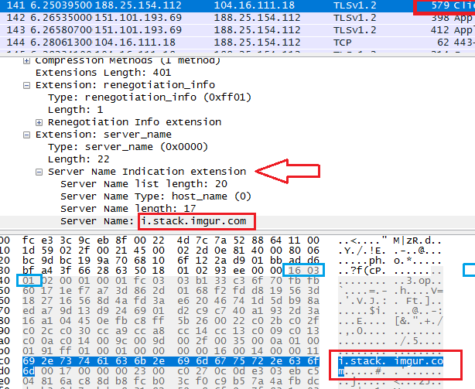
SSL/TLS Encryption
  Secure Sockets Layer
  Transport Layer Security
  Encrypted link between server and client
  Used for web servers around the world
  Very important for trusted businesses
  TLS evolved from SSL
https://stackoverflow.com/questions/499591/are-https-urls-encrypted?rq=1

Slide 6


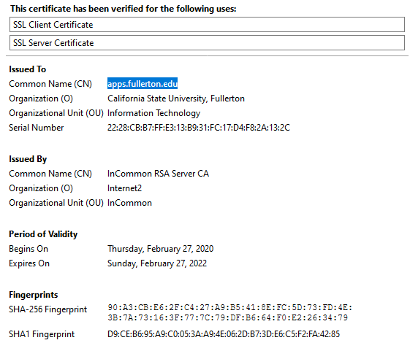


Slide 7
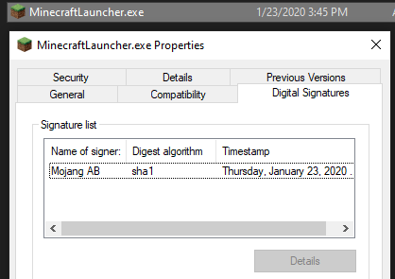
Process of Code Signing
  https://docs.microsoft.com/en-us/windows/win32/appxpkg/how-to-create-a-package-signing-certificate
  https://docs.microsoft.com/en-us/windows/win32/appxpkg/how-to-sign-a-package-using-signtool
  Buy or generate certificate using makecert. Buying = production.
  Signing process signtool sign /tr http://timestamp.digicert.com /td sha256 /fd sha256 /f "c:\path\to\mycert.pfx" /p pfxpassword "c:\path\to\file.exe"
https://docs.microsoft.com/en-us/dotnet/framework/tools/signtool-exe
https://stackoverflow.com/questions/252226/signing-a-windows-exe-file

Slide 8
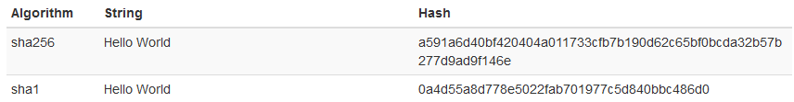
SHA-0 vs SHA-1 vs SHA-2
  Secure Hashing algorithms
  SHA-0: Created by National Security Agency
  SHA-1: Popular today but weak
  SHA-2: Recommended for high security

Slide 9
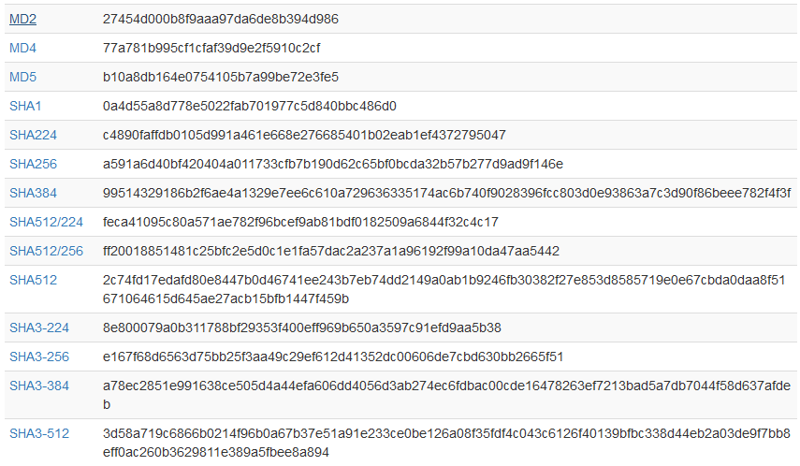

Slide 10

Example in Practice

Slide 11
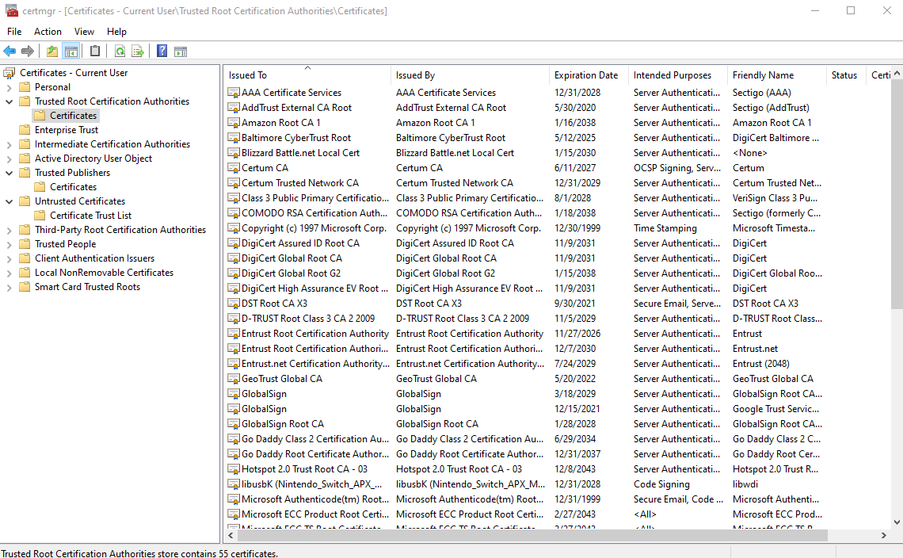
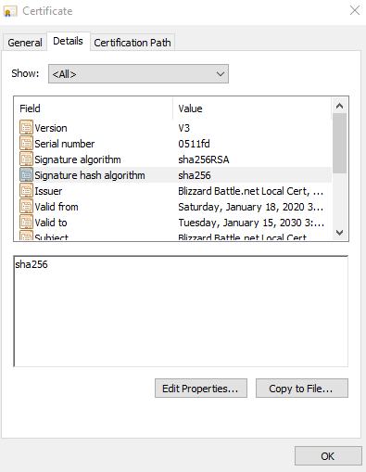

Slide 12
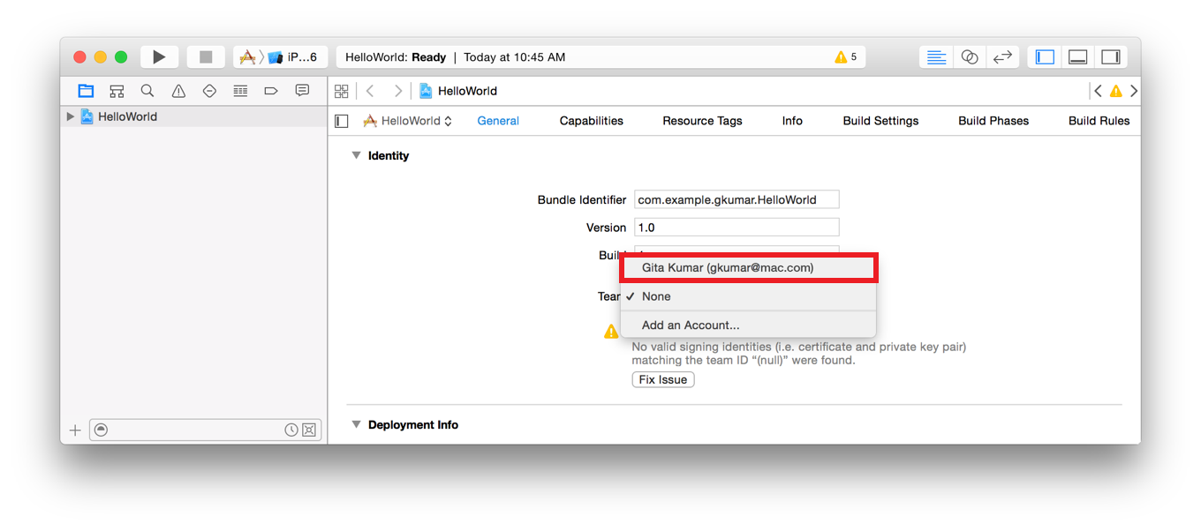
Apple Implementation
  Requires Apple Developer ID to submit
  Easy to use and obtain however requires higher monetary compensation
  Deteriorates independent developers with pricing through Apple’s end
https://devcenter.bitrise.io/img/code-signing/ios-code-signing/xcode_team_selector.png

Slide 13
Drawbacks
  Doesn’t 100% guarantee safe code
  Not typically free when using in business sense (with exceptions)
  Still not trustworthy with closed-source software

Slide 14
Conclusion
  Recommended and acceptable
  Mandated by various operating systems (Windows, MacOS, etc.)
  Essential for running trusted software

