Slide 1

U.S. Airline Safety – Statistics in Perspective
David Kinney – dsc640 – fall 2020
Professor dr. bushart

Slide 2
“I've spent my life as an airplane mechanic, pilot, aircraft manufacturer and airline CEO who never lost a life or an airplane. I am considerate of the risk we take every time we fly. I also know we need to fly and always to improve safety.”
- Gordon bethune

Slide 3
Introduction
Due to recent unfortunate airline crashes, the media has been promoting statistics stating air is no longer a safe way to travel. The news and media outlets have been bombarding the public with reports and figures about the trends of airline safety and that things are not looking good. What was previously thought as the safest way to travel, especially when compared to automobiles, is now being presented as one of the most dangerous to the public.
But are any of these claims based on facts?

Slide 4
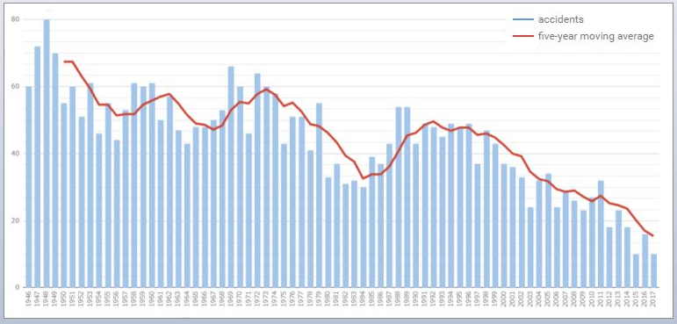
The Facts…
Airline accidents through 2017
Executive summary
While departures remained fairly consistent over the previous 20-year span, both accidents and casualties, as a percentage of departures, have continued downward trends.
Traffic fatalities continue to outpace airline fatalities by an order of magnitude, which would indicate that air travel still remains safer than travel by automobile.
U.S. Passenger airlines account for a relatively small portion of total air travel related fatalities.
While the major U.S. Passenger airlines struggled financially during the first decade of the 21st century, Net Profit has remained positive in recent years (through 2019).
Source: https://aviation-safety.net

Slide 5
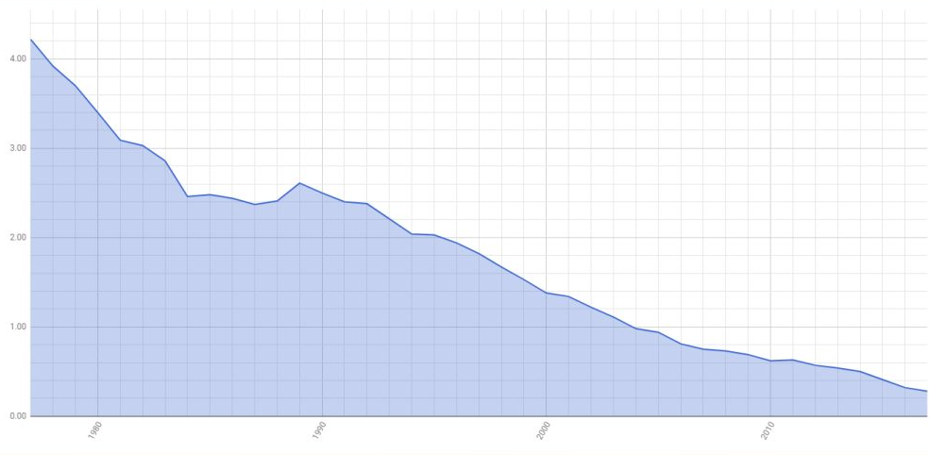
Airliner Accidents per 1 Million Flights 1997 - 2017

Slide 6
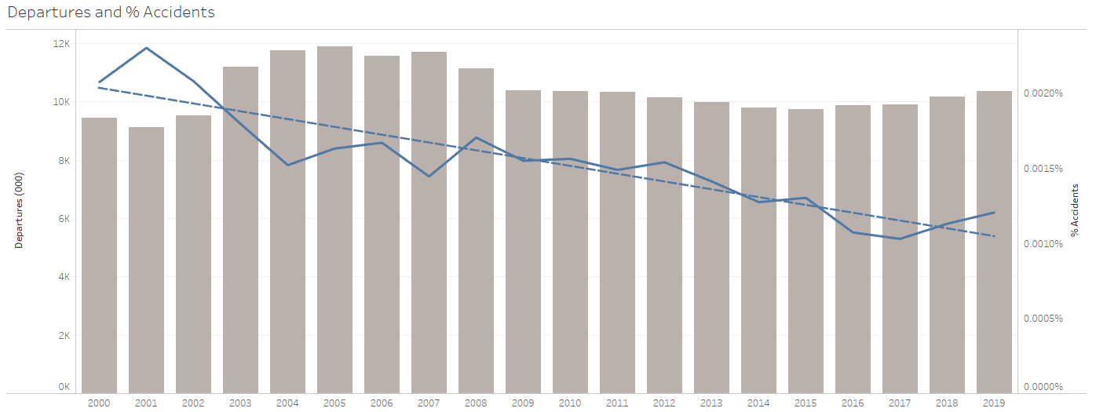
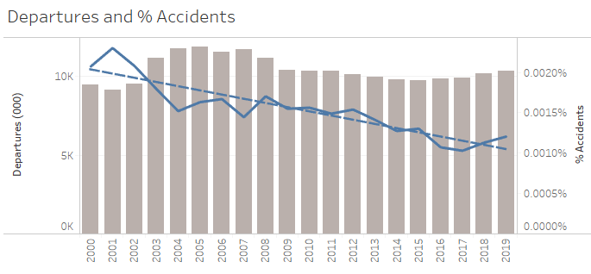
Accidents as a Percentage of Departures
Following a downward trend of airline departures from 2005 to 2015, volume has been steadily increasing. However over the course of the past two decades the percentage of accidents has consistently trended downwards.

Slide 7
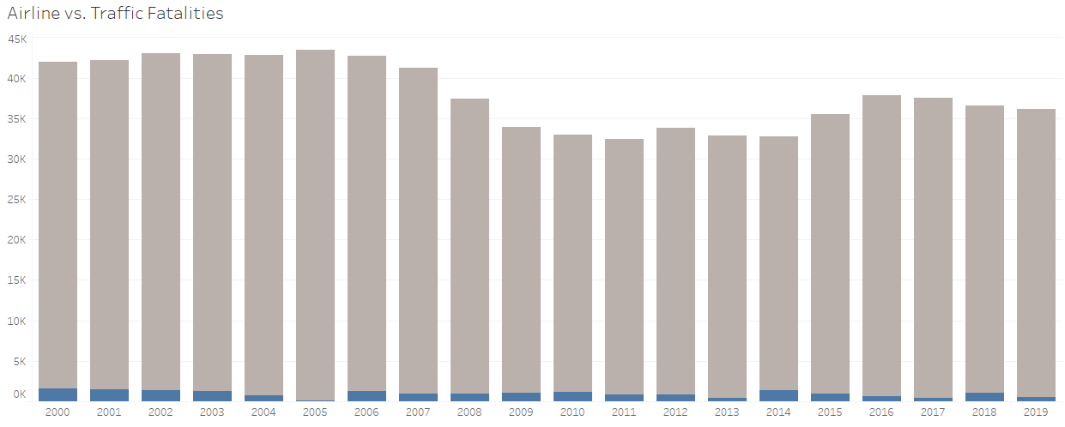

Airline vs. Traffic Fatalities
Media claims that airline travel has become less safe than by automobile are unsubstantiated by data.

Slide 8
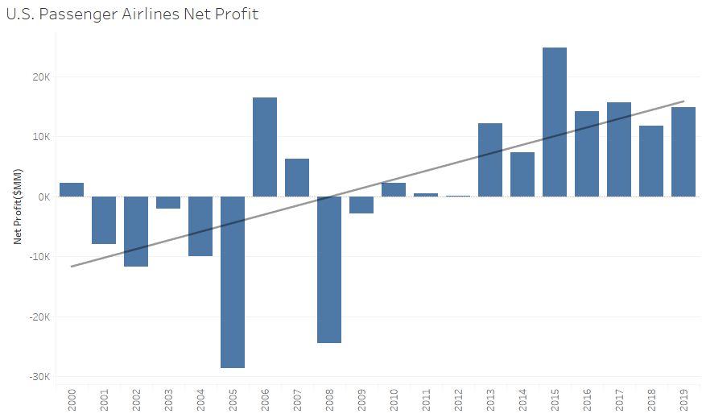
Net Profit remains strong despite the false claims.
While the first decade of the 21st century was a wild ride for the airline industry, profits are trending more positively over the second decade.

Slide 9

Safely Upward

Slide 10
References
Departures: https://www.airlines.org/dataset/annual-results-u-s-airlines-2
Accidents: http://www.baaa-acro.com/statistics
Airline Safety: https://github.com/fivethirtyeight/data/tree/master/airline-safety
Traffic Fatalities: https://en.wikipedia.org/wiki/Motor_vehicle_fatality_rate_in_U.S._by_year
Net Profit: https://www.airlines.org/dataset/annual-results-u-s-passenger-airlines
Additional source: https://aviation-safety.net

