Slide 1
D_Kinney_DSC640_Infographic
File created on: 11/07/2020 8:46:07 AM

Slide 2
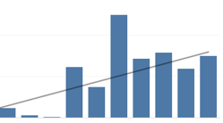

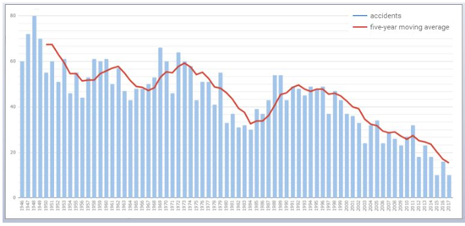
U.S. Airline Safety – Statistics in Perspective
Airline fatalities continue to dwarf those on U.S. roads…
Airline net profits trending up…
Year | Airline | Automobile
2010 | 1144 | 32999 | 3%
2011 | 828 | 32479 | 3%
2012 | 800 | 33782 | 2%
2013 | 453 | 32893 | 1%
2014 | 1329 | 32744 | 4%
2015 | 904 | 35485 | 3%
2016 | 631 | 37806 | 2%
2017 | 399 | 37473 | 1%
2018 | 1039 | 36560 | 3%
2019 | 578 | 36120 | 2%
While departures remained fairly consistent over the previous 20-year span, both accidents and casualties, as a percentage of departures, have continued downward trends.
Traffic fatalities continue to outpace airline fatalities by an order of magnitude; air travel remains safer than travel by automobile.
U.S. Passenger airlines account for a relatively small portion of total air travel related fatalities.
While the major U.S. Passenger airlines struggled financially during the first decade of the 21st century, Net Profit has remained positive in recent years (through 2019).
Airline accidents have consistently declined for over 7 decades…

