Slide 1


2017 Vehicle Fatalities Analysis
D. Kinney – dsc 530 – Spring 2019 – final project

Slide 2
Statistical Question & Variables for Analysis
Given the NHTSA statistics for national vehicle fatalities in 2017, is it possible to identify the predominant causes?
Conversely, is it possible to identify variables that do not reflect a direct cause?
Focus Variables
Month of Crash
Day of Crash
Day of Week
Hour of Crash
Type of Roadway
Manner of Collision
Light Condition
Atmospheric Condition

Slide 3
Variable Definitions
Variable | Definition
Month of Crash | The month in which the crash occurred.
Day of Crash | The day of the month on which the crash occurred.
Day of Week | The day of the week on which the crash occurred.
Hour of Crash | The hour at which the crash occurred.
Type of Roadway | Interstate, State Route, Major Artery, Local Street, etc.
Manner of Collision | Describes the orientation of two motor vehicles in-transport when they are involved in the “First Harmful Event” of a collision crash.
Light Condition | The type/level of light that existed at the time of the crash.
Atmospheric Condition | The prevailing atmospheric conditions that existed at the time of the crash.
Source: Fatality Analysis Reporting System (FARS) Analytical User’s Manual 1975-2017
DOT HS 812 602 October 2018 National Highway Traffic Safety Administration

Slide 4
Notes along the way…
After initial histogram plotting, some data cleaning was performed…
FARS reports unknown hours as 99.
Manner of Collision: Not reported as 98 and Unknown as 99
Weather Conditions: Not reported as 98 and Unknown as 99
In all cases, these values were replaced with NaN
After plotting histograms, two of the initial variables were deemed to be unsuitable. Explanations follow…

Slide 5
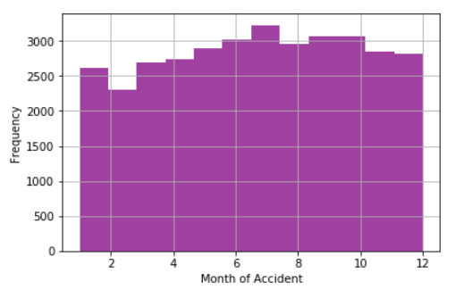
Descriptive Analyses
Month of Accident
Mean: 6.67
Spread: 11.36
Unimodal
No skew
July appears to have a slight edge over the other months, with February displaying the least number of fatalities. But the descriptive statistics do corroborate a more or less slightly curved spread across all months (the variance backs this as well).

Slide 6
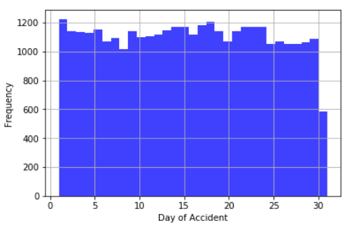
Descriptive Analyses
Day of Month of Accident
Mean: 15.66
Spread: 77.06
Uniform Distribution
No skew
I was not at all surprised by this one. Day of the month appears to be more or less irrelevant; it was removed from the analysis.

Slide 7
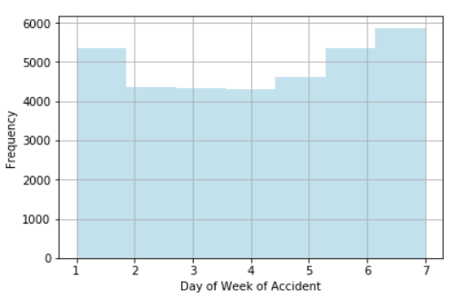
Descriptive Analyses
Day of Week of Accident
Mean: 4.11
Spread: 4.34
Bimodal
No skew
Not surprisingly, accidents begin to ramp up during the end of the work week, culminating in a high point on Saturdays.
Legend:
1 Sunday
2 Monday
3 Tuesday
4 Wednesday
5 Thursday
6 Friday
7 Saturday

Slide 8
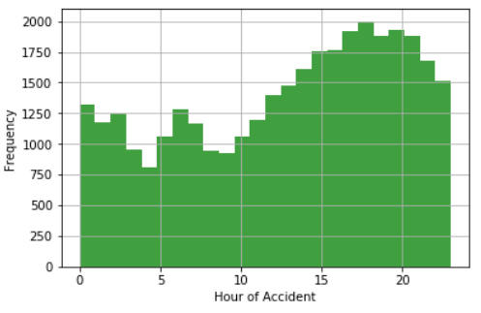
Descriptive Analyses
Hour of Accident
Mean: 12.9
Spread: 47.28
Unimodal
Left-tailed
I found this one particularly interesting (and surprising). The hour with most fatalities is around 7pm, with a steady increase beginning at 10am. I thought it would’ve been bimodal around morning and evening commute hours.

Slide 9
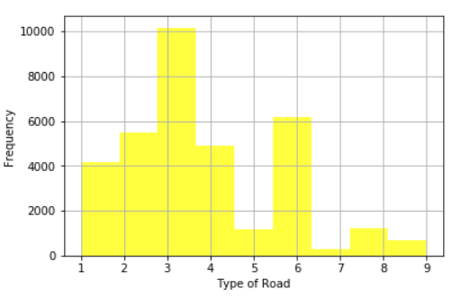
Descriptive Analyses
Type of Road
Mean: 3.68
Spread: 3.84
Fatalities on State highways were almost twice the number of the next closest road type—local municipal streets. My big surprise here was the relatively low number on interstates.
Legend:
1 Interstate
2 U.S. Highway
3 State Highway
4 County Road
5 Local Street – Township
6 Local Street – Municipality
7 Local Street – Frontage Road (Since 1994)
8 Other
9 Unknown

Slide 10
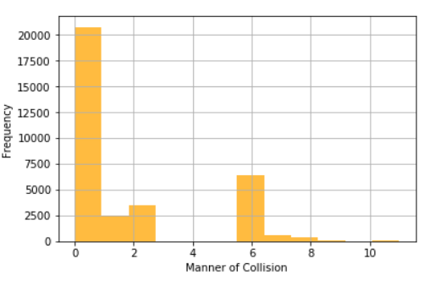
Descriptive Analyses
Manner of Collision
Mean: 1.64
Spread: 6.47
This could’ve been an interesting variable but sadly the overwhelming majority were coded as, “Not Collision with Motor Vehicle in Transport”. I’m not sure what that means; did the person hit a tree? A pedestrian? Abducted by aliens? There was no explanation, so I thought it best to drop it as a meaningful variable.

Slide 11
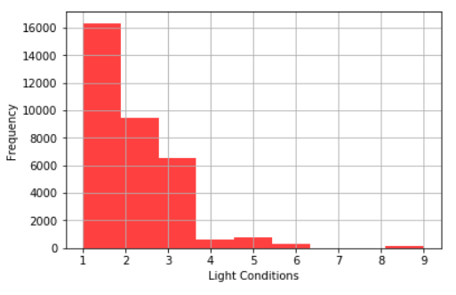
Descriptive Analyses
Light Conditions
Mean: 1.89
Spread: 1.33
Unimodal
Right-tailed
Another shocker—accidents in broad daylight were almost double the next closest category: dark – not lighted—which I would’ve thought would’ve been number one.
I was glad there were no “Other”’s; what would that even mean…
Legend:
1 Daylight
2 Dark – Not Lighted
3 Dark – Lighted
4 Dawn
5 Dusk
6 Dark – Unknown Lighting
7 Other
8 Not Reported
9 Unknown

Slide 12
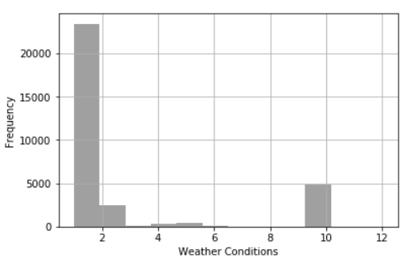
Descriptive Analyses
Weather Conditions
Mean: 2.57
Spread: 10.54
Similar to lighting conditions, the overwhelming majority of fatalities took place in clear weather conditions. The only other contenders was “cloudy” and “rain”.
Legend:
1 Clear
2 Rain
3 Sleet, Hail
4 Snow
5 Fog, Smog, Smoke
6 Severe Crosswinds
7 Blowing Sand, Soil, Dirt
8 Other
10 Cloudy
11 Blowing Snow
12 Freezing Rain or Drizzle

Slide 13
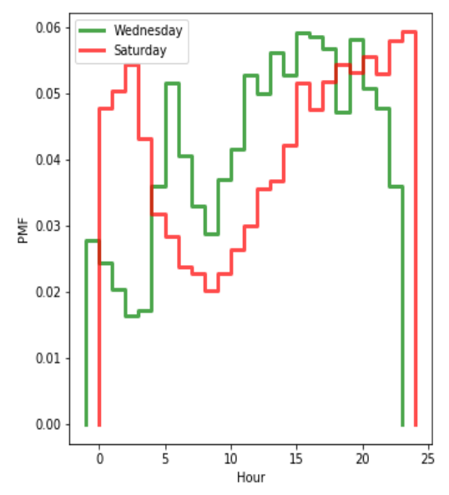
Probability Mass Function
Comparison of PMF for accidents that took place on Wednesdays and Saturdays, and the hour in which they occurred.
This bears out my earlier thoughts: Wednesday PMF is highest around rush hours, while Saturdays spike between midnight and 2am (tired and/or inebriated?).

Slide 14
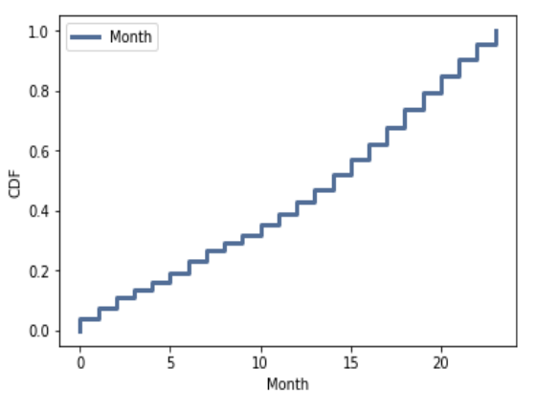
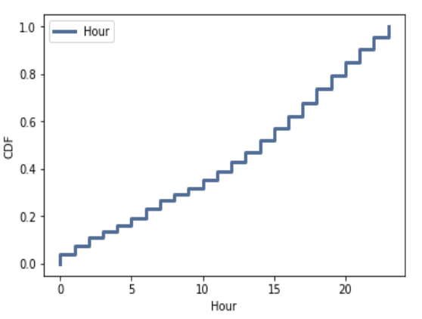
Cumulative Distribution Function
The CDF is fairly uniform.
Taking two data points, the CDF tells us that about 20% of the data points are between midnight and 5am. In the same fashion, about 20% are between 8pm and midnight.

Slide 15
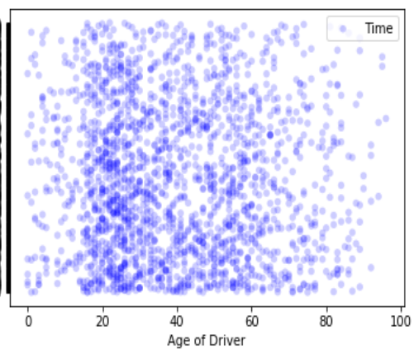
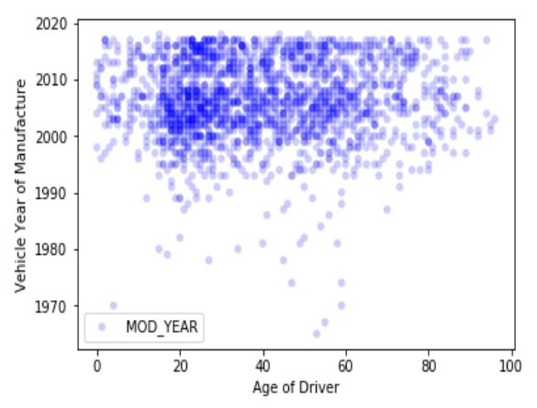
Scatter Plots
Time of accident as a function of driver’s age
Covariance and Pearson’s Coefficient are both near 0, defining no relationship between the variables.
Vehicle Year as a function of driver’s age
Covariance and Pearson’s Coefficient are both near 0, defining no relationship between the variables.

Slide 16
Hypothesis Testing
Day of Week as a function of Hour of Accident.
Pearson’s Correlation: 0.07
P-Value: 0.0
Correlation is small but statistically significant.

Slide 17
Regression Analysis OLS Regression Results
Dep. Variable: | DAY_WEEK | R-squared: | 0.002
Model: | OLS | Adj. R-squared: | 0.002
Method: | Least Squares | F-statistic: | 53.18
Date: | Sun, 02 Jun 2019 | Prob (F-statistic): | 3.12e-13
Time: | 19:03:43 | Log-Likelihood: | -73128.
No. Observations: | 33985 | AIC: | 1.463e+05
Df Residuals: | 33983 | BIC: | 1.463e+05
Omnibus: | 473061.577 | Durbin-Watson: | 1.651
Prob(Omnibus): | 0.000 | Jarque-Bera (JB): | 2530.983
Skew: | -0.083 | Prob(JB): | 0.00
Kurtosis: | 1.673 | Cond. No. | 31.2
 | coef | std err | t | P>|t| | [0.025 | 0.975]
Intercept | 3.9573 | 0.024 | 164.927 | 0.000 | 3.910 | 4.004
HOUR | 0.0120 | 0.002 | 7.292 | 0.000 | 0.009 | 0.015

