Slide 1
Monte Carlo: Tic-Tac-Toe
Dawson Kinsman and Sabastian Zuhorski

Slide 2
Research Questions
For each player, what are the probabilities of winning…
If each player choose a move randomly?
If each player strategizes?
Which first move leads to the highest probability of winning for Player 1?
Given that Player 1 has made the first move, what is the optimal move for Player 2?

Slide 3
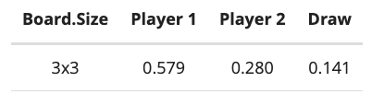
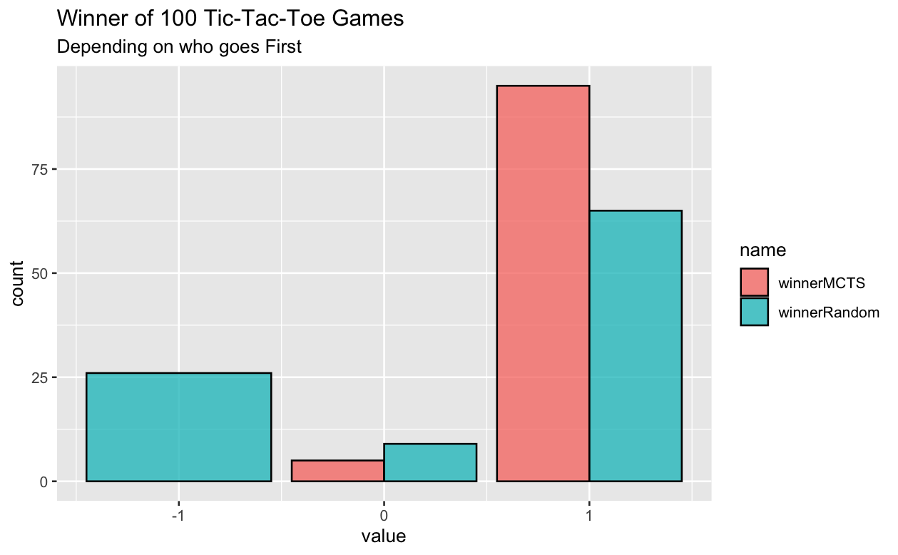
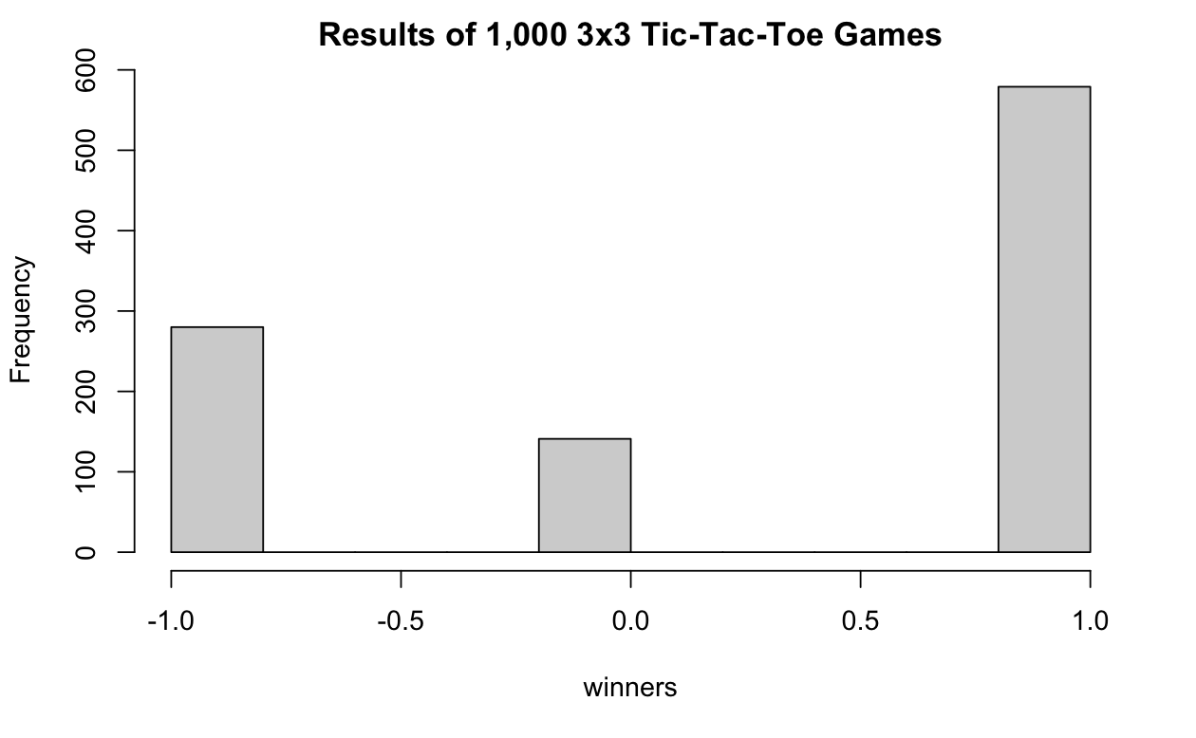
Probabilities Based on First Player

Slide 4
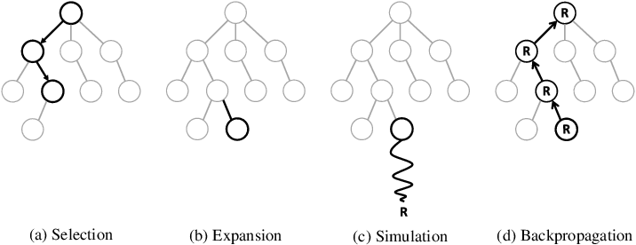
Monte Carlo Tree Search
Visualization: https://vgarciasc.github.io/mcts-viz/

Slide 5
Functions
if(!is.na(checkWin(root$board))) return (root$board)
ucb = c()
for (i in 1:length(root$children)){
kid = root$children[[i]]
ucb = append(ucb, findUCB(kid))
}
index = which(ucb==max(ucb))
if (length(which(ucb==max(ucb)))>1) index <- sample(which(ucb==max(ucb)), 1)
winnerNode = root$children[[index]]
root = winnerNode
cat('UCB:', ucb, '\nMaxUCB: ', max(ucb),
'\nNode UCB:', findUCB(root),'\n')
cat('\nNode visits: ', root$visits, '\nNode wins: ', root$wins, '\n')
return(root$board)
}
MCTSplay = function(board = array(rep(NA, 3^2), dim = c(3, 3)),
player = 1, iterations){
# create a root
root <- node$new()
root$board = board
root$player = player
# repeat the simulations for specified iterations
for (i in 1:iterations){
#select node (root) to expand, we select the child with the highest UCB value
node <- selectNode(root)
#expand the node if terminal
exploreNode <- node
if (is.na(checkWin(node$board))) exploreNode = expandNode(node)
# if node is not terminal, select a child to explore
if(length(exploreNode$children)> 0) exploreNode <- explorenode$getRandomChild
winner <- playGame(exploreNode)
root <- backpropogate(exploreNode, winner)
}
Selection Step

Slide 6
Functions
if(!is.na(checkWin(root$board))) return (root$board)
ucb = c()
for (i in 1:length(root$children)){
kid = root$children[[i]]
ucb = append(ucb, findUCB(kid))
}
index = which(ucb==max(ucb))
if (length(which(ucb==max(ucb)))>1) index <- sample(which(ucb==max(ucb)), 1)
winnerNode = root$children[[index]]
root = winnerNode
cat('UCB:', ucb, '\nMaxUCB: ', max(ucb),
'\nNode UCB:', findUCB(root),'\n')
cat('\nNode visits: ', root$visits, '\nNode wins: ', root$wins, '\n')
return(root$board)
}
MCTSplay = function(board = array(rep(NA, 3^2), dim = c(3, 3)),
player = 1, iterations){
# create a root
root <- node$new()
root$board = board
root$player = player
# repeat the simulations for specified iterations
for (i in 1:iterations){
#select node (root) to expand, we select the child with the highest UCB value
node <- selectNode(root)
#expand the node if terminal
exploreNode <- node
if (is.na(checkWin(node$board))) exploreNode = expandNode(node)
# if node is not terminal, select a child to explore
if(length(exploreNode$children)> 0) exploreNode <- explorenode$getRandomChild
winner <- playGame(exploreNode)
root <- backpropogate(exploreNode, winner)
}
Expansion Step

Slide 7
Functions
if(!is.na(checkWin(root$board))) return (root$board)
ucb = c()
for (i in 1:length(root$children)){
kid = root$children[[i]]
ucb = append(ucb, findUCB(kid))
}
index = which(ucb==max(ucb))
if (length(which(ucb==max(ucb)))>1) index <- sample(which(ucb==max(ucb)), 1)
winnerNode = root$children[[index]]
root = winnerNode
cat('UCB:', ucb, '\nMaxUCB: ', max(ucb),
'\nNode UCB:', findUCB(root),'\n')
cat('\nNode visits: ', root$visits, '\nNode wins: ', root$wins, '\n')
return(root$board)
}
MCTSplay = function(board = array(rep(NA, 3^2), dim = c(3, 3)),
player = 1, iterations){
# create a root
root <- node$new()
root$board = board
root$player = player
# repeat the simulations for specified iterations
for (i in 1:iterations){
#select node (root) to expand, we select the child with the highest UCB value
node <- selectNode(root)
#expand the node if terminal
exploreNode <- node
if (is.na(checkWin(node$board))) exploreNode = expandNode(node)
# if node is not terminal, select a child to explore
if(length(exploreNode$children)> 0) exploreNode <- explorenode$getRandomChild
winner <- playGame(exploreNode)
root <- backpropogate(exploreNode, winner)
}
Playout Step

Slide 8
Functions
if(!is.na(checkWin(root$board))) return (root$board)
ucb = c()
for (i in 1:length(root$children)){
kid = root$children[[i]]
ucb = append(ucb, findUCB(kid))
}
index = which(ucb==max(ucb))
if (length(which(ucb==max(ucb)))>1) index <- sample(which(ucb==max(ucb)), 1)
winnerNode = root$children[[index]]
root = winnerNode
cat('UCB:', ucb, '\nMaxUCB: ', max(ucb),
'\nNode UCB:', findUCB(root),'\n')
cat('\nNode visits: ', root$visits, '\nNode wins: ', root$wins, '\n')
return(root$board)
}
MCTSplay = function(board = array(rep(NA, 3^2), dim = c(3, 3)),
player = 1, iterations){
# create a root
root <- node$new()
root$board = board
root$player = player
# repeat the simulations for specified iterations
for (i in 1:iterations){
#select node (root) to expand, we select the child with the highest UCB value
node <- selectNode(root)
#expand the node if terminal
exploreNode <- node
if (is.na(checkWin(node$board))) exploreNode = expandNode(node)
# if node is not terminal, select a child to explore
if(length(exploreNode$children)> 0) exploreNode <- explorenode$getRandomChild
winner <- playGame(exploreNode)
root <- backpropogate(exploreNode, winner)
}
Backpropagation Step

Slide 9
Functions
if(!is.na(checkWin(root$board))) return (root$board)
ucb = c()
for (i in 1:length(root$children)){
kid = root$children[[i]]
ucb = append(ucb, findUCB(kid))
}
index = which(ucb==max(ucb))
if (length(which(ucb==max(ucb)))>1) index <- sample(which(ucb==max(ucb)), 1)
winnerNode = root$children[[index]]
root = winnerNode
cat('UCB:', ucb, '\nMaxUCB: ', max(ucb),
'\nNode UCB:', findUCB(root),'\n')
cat('\nNode visits: ', root$visits, '\nNode wins: ', root$wins, '\n')
return(root$board)
}
MCTSplay = function(board = array(rep(NA, 3^2), dim = c(3, 3)),
player = 1, iterations){
# create a root
root <- node$new()
root$board = board
root$player = player
# repeat the simulations for specified iterations
for (i in 1:iterations){
#select node (root) to expand, we select the child with the highest UCB value
node <- selectNode(root)
#expand the node if terminal
exploreNode <- node
if (is.na(checkWin(node$board))) exploreNode = expandNode(node)
# if node is not terminal, select a child to explore
if(length(exploreNode$children)> 0) exploreNode <- explorenode$getRandomChild
winner <- playGame(exploreNode)
root <- backpropogate(exploreNode, winner)
}
Backpropagation Step

Slide 10
Functions
if(!is.na(checkWin(root$board))) return (root$board)
ucb = c()
for (i in 1:length(root$children)){
kid = root$children[[i]]
ucb = append(ucb, findUCB(kid))
}
index = which(ucb==max(ucb))
if (length(which(ucb==max(ucb)))>1) index <- sample(which(ucb==max(ucb)), 1)
winnerNode = root$children[[index]]
root = winnerNode
cat('UCB:', ucb, '\nMaxUCB: ', max(ucb),
'\nNode UCB:', findUCB(root),'\n')
cat('\nNode visits: ', root$visits, '\nNode wins: ', root$wins, '\n')
return(root$board)
}
MCTSplay = function(board = array(rep(NA, 3^2), dim = c(3, 3)),
player = 1, iterations){
# create a root
root <- node$new()
root$board = board
root$player = player
# repeat the simulations for specified iterations
for (i in 1:iterations){
#select node (root) to expand, we select the child with the highest UCB value
node <- selectNode(root)
#expand the node if terminal
exploreNode <- node
if (is.na(checkWin(node$board))) exploreNode = expandNode(node)
# if node is not terminal, select a child to explore
if(length(exploreNode$children)> 0) exploreNode <- explorenode$getRandomChild
winner <- playGame(exploreNode)
root <- backpropogate(exploreNode, winner)
}
Select Best Move

Slide 11
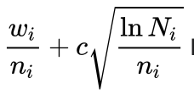
Upper Confidence Bound for Trees (UCT)
Goal: Approximate the true game-theoretic value of the actions that may be taken from the current state.
UCT is a variation of the MCTS at the Selection step
MCTS well-performance is mainly due to the tree’s policy.
How does the tree select the best node?
Important theoretical properties:
Convergence to Minimax tree
It can take a long time!
No evaluation function needed.
Exploration term ensures that each child has a non-zero probability of being selected
Exploitation term ↑
Exploration term ↓
Exploration parameter
Notes:
There is an essential balance between the first (ex- ploitation) and second (exploration) terms of the UCB equation. As each node is visited, the denominator of the exploration term increases, which decreases its contribu- tion. On the other hand, if another child of the parent node is visited, the numerator increases and hence the exploration values of unvisited siblings increase. The exploration term ensures that each child has a non- zero probability of selection, which is essential given the random nature of the playouts. This also imparts an inherent restart property to the algorithm, as even low- reward children are guaranteed to be chosen eventually (given sufficient time), and hence different lines of play explore

Slide 12
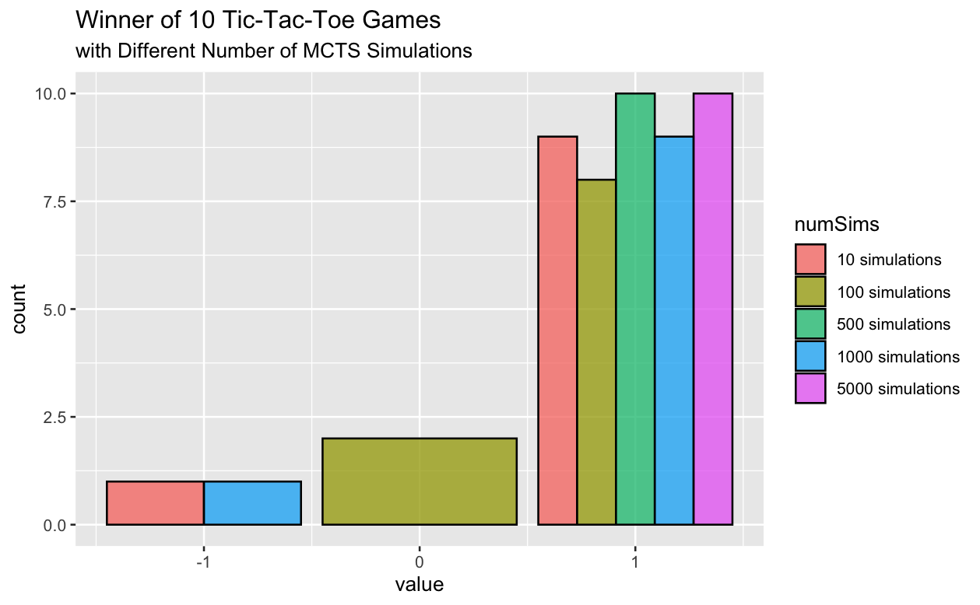
MCTS vs. Random Player:
MCTS moves first for these simulations.
Based on these results:
We pick 100 games to simulate and 500 iterations of the MCTS.
Runtime ≈ 1-1.3 minutes

Slide 13
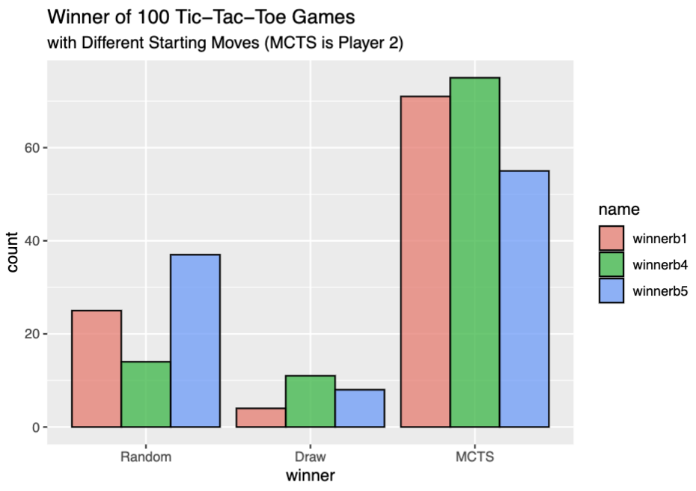
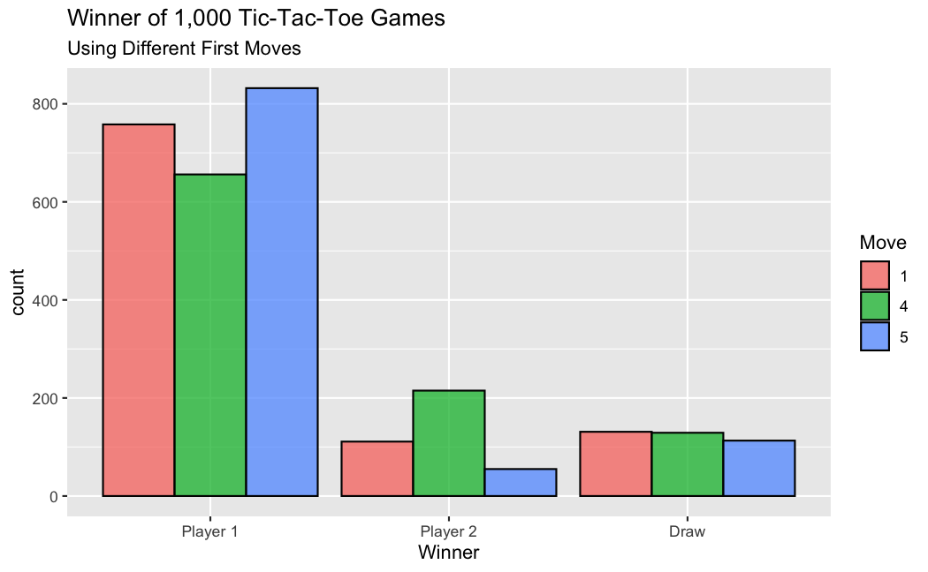
MCTS vs. Random Player:
1 | 4 | 7
2 | 5 | 8
3 | 6 | 9

Slide 14
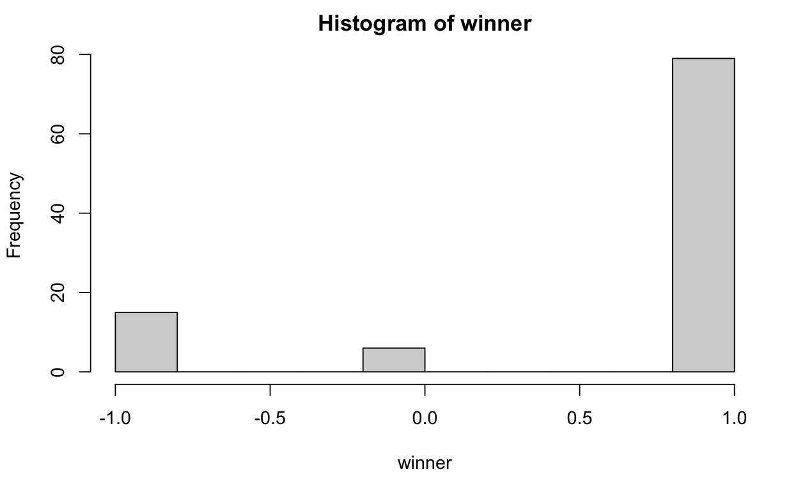
Further Research
MCTS vs MCTS
https://nestedsoftware.com/2019/08/07/tic-tac-toe-with-mcts-2h5k.152104.html
Implement Minimax Algorithm
With enough iterations MCTS should converge to the same root probabilities as Minimax
Both algorithms when playing against themselves should lead to a draw!
How many iterations of MCTS are needed?
Tune the exploration parameter c
Parallel Computing

Slide 15
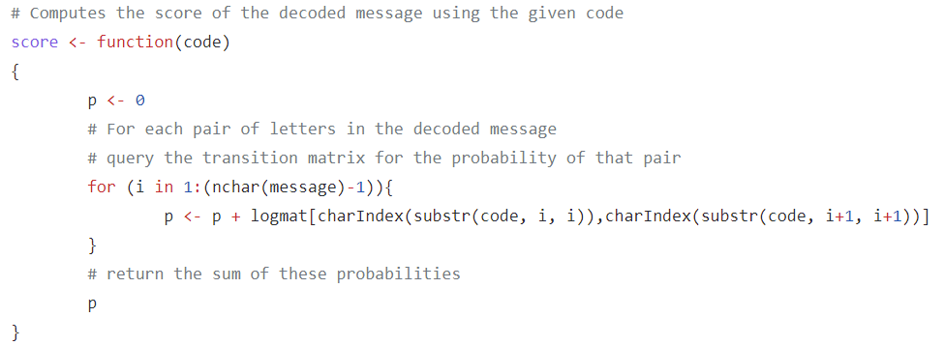
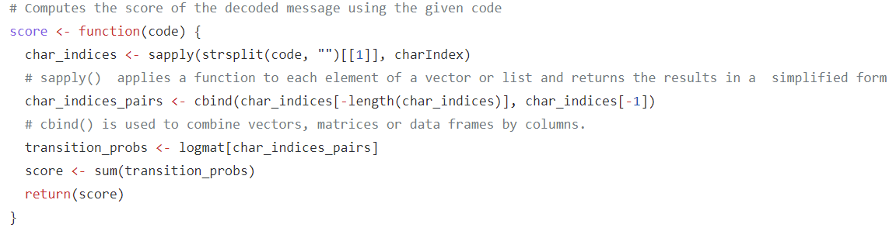
Decoding
Original
New
Notes:
The first difference comes in the score() function where we use vectorization. The score function currently uses a loop that iterates over every pair of characters in the input code. Instead of doing that, we use vectorization to compute the transition probabilities for all pairs of indices at once using matrix indexing. Vectorization operates on entire arrays or vectors of data at once, rather than processing each element of the array individually. This will make the code more efficient.

Slide 16
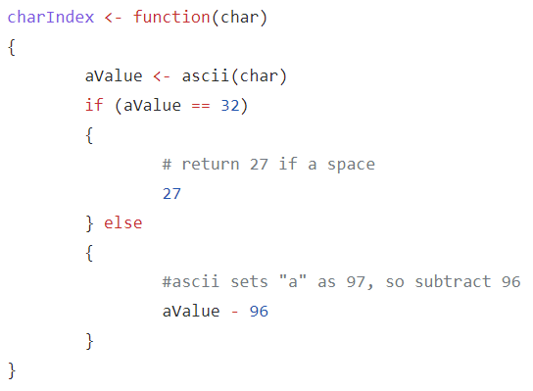
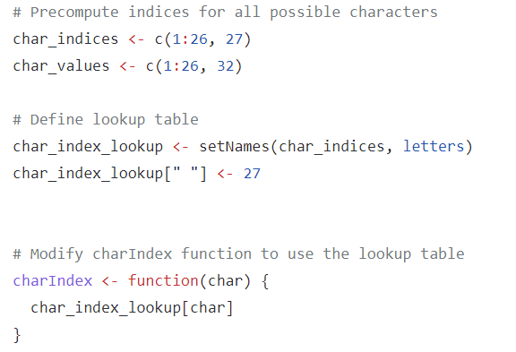
Decoding (cont.)
Original
New
Notes:
The second difference is that we avoid unnecessary function calls. Specifically the charIndex function is called for every character in the input code. We can avoid unnecessary function calls by precomputing the indices for all possible characters and storing them in a table for lookup.

Slide 17
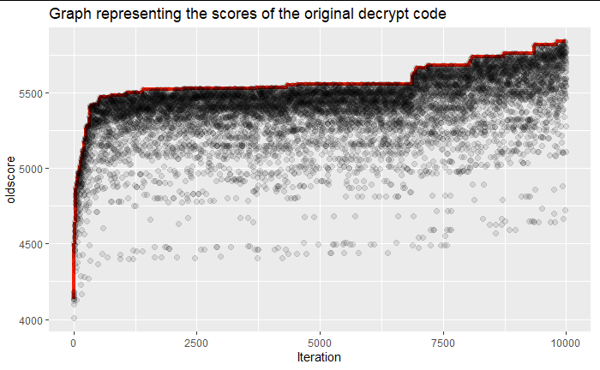
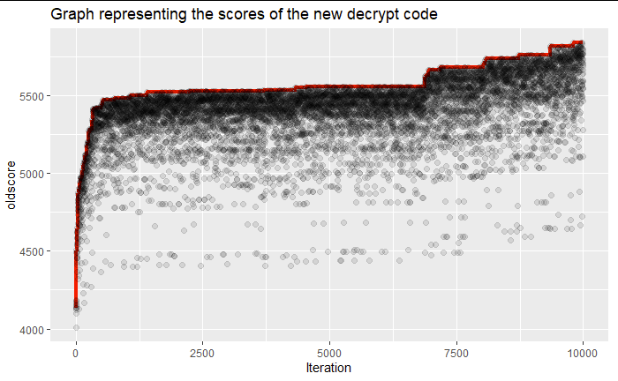
Decoding (cont.)
They reach the best score at the same time because the core functionality of the algorithm didn’t change. However, the amount of time taken to reach this point is dramatically different between the two.

Slide 18
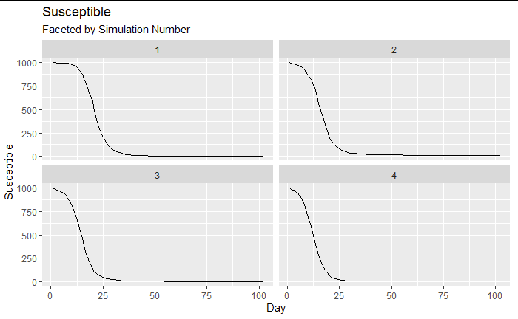
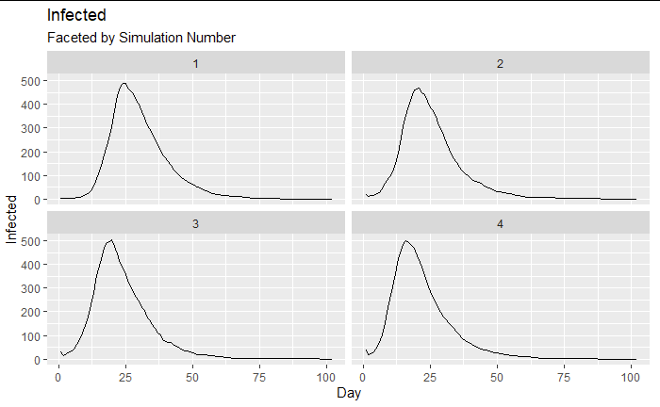
Infectious Disease Q1
As you increase the number of people infected at the start of the simulation, the disease dies out more quickly.
Constant infection rate, recover rate, and susceptible people.
Notes:
Each plot is based on different number of infections to start

Slide 19
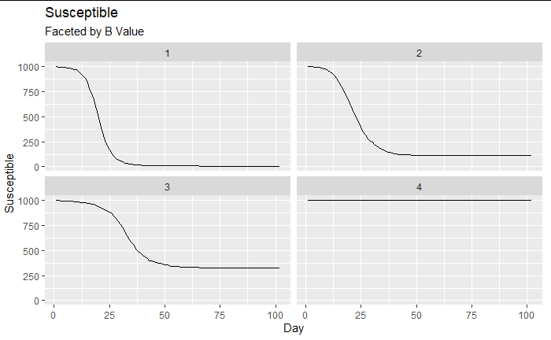
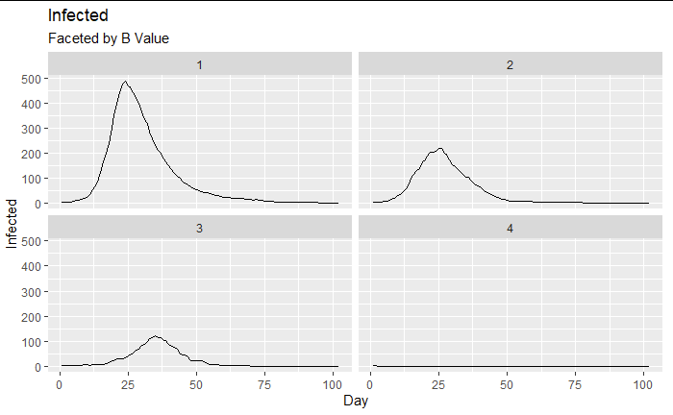
Infectious Disease Q1 (cont.)
As we increase the rate of removal, the less people become infected by the disease. The peak of infections happens at a later time, however, the size of the peak is smaller.

Slide 20
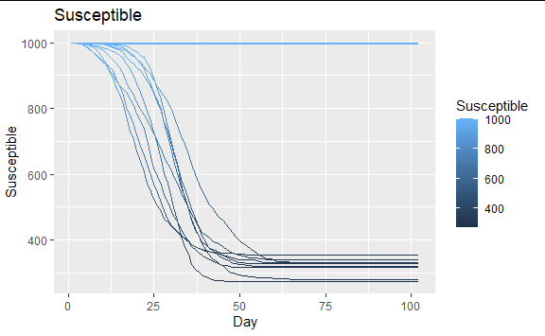
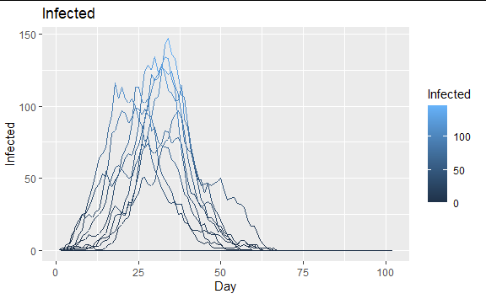
Infectious Disease Q2
With an infection rate of 0.0005 and recover rate of 0.3, the disease approaches a 70% average for total infections.

Slide 21
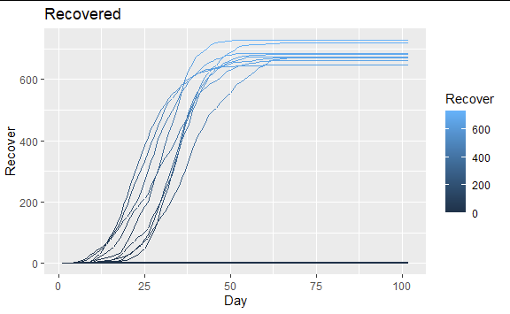
Infectious Disease Q2

Slide 22
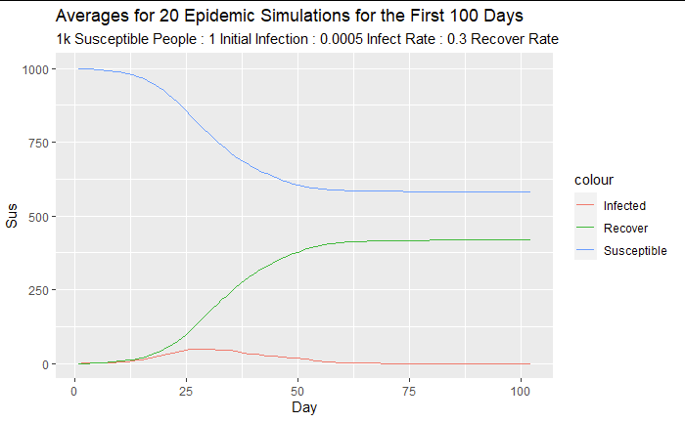
Infectious Disease Q2 (cont.)
I grouped the dataframe by the day and took the average value for Susceptible, Infected, and Recovered for a day.

Slide 23
References
C. B. Browne et al., "A Survey of Monte Carlo Tree Search Methods," in IEEE Transactions on Computational Intelligence and AI in Games, vol. 4, no. 1, pp. 1-43, March 2012, doi: 10.1109/TCIAIG.2012.2186810.
https://www.r-bloggers.com/2022/07/programming-a-simple-minimax-chess-engine-in-r/
https://towardsdatascience.com/reinforcement-learning-and-deep-reinforcement-learning-with-tic-tac-toe-588d09c41dda
https://en.wikipedia.org/wiki/Monte_Carlo_tree_search#Pure_Monte_Carlo_game_search
https://martin-ueding.de/posts/tic-tac-toe-with-monte-carlo-tree-search/
https://web.eecs.umich.edu/~weimerw/2014-4610/lectures/weimer-game-theory-intro.pdf
https://faculty.cc.gatech.edu/~surban6/2019fa-gameAI/lectures/2019-11-20%20Minimax%20MCTS%20and%20CBR.pdf
https://nestedsoftware.com/2019/08/07/tic-tac-toe-with-mcts-2h5k.152104.html
GitHub: https://github.com/dkinsman/stat327project

