Slide 1
Chapter 11 Pointers and Dynamic Memory Management

Slide 2
Objectives
To describe what a pointer is (§11.1).
To learn how to declare a pointer and assign a memory address to it (§11.2).
To access values via pointers (§11.2).
To define synonymous types using the typedef keyword (§11.3).
To declare constant pointers and constant data (§11.4).
To explore the relationship between arrays and pointers (§11.5).
To access array elements using pointers (§11.6).
To pass pointer arguments to a function (§11.7).
To learn how to return a pointer from a function (§11.8).
To use the new operator to create dynamic arrays (§11.9).
To create objects dynamically and access objects via pointers (§11.10).
To reference the calling object using the this pointer (§11.11).
To implement the destructor for performing customized operations (§11.12).
To design a class for students registering courses (§11.13).
To create an object using the copy constructor that copies data from another object of the same type (§11.14).
To customize the copy constructor for performing a deep copy (§11.15).

Slide 3
What is a Pointer?
Pointer variables, simply called pointers, are designed to hold memory addresses as their values. Normally, a variable contains a specific value, e.g., an integer, a floating-point value, and a character. However, a pointer contains the memory address of a variable that in turn contains a specific value.

Slide 4
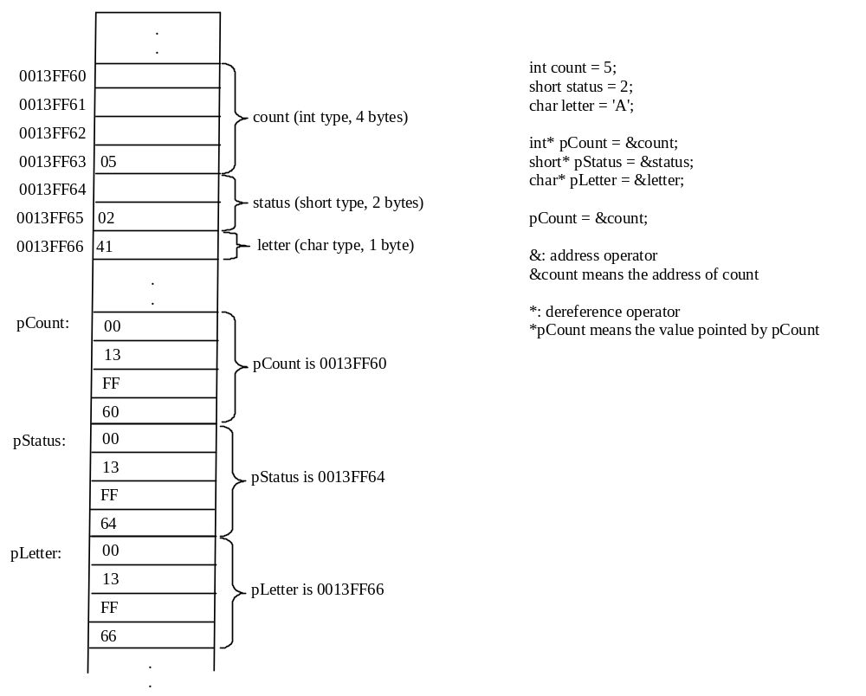
What is a Pointer?

Slide 5
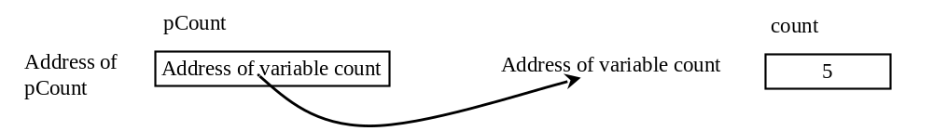
Declare a Pointer
Like any other variables, pointers must be declared before they can be used. To declare a pointer, use the following syntax:
dataType* pVarName;
Each variable being declared as a pointer must be preceded by an asterisk (*). For example, the following statement declares a pointer variable named pCount that can point to an int varaible.
int* pCount;
TestPointer
Run

Slide 6
Dereferencing
Referencing a value through a pointer is called indirection. The syntax for referencing a value from a pointer is
*pointer
For example, you can increase count using
count++; // direct reference, increment the value in count by 1
or
(*pCount)++; // indirect reference, the value in the memory pointed by pCount is incremented by 1

Slide 7
Pointer Type
A pointer variable is declared with a type such as int, double, etc. You have to assign the address of the variable of the same type. It is a syntax error if the type of the variable does not match the type of the pointer. For example, the following code is wrong.
  int area = 1;
  double* pArea = &area; // Wrong

Slide 8
Initializing Pointer
Like a local variable, a local pointer is assigned an arbitrary value if you don’t initialize it. A pointer may be initialized to 0, which is a special value for a pointer to indicate that the pointer points to nothing. You should always initialize pointers to prevent errors. Dereferencing a pointer that is not initialized could cause fatal runtime error or it could accidentally modify important data.

Slide 9
Caution
You can declare two variables on the same line. For example, the following line declares two int variables:
  int i = 0, j = 1;
Can you declare two pointer variables on the same line as follows?
  int* pI, pJ;
No, this line is equivalent to
  int *pI, pJ;

Slide 10
typedef
A synonymous type can be defined using the typedef keyword.
Syntax:
typedef existingType newType;
Example:
typedef int integer;
typedef int* intPointer;
integer value = 40;
intPointer p1, p2; // This declares two pointers of int type.

Slide 11
nullptr
A pointer may be initialized to 0, which is a special value to indicate that the pointer points to nothing. To prevent errors, you should always initialize pointers. A number of C++ libraries including <iostream> define NULL as a constant with value 0. It is more descriptive to use NULL than 0.
C++11 introduced a new keyword nullptr for null pointer. Using nullptr is better than using NULL, because NULL may be accidentally redefined in the program.
C++11: The keyword nulptr is defined in C++11

Slide 12
Effect of Assignment =
Suppose pX and pY are two pointer variables for variables x and y, as shown in Figure 11.3. To understand the relationships between the variables and their pointers, let us examine the effect of assigning pY to pX and *pY to *pX.

Slide 13
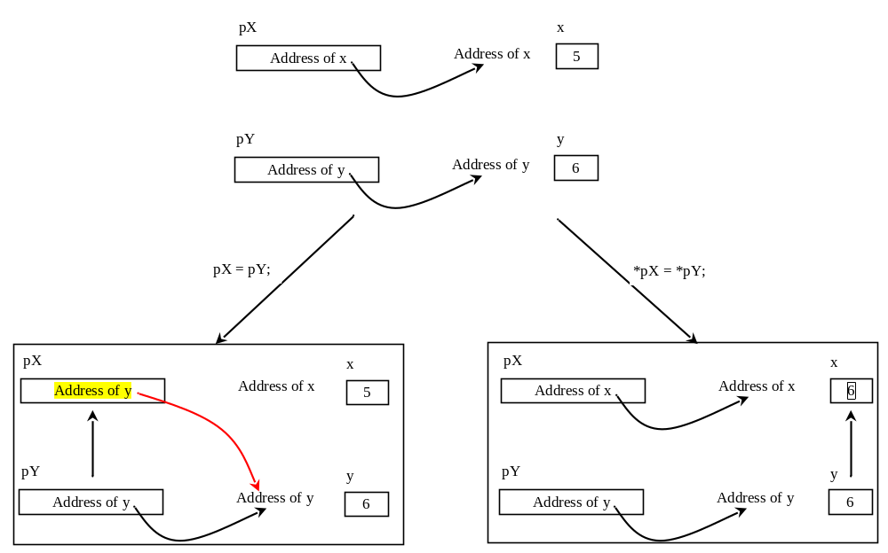
Effect of Assignment =

Slide 14
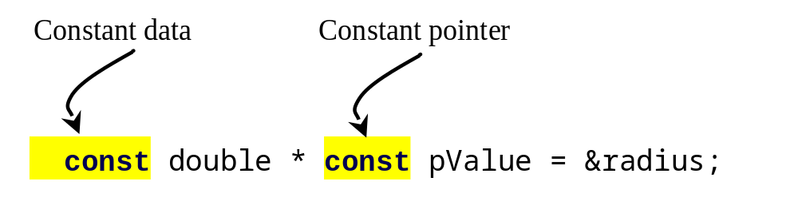
Using const with Pointers
You learned how to declare a constant using the const keyword. A constant cannot be changed once it is declared. You can declare a constant pointer. For example, see the following code:
double radius = 5;
double* const pValue = &radius;

Slide 15
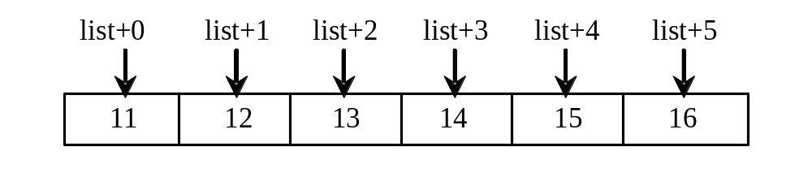
Arrays and Pointers
An array variable without a bracket and a subscript actually represents the starting address of the array. In this sense, an array variable is essentially a pointer. Suppose you declare an array of int value as follows:
int list[6] = {11, 12, 13, 14, 15, 16};

Slide 16
Array Pointer
*(list + 1) is different from *list + 1. The dereference operator (*) has precedence over +. So, *list + 1 adds 1 to the value of the first element in the array, while *(list + 1) dereference the element at address (list + 1) in the array.
ArrayPointer
Run
PointerWithIndex
Run

Slide 17
Passing Pointer Arguments
A pointer argument can be passed by value or by reference. For example, you can define a function as follows:
void f(int* p1, int* &p2)
which is equivalently to
typedef int* intPointer;
void f(intPointer p1, intPointer& p2)
Here p1 is pass-by-value and p2 is pass-by-reference.
TestPointerArgument
Run

Slide 18
array parameter or pointer parameter

Slide 19
const parameter
If an object value does not change, you should declare it const to prevent it from being modified accidentally.
ConstParameter
Run

Slide 20
Returning a Pointer from Functions
You can use pointers as parameters in a function. Can you return a pointer from a function? The answer is yes.
ReverseArrayUsingPointer
Run

Slide 21
Useful Array Functions
C++ provides several functions for manipulating arrays. You can use the min_element and max_element functions to return the pointer to the minimal and maximal element in an array, the sort function to sort an array, the random_shuffle function to randomly shuffle an array, and the find function to find an element in an array. All these functions use pointers in the arguments.
UsefulArrayFunctions
Run

Slide 22
Why Do We Need Dynamic Memory Allocation?
See this example
WrongReverse
Run
CorrectReverse
Run

Slide 23
Dynamic Memory Allocation
int* result = new int[6]; // Allocate
delete [] result; // Deallocate
int* p = new int; // Allocate
delete p; // Deallocate

Slide 24
Creating Dynamic Objects
You can also create objects dynamically on the heap using the following syntax:
ClassName* pObject = new ClassName(); or ClassName *pObject = new ClassName; or
ClassName* pObject = new ClassName(arguments);
// Create an object using the no-arg constructor
string* p = new string(); // or string* p = new string;
// Create an object using the constructor with arguments
string* p = new string("abcdedfg");

Slide 25
Accessing Dynamic Objects
To access object members via a pointer, you must dereference the pointer and use the dot (.) operator to object’s members. For example,
string* p = new string("abcdedfg");
cout << "The first three characters in the string are "
<< (*p).substr(0, 3) << endl;
cout << "The length of the string is " << (*p).length() << endl;

Slide 26
Accessing Dynamic Objects
C++ also provides a shorthand member selection operator for accessing object members from a pointer: arrow (->) operator, which is a dash (-) immediately followed by the greater than (>) symbol. For example,
cout << "The first three characters in the string are "
<< p->substr(0, 3) << endl;
cout << "The length of the string is " << p->length() << endl;

Slide 27
The this Pointer
Sometimes you need to reference a class’s hidden data field in a function. For example, a data field name is often used as the parameter name in a set function for the data field. In this case, you need to reference the hidden data field name in the function in order to set a new value to it. A hidden data field can be accessed by using the this keyword, which is a special built-in pointer that references to the calling object.
CircleWithThisPointer.cpp

Slide 28
Destructors
Destructors are the opposite of constructors. A constructor is invoked when an object is created and a destructor is invoked when the object is destroyed. Every class has a default destructor if the destructor is not explicitly defined. Sometimes, it is desirable to implement destructors to perform customized operations. Destructors are named the same as constructors, but you must put a tilde character (~) in front of it.
CircleWithDestructor.h
TestCircleWithDestructor
CircleWithDestructor.cpp
Run

Slide 29
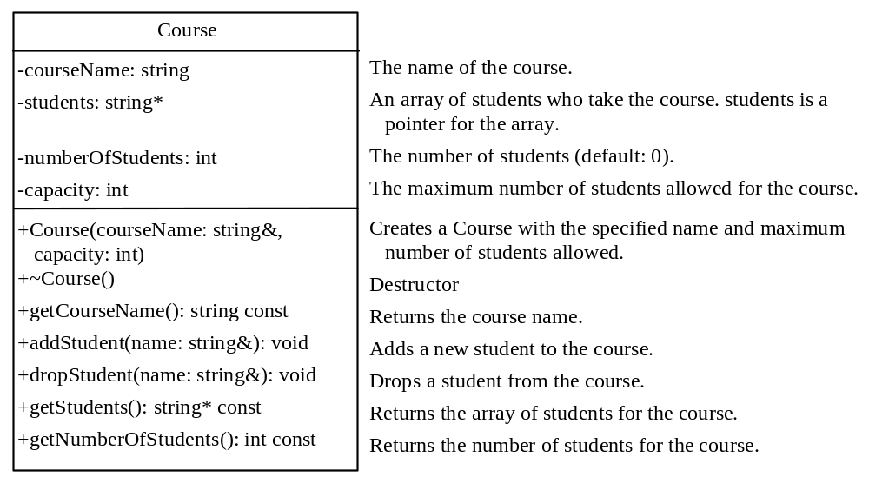
The Course Class
Course.h
TestCourse
Course.cpp
Run

Slide 30
Copy Constructor
Each class may define several overloaded constructors and one destructor. Additionally, every class has a copy constructor. The signature of the copy constructor is:
ClassName(const ClassName&)
For example, the copy constructor for the Circle class is
Circle(const Circle&)
The copy constructor can be used to create an object initialized with another object’s data. By default, the copy constructor simply copies each data field in one object to its counterpart in the other object.
CopyConstructorDemo
Run

Slide 31
Shallow Copy vs. Deep Copy
The default copy constructor or assignment operator for copying objects performs a shallow copy, rather than a deep copy, meaning that if the field is a pointer to some object, the address of the pointer is copied rather than its contents.
ShallowCopyDemo
Run

Slide 32
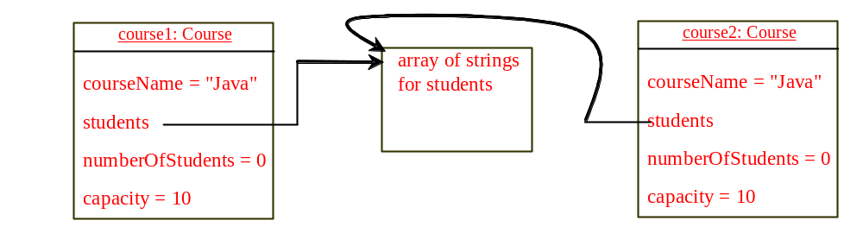
Shallow Copy
Copy course1 to course2. After copying course1 to course2, both course1 and course2 point to the same student.

Slide 33
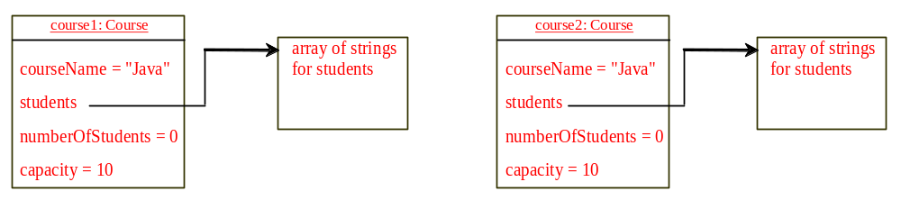
Deep Copy
After course1 is copied to course2, the students data field of course1 and course2 point to two different arrays.
CourseWithCustomCopyConstructor.h
CourseWithCustomCopyConstructor.cpp
CustomCopyConstructorDemo
Run

