Slide 1
Chapter 14
Operator Overloading

Slide 2
Objectives
To define the Rational class for creating rational numbers (§14.2).
To discover how an operator can be overloaded in C++ using a function (§14.3).
To overload the relational operators (<, <=, =, !=, >=, >) and arithmetic operators (+, -, *, /) (§14.3).
To overload the subscript operator [] (§14.4).
To overload the shorthand assignment operators +=, -=, *=, and /= (§14.5).
To overload the unary operators + and - (§14.6).
To overload the prefix and postfix ++ and –- operators (§14.7).
To enable friend functions and friend classes to access a class’s private members (§14.8).
To overload the stream insertion and extraction operators << and >> as friend non-member functions (§14.9).
To define operator functions to perform object conversions to a primitive type (§14.10.1).
To define appropriate constructors to perform conversions from a numeric value to an object type (§14.10.2).
To define a new Rational class with overloaded operators (§14.11).
To overload the = operator to perform a deep copy (§14.12).

Slide 3
Function operators in string and vector
string s1("Washington");
string s2("California");
cout << "The first character in s1 is " << s1[0] << endl;
cout << "s1 + s2 is " << (s1 + s2) << endl;
cout << "s1 < s2? " << (s1 < s2) << endl;
vector<int> v;
v.push_back(3);
v.push_back(5);
cout << "The first element in v is " << v[0] << endl;

Slide 4
Function operators in string and vector
string s1("Washington");
string s2("California");
cout << "The first character in s1 is " << s1.operator[](0) << endl;
cout << "s1 + s2 is " << operator+(s1, s2) << endl;
cout << "s1 < s2? " << operator<(s1, s2) << endl;
vector<int> v;
v.push_back(3);
v.push_back(5);
cout << "The first element in v is " << v.operator[](0) << endl;

Slide 5
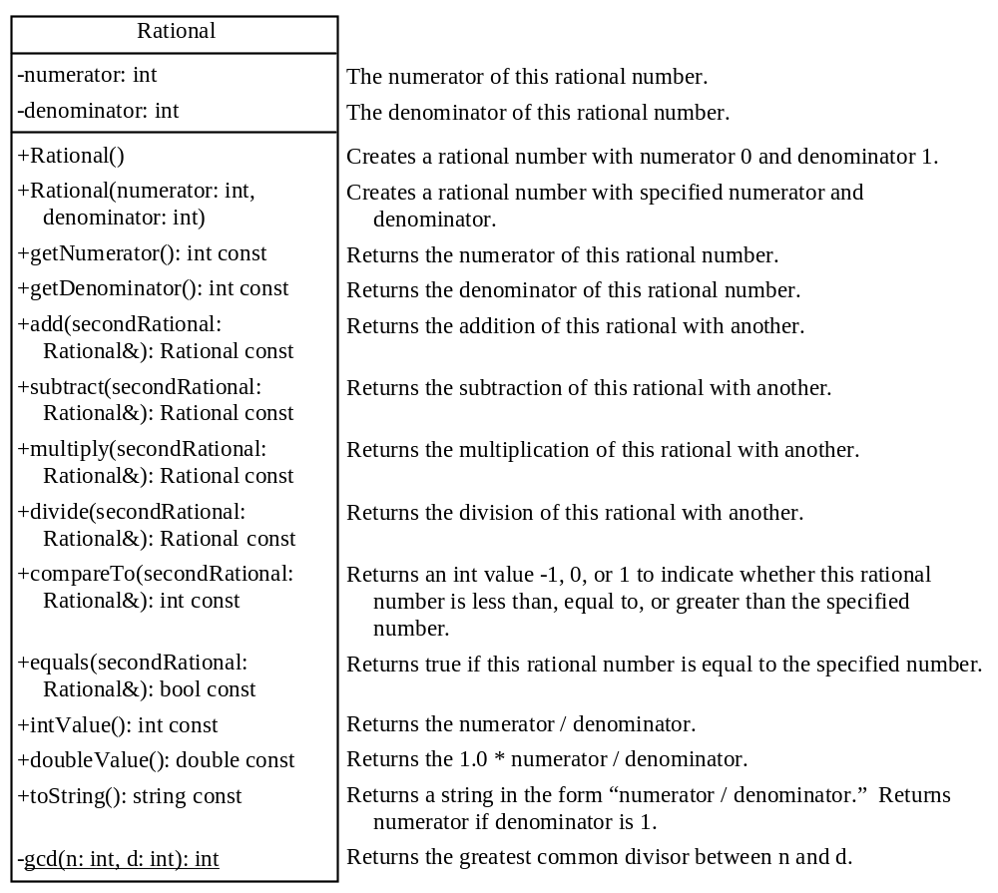
The Rational Class
Rational.h
Rational.cpp
TestRationalClass
Run

Slide 6
Operator Functions
bool Rational::operator<(Rational &secondRational)
{
return compareTo(secondRational) < 0
}

Slide 7
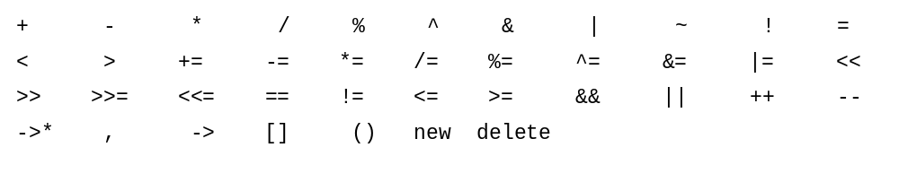
Overloadable Operators

Slide 8

Operators That Cannot Be Overloaded

Slide 9
Precedence and Associativity
C++ defines the operator precedence and associativity (see §3.12, “Operator Precedence and Associativity.”) You cannot change the operator precedence and associativity by overloading.

Slide 10
< Function Operator
bool Rational::operator<(const Rational &secondRational) const
{
// compareTo is already defined Rational.h
if (compareTo(secondRational) < 0)
return true;
else
return false;
}
Rational r1(4, 2);
Rational r2(2, 3);
cout << "r1 < r2 is " << (r1.operator<(r2) ? "true" : "false");
cout << "\nr1 < r2 is " << ((r1 < r2) ? "true" : "false");
cout << "\nr2 < r1 is " << (r2.operator<(r1) ? "true" : "false");

Slide 11
+ Function Operator
Rational Rational::operator+(const Rational &secondRational) const
{
// add is already defined Rational.h
return add(secondRational);
}
Rational r1(4, 2);
Rational r2(2, 3);
cout << "r1 + r2 is " << (r1 + r2).toString() << endl;

Slide 12
Overloading the [] Operators
int Rational::operator[](int index)
{
if (index == 0)
return numerator;
else if (index == 1)
return denominator;
else
{
throw runtime_error("subscript out of range");
}
}

Slide 13
[] accessor and mutator
The [] operator functions as both accessor and mutator. For example, you use r2[0] as an accessor to retrieve the numerator in an expression, and use r2[0] = value as a mutator. After adding this operator to the Rational class, the Rational class is mutable.

Slide 14
Correct Overloading of the [] Operators
int Rational::&operator[](int index)
{
if (index == 0)
return numerator;
else if (index == 1)
return denominator;
else
{
throw runtime_error("subscript out of range");
}
}

Slide 15
Overloading the Augmented (Compound) Operators
C++ has shorthand operators +=, -=, *=, and /= for adding, subtracting, multiplying, and dividing a value in a variable. You can overload these operators in the Rational class.
Rational& Rational::operator+=(const Rational &secondRational)
{
*this = add(secondRational);
return *this;
}

Slide 16
Overloading the Shorthand Operators
Rational r1(2, 4);
Rational r2 = r1 += Rational(2, 3);
cout << "r1 is " << r1.toString() << endl;
cout << "r2 is " << r2.toString() << endl;

Slide 17
Overloading the [] Operators
In C++, the subscript [] is an operator. You can overload this operator to access the contents of the object using the array-like syntax if desirable. For example, you may wish to access the numerator and denominator using r[0] and r[1].

Slide 18
Overloading the Unary Operators
The + and - are unary operators. They can be overloaded too. Since the unary operator operates on one operand that is the calling object itself, the unary function operator has no parameters.
Rational Rational::operator-()
{
return Rational(-numerator, denominator);
}

Slide 19
Overloading the ++ and -- Operators
The ++ and -- operators may be prefix or postfix. The prefix ++var or --var first adds or subtracts 1 from the variable and then evaluates to the new value in the var. The postfix var++ or var-- adds or subtracts 1 from the variable, but evaluates to the old value in the var.
If the ++ and -- are implemented correctly, the following code
r3 = r1++;
r3 = ++r1;
r1--;
++r1;
--r1;

Slide 20
Overloading the ++ and – Operators, cont.
Rational Rational::operator++()
{
numerator += denominator;
return *this;
}
Rational Rational::operator++(int dummy)
{
Rational temp(numerator, denominator);
numerator += denominator;
return temp;
}

Slide 21
Friend Functions and Classes
C++ allows you to overload the stream insertion operator (<<) for outputting to cout and overload the stream extraction operator (>>) for reading values from cin. To overload these two operators, you need to use the friend functions. This section introduces friend functions and friend classes.

Slide 22
Friend Functions and Classes
Private members of a class cannot be accessed from outside of the class. Occasionally, it is convenient to allow some trusted functions and classes to access a class’s private members. C++ enables you to use the friend keyword to declare friend functions and friend classes for a class so these functions and classes can access the class’s private members.

Slide 23
Friend Classes
Date.h
TestFriendClass
Run

Slide 24
Friend Functions
TestFriendFunction
Run

Slide 25
Overloading the << and >> Operators
C++ allows you to overload the stream insertion operator (<<) for sending an object to cout and overload the stream extraction operator (>>) for reading values from cin. Overloading these two operators is different from other operators you have seen in this chapter. Since the first parameter of the << (>>) operator is an instance of ostream (istream), these two operators are defined in the ostream and istream classes, not in the Rational class.
cout << r1 << " followed by " << r2;
This is equivalent to
((cout << r1) << " followed by ") << r2;

Slide 26
Overloading the << and >> Operators
ostream& operator<<(ostream& out, const Rational &rational)
{
out << rational.numerator << "/" << rational.denominator;
return out;
}

Slide 27
Overloading the << and >> Operators
istream& operator>>(istream& in, Rational& rational)
{
cout << "Enter numerator: ";
in >> rational.numerator;
cout << "Enter denominator: ";
in >> rational.denominator;
return in;
}

Slide 28
Type Conversion: Rational to double
You can add an int value with a double value such as
4 + 5.5
In this case, C++ performs automatic type conversion to convert an int value 4 to a double value 4.0.
Can you add a rational number with an int or a double value? Yes. You have to define a function operator to convert an object into int or double. Here is the implementation of the function to convert a Rational object to a double value.

Slide 29
Rational to double
Rational::operator double()
{
return doubleValue();
}
Rational r1(1, 4);
double d = r1 + 5.1;
cout << "r1 + 5.1 is " << d << endl;

Slide 30
Type Conversion: number to Rational
A Rational object can be automatically converted to a numeric value. Can a numeric value be automatically converted to a Rational object? The answer is yes.
To achieve this, define the following constructor in the header file
Rational(int numerator);
and implement it in the implementation file .

Slide 31
Type Conversion: number to Rational
Provided that the + operator is also overloaded (see §14.3), the following code
Rational r1(2, 3);
Rational r = r1 + 4; // Automatic converting 4 to Rational
cout << r << endl;
displays
14 / 3

Slide 32
Type Conversion: number to Rational
You can add a Rational object with an integer like this:
r1 + 4 (r1.operator+(4))
Can you add an integer with a Rational object like this:
4 + r1 (4.operator+(r1)???)
Naturally you would think the + operator is symmetric. However, it does not work. Why?

Slide 33
The New Rational Class
The preceding sections introduced how to overload function operators. You are ready to give a new Rational class with all appropriate function operators.
RationalWithOperators.h
TestRationalWithOperators
Run
RationalWithOperators.cpp

Slide 34
Overloading the = Operator
By default, the = operator performs a memberwise copy from one object to the other. For example, the following code copies r2 to r1.
Rational r1(1, 2);
Rational r2(4, 5);
r1 = r2;
cout << "r1 is " << r1.toString() << endl;
cout << "r2 is " << r2.toString() << endl;

Slide 35
Overloading the = Operator
DefaultAssignmentDemo
Run

Slide 36
Overloading the = Operator
CourseWithAssignmentOperatorOverloaded
CustomAssignmentDemo
Run

Slide 37
Overloading the = Operator
To change the way the default assignment operator = works, you need to overload the = operator. In the Couse.h file, define
const Course& operator=(const Course& course)
Why the return type is Course not void? C++ allows multiple assignments such as:
course1 = course2 = course3;
In this statement, course3 is copied to course2, and then returns course2, and then course2 is copied to course1. So the = operator must have a valid return value type.

Slide 38
Rule of Three
The copy constructor, the = assignment operator, and the destructor are called the rule of three, or the Big Three. If they are not defined explicitly, all three are created by the compiler automatically. You should customize them if the class contains a pointer data field. If you have to customize one of the three, you should customize the other two as well.

