Slide 1
Chapter 16 Exception Handling

Slide 2
Objectives
To get an overview of exceptions and exception handling (§16.2).
To know how to throw an exception and how to catch it (§16.2).
To explore the advantages of using exception handling (§16.3).
To create exceptions using C++ standard exception classes (§16.4).
To define custom exception classes (§16.5).
To catch multiple exceptions (§16.6).
To explain how an exception is propagated (§16.7).
To rethrow exceptions in a catch block (§16.8).
To define functions with an exception throw list (§16.9).
To use exception handling appropriately (§16.10).

Slide 3
Exception-Handling Overview
To demonstrate exception-handling, let us begin with an example in Listing 16.1 that reads in two integers and displays their quotient.
Quotient
Run

Slide 4
Exception-Handling Overview
If you enter 0 for the second number, a runtime error would occur, because you cannot divide an integer by 0. A simple way to fix the error is to add an if statement to test the second number as shown in Listing 16.2.
QuotientWithIf
Run

Slide 5
Exception-Handling Overview
Listing 16.2 can be rewritten using exception handling as shown in Listing 16.3. Listing 16.2 is simpler than Listing 16.3. You should not use exception handling in this case. However, the purpose of Listing 16.3 is to give a simple example to demonstrate the concept of exception handling. Later you will see the advantages of using exception handling.
QuotientWithFunction
Run

Slide 6
Template for try-throw-catch
try
{
Code to try;
Throw an exception with a throw statement or
from function if necessary;
More code to try;
}
catch (type e)
{
Code to process the exception;
}

Slide 7
omit catch block parameter
If you are not interested in the contents of an exception object, the catch block parameter may be omitted. For example, the following catch block is legal.
try
{
// ...
}
catch (type)
{
cout << "Error occurred " << endl;
}

Slide 8
Exception-Handling Advantages
The purpose of Listing 16.3 is to give a simple example to demonstrate exception handling. It does not show any real advantages. This section uses functions to demonstrate the advantages of using exception handling.
QuotientWithException
Run

Slide 9
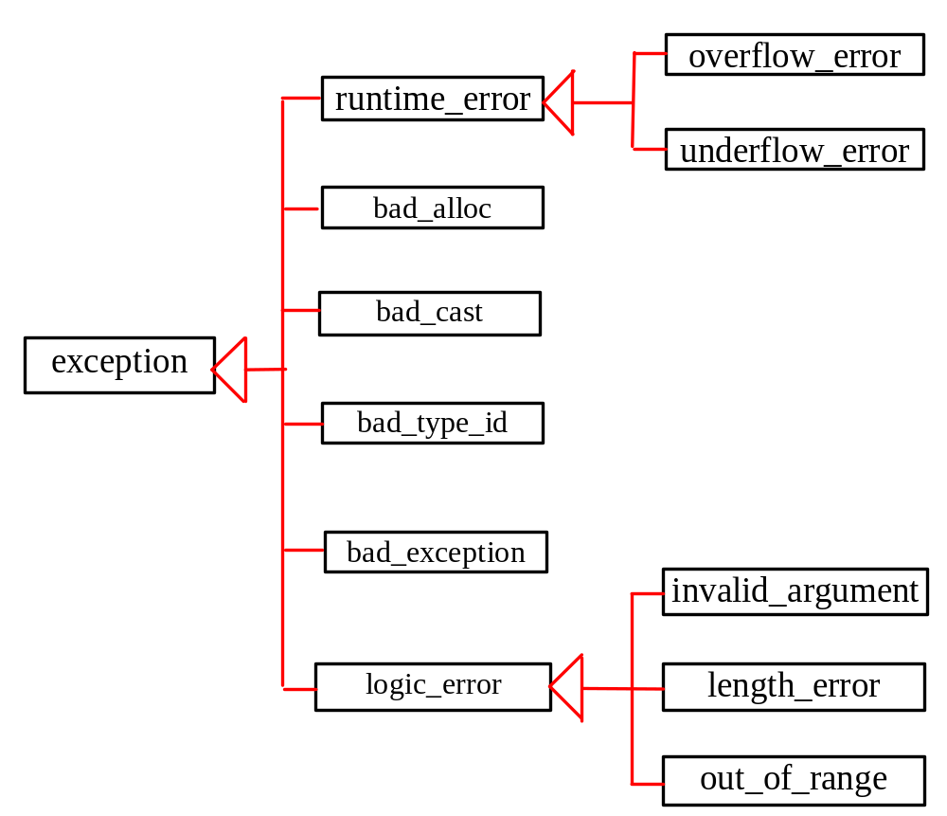
Exception Classes

Slide 10
Using Standard Classes
These classes are used by some functions in the C++ standard library to throw exceptions. You can also use these classes to throw exceptions in your programs. Listing 16.5 shows an example that handles the bad_alloc exception.
BadAllocExceptionDemo
Run
BadCastExceptionDemo
Run
InvalidArgumentExceptionDemo
Run

Slide 11
Custom Exception Classes
C++ provides quite a few exception classes. Use them whenever possible instead of defining your own exception classes. However, if you run into a problem that cannot be adequately described by the predefined exception classes, you can create your own exception class. This class is just like any C++ class, but often it is desirable to derive it from exception or a derived class of exception so you can utilize the common operations (e.g., the what() function) in the exception class.

Slide 12
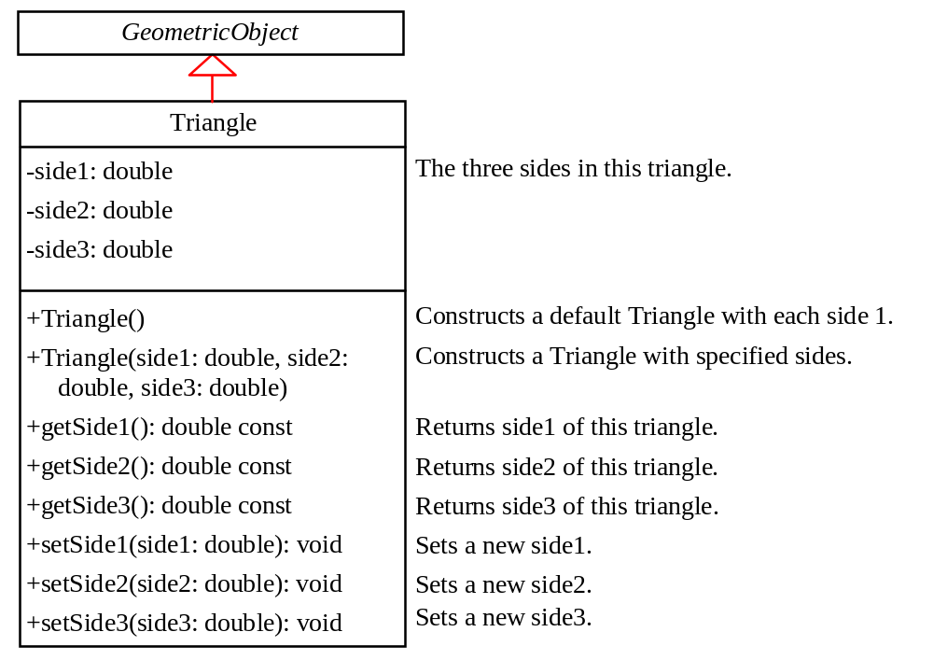
The Triangle Class
TriangleException.h
Triangle.h
TestTriangle.cpp
Run

Slide 13
Multiple Catches
Most of time, a try block should run without exceptions. But occasionally, it may throw an exception. The exception can be of differing types. For example, you may consider a non-positive value for a side in a triangle in the preceding example in Listing 16.10 is another type of exception different from a TriangleException. So, the try block may throw a non-positve side exception or a TriangleException depending on the occasion. One catch block can catch only one type of exception. C++ allows you to add multiple catch blocks after a try block in order to catch multiple types of exceptions.
NonPositiveSideException.h
MultipleCatchDemo
NewTriangle.h
Run

Slide 14
catch block
Various exception classes can be derived from a common base class. If a catch block catches exception objects of a base class, it can catch all the exception objects of the derived classes of that base class.

Slide 15
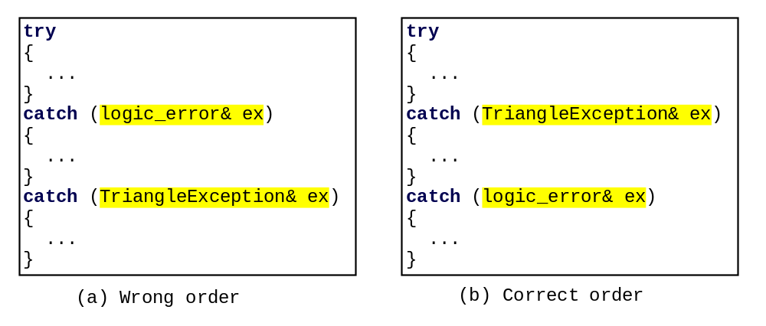
order of exception handlers
The order in which exceptions are specified in catch blocks is important. A catch block for a base class type should appear after a catch block for a derived class type. Otherwise, the exception of a derived class is always caught by the catch block for the base class. For example, the ordering in (a) is erroneous, because TriangleException is a derived class of logic_error. The correct ordering should be as shown in (b). In (a), a TriangleException occurred in the try block is caught by the catch block for logic_error.

Slide 16
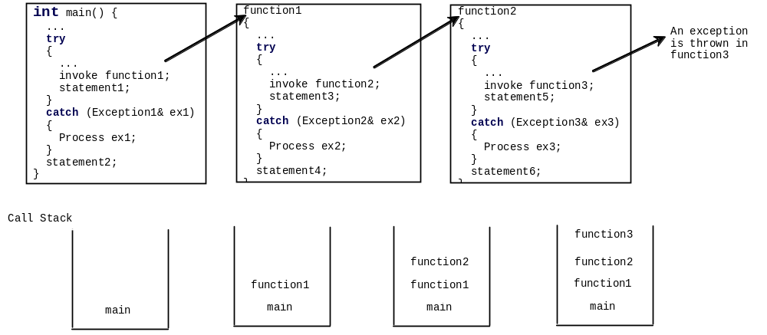
Exception Propagation
You now know how to declare an exception and how to throw an exception. When an exception is thrown, it can be caught and handled in a try-catch block, as follows:

Slide 17
Rethrowing Exceptions
C++ allows an exception handler to rethrow the exception if the handler cannot process the exception or the handler simply wants to let its caller be notified of the exception. The syntax may look like this:
try
{
statements;
}
catch (TheException &ex)
{
perform operations before exits;
throw;
}
RethrowExceptionDemo
Run

Slide 18
Exception Specification
An exception specification, also known as throw list, lists exceptions that a function can throw. So far, you have seen the function defined without a throw list. In this case, the function can throw any exception. So, it is attempting to omit exception specification. However, this is not a good practice. A function should warn the programmers that any exceptions it might throw, so the programmers can write robust program to deal with these potential exceptions in a try-catch block.
returnType functionName(parameterList) throw (exceptionList)

Slide 19
empty exception specification
Placing throw() after a function header, known as an empty exception specification, declares that the function does not throw any exceptions. If a function attempts to throw an exception, a standard C++ function unexpected is invoked, which normally terminates the program.

Slide 20
undeclared exception
Throwing an exception that is not declared in the throw list will cause function unexpected to be invoked. However, a function without exception specification can throw any exception and will not cause unexpected to be invoked.

Slide 21
When to Use Exceptions
In general, common exceptions that may occur in multiple classes in a project are candidates for exception classes. Simple errors that may occur in individual functions are best handled locally without throwing exceptions.
Exception handling is for dealing with unexpected error conditions. Do not use a try-catch block to deal with simple, expected situations. Which situations are exceptional and which are expected is sometimes difficult to decide. The point is not to abuse exception handling as a way to deal with a simple logic test.

Slide 22
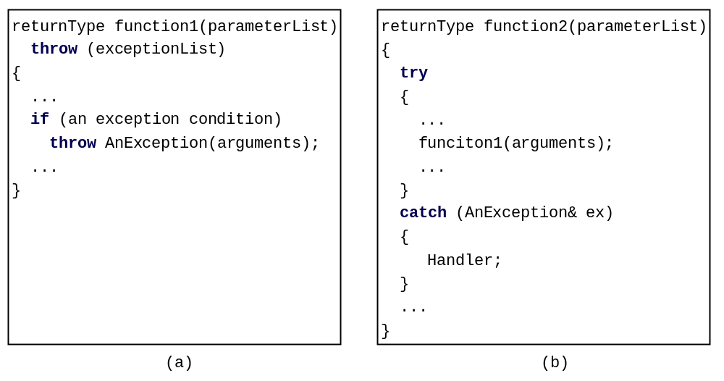
General Paradigm for Exception
A general paradigm for exception handling is that you declare to throw an exception in a function as shown in (a), and use the function in a try-catch block as shown in (b).

