Slide 1
Chapter 17 Recursion

Slide 2
Motivations
Suppose you want to find all the files under a directory that contains a particular word. How do you solve this problem? There are several ways to solve this problem. An intuitive solution is to use recursion by searching the files in the subdirectories recursively.

Slide 3
Objectives
To describe what a recursive function is and the benefits of using recursion (§17.1).
To develop recursive programs for recursive mathematical functions (§§17.2-17.3).
To explain how recursive function calls are handled in a call stack (§§17.2-17.3).
To use an overloaded helper function to derive a recursive function (§17.5).
To solve selection sort using recursion (§17.5.1).
To solve binary search using recursion (§17.5.2).
To understand how recursive function calls are handled in a call stack (§§17.2-17.6).
To solve the Tower of Hanoi problem using recursion (§17.6).
To solve the Eight Queens problem using recursion (§17.7).
To understand the relationship and difference between recursion and iteration (§17.8).

Slide 4
Computing Factorial
factorial(0) = 1;
factorial(n) = n*factorial(n-1);
ComputeFactorial
Run

Slide 5
Computing Factorial
animation
factorial(0) = 1;
factorial(n) = n*factorial(n-1);
factorial(4)

Slide 6
Computing Factorial
animation
factorial(0) = 1;
factorial(n) = n*factorial(n-1);
factorial(4) = 4 * factorial(3)

Slide 7
Computing Factorial
animation
factorial(0) = 1;
factorial(n) = n*factorial(n-1);
factorial(4) = 4 * factorial(3)
= 4 * 3 * factorial(2)

Slide 8
Computing Factorial
animation
factorial(0) = 1;
factorial(n) = n*factorial(n-1);
factorial(4) = 4 * factorial(3)
= 4 * 3 * factorial(2)
= 4 * 3 * (2 * factorial(1))

Slide 9
Computing Factorial
animation
factorial(0) = 1;
factorial(n) = n*factorial(n-1);
factorial(4) = 4 * factorial(3)
= 4 * 3 * factorial(2)
= 4 * 3 * (2 * factorial(1))
= 4 * 3 * ( 2 * (1 * factorial(0)))

Slide 10
Computing Factorial
animation
factorial(0) = 1;
factorial(n) = n*factorial(n-1);
factorial(4) = 4 * factorial(3)
= 4 * 3 * factorial(2)
= 4 * 3 * (2 * factorial(1))
= 4 * 3 * ( 2 * (1 * factorial(0)))
= 4 * 3 * ( 2 * ( 1 * 1)))

Slide 11
Computing Factorial
animation
factorial(0) = 1;
factorial(n) = n*factorial(n-1);
factorial(4) = 4 * factorial(3)
= 4 * 3 * factorial(2)
= 4 * 3 * (2 * factorial(1))
= 4 * 3 * ( 2 * (1 * factorial(0)))
= 4 * 3 * ( 2 * ( 1 * 1)))
= 4 * 3 * ( 2 * 1)

Slide 12
Computing Factorial
animation
factorial(0) = 1;
factorial(n) = n*factorial(n-1);
factorial(4) = 4 * factorial(3)
= 4 * 3 * factorial(2)
= 4 * 3 * (2 * factorial(1))
= 4 * 3 * ( 2 * (1 * factorial(0)))
= 4 * 3 * ( 2 * ( 1 * 1)))
= 4 * 3 * ( 2 * 1)
= 4 * 3 * 2

Slide 13
Computing Factorial
animation
factorial(0) = 1;
factorial(n) = n*factorial(n-1);
factorial(4) = 4 * factorial(3)
= 4 * 3 * factorial(2)
= 4 * 3 * (2 * factorial(1))
= 4 * 3 * ( 2 * (1 * factorial(0)))
= 4 * 3 * ( 2 * ( 1 * 1)))
= 4 * 3 * ( 2 * 1)
= 4 * 3 * 2
= 4 * 6

Slide 14
Computing Factorial
animation
factorial(0) = 1;
factorial(n) = n*factorial(n-1);
factorial(4) = 4 * factorial(3)
= 4 * 3 * factorial(2)
= 4 * 3 * (2 * factorial(1))
= 4 * 3 * ( 2 * (1 * factorial(0)))
= 4 * 3 * ( 2 * ( 1 * 1)))
= 4 * 3 * ( 2 * 1)
= 4 * 3 * 2
= 4 * 6
= 24

Slide 15



Trace Recursive factorial
animation
Executes factorial(4)

Slide 16
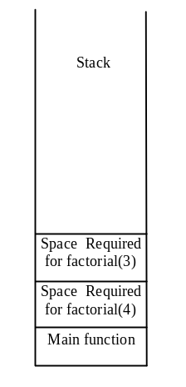
Trace Recursive factorial
animation
Executes factorial(3)

Slide 17
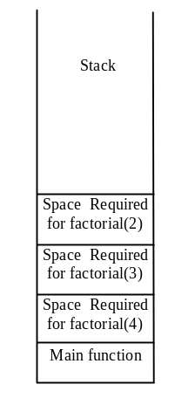
Trace Recursive factorial
animation
Executes factorial(2)

Slide 18
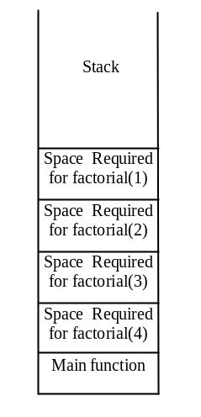
Trace Recursive factorial
animation
Executes factorial(1)

Slide 19
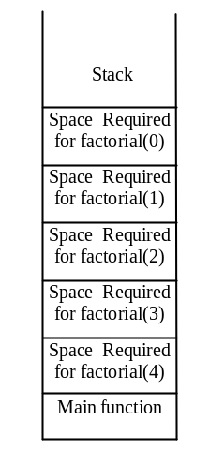
Trace Recursive factorial
animation
Executes factorial(0)

Slide 20
Trace Recursive factorial
animation
returns 1

Slide 21
Trace Recursive factorial
animation
returns factorial(0)

Slide 22
Trace Recursive factorial
animation
returns factorial(1)

Slide 23

Trace Recursive factorial
animation
returns factorial(2)

Slide 24
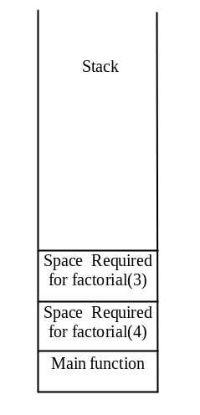
Trace Recursive factorial
animation
returns factorial(3)

Slide 25
Trace Recursive factorial
animation
returns factorial(4)

Slide 26

factorial(4) Stack Trace

Slide 27
Other Examples
f(0) = 0;
f(n) = n + f(n-1);

Slide 28
Fibonacci Numbers
Finonacci series: 0 1 1 2 3 5 8 13 21 34 55 89…
indices: 0 1 2 3 4 5 6 7 8 9 10 11
fib(0) = 0;
fib(1) = 1;
fib(index) = fib(index -1) + fib(index -2); index >=2
fib(3) = fib(2) + fib(1) = (fib(1) + fib(0)) + fib(1) = (1 + 0) +fib(1) = 1 + fib(1) = 1 + 1 = 2
ComputeFibonacci
Run

Slide 29

Fibonnaci Numbers, cont.

Slide 30
Characteristics of Recursion
All recursive functions have the following characteristics:
  One or more base cases (the simplest case) are used to stop recursion.
  Every recursive call reduces the original problem, bringing it increasingly closer to a base case until it becomes that case.
In general, to solve a problem using recursion, you break it into subproblems. If a subproblem resembles the original problem, you can apply the same approach to solve the subproblem recursively. This subproblem is almost the same as the original problem in nature with a smaller size.

Slide 31
Problem Solving Using Recursion
Let us consider a simple problem of printing a message for n times. You can break the problem into two subproblems: one is to print the message one time and the other is to print the message for n-1 times. The second problem is the same as the original problem with a smaller size. The base case for the problem is n==0. You can solve this problem using recursion as follows:
void nPrintln(string& message, int times)
{
if (times >= 1) {
cout << message << endl;
nPrintln(message, times - 1);
} // The base case is n == 0
}

Slide 32
Think Recursively
Many of the problems presented in the early chapters can be solved using recursion if you think recursively. For example, the palindrome problem in Listing 7.16 can be solved recursively as follows:
bool isPalindrome(const string& s)
{
if (s.size() <= 1) // Base case
return true;
else if (s[0] != s[s.size() - 1]) // Base case
return false;
else
return isPalindrome(s.substr(1, s.size() - 2));
}
RecursivePalindrome
Run

Slide 33
Recursive Helper Functions
The preceding recursive isPalindrome function is not efficient, because it creates a new string for every recursive call. To avoid creating new strings, use a helper function:
bool isPalindrome(const string& s, int low, int high)
{
if (high <= low) // Base case
return true;
else if (s[low] != s[high]) // Base case
return false;
else
return isPalindrome(s, low + 1, high - 1);
}
bool isPalindrome(const string& s)
{
return isPalindrome(s, 0, s.size() - 1);
}

Slide 34
Recursive Selection Sort
Find the largest number in the list and swaps it with the last number.
Ignore the last number and sort the remaining smaller list recursively.
RecursiveSelectionSort
Run

Slide 35
Recursive Binary Search
Case 1: If the key is less than the middle element, recursively search the key in the first half of the array.
Case 2: If the key is equal to the middle element, the search ends with a match.
Case 3: If the key is greater than the middle element, recursively search the key in the second half of the array.
RecursiveBinarySearch
Run

Slide 36
Recursive Implementation
Optional
int binarySearch(const int list[], int key, int low, int high)
{
if (low > high) // The list has been exhausted without a match
return -low - 1; // Return -insertion point - 1
int mid = (low + high) / 2;
if (key < list[mid])
return binarySearch(list, key, low, mid - 1);
else if (key == list[mid])
return mid;
else
return binarySearch(list, key, mid + 1, high);
}
int binarySearch(const int list[], int key, int size)
{
int low = 0;
int high = size - 1;
return binarySearch(list, key, low, high);
}

Slide 37
Tower of Hanoi
There are n disks labeled 1, 2, 3, . . ., n, and three towers labeled A, B, and C.
No disk can be on top of a smaller disk at any time.
All the disks are initially placed on tower A.
Only one disk can be moved at a time, and it must be the top disk on the tower.

Slide 38
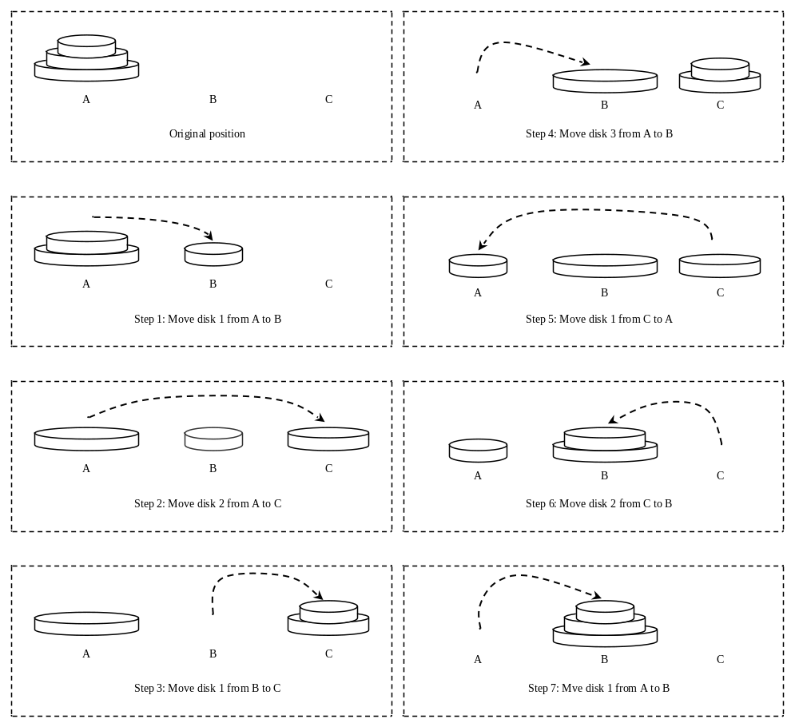
Tower of Hanoi, cont.

Slide 39
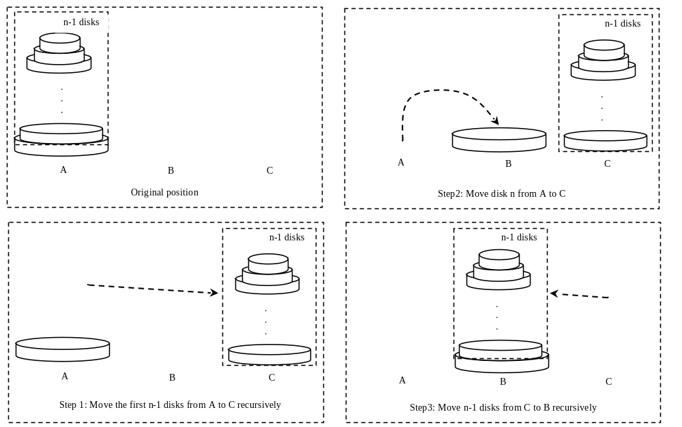
Solution to Tower of Hanoi
The Tower of Hanoi problem can be decomposed into three subproblems.

Slide 40
Solution to Tower of Hanoi
Move the first n - 1 disks from A to C with the assistance of tower B.
Move disk n from A to B.
Move n - 1 disks from C to B with the assistance of tower A.
TowerOfHanoi
Run

Slide 41
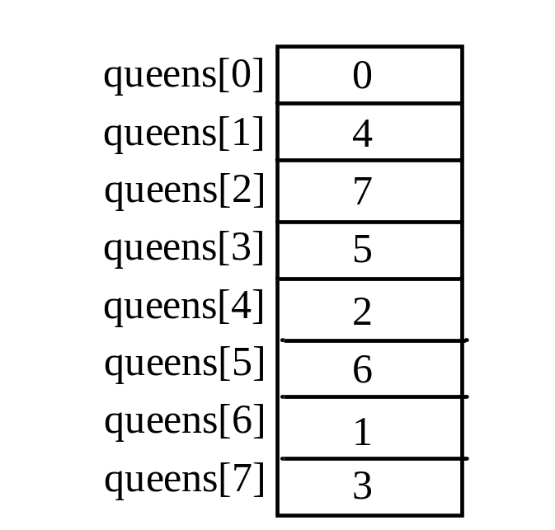
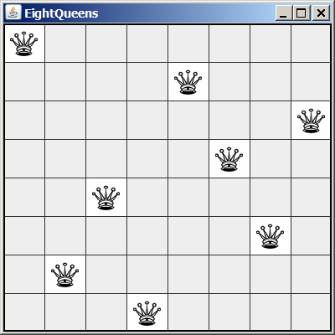
Eight Queens
EightQueen
Run

Slide 42
Recursion vs. Iteration
Recursion is an alternative form of program control. It is essentially repetition without a loop.
Recursion bears substantial overhead. Each time the program calls a function, the system must assign space for all of the function’s local variables and parameters. This can consume considerable memory and requires extra time to manage the additional space.

Slide 43
Advantages of Using Recursion
Recursion is good for solving the problems that are inherently recursive.

Slide 44
Tail Recursion
A recursive function is said to be tail recursive if there are no pending operations to be performed on return from a recursive call.
Non-tail recursive
ComputeFactorial
Run
Tail recursive
ComputeFactorialTailRecursion
Run

