Slide 1
Chapter 19 Sorting

Slide 2
Objectives
To study and analyze time complexity of various sorting algorithms (§§19.2–19.7).
To design, implement, and analyze insertion sort (§19.2).
To design, implement, and analyze bubble sort (§19.3).
To design, implement, and analyze merge sort (§19.4).
To design, implement, and analyze quick sort (§19.5).
To design and implement a binary heap (§19.6).
To design, implement, and analyze heap sort (§19.6).
To design, implement, and analyze bucket sort and radix sort (§19.7).
To design, implement, and analyze external sort for files that have a large amount of data (§19.8).

Slide 3
why study sorting?
Sorting is a classic subject in computer science. There are three reasons for studying sorting algorithms.
  First, sorting algorithms illustrate many creative approaches to problem solving and these approaches can be applied to solve other problems.
  Second, sorting algorithms are good for practicing fundamental programming techniques using selection statements, loops, methods, and arrays.
  Third, sorting algorithms are excellent examples to demonstrate algorithm performance.

Slide 4
what data to sort?
The data to be sorted might be integers, doubles, characters, or objects. §6.8, “Sorting Arrays,” presented selection sort and insertion sort for numeric values.
data to be sorted are integers,
data are sorted in ascending order, and
data are stored in an array. The programs can be easily modified to sort other types of data, to sort in descending order, or to sort data in an ArrayList or a LinkedList.

Slide 5
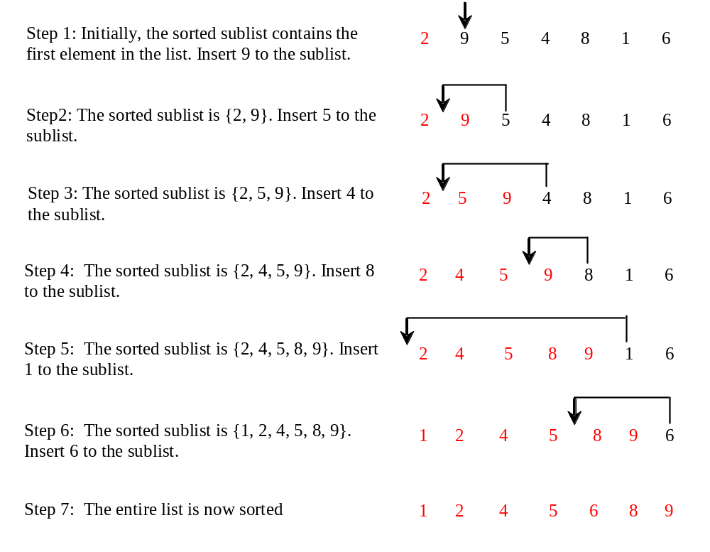
Insertion Sort
int[] myList = {2, 9, 5, 4, 8, 1, 6}; // Unsorted
The insertion sort algorithm sorts a list of values by repeatedly inserting an unsorted element into a sorted sublist until the whole list is sorted.

Slide 6
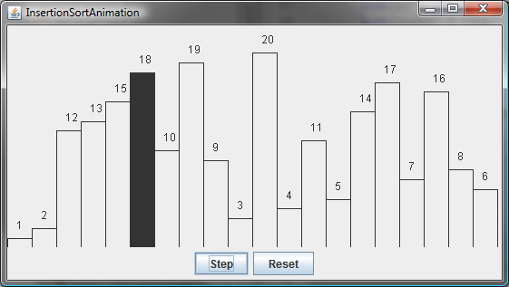
Insertion Sort Animation
animation
http://www.cs.armstrong.edu/liang/animation/InsertionSortAnimation.html

Slide 7
Insertion Sort
animation
int myList[] = {2, 9, 5, 4, 8, 1, 6}; // Unsorted
2 | 9 | 5 | 4 | 8 | 1 | 6
2 | 9 | 5 | 4 | 8 | 1 | 6
2 | 5 | 9 | 4 | 8 | 1 | 6
2 | 4 | 5 | 9 | 8 | 1 | 6
2 | 4 | 5 | 8 | 9 | 1 | 6
1 | 2 | 4 | 5 | 8 | 9 | 6
1 | 2 | 4 | 5 | 6 | 8 | 9

Slide 8

Insertion Sort
InsertionSort
Run

Slide 9
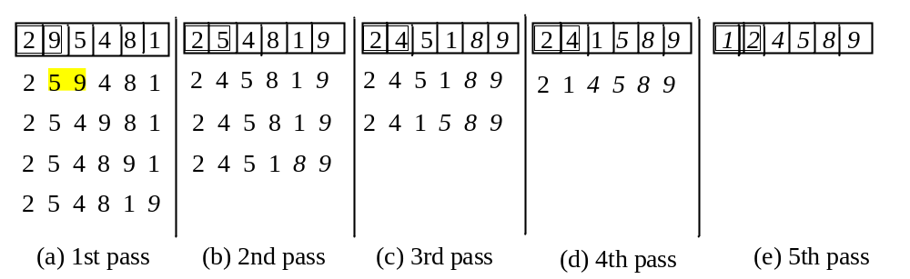
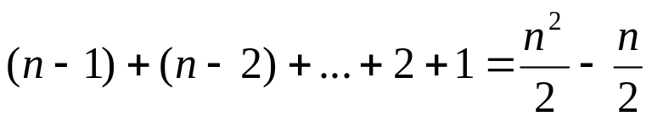
Bubble Sort
Bubble sort time: O(n²)

Slide 10
Bubble Sort Animation
http://www.cs.armstrong.edu/liang/animation/BubbleSortAnimation.html
BubbleSort
Run

Slide 11
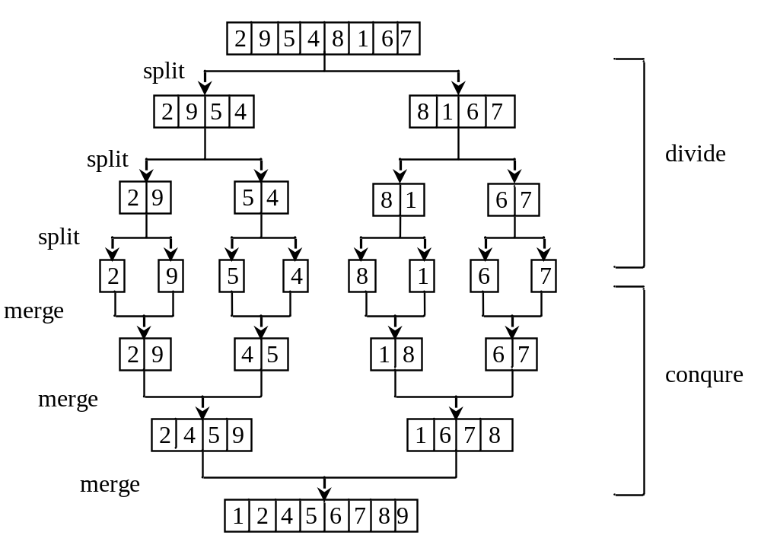
Merge Sort

Slide 12
Merge Sort
MergeSort
Run

Slide 13
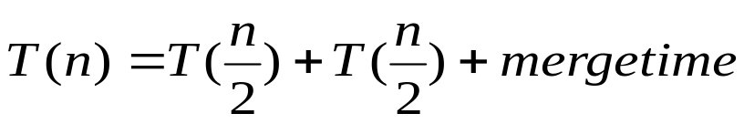
Merge Sort Time
Let T(n) denote the time required for sorting an array of n elements using merge sort. Without loss of generality, assume n is a power of 2. The merge sort algorithm splits the array into two subarrays, sorts the subarrays using the same algorithm recursively, and then merges the subarrays. So,

Slide 14
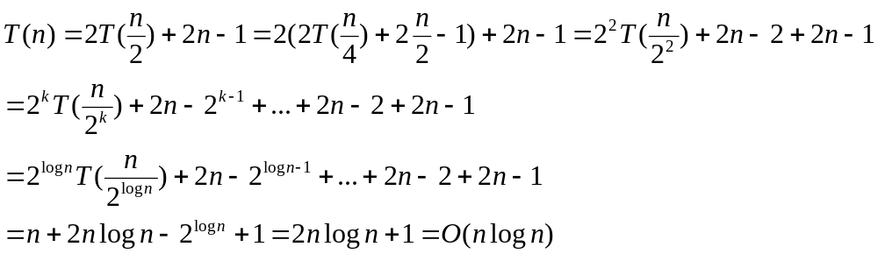
Merge Sort Time
The first T(n/2) is the time for sorting the first half of the array and the second T(n/2) is the time for sorting the second half. To merge two subarrays, it takes at most n-1 comparisons to compare the elements from the two subarrays and n moves to move elements to the temporary array. So, the total time is 2n-1. Therefore,

Slide 15
Quick Sort
Quick sort, developed by C. A. R. Hoare (1962), works as follows: The algorithm selects an element, called the pivot, in the array. Divide the array into two parts such that all the elements in the first part are less than or equal to the pivot and all the elements in the second part are greater than the pivot. Recursively apply the quick sort algorithm to the first part and then the second part.

Slide 16
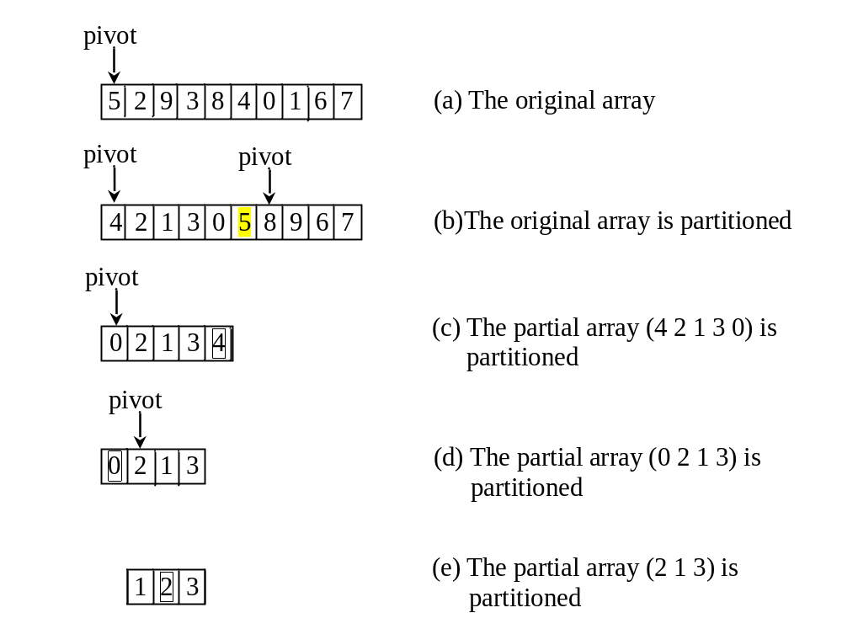
Quick Sort

Slide 17
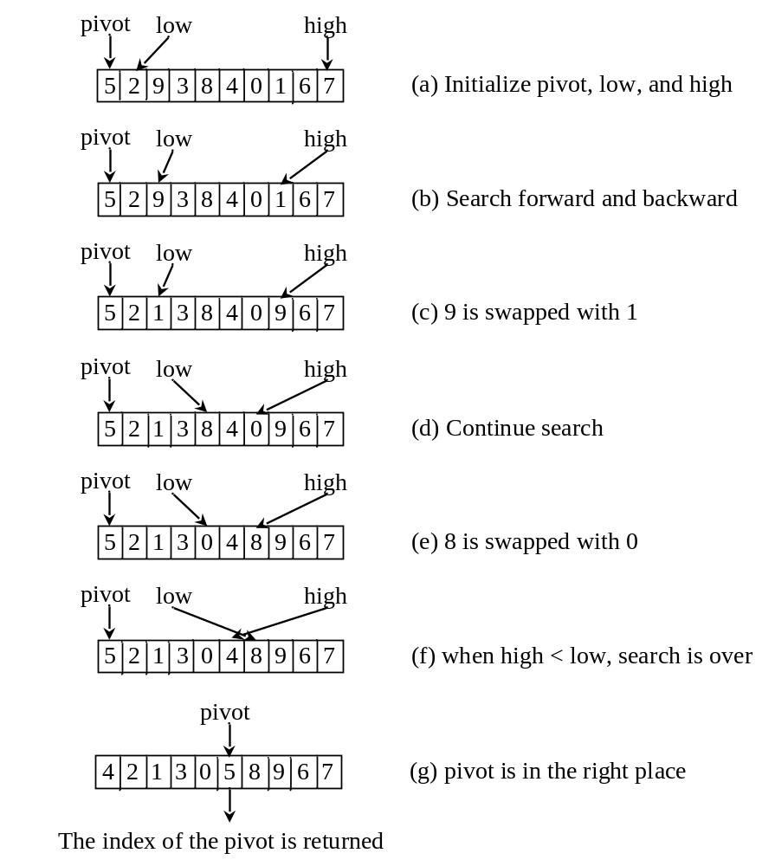
Partition

Slide 18
Quick Sort
QuickSort
Run

Slide 19

Quick Sort Time
To partition an array of n elements, it takes n comparisons and n moves in the worst case. So, the time required for partition is O(n).
In the worst case, each time the pivot divides the array into one big subarray with the other empty. The size of the big subarray is one less than the one before divided. The algorithm requires time:

Slide 20
Worst-Case Time
In the worst case, each time the pivot divides the array into one big subarray with the other empty. The size of the big subarray is one less than the one before divided. The algorithm requires:

Slide 21
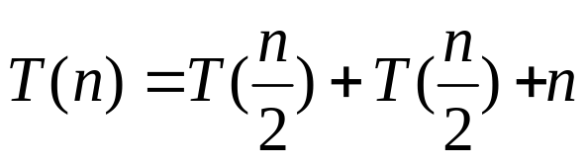
Best-Case Time
In the best case, each time the pivot divides the array into two parts of about the same size. Let T(n) denote the time required for sorting an array of elements using quick sort. So,

Slide 22
Average-Case Time
On the average, each time the pivot will not divide the array into two parts of the same size nor one empty part. Statistically, the sizes of the two parts are very close. So the average time is O(logn). The exact average-case analysis is beyond the scope of this book.

Slide 23
Heaps
Heap is a useful data structure for designing efficient sorting algorithms and priority queues. A heap is a binary tree with the following properties:
It is a complete binary tree.
Each node is greater than or equal to any of its children.

Slide 24
complete binary tree
A binary tree is complete if every level of the tree is full except that the last level may not be full and all the leaves on the last level are placed left-most. For example, in Figure 17.6, the binary trees in (a) and (b) are complete, but the binary trees in (c) and (d) are not complete. Further, the binary tree in (a) is a heap, but the binary tree in (b) is not a heap, because the root (39) is less than its right child (42).

Slide 25
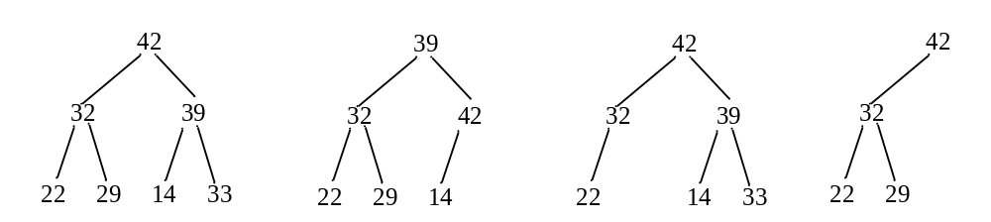
complete binary tree

Slide 26
See How a Heap Works
http://www.cs.armstrong.edu/liang/animation/HeapAnimation.html

Slide 27
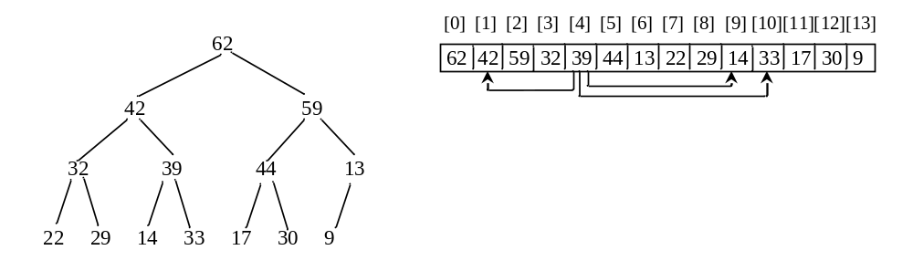
Representing a Heap
A heap is a binary tree. So it can be represented using a binary tree data structure. However, a more efficient representation for a heap is using an array or a vector if the heap size is known in advance.

Slide 28
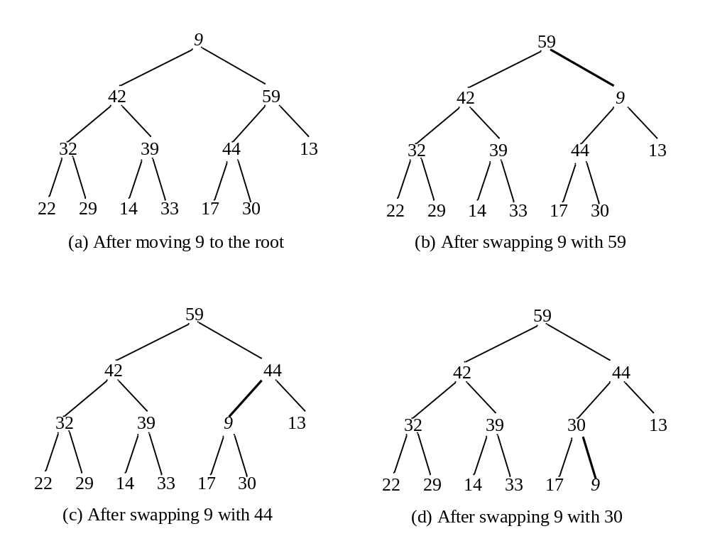
Removing the Root

Slide 29
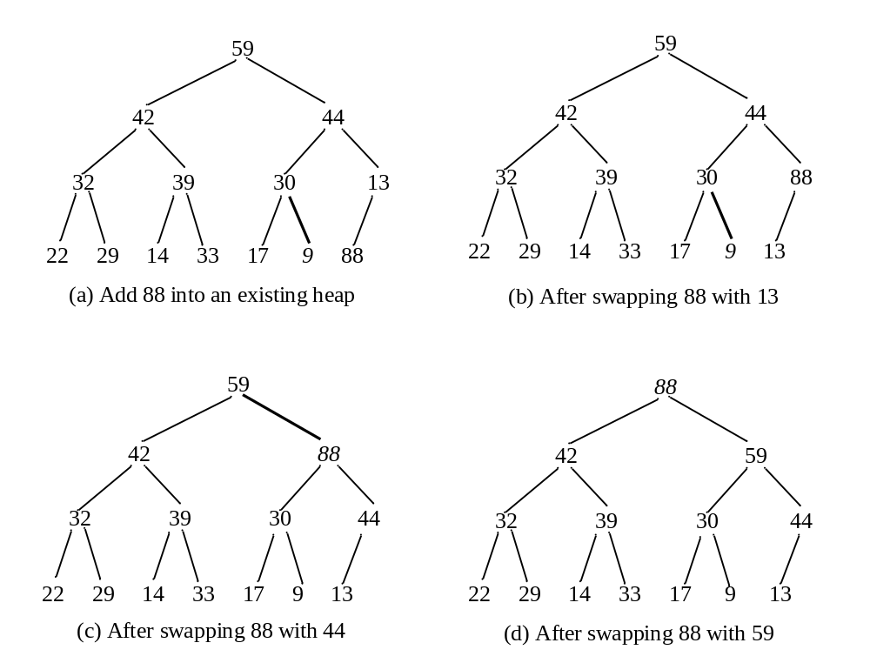
Adding a New Node

Slide 30
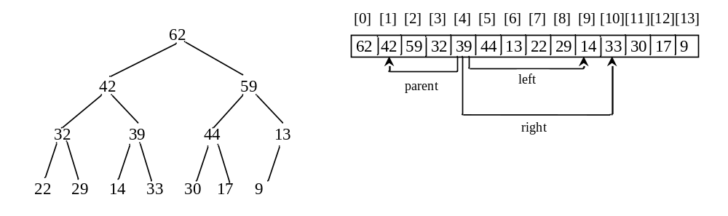
Representing a Heap
For a node at position i, its left child is at position 2i+1 and its right child is at position 2i+2, and its parent is (i-1)/2. For example, the node for element 39 is at position 4, so its left child (element 14) is at 9 (2*4+1), its right child (element 33) is at 10 (2*4+2), and its parent (element 42) is at 1 ((4-1)/2).

Slide 31
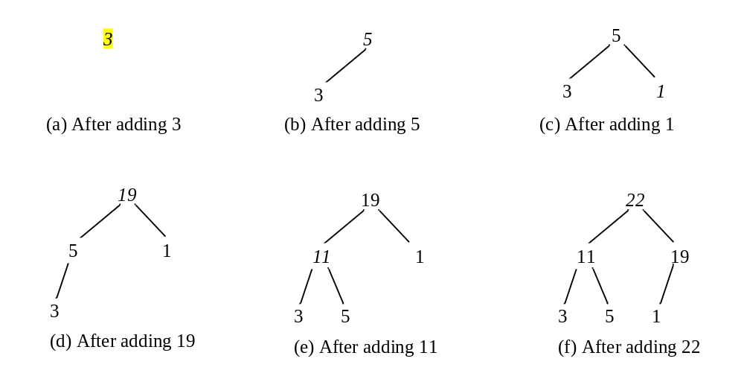
Adding Elements to the Heap
Adding 3, 5, 1, 19, 11, and 22 to a heap, initially empty

Slide 32
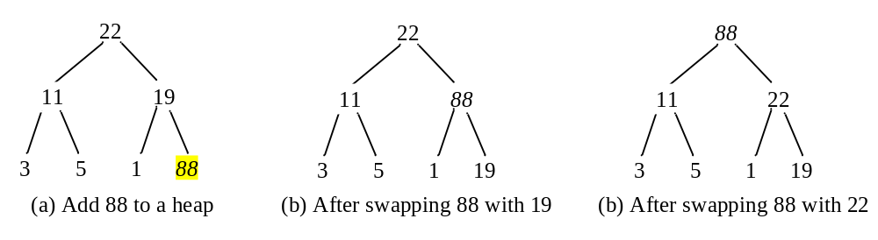
Rebuild the heap after adding a new node
Adding 88 to the heap

Slide 33
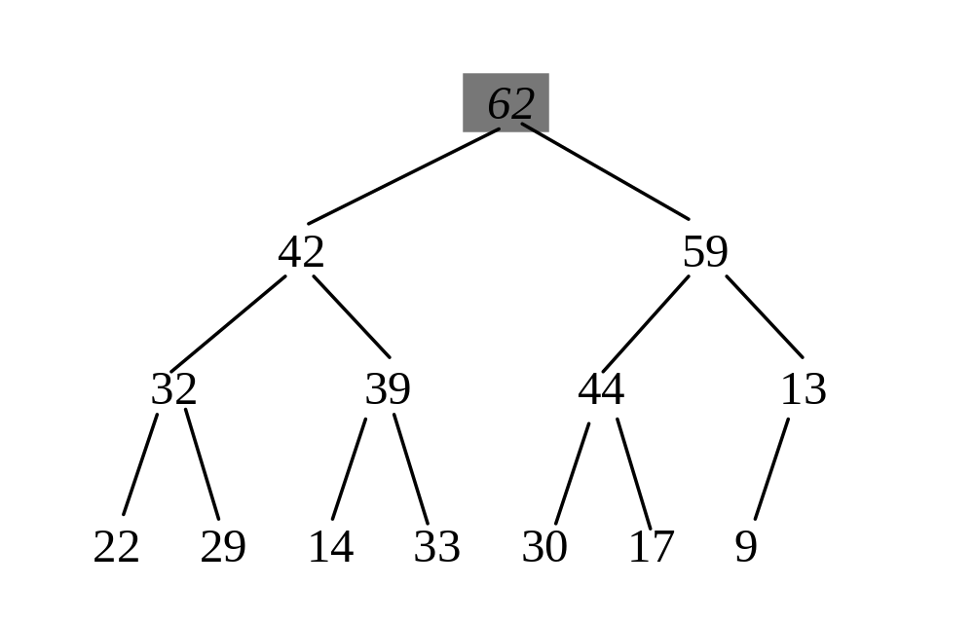
Removing the Root and Rebuild the Tree
Removing root 62 from the heap

Slide 34
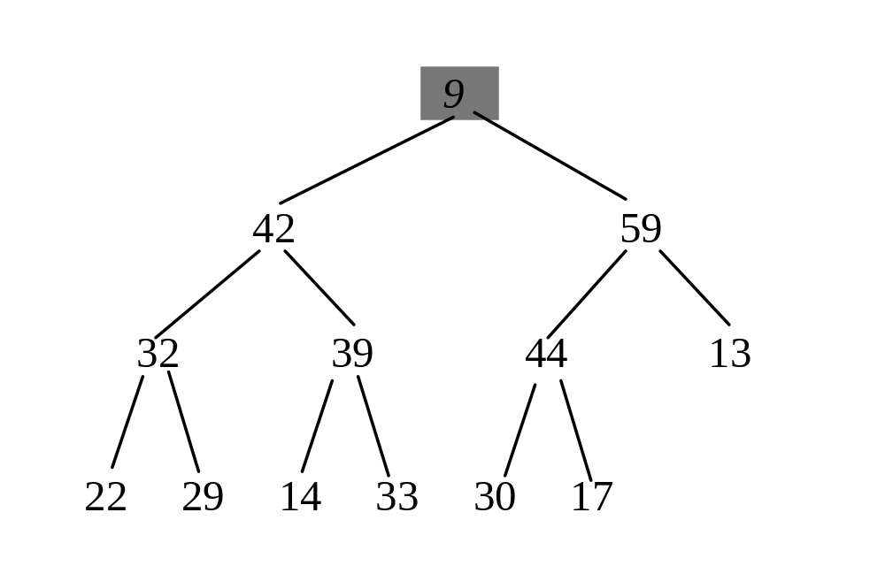
Removing the Root and Rebuild the Tree
Move 9 to root

Slide 35
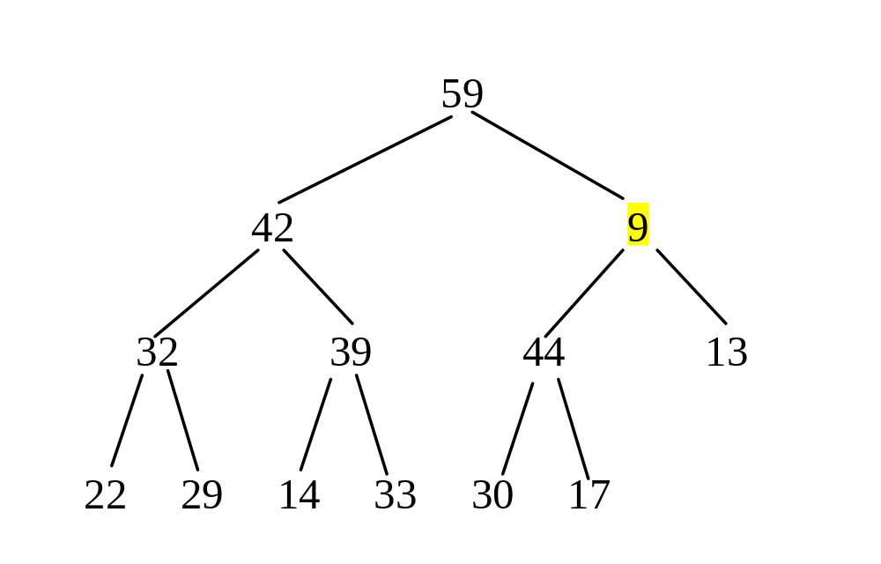
Removing the Root and Rebuild the Tree
Swap 9 with 59

Slide 36
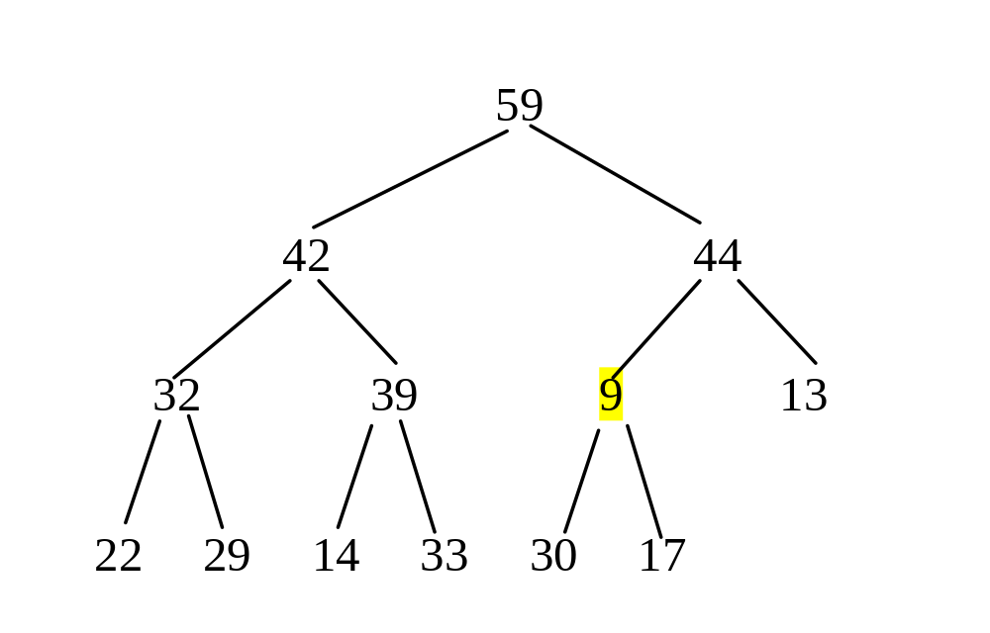
Removing the Root and Rebuild the Tree
Swap 9 with 44

Slide 37
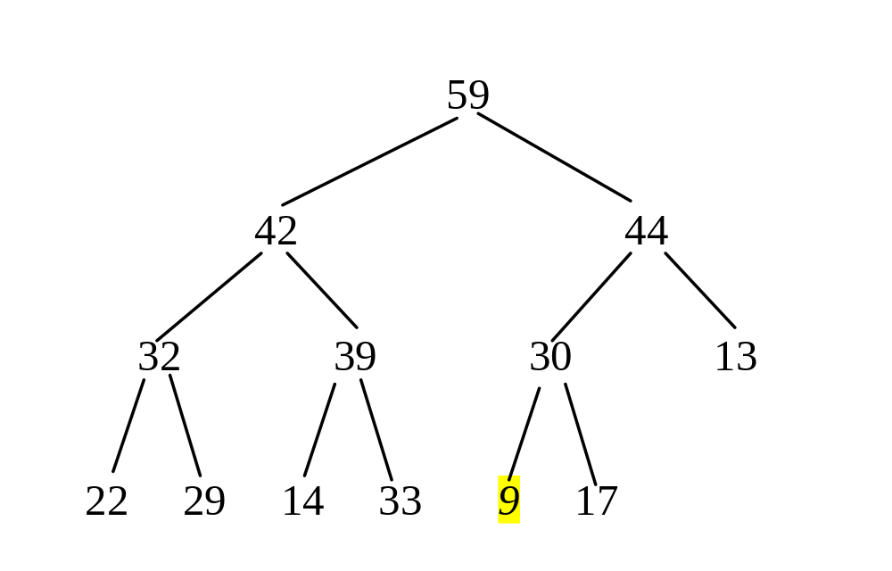
Removing the Root and Rebuild the Tree
Swap 9 with 30

Slide 38
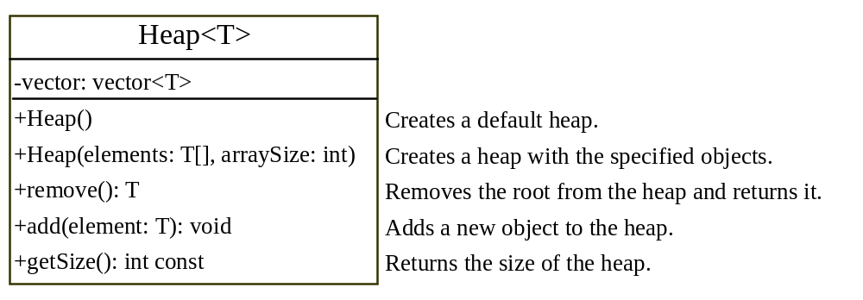
The Heap Class
Heap
HeapSort
Run

Slide 39
Heap Sort
Heap sort uses a binary heap to sort an array.

Slide 40
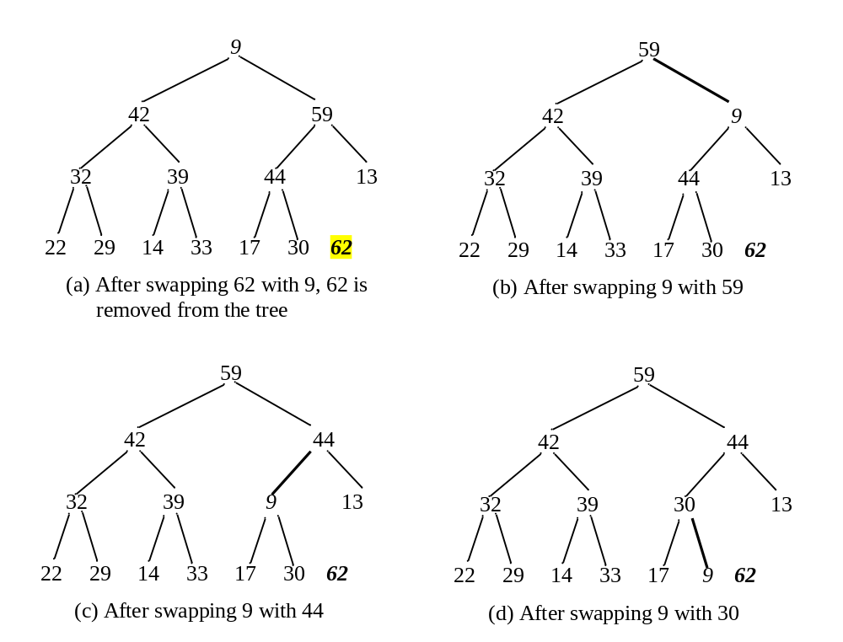
Heap Sort

Slide 41
Creating an Initial Heap

Slide 42


Heap Sort Time
Let h denote the height for a heap of n elements. Since a heap is a complete binary tree, the first level has 1 node, the second level has 2 nodes, the kth level has 2^{(k-1)} nodes, the hth level has nodes, and the (h-1)th level has at least one node and at most 2^{(h-1)} nodes. Therefore,

Slide 43
Bucket Sort and Radix Sort
All sort algorithms discussed so far are general sorting algorithms that work for any types of keys (e.g., integers, strings, and any comparable objects). These algorithms sort the elements by comparing their keys. The lower bound for general sorting algorithms is O(nlogn). So, no sorting algorithms based on comparisons can perform better than O(nlogn). However, if the keys are small integers, you can use bucket sort without having to compare the keys.

Slide 44
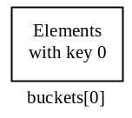
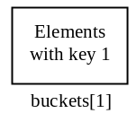
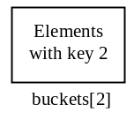
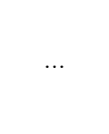
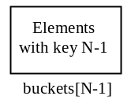
Bucket Sort
The bucket sort algorithm works as follows. Assume the keys are in the range from 0 to N-1. We need N buckets labeled 0, 1, ..., and N-1. If an element’s key is i, the element is put into the bucket i. Each bucket holds the elements with the same key value. You can use an ArrayList to implement a bucket.

Slide 45
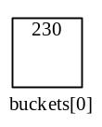
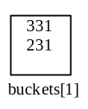
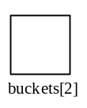

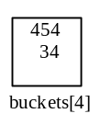
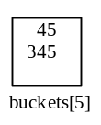
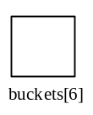
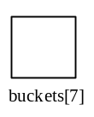
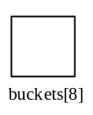
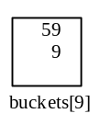
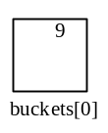

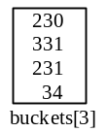
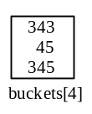
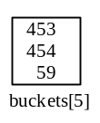
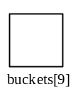
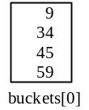
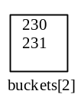
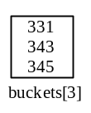
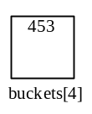

Radix Sort
Sort 331, 454, 230, 34, 343, 45, 59, 453, 345, 231, 9
230, 331, 231, 343, 453, 454, 34, 45, 345, 59, 9
9, 230, 331, 231, 34, 343, 45, 345, 453, 454, 59
9, 34, 45, 59, 230, 231, 331, 343, 345, 453

Slide 46
Bubble Sort Animation
http://www.cs.armstrong.edu/liang/animation/BubbleSortAnimation.html

Slide 47
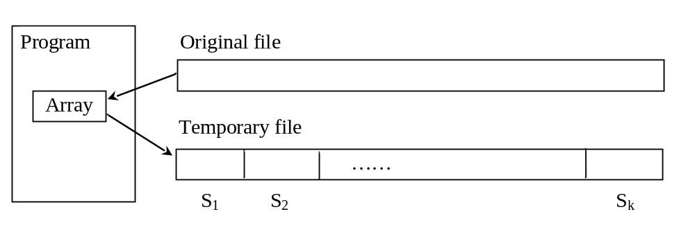
External Sort
All the sort algorithms discussed in the preceding sections assume that all data to be sorted is available at one time in internal memory such as an array. To sort data stored in an external file, you may first bring data to the memory, then sort it internally. However, if the file is too large, all data in the file cannot be brought to memory at one time.

Slide 48
Phase I
Repeatedly bring data from the file to an array, sort the array using an internal sorting algorithm, and output the data from the array to a temporary file.

Slide 49
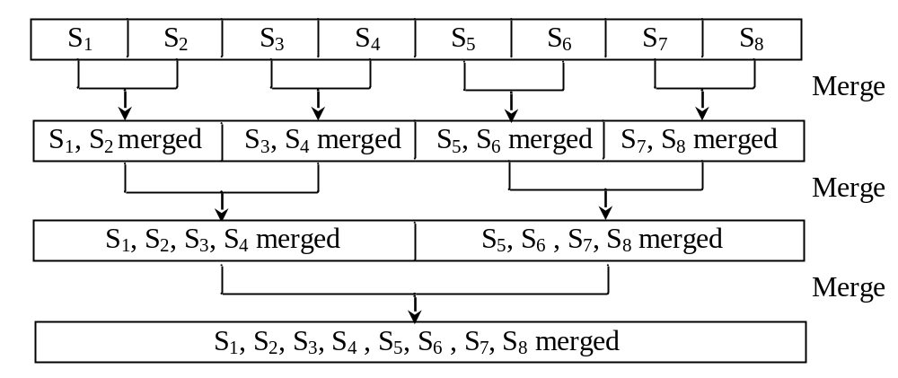
Phase II
Merge a pair of sorted segments (e.g., S1 with S2, S3 with S4, ..., and so on) into a larger sorted segment and save the new segment into a new temporary file. Continue the same process until one sorted segment results.

Slide 50
Implementing Phase II
Each merge step merges two sorted segments to form a new segment. The new segment doubles the number elements. So the number of segments is reduced by half after each merge step. A segment is too large to be brought to an array in memory. To implement a merge step, copy half number of segments from file f1.dat to a temporary file f2.dat. Then merge the first remaining segment in f1.dat with the first segment in f2.dat into a temporary file named f3.dat.

Slide 51
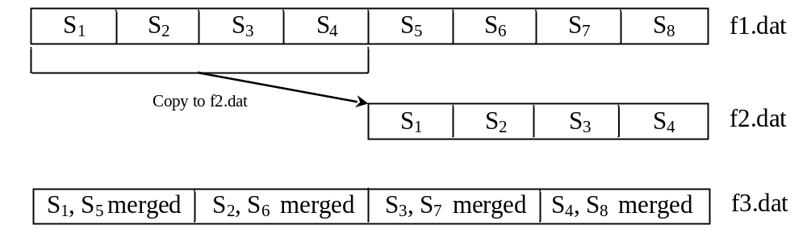
Implementing Phase II

