Slide 1
Chapter 20
Linked Lists, Queues, and Priority Queues

Slide 2
Objectives
To create nodes to store elements in a linked list (§20.2).
To access the nodes in a linked list via pointers (§20.3).
To declare a LinkedList class for storing and processing data in a list (§20.4).
To add an element to the head of a list (§20.4.1).
To add an element to the end of a list (§20.4.2).
To insert an element into a list (§20.4.3).
To remove the first element from a list (§20.4.4).
To remove the last element from a list (§20.4.5).
To remove an element at a specified position in a list (§20.4.6).
To implement iterators for traversing the elements in various types of containers (§20.5).
To traverse the elements in a container using a foreach loop (§20.6).
To explore the variations of linked lists (§20.7).
To implement the Stack class using a linked list (§20.8).
To implement the Queue class using a linked list (§20.9).
To implement the PriorityQueue class using a heap (§20.10).

Slide 3
Linked List
This chapter introduces a new data structure, called linked list. A linked list is efficient for storing and managing a varying number of elements. This chapter will also discuss how to implement stacks and queues using linked lists.

Slide 4
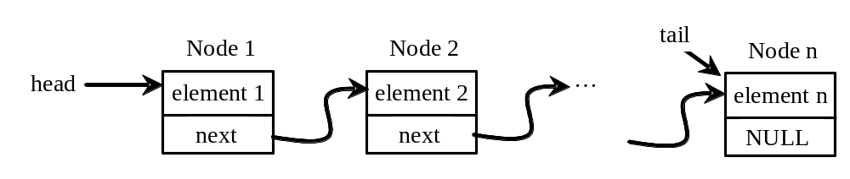
Nodes in Linked Lists
A linked list consists of nodes. Each node contains an element, and each node is linked to its next neighbor. Thus a node can be defined as a class, as follows:

Slide 5
The Node Class
template<typename T>
class Node
{
public:
T element; // Element contained in the node
Node* next; // Pointer to the next node
Node() // No-arg constructor
{
next = NULL;
}
Node(T element) // Constructor
{
this->element = element;
next = NULL;
}
};

Slide 6
The NULL Constant
By convention, pointer variables named head and tail are used to point to the first node and last node in the list. If the list is empty, both head and tail should be NULL. NULL is a C++ constant for 0, which indicates that a pointer does not point to any node. The definition of NULL is in a number of standard libraries including <iostream> and <cstddef>.

Slide 7
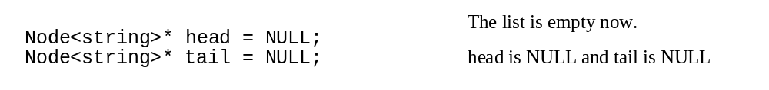
Adding Three Nodes
Here is an example that creates three nodes to store three strings in a list.
Step 1: Declare head and tail:

Slide 8
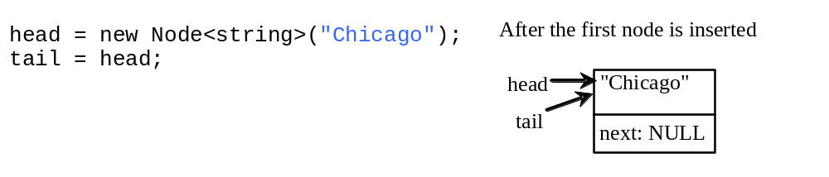
Adding Three Nodes, cont.
Step 2: Create the first node and insert it to the list:

Slide 9
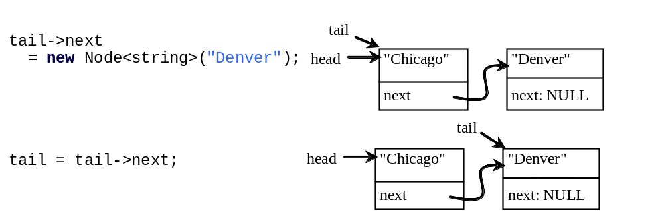
Adding Three Nodes, cont.
Step 3: Create the second node and insert it to the list:

Slide 10
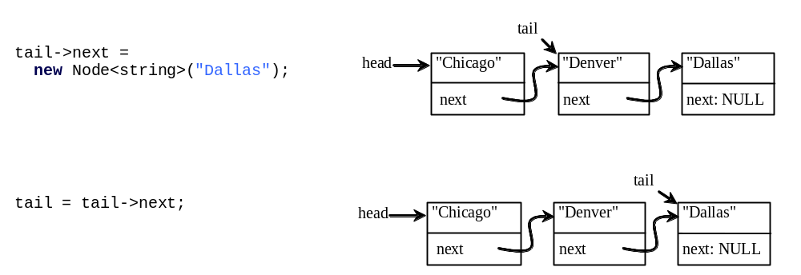
Adding Three Nodes, cont.
Step 4: Create the third node and insert it to the list:

Slide 11
Traversing All Elements in the List
Each node contains the element and a data field named next that points to the next element. If the node is the last in the list, its pointer data field next contains the value NULL. You can use this property to detect the last node. For example, you may write the following loop to traverse all the nodes in the list.
Node<string>* current = head;
while (current != NULL)
{
cout << current->element << endl;
current = current->next;
}

Slide 12
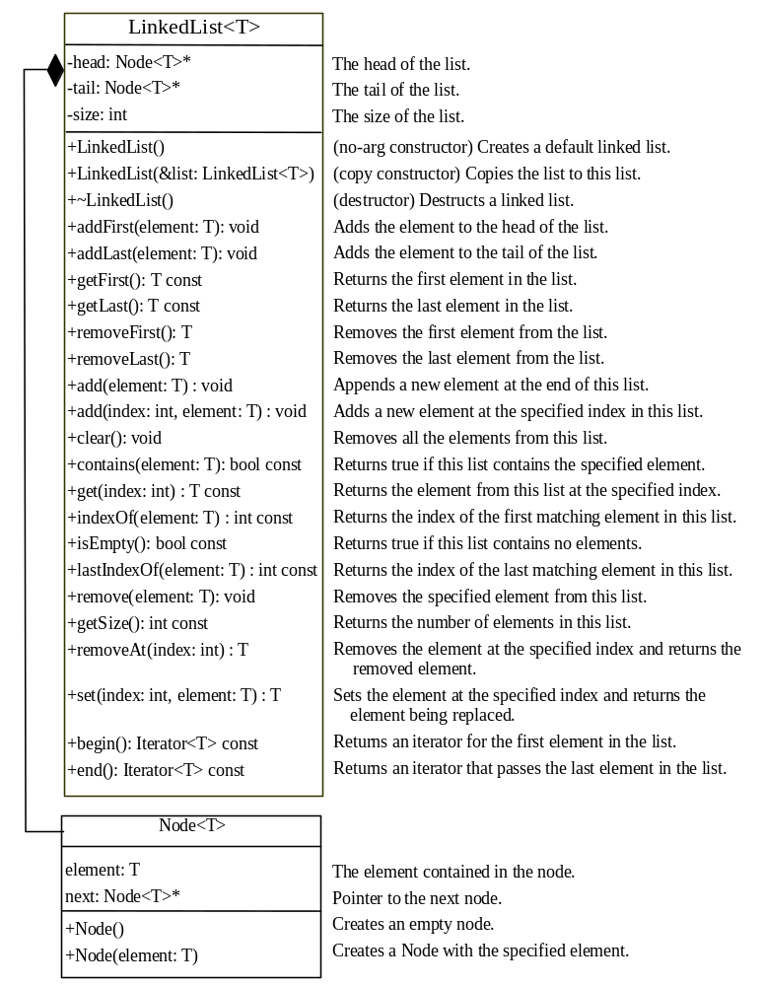
The LinkedList Class
LinkedList
TestLinkedList
Run

Slide 13
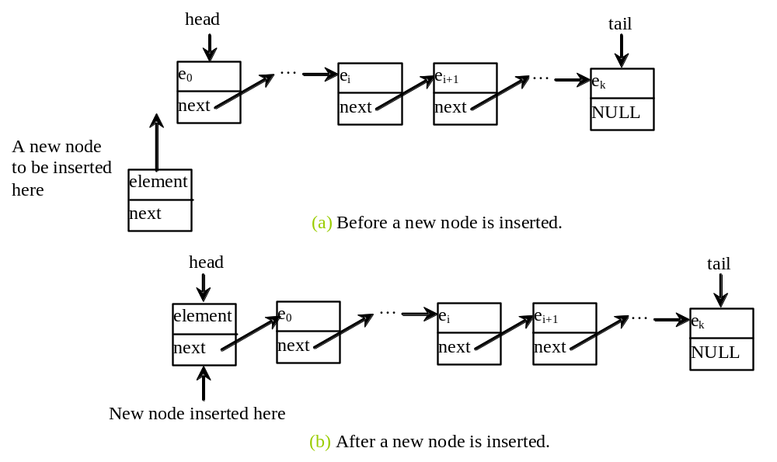
Implementing addFirst(T element)
template<typename T>
void LinkedList<T>::addFirst(T element)
{
Node<T>* newNode = new Node<T>(element);
newNode->next = head;
head = newNode;
size++;
if (tail == NULL)
tail = head;
}

Slide 14
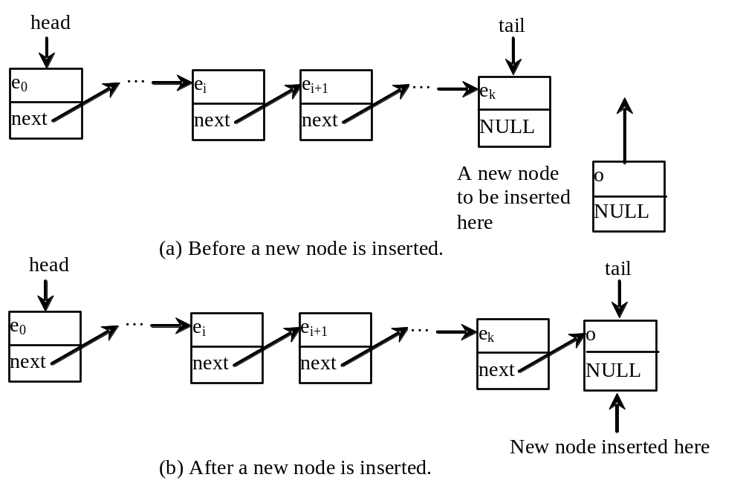
Implementing addLast(T element)
template<typename T>
void LinkedList<T>::addLast(T element)
{
if (tail == NULL)
{
head = tail = new Node<T>(element);
}
else {
tail->next = new Node<T>(element);
tail = tail->next;
}
size++;
}

Slide 15
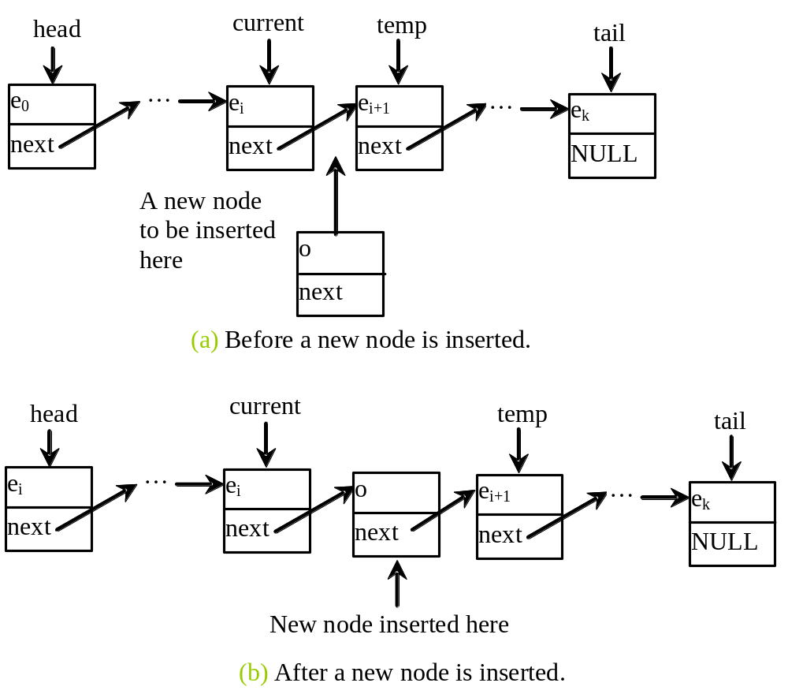
Implementing add(int index, T element)
template<typename T>
void LinkedList<T>::add(int index, T element)
{
if (index == 0)
addFirst(element);
else if (index >= size)
addLast(element);
else
{
Node<T>* current = head;
for (int i = 1; i < index; i++)
current = current->next;
Node<T>* temp = current->next;
current->next = new Node<T>(element);
(current->next)->next = temp;
size++;
}
}

Slide 16
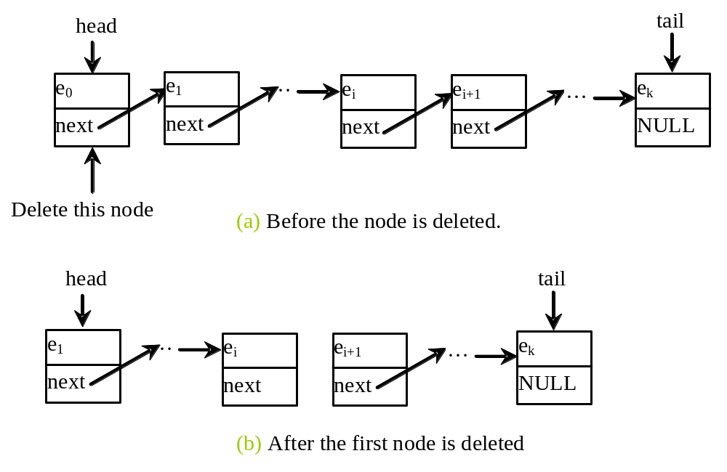
Implementing removeFirst()
template<typename T>
T LinkedList<T>::removeFirst() throw (runtime_error)
{
if (size == 0)
throw runtime_error("No elements in the list");
else
{
Node<T>* temp = head;
head = head->next;
size--;
if (head == NULL) tail = NULL;
T element = temp->element;
delete temp;
return element;
}
}

Slide 17
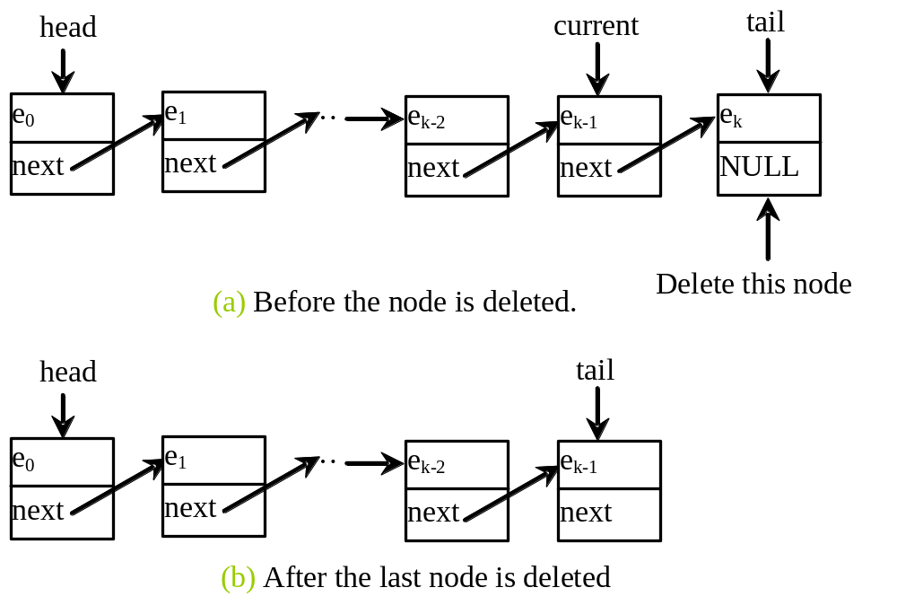
Implementing removeLast()
template<typename T>
T LinkedList<T>::removeLast() throw (runtime_error)
{
if (size == 0)
throw runtime_error("No elements in the list");
else if (size == 1)
{
Node<T>* temp = head;
head = tail = NULL;
size = 0;
T element = temp->element;
delete temp;
return element;
}
else
{
Node<T>* current = head;
for (int i = 0; i < size - 2; i++)
current = current->next;
Node<T>* temp = tail;
tail = current;
tail->next = NULL;
size--;
T element = temp->element;
delete temp;
return element;
}
}

Slide 18
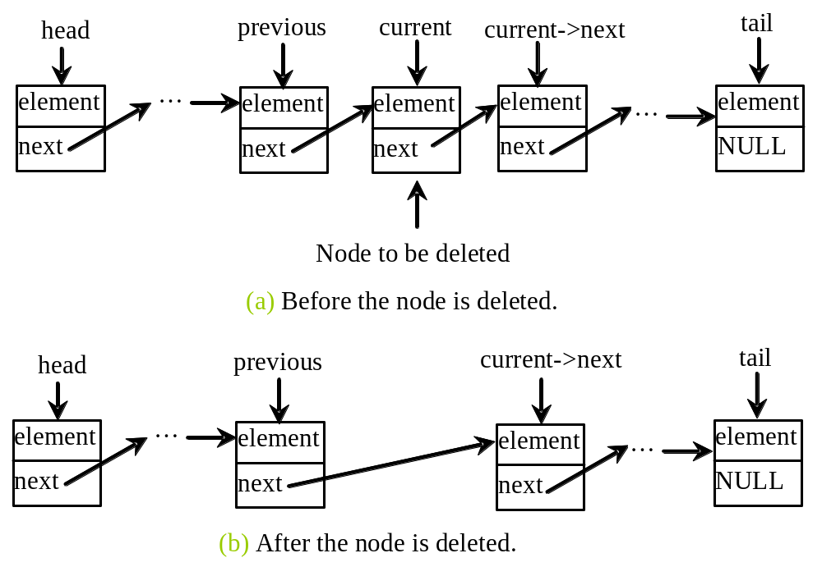
Implementing removeAt(int index)
template<typename T>
T LinkedList<T>::removeAt(int index) throw (runtime_error)
{
if (index < 0 || index >= size)
throw runtime_error("Index out of range");
else if (index == 0)
return removeFirst();
else if (index == size - 1)
return removeLast();
else {
Node<T>* previous = head;
for (int i = 1; i < index; i++)
{
previous = previous->next;
}
Node<T>* current = previous->next;
previous->next = current->next;
size--;
T element = current->element;
delete current;
return element;
}
}

Slide 19
Iterators
Iterator is an important construct in C++. It provides a uniform way for traversing elements in various types of containers. The Standard Template Library (STL) uses iterators to access the elements in the containers. This section defines an iterator class for traversing the elements in a linked list. The objectives of this section are twofold:
(1) to provide an example on how to define an iterator class; (2) to become familiar with iterators and how to use it to traverse the elements in a container.

Slide 20
The Iterator Class
Iterators can be viewed as encapsulated pointers. In a linked list, you can use pointers to traverse the list. But iterators have more functions than pointers. Iterators are objects. Iterators contain functions for accessing and manipulating elements. §20.3, “The LinkedList Class,” introduced the LinkedList class. Let us create an iterator class for LinkedList, as shown in Figure 20.13.

Slide 21
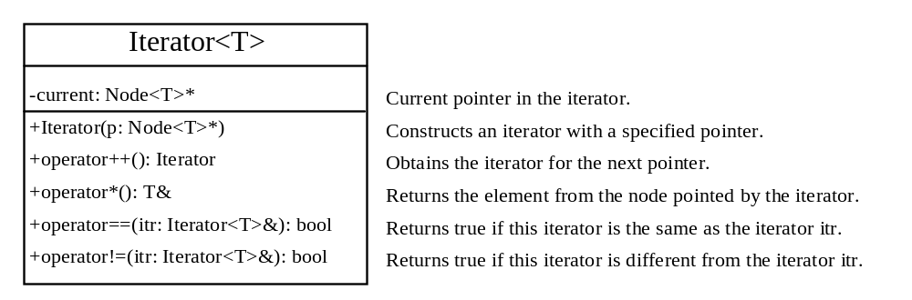
The Iterator Class for LinkedList
TestIterator
Run

Slide 22
Benefits of Iterators
An iterator functions like a pointer. It may be implemented using pointers, array indexes, or other data structures. The abstraction of iterators spares you the details of implementation. Chapter 22, “STL Containers,” will introduce iterators in STL. STL Iterators provide a uniformed interface for accessing the elements in a container so you can use iterators to access the elements in a vector or a set just in the same way in a linked list.

Slide 23
Iterators
Iterator is an important construct in C++. It provides a uniform way for traversing elements in various types of containers. The Standard Template Library (STL) uses iterators to access the elements in the containers. This section defines an iterator class for traversing the elements in a linked list. The objectives of this section are twofold:
(1) to provide an example on how to define an iterator class; (2) to become familiar with iterators and how to use it to traverse the elements in a container.

Slide 24
The Iterator Class
Iterators can be viewed as encapsulated pointers. In a linked list, you can use pointers to traverse the list. But iterators have more functions than pointers. Iterators are objects. Iterators contain functions for accessing and manipulating elements. §20.3, “The LinkedList Class,” introduced the LinkedList class. Let us create an iterator class for LinkedList, as shown in Figure 20.13.

Slide 25
Iterator and foreach Loops
TestForeachLoop
Run

Slide 26
Benefits of Iterators
An iterator functions like a pointer. It may be implemented using pointers, array indexes, or other data structures. The abstraction of iterators spares you the details of implementation. Chapter 22, “STL Containers,” will introduce iterators in STL. STL Iterators provide a uniformed interface for accessing the elements in a container so you can use iterators to access the elements in a vector or a set just in the same way in a linked list.

Slide 27
Variations of Linked Lists
The linked list introduced in the preceding section is known as a singly linked list. It contains a pointer to the list’s first node, and each node contains a pointer to the next node sequentially. Several variations of the linked list are useful in certain applications.

Slide 28
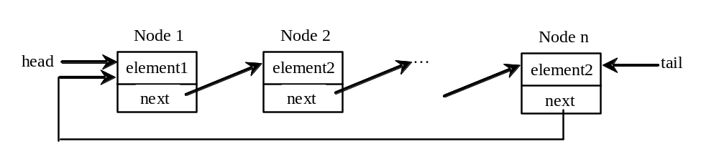
Circular Linked Lists
A circular, singly linked list is like a singly linked list, except that the pointer of the last node points back to the first node.

Slide 29
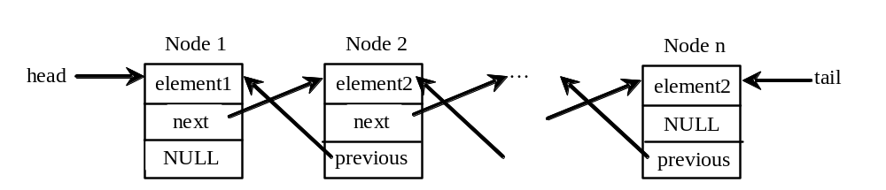
Doubly Linked Lists
A doubly linked list contains the nodes with two pointers. One points to the next node and the other points to the previous node. These two pointers are conveniently called a forward pointer and a backward pointer. So, a doubly linked list can be traversed forward and backward.

Slide 30
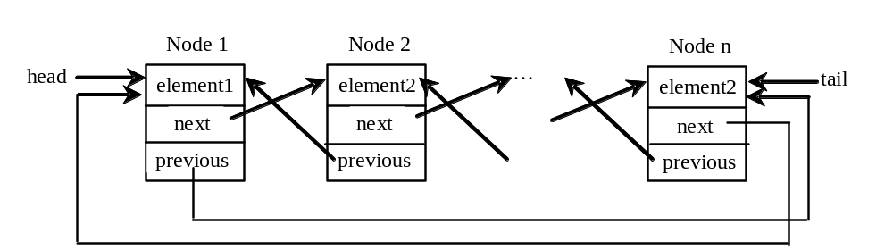
Circular Doubly Linked Lists
A circular, doubly linked list is doubly linked list, except that the forward pointer of the last node points to the first node and the backward pointer of the first pointer points to the last node.

Slide 31
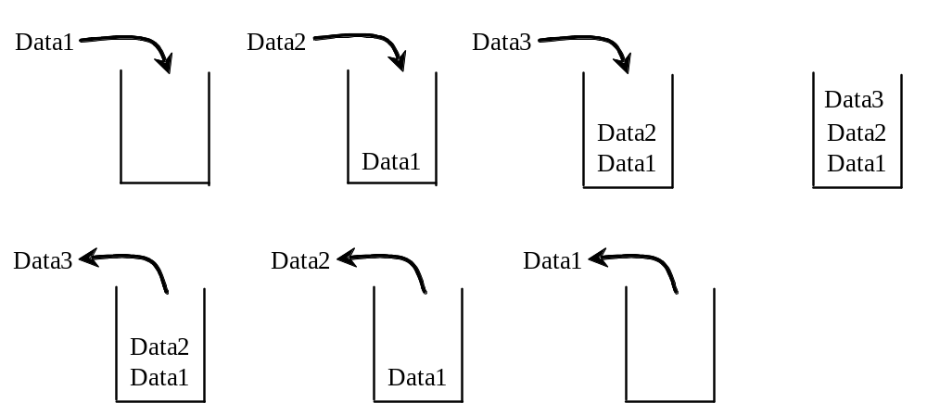
Stacks
A stack can be viewed as a special type of list, where the elements are accessed, inserted, and deleted only from the end, called the top, of the stack.

Slide 32
Stacks
Stack can be implemented using an array.
You can replace array in Listing 12.7 using a stack.

Slide 33
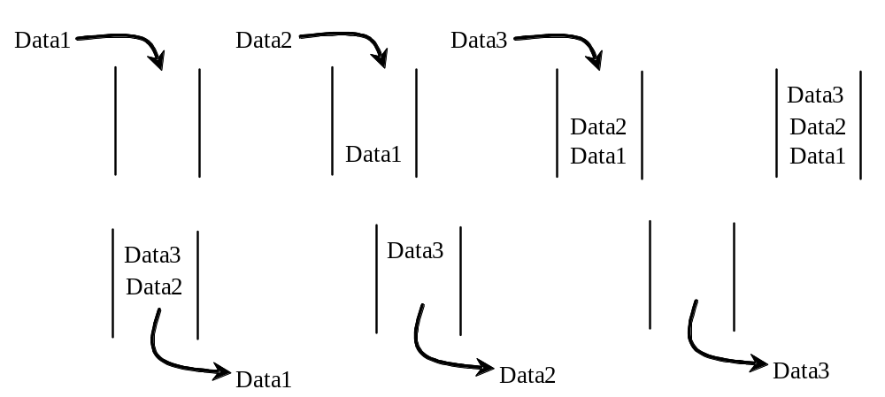
Queues
A queue represents a waiting list. A queue can be viewed as a special type of list whose elements are inserted into the end (tail) of the queue, and are accessed and deleted from the beginning (head) of the queue, as shown in Figure 16.10.

Slide 34
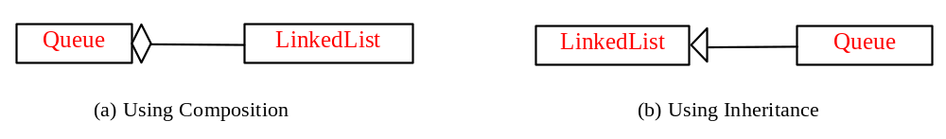
Design of the Queue Class
There are two ways to design the queue class:
  Using inheritance: You can declare the queue class by extending the linked list class.
  Using composition: You can declare a linked list as a data field in the queue class.

Slide 35
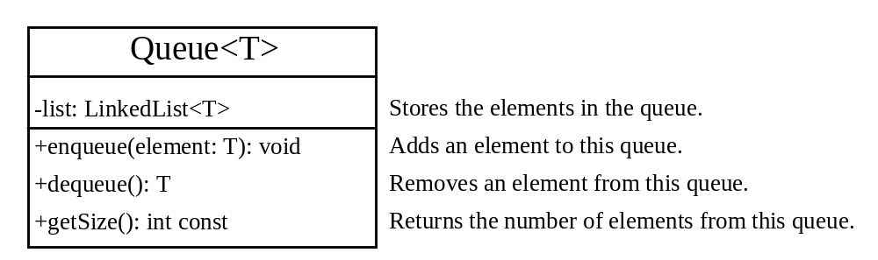
Design and Implement Queues
Queue
TestQueue
Run

Slide 36
Priority Queues
A regular queue is a first-in and first-out data structure. Elements are appended to the end of the queue and are removed from the beginning of the queue. In a priority queue, elements are assigned with priorities. The element with the highest priority is accessed or removed first. A priority queue has a largest-in, first-out behavior. For example, the emergency room in a hospital assigns patients with priority numbers; the patient with the highest priority is treated first.

Slide 37
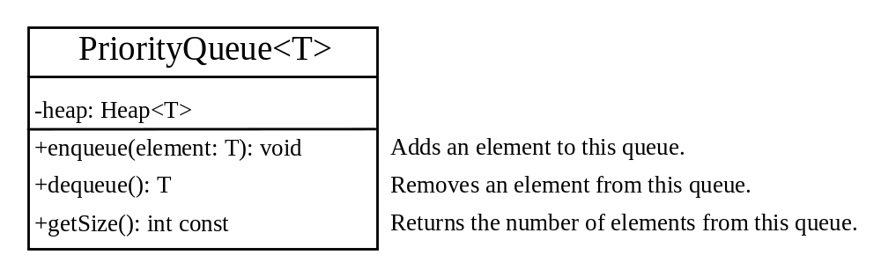
Priority Queues
PriorityQueue
TestPriorityQueue
Run

