Slide 1
Chapter 21 Binary Search Trees

Slide 2
Objectives
To represent and access the elements in a binary search tree (§21.2.2).
To represent binary trees using linked data structures (§21.2.1).
To search an element in binary search tree (§21.2.2).
To insert an element into a binary tree (§21.2.3).
To traverse a binary tree in inorder, postorder, and preorder (§21.2.4).
To define and implement the BST tree class (§21.2.5).
To delete a node in a binary search tree (§21.3).
To design and implement the iterator for traversing the elements in a binary tree (§21.4).

Slide 3
Binary Trees
A list, stack, or queue is a linear structure that consists of a sequence of elements. A binary tree is a hierarchical structure. It is either empty or consists of an element, called the root, and two distinct binary trees, called the left subtree and right subtree. Examples of binary trees are shown in Figure 21.1.

Slide 4
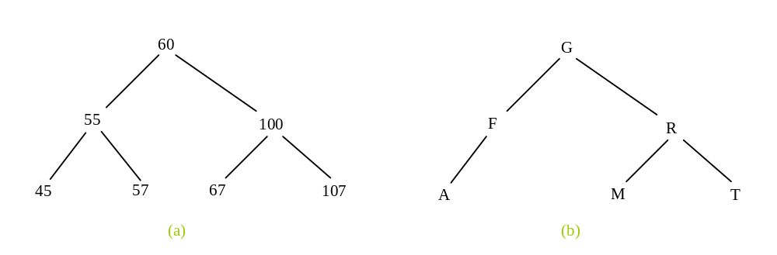
Binary Tree

Slide 5
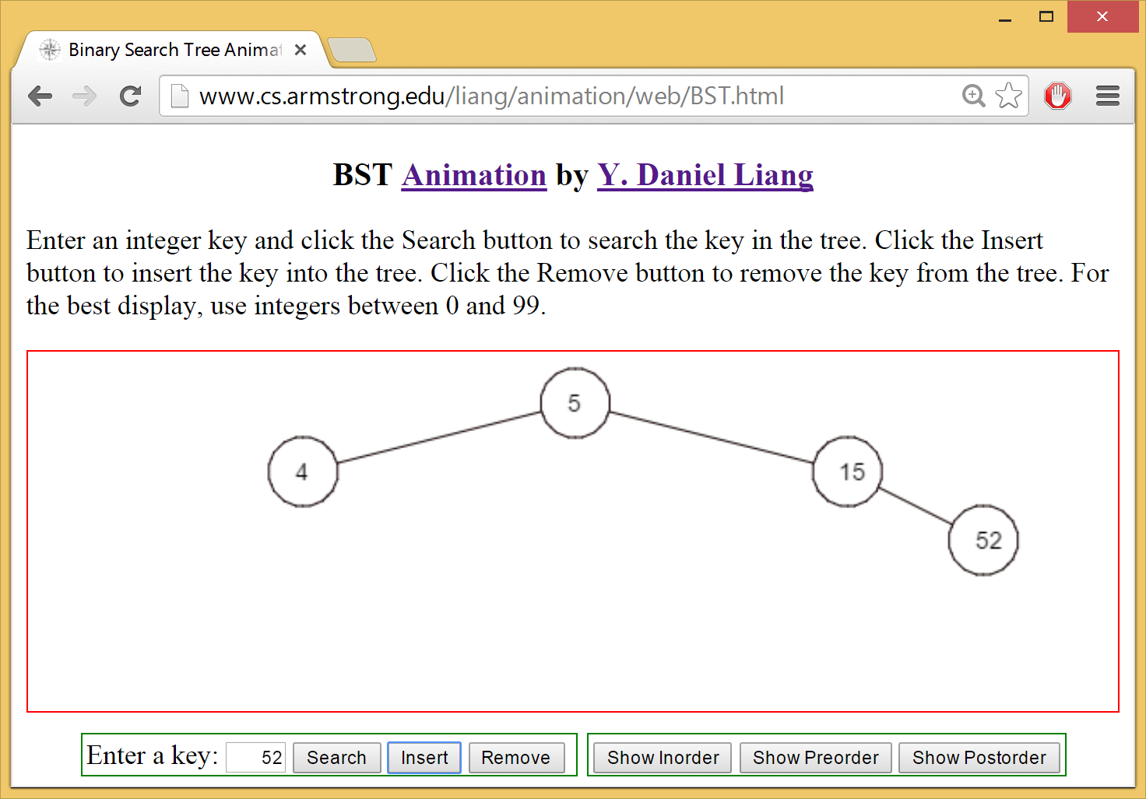
See How a Binary Search Tree Works
http://www.cs.armstrong.edu/liang/animation/web/BST.html

Slide 6
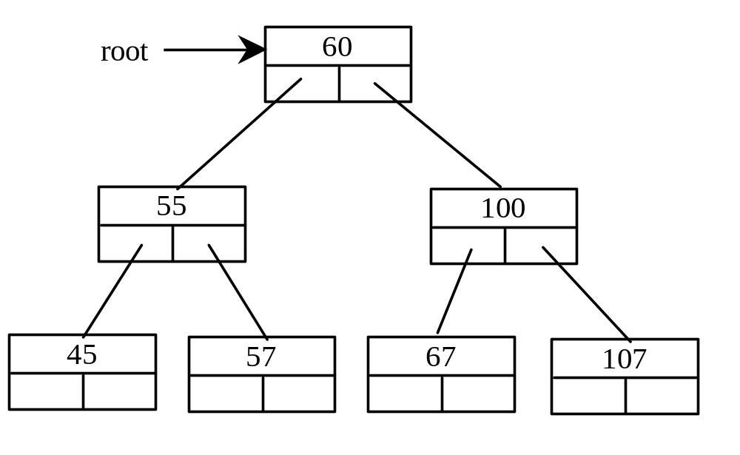
Representing Binary Trees
A binary tree can be represented using a set of linked nodes. Each node contains a value and two links named left and right that reference the left child and right child, respectively, as shown in Figure 21.2.

Slide 7
Representing a TreeNode
template<typename T>
class TreeNode
{
public:
T element; // Element contained in the node
TreeNode<T> * left; // Pointer to the left child
TreeNode<T> * right; // Pointer to the right child
TreeNode() // No-arg constructor
{
left = NULL;
right = NULL;
}
TreeNode(T element) // Constructor
{
this->element = element;
left = NULL;
right = NULL;
}
};

Slide 8
Adding Nodes
// Create the root node
TreeNode<int> *root = new
TreeNode<int>(60);
// Create the left child node
root->left = new TreeNode<int>(55);
// Create the right child node
root->right = new TreeNode<int>(100);

Slide 9
Accessing Nodes in Binary Trees
// Display the root element
cout << root->element << endl;
// Display the element in the left child of the root
cout << (root->left)->element << endl;
// Display the element in the right child of the root
cout << (root->right)->element << endl;

Slide 10
Inserting an Element to a Binary Tree
If a binary tree is empty, create a root node with the new element. Otherwise, locate the parent node for the new element node. If the new element is less than the parent element, the node for the new element becomes the left child of the parent. If the new element is greater than the parent element, the node for the new element becomes the right child of the parent. Here is the algorithm:

Slide 11
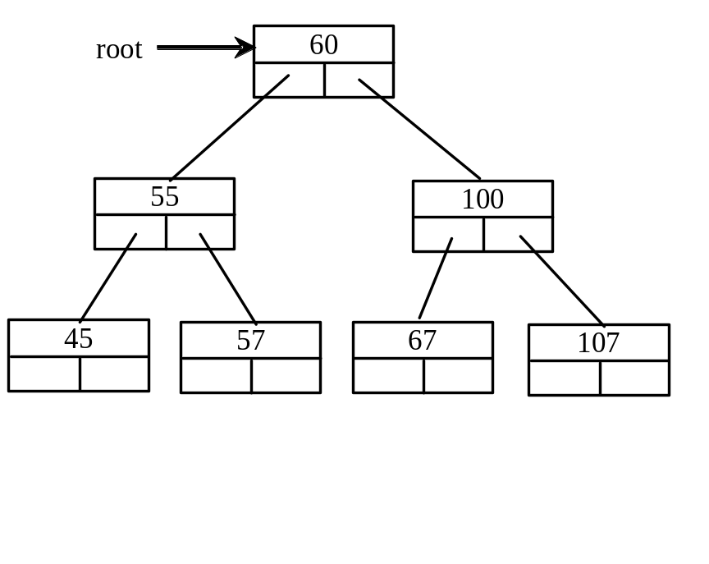
Inserting an Element to a Binary Tree
if (root == NULL)
root = new TreeNode<T>(element);
else
{
// Locate the parent node
current = root;
while (current != NULL)
if (element value < the value in current.element)
{
parent = current;
current = current->left;
}
else if (element value > the value in current.element)
{
parent = current;
current = current->right;
}
else
return false; // Duplicate node not inserted
// Create the new node and attach it to the parent node
if (element < parent->element)
parent->left = new TreeNode<T>(elemenet);
else
parent->right = new TreeNode<T>(elemenet);
return true; // Element inserted
}
Insert 101 into the following tree.

Slide 12
Trace Inserting 101 into the following tree
if (root == NULL)
root = new TreeNode<T>(element);
else
{
// Locate the parent node
current = root;
while (current != NULL)
if (element value < the value in current.element)
{
parent = current;
current = current->left;
}
else if (element value > the value in current.element)
{
parent = current;
current = current->right;
}
else
return false; // Duplicate node not inserted
// Create the new node and attach it to the parent node
if (element < parent->element)
parent->left = new TreeNode<T>(elemenet);
else
parent->right = new TreeNode<T>(elemenet);
return true; // Element inserted
}
Insert 101 into the following tree.

Slide 13
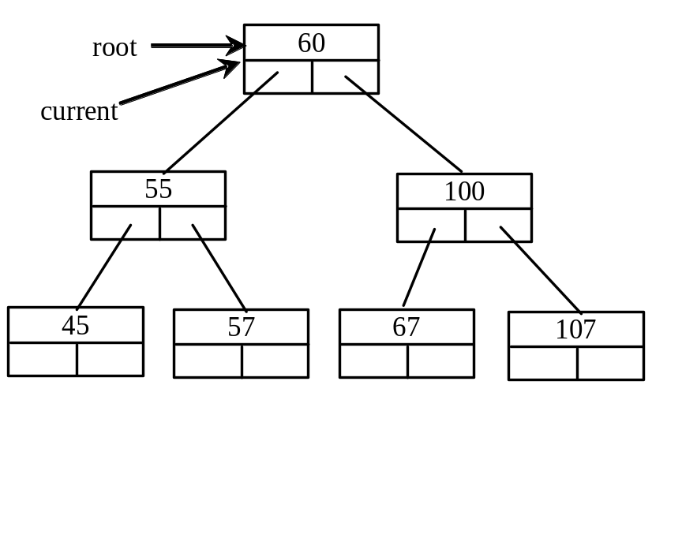
Trace Inserting 101 into the following tree, cont.
if (root == NULL)
root = new TreeNode<T>(element);
else
{
// Locate the parent node
current = root;
while (current != NULL)
if (element value < the value in current.element)
{
parent = current;
current = current->left;
}
else if (element value > the value in current.element)
{
parent = current;
current = current->right;
}
else
return false; // Duplicate node not inserted
// Create the new node and attach it to the parent node
if (element < parent->element)
parent->left = new TreeNode<T>(elemenet);
else
parent->right = new TreeNode<T>(elemenet);
return true; // Element inserted
}
Insert 101 into the following tree.

Slide 14
Trace Inserting 101 into the following tree, cont.
if (root == NULL)
root = new TreeNode<T>(element);
else
{
// Locate the parent node
current = root;
while (current != NULL)
if (element value < the value in current.element)
{
parent = current;
current = current->left;
}
else if (element value > the value in current.element)
{
parent = current;
current = current->right;
}
else
return false; // Duplicate node not inserted
// Create the new node and attach it to the parent node
if (element < parent->element)
parent->left = new TreeNode<T>(elemenet);
else
parent->right = new TreeNode<T>(elemenet);
return true; // Element inserted
}
Insert 101 into the following tree.

Slide 15
Trace Inserting 101 into the following tree, cont.
if (root == NULL)
root = new TreeNode<T>(element);
else
{
// Locate the parent node
current = root;
while (current != NULL)
if (element value < the value in current.element)
{
parent = current;
current = current->left;
}
else if (element value > the value in current.element)
{
parent = current;
current = current->right;
}
else
return false; // Duplicate node not inserted
// Create the new node and attach it to the parent node
if (element < parent->element)
parent->left = new TreeNode<T>(elemenet);
else
parent->right = new TreeNode<T>(elemenet);
return true; // Element inserted
}
Insert 101 into the following tree.
101 < 60?

Slide 16
Trace Inserting 101 into the following tree, cont.
if (root == NULL)
root = new TreeNode<T>(element);
else
{
// Locate the parent node
current = root;
while (current != NULL)
if (element value < the value in current.element)
{
parent = current;
current = current->left;
}
else if (element value > the value in current.element)
{
parent = current;
current = current->right;
}
else
return false; // Duplicate node not inserted
// Create the new node and attach it to the parent node
if (element < parent->element)
parent->left = new TreeNode<T>(elemenet);
else
parent->right = new TreeNode<T>(elemenet);
return true; // Element inserted
}
Insert 101 into the following tree.
101 > 60?

Slide 17
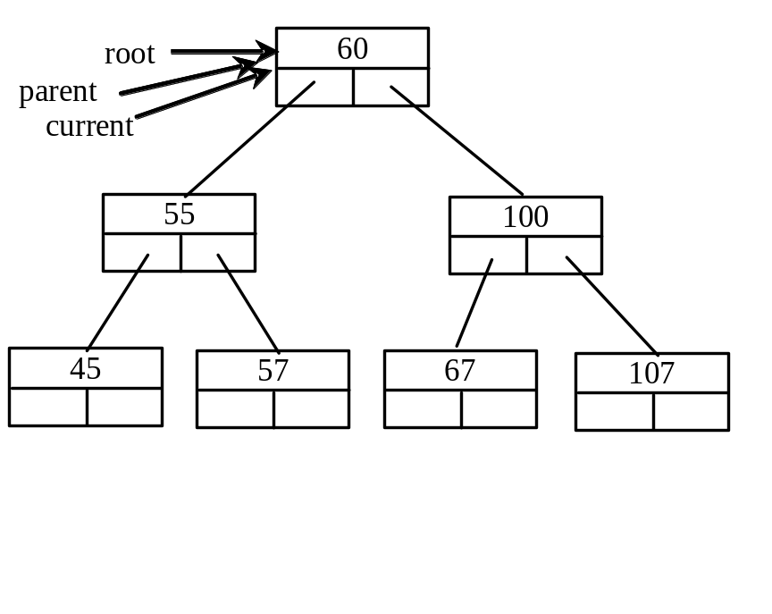
Trace Inserting 101 into the following tree, cont.
if (root == NULL)
root = new TreeNode<T>(element);
else
{
// Locate the parent node
current = root;
while (current != NULL)
if (element value < the value in current.element)
{
parent = current;
current = current->left;
}
else if (element value > the value in current.element)
{
parent = current;
current = current->right;
}
else
return false; // Duplicate node not inserted
// Create the new node and attach it to the parent node
if (element < parent->element)
parent->left = new TreeNode<T>(elemenet);
else
parent->right = new TreeNode<T>(elemenet);
return true; // Element inserted
}
Insert 101 into the following tree.
101 > 60 true

Slide 18
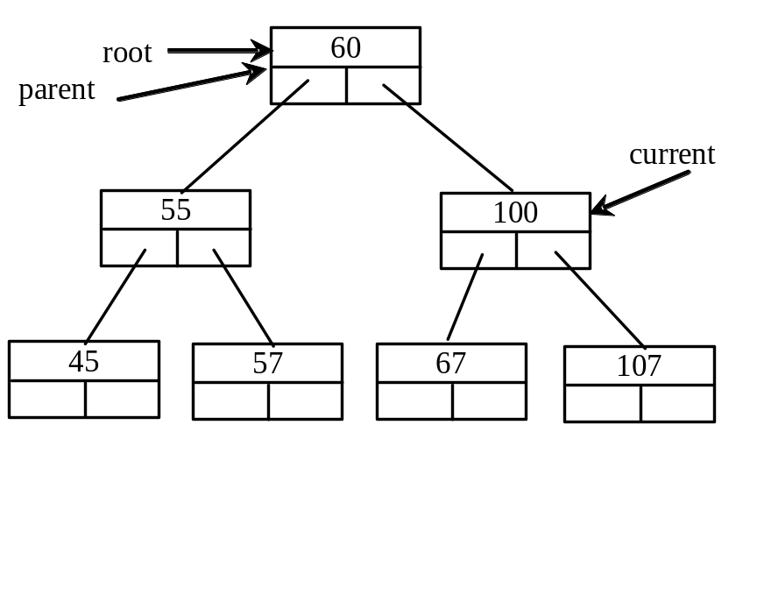
Trace Inserting 101 into the following tree, cont.
if (root == NULL)
root = new TreeNode<T>(element);
else
{
// Locate the parent node
current = root;
while (current != NULL)
if (element value < the value in current.element)
{
parent = current;
current = current->left;
}
else if (element value > the value in current.element)
{
parent = current;
current = current->right;
}
else
return false; // Duplicate node not inserted
// Create the new node and attach it to the parent node
if (element < parent->element)
parent->left = new TreeNode<T>(elemenet);
else
parent->right = new TreeNode<T>(elemenet);
return true; // Element inserted
}
Insert 101 into the following tree.
101 > 60 true

Slide 19
Trace Inserting 101 into the following tree, cont.
if (root == NULL)
root = new TreeNode<T>(element);
else
{
// Locate the parent node
current = root;
while (current != NULL)
if (element value < the value in current.element)
{
parent = current;
current = current->left;
}
else if (element value > the value in current.element)
{
parent = current;
current = current->right;
}
else
return false; // Duplicate node not inserted
// Create the new node and attach it to the parent node
if (element < parent->element)
parent->left = new TreeNode<T>(elemenet);
else
parent->right = new TreeNode<T>(elemenet);
return true; // Element inserted
}
Insert 101 into the following tree.
101 > 60 true

Slide 20
Trace Inserting 101 into the following tree, cont.
if (root == NULL)
root = new TreeNode<T>(element);
else
{
// Locate the parent node
current = root;
while (current != NULL)
if (element value < the value in current.element)
{
parent = current;
current = current->left;
}
else if (element value > the value in current.element)
{
parent = current;
current = current->right;
}
else
return false; // Duplicate node not inserted
// Create the new node and attach it to the parent node
if (element < parent->element)
parent->left = new TreeNode<T>(elemenet);
else
parent->right = new TreeNode<T>(elemenet);
return true; // Element inserted
}
Insert 101 into the following tree.
101 > 100 false

Slide 21
Trace Inserting 101 into the following tree, cont.
if (root == NULL)
root = new TreeNode<T>(element);
else
{
// Locate the parent node
current = root;
while (current != NULL)
if (element value < the value in current.element)
{
parent = current;
current = current->left;
}
else if (element value > the value in current.element)
{
parent = current;
current = current->right;
}
else
return false; // Duplicate node not inserted
// Create the new node and attach it to the parent node
if (element < parent->element)
parent->left = new TreeNode<T>(elemenet);
else
parent->right = new TreeNode<T>(elemenet);
return true; // Element inserted
}
Insert 101 into the following tree.
101 > 100 true

Slide 22
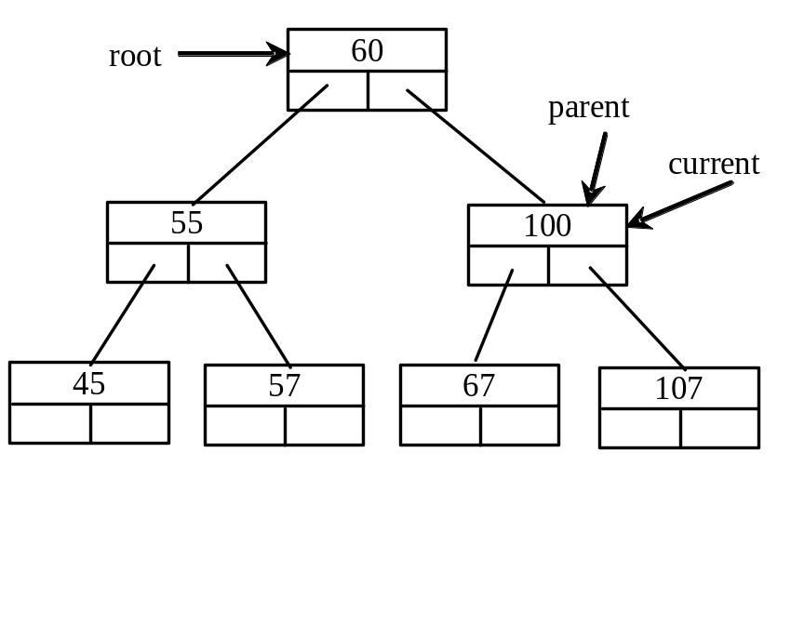
Trace Inserting 101 into the following tree, cont.
if (root == NULL)
root = new TreeNode<T>(element);
else
{
// Locate the parent node
current = root;
while (current != NULL)
if (element value < the value in current.element)
{
parent = current;
current = current->left;
}
else if (element value > the value in current.element)
{
parent = current;
current = current->right;
}
else
return false; // Duplicate node not inserted
// Create the new node and attach it to the parent node
if (element < parent->element)
parent->left = new TreeNode<T>(elemenet);
else
parent->right = new TreeNode<T>(elemenet);
return true; // Element inserted
}
Insert 101 into the following tree.
101 > 100 true

Slide 23
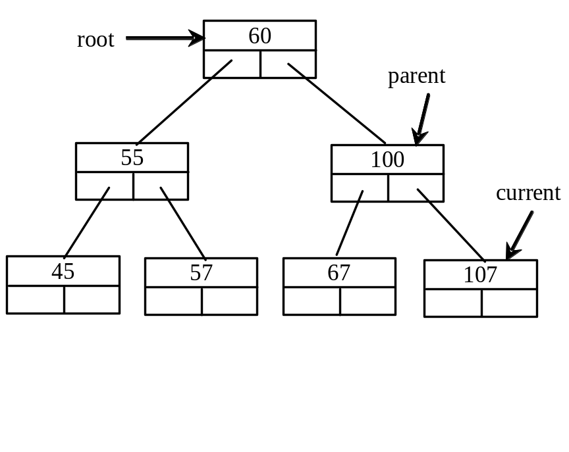
Trace Inserting 101 into the following tree, cont.
if (root == NULL)
root = new TreeNode<T>(element);
else
{
// Locate the parent node
current = root;
while (current != NULL)
if (element value < the value in current.element)
{
parent = current;
current = current->left;
}
else if (element value > the value in current.element)
{
parent = current;
current = current->right;
}
else
return false; // Duplicate node not inserted
// Create the new node and attach it to the parent node
if (element < parent->element)
parent->left = new TreeNode<T>(elemenet);
else
parent->right = new TreeNode<T>(elemenet);
return true; // Element inserted
}
Insert 101 into the following tree.
101 > 100 true

Slide 24
Trace Inserting 101 into the following tree, cont.
if (root == NULL)
root = new TreeNode<T>(element);
else
{
// Locate the parent node
current = root;
while (current != NULL)
if (element value < the value in current.element)
{
parent = current;
current = current->left;
}
else if (element value > the value in current.element)
{
parent = current;
current = current->right;
}
else
return false; // Duplicate node not inserted
// Create the new node and attach it to the parent node
if (element < parent->element)
parent->left = new TreeNode<T>(elemenet);
else
parent->right = new TreeNode<T>(elemenet);
return true; // Element inserted
}
Insert 101 into the following tree.
101 > 100 true

Slide 25
Trace Inserting 101 into the following tree, cont.
if (root == NULL)
root = new TreeNode<T>(element);
else
{
// Locate the parent node
current = root;
while (current != NULL)
if (element value < the value in current.element)
{
parent = current;
current = current->left;
}
else if (element value > the value in current.element)
{
parent = current;
current = current->right;
}
else
return false; // Duplicate node not inserted
// Create the new node and attach it to the parent node
if (element < parent->element)
parent->left = new TreeNode<T>(elemenet);
else
parent->right = new TreeNode<T>(elemenet);
return true; // Element inserted
}
Insert 101 into the following tree.
101 < 107 true

Slide 26
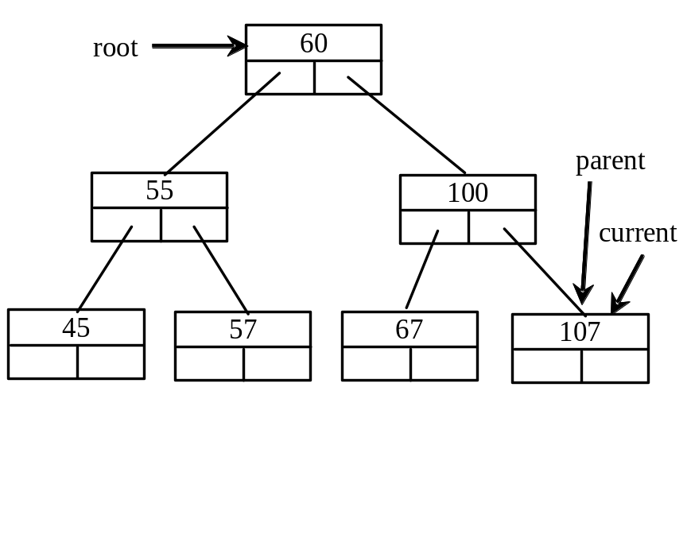
Trace Inserting 101 into the following tree, cont.
if (root == NULL)
root = new TreeNode<T>(element);
else
{
// Locate the parent node
current = root;
while (current != NULL)
if (element value < the value in current.element)
{
parent = current;
current = current->left;
}
else if (element value > the value in current.element)
{
parent = current;
current = current->right;
}
else
return false; // Duplicate node not inserted
// Create the new node and attach it to the parent node
if (element < parent->element)
parent->left = new TreeNode<T>(elemenet);
else
parent->right = new TreeNode<T>(elemenet);
return true; // Element inserted
}
Insert 101 into the following tree.
101 < 107 true

Slide 27
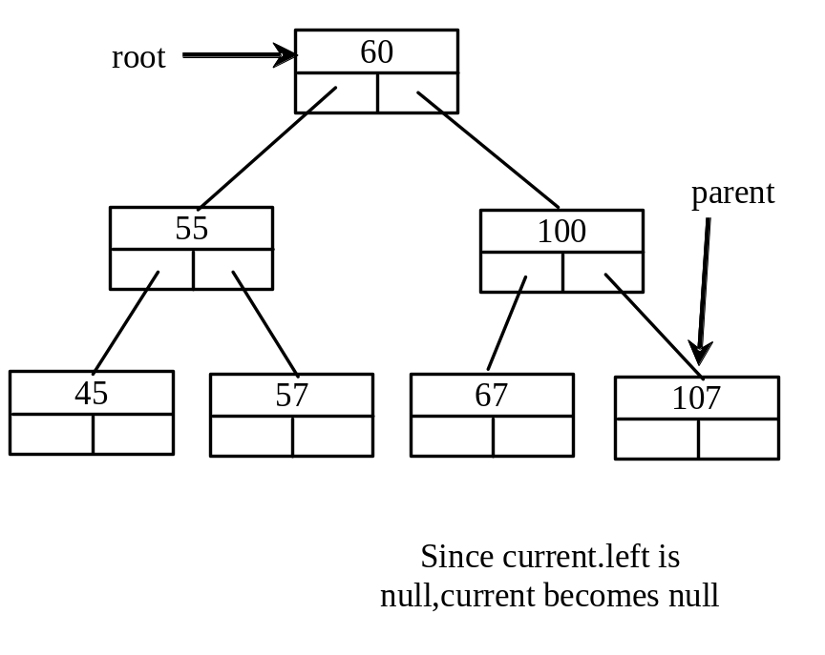
Trace Inserting 101 into the following tree, cont.
if (root == NULL)
root = new TreeNode<T>(element);
else
{
// Locate the parent node
current = root;
while (current != NULL)
if (element value < the value in current.element)
{
parent = current;
current = current->left;
}
else if (element value > the value in current.element)
{
parent = current;
current = current->right;
}
else
return false; // Duplicate node not inserted
// Create the new node and attach it to the parent node
if (element < parent->element)
parent->left = new TreeNode<T>(elemenet);
else
parent->right = new TreeNode<T>(elemenet);
return true; // Element inserted
}
Insert 101 into the following tree.
101 < 107 true

Slide 28
Trace Inserting 101 into the following tree, cont.
if (root == NULL)
root = new TreeNode<T>(element);
else
{
// Locate the parent node
current = root;
while (current != NULL)
if (element value < the value in current.element)
{
parent = current;
current = current->left;
}
else if (element value > the value in current.element)
{
parent = current;
current = current->right;
}
else
return false; // Duplicate node not inserted
// Create the new node and attach it to the parent node
if (element < parent->element)
parent->left = new TreeNode<T>(elemenet);
else
parent->right = new TreeNode<T>(elemenet);
return true; // Element inserted
}
Insert 101 into the following tree.
current is null now

Slide 29
Trace Inserting 101 into the following tree, cont.
if (root == NULL)
root = new TreeNode<T>(element);
else
{
// Locate the parent node
current = root;
while (current != NULL)
if (element value < the value in current.element)
{
parent = current;
current = current->left;
}
else if (element value > the value in current.element)
{
parent = current;
current = current->right;
}
else
return false; // Duplicate node not inserted
// Create the new node and attach it to the parent node
if (element < parent->element)
parent->left = new TreeNode<T>(elemenet);
else
parent->right = new TreeNode<T>(elemenet);
return true; // Element inserted
}
Insert 101 into the following tree.
101 < 107 true

Slide 30
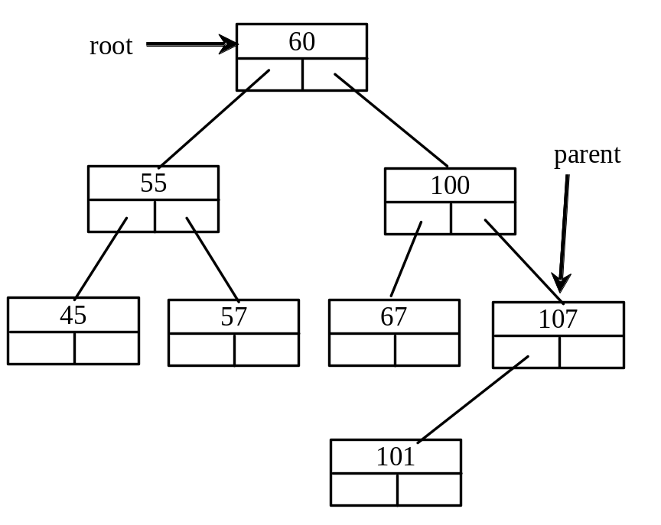
Trace Inserting 101 into the following tree, cont.
if (root == NULL)
root = new TreeNode<T>(element);
else
{
// Locate the parent node
current = root;
while (current != NULL)
if (element value < the value in current.element)
{
parent = current;
current = current->left;
}
else if (element value > the value in current.element)
{
parent = current;
current = current->right;
}
else
return false; // Duplicate node not inserted
// Create the new node and attach it to the parent node
if (element < parent->element)
parent->left = new TreeNode<T>(elemenet);
else
parent->right = new TreeNode<T>(elemenet);
return true; // Element inserted
}
Insert 101 into the following tree.
101 < 107 true

Slide 31
Trace Inserting 101 into the following tree, cont.
if (root == NULL)
root = new TreeNode<T>(element);
else
{
// Locate the parent node
current = root;
while (current != NULL)
if (element value < the value in current.element)
{
parent = current;
current = current->left;
}
else if (element value > the value in current.element)
{
parent = current;
current = current->right;
}
else
return false; // Duplicate node not inserted
// Create the new node and attach it to the parent node
if (element < parent->element)
parent->left = new TreeNode<T>(elemenet);
else
parent->right = new TreeNode<T>(elemenet);
return true; // Element inserted
}
Insert 101 into the following tree.
101 < 107 true

Slide 32
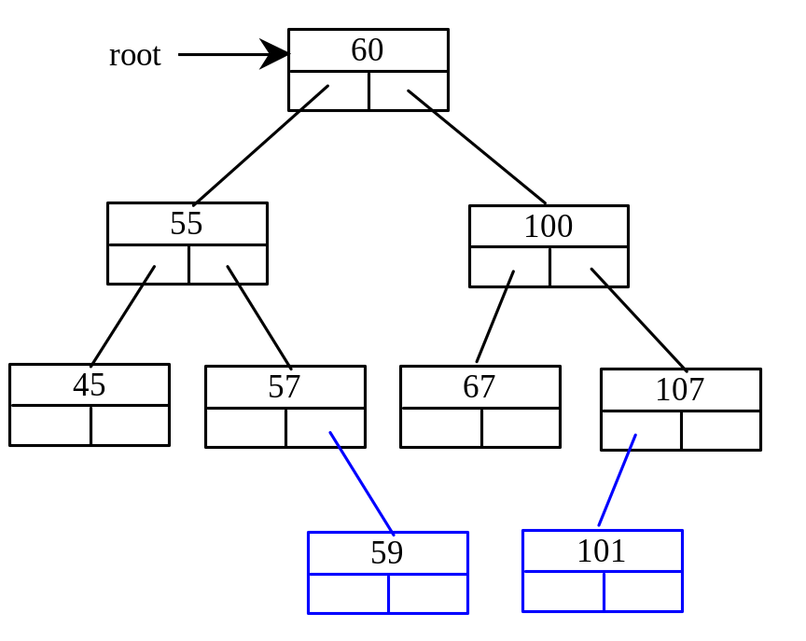
Inserting 59 into the Tree
if (root == NULL)
root = new TreeNode<T>(element);
else
{
// Locate the parent node
current = root;
while (current != NULL)
if (element value < the value in current.element)
{
parent = current;
current = current->left;
}
else if (element value > the value in current.element)
{
parent = current;
current = current->right;
}
else
return false; // Duplicate node not inserted
// Create the new node and attach it to the parent node
if (element < parent->element)
parent->left = new TreeNode<T>(elemenet);
else
parent->right = new TreeNode<T>(elemenet);
return true; // Element inserted
}

Slide 33
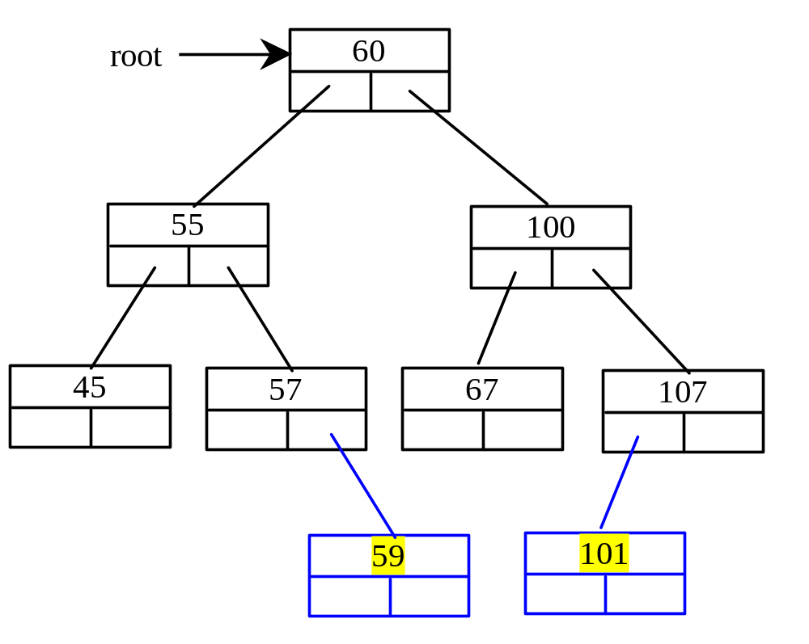
Inserting an Element into a Binary Search Tree

Slide 34
Tree Traversal
Tree traversal is the process of visiting each node in the tree exactly once in certain order. There are several ways to traverse a tree. This section presents inorder, preorder, postorder, depth-first, and breadth-first traversals.

Slide 35
Inorder Traversal
With inorder traversal, the left subtree of the current node is visited first, then the current node, and finally the right subtree of the current node. The inorder traversal displays all the nodes in a binary search tree in increasing order.

Slide 36
Postorder Traversal
With postorder traversal, the left subtree of the current node is visited first, then the right subtree of the current node, and finally the current node itself.

Slide 37
Preorder Traversal
With preorder traversal, the current node is visited first, then the left subtree of the current node, and finally the right subtree of the current node. Depth-first traversal is the same as preorder traversal.

Slide 38
breadth-first Traversal
With breadth-first traversal, the nodes are visited level by level. First the root is visited, then all the children of the root from left to right, then the grandchildren of the root from left to right, and so on.

Slide 39
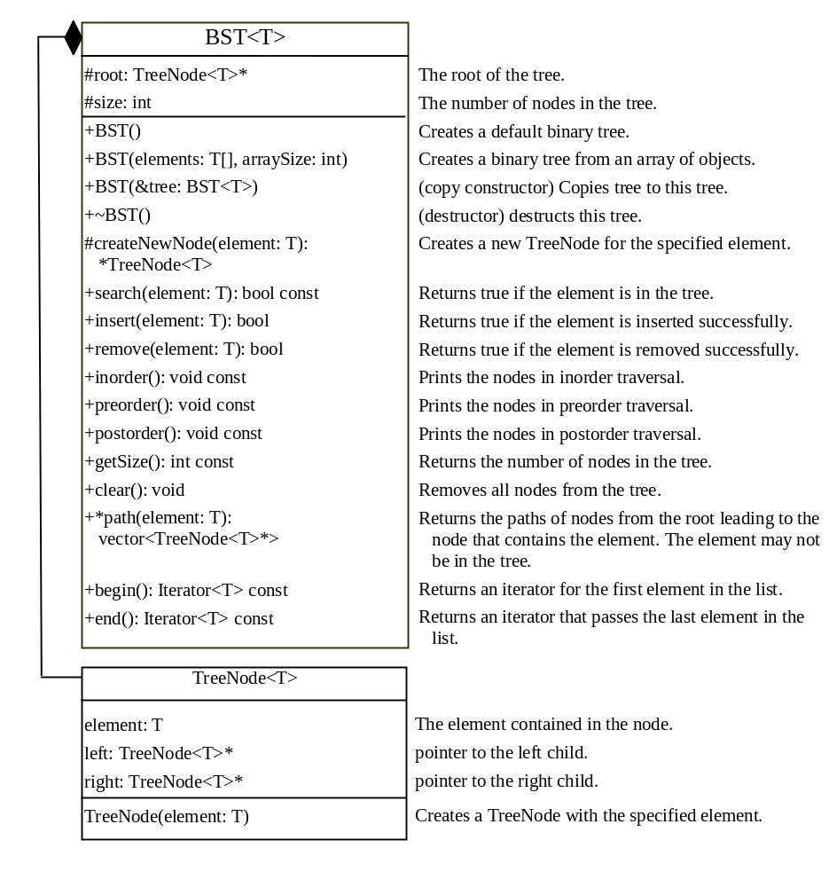
The BST Class
BST
TestBST
Run

Slide 40
Deleting Elements in a Binary Search Tree
To delete an element from a binary tree, you need to first locate the node that contains the element and also its parent node. Let current point to the node that contains the element in the binary tree and parent point to the parent of the current node. The current node may be a left child or a right child of the parent node. There are two cases to consider:

Slide 41
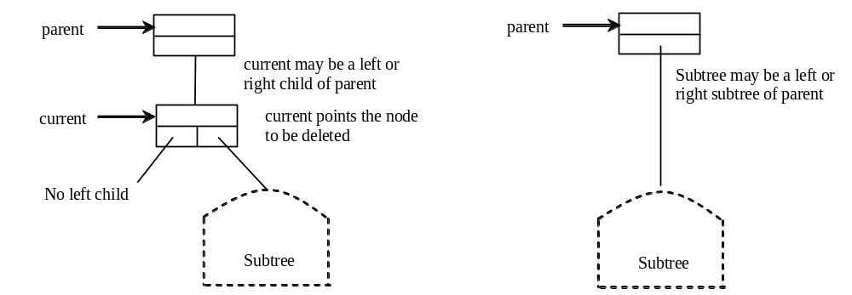
Deleting Elements in a Binary Search Tree
Case 1: The current node does not have a left child, as shown in this figure (a). Simply connect the parent with the right child of the current node, as shown in this figure (b).

Slide 42
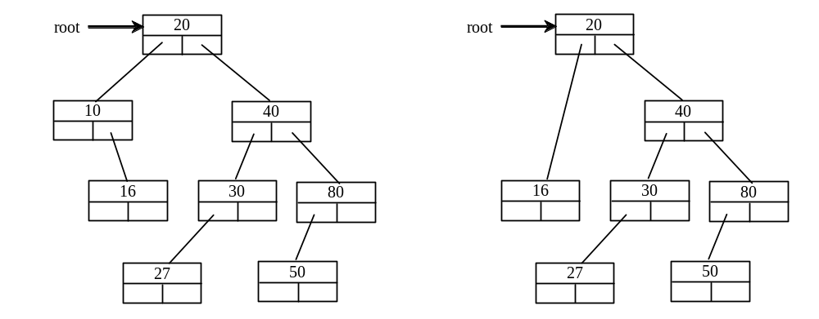
Deleting Elements in a Binary Search Tree
For example, to delete node 10 in Figure 27.9a. Connect the parent of node 10 with the right child of node 10, as shown in Figure 27.9b.

Slide 43
Deleting Elements in a Binary Search Tree
Case 2: The current node has a left child. Let rightMost point to the node that contains the largest element in the left subtree of the current node and parentOfRightMost point to the parent node of the rightMost node, as shown in Figure 27.10a. Note that the rightMost node cannot have a right child, but may have a left child. Replace the element value in the current node with the one in the rightMost node, connect the parentOfRightMost node with the left child of the rightMost node, and delete the rightMost node, as shown in Figure 27.10b.

Slide 44
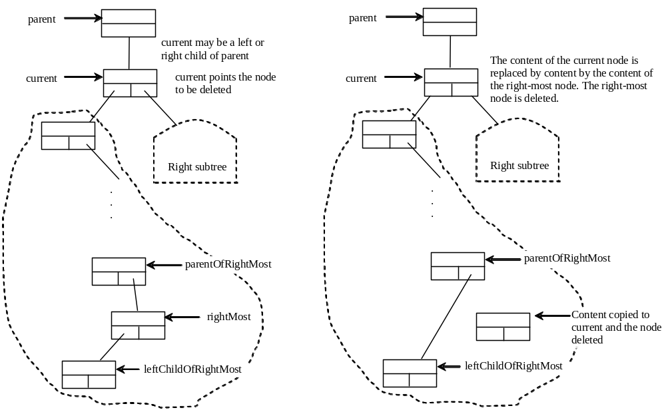
Deleting Elements in a Binary Search Tree
Case 2 diagram

Slide 45
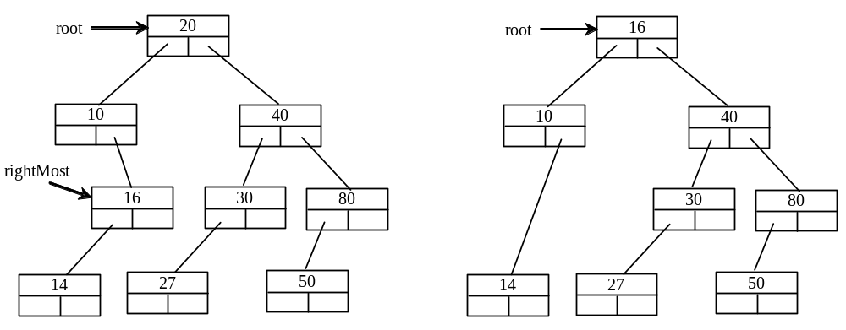
Deleting Elements in a Binary Search Tree
Case 2 example, delete 20

Slide 46
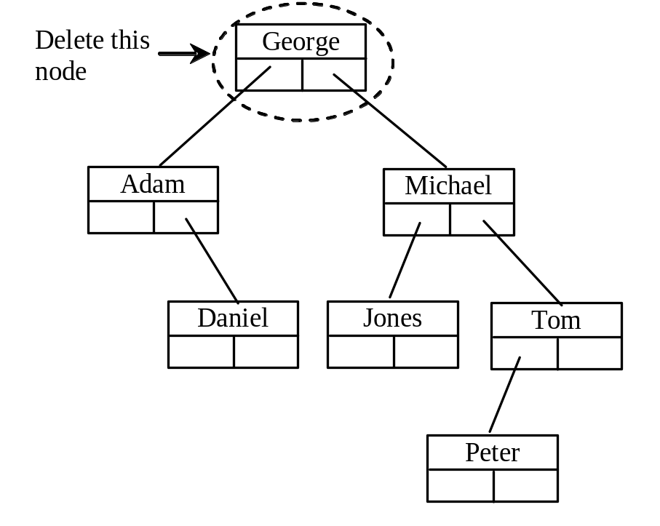
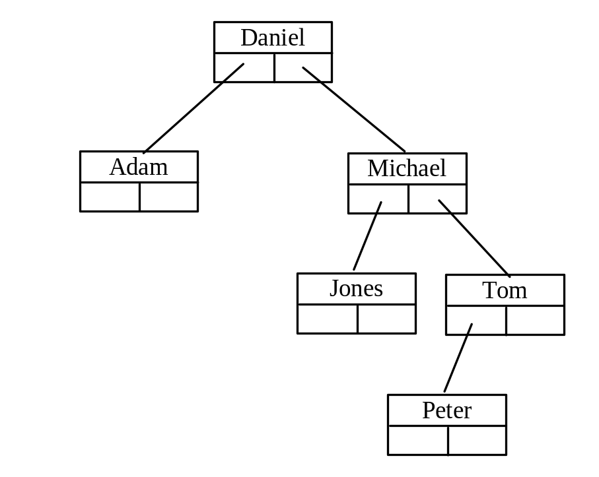
Examples

Slide 47
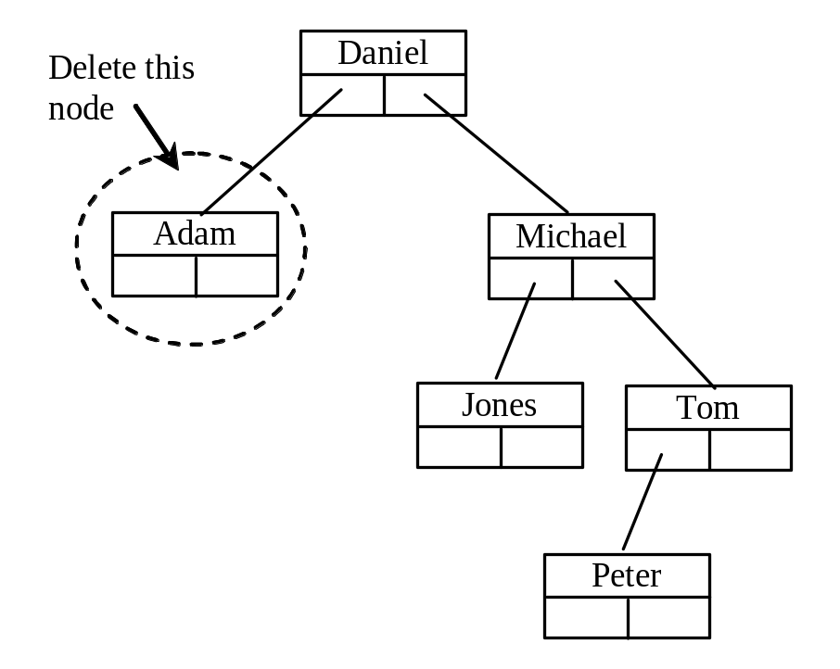
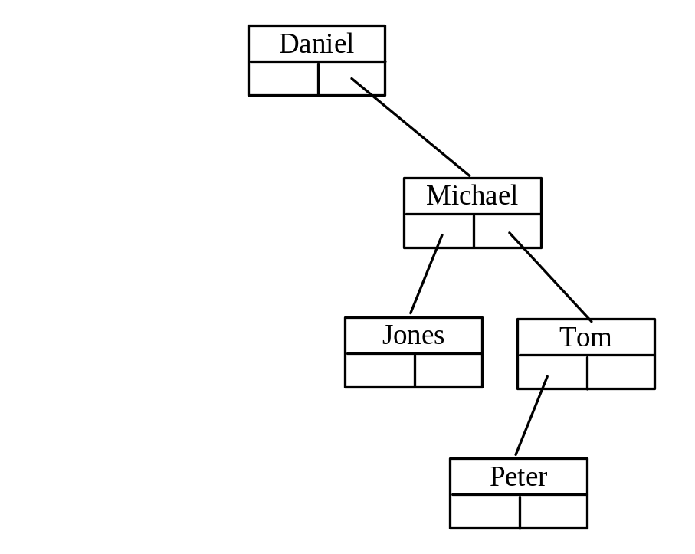
Examples

Slide 48
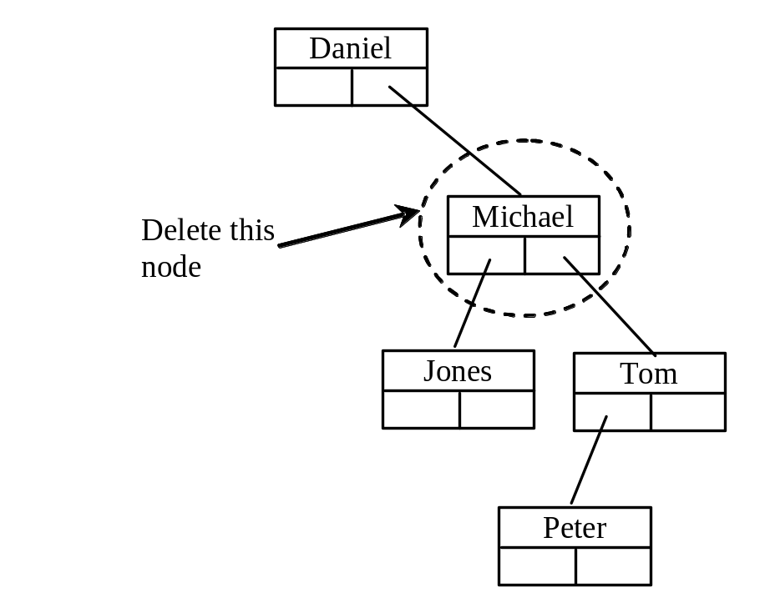
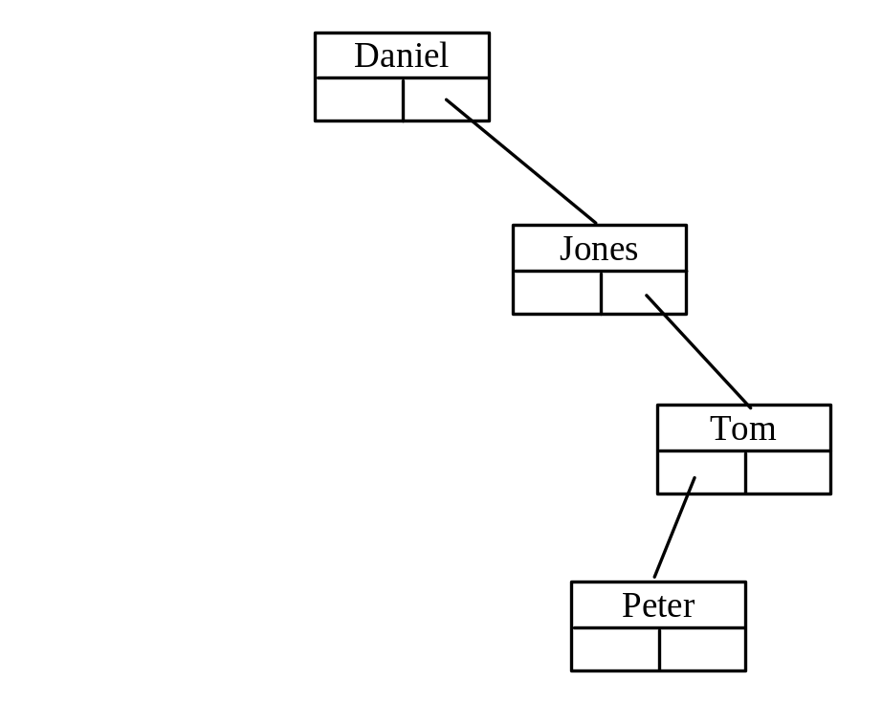
Examples
TestBSTDelete
Run

Slide 49
binary tree time complexity
It is obvious that the time complexity for the inorder, preorder, and postorder is O(n), since each node is traversed only once. The time complexity for search, insertion and deletion is the height of the tree. In the worst case, the height of the tree is O(n).

Slide 50
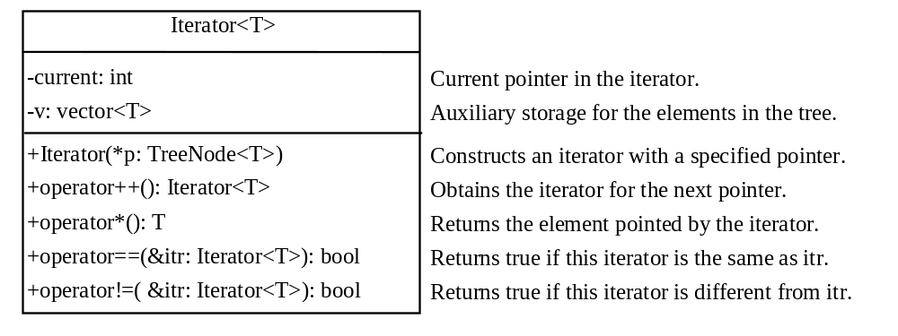
Iterators
An iterator is an object that provides a uniform way for traversing the elements in a container such as a set, list, binary tree, etc.
TestBSTIterator
Run

