Slide 1
Chapter 22 STL Containers

Slide 2
Objectives
To know the relationships among containers, iterators, and algorithms (§22.2).
To distinguish sequence containers, associative containers, and container adapters (§22.2).
To distinguish containers vector, deque, list, set, multiset, map, multimap, stack, queue, and priority_queue (§22.2).
To use common features of containers (§22.2).
To access elements in a container using iterators (§22.3).
To distinguish iterator types: input, output, forward, bidirectional, and random-access (§22.3.1).
To manipulate iterators using operators (§22.3.2).
To obtain iterators from containers and know the type of interators supported by containers (§22.3.3).
To perform input and output using istream_iterator and ostream_iterator (§22.3.4).
To store, retrieve and process elements in sequence containers: vector, deque, list (§22.4).
To store, retrieve and process elements in associative containers: set, multiset, map, and multimap (§22.5).
To store, retrieve and process elements in container adapters: stack, queue, and priority_queue (§22.6).

Slide 3
Three components of STL
Containers: Classes in the STL are container classes. A container object such as a vector is used to store a collection of data, often referred to as elements.
Iterators: The STL container classes make extensive use of iterators, which are objects that facilitate traversing through the elements in a container. Iterators are like built-in pointers that provide a convenient way to access and manipulate the elements in a container.
Algorithms: Algorithms are used in the functions to manipulate data such as sorting, searching, and comparing elements. There are about 80 algorithms implemented in the STL. Most of these algorithms use iterators to access the elements in the container.

Slide 4
Sequence Containers
The sequence containers (also known as sequential containers) represent linear data structures. The three sequence containers are vector, list, and deque (pronounced deck).

Slide 5
Associative Containers
Associative containers are non-linear containers that can locate elements stored in the container quickly. Such containers can store sets of values or key/value pairs. The four associative containers are set, multiset, map, and multimap.

Slide 6
Container Adapters
Container adapters are constrained versions of sequence containers. They are adapted from sequence containers for handling special cases. The three container adapters are stack, queue, and priority_queue.

Slide 7
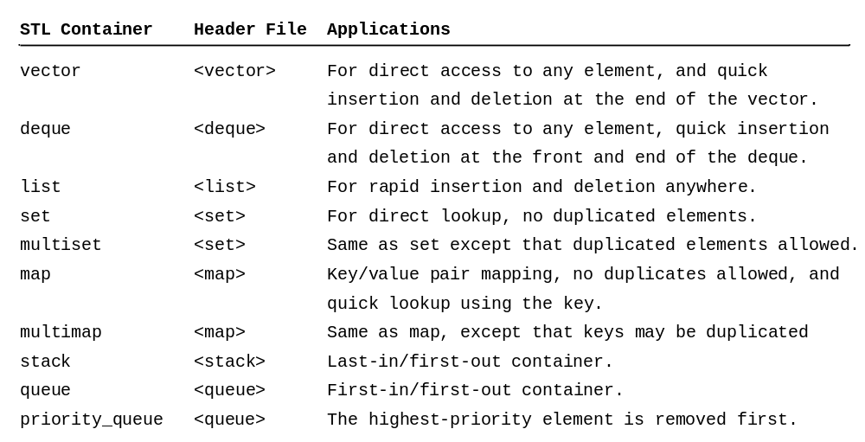
Container Classes

Slide 8
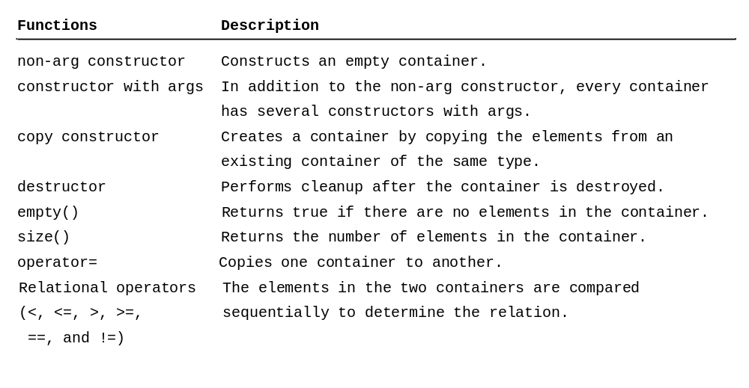
Common Functions to All Containers

Slide 9
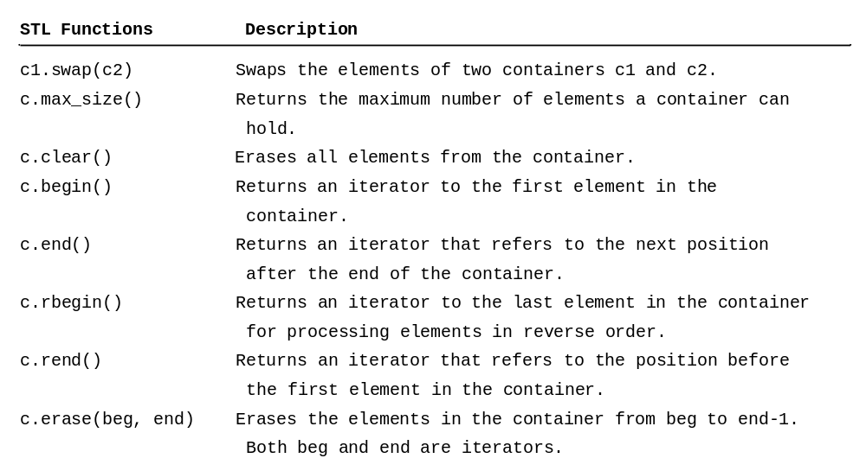
Common Functions to First-Class Containers

Slide 10
Simple Demo
Listing 22.1 gives a simple example that demonstrates how to create a vector, list, deque, set, multiset, stack, and queue.
SimpleSTLDemo
Run

Slide 11
Iterators
Iterators are used extensively in the first-class containers for accessing and manipulating the elements. As you already have seen in Table 22.3 that several functions (e.g., begin() and end()) in the first-class containers are related to iterators.
IteratorDemo
Run

Slide 12
Type of Iterators
Each first-class container has its own iterator type. Iterators can be classified into five categories:
  Input iterators
  Output iterators
  Forward iterators
  Bidirectional iterators
  Random access iterators

Slide 13
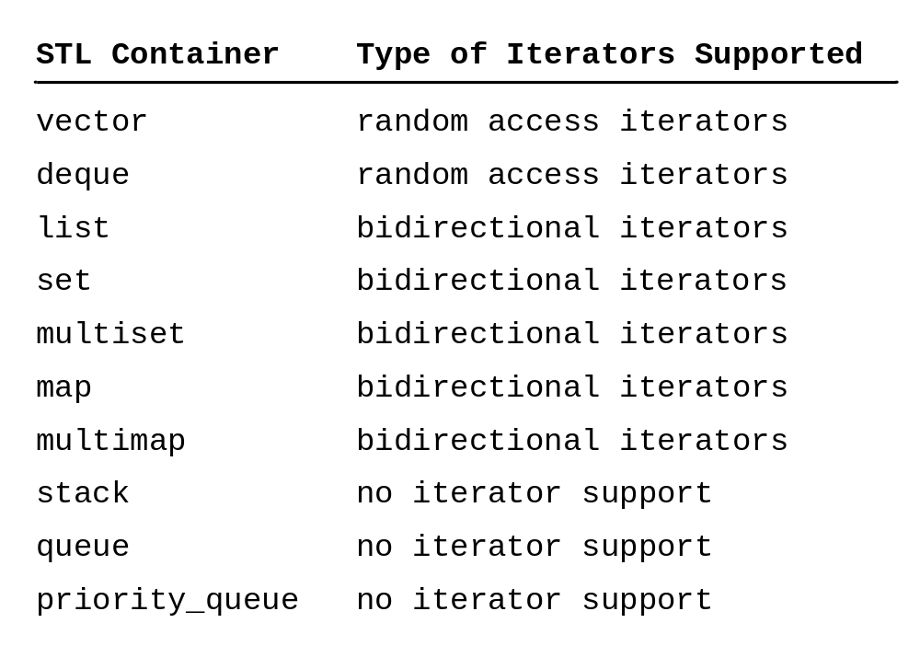
Iterator Types Supported by Containers

Slide 14
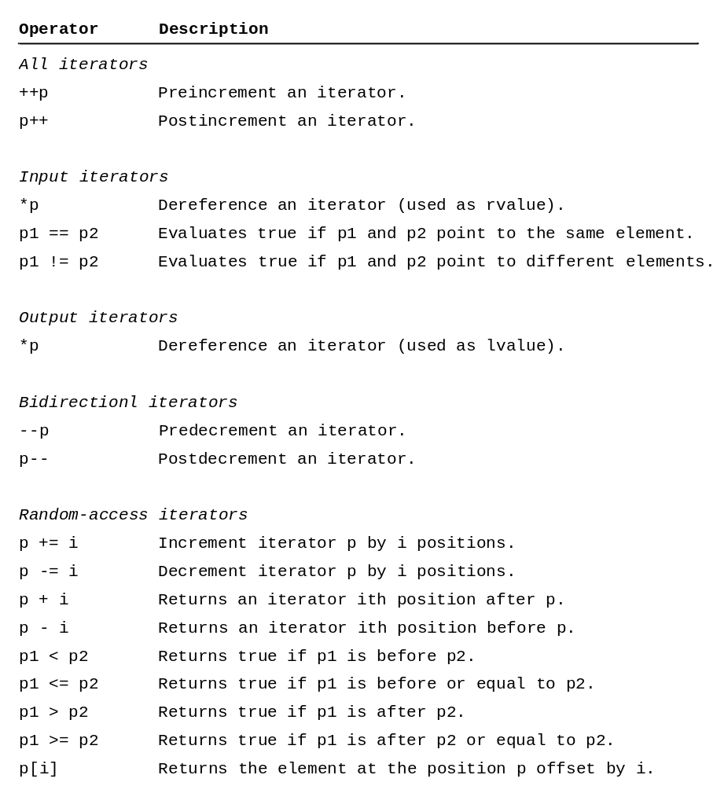
Operators Supported by Iterators

Slide 15
Iterator Demo
Iterators are used extensively in the first-class containers for accessing and manipulating the elements. As you already have seen in Table 22.3 that several functions (e.g., begin() and end()) in the first-class containers are related to iterators.
IteratorOperatorDemo
Run

Slide 16
Predefined Iterators
The STL containers use the typedef keyword to predefine iterators. The typedef keyword is used to define synonyms for data types. For example, the following statement declares integer as a synonym for int.
typedef int integer;
So now you can declarer a variable using
integer value = 40;

Slide 17
auto Keyword
C++11
The new C++11 auto keyword can be used to declare a variable. The type of the variable is automatically determined by the compiler based on the type of the value assigned to the variable. This is known as auto-type inference.
auto x = 3;

Slide 18
auto Keyword
C++11
vector<int>::reverse_iterator p1 = intVector.rbegin(); is better replaced by
auto p1 = intVector.rbegin();

Slide 19
Constant Iterator Demo
ConstIteratorDemo
Run
ReverseIteratorDemo
Run

Slide 20
istream_iterator and ostream_iterator
InputOutputStreamIteratorDemo
Run

Slide 21
Sequence Containers
The STL provides three sequence containers: vector, list, and deque. The vector and deque containers are implemented using arrays and the list container is implemented using a linked list.

Slide 22
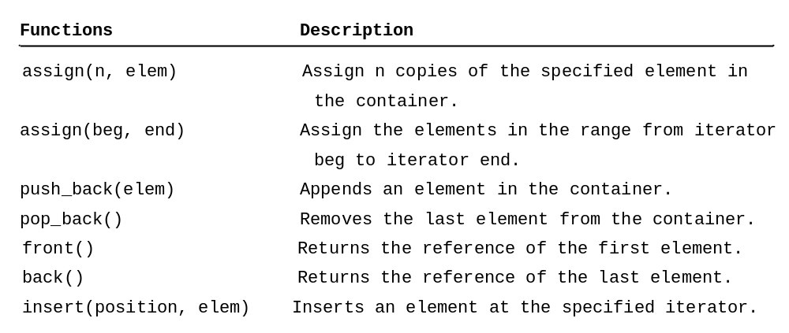
Common Functions in Sequence Containers

Slide 23
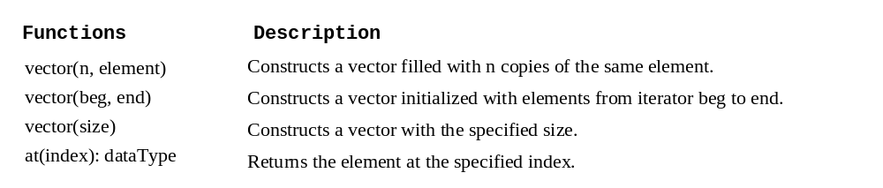
Sequence Containers: vector
VectorDemo
Run

Slide 24
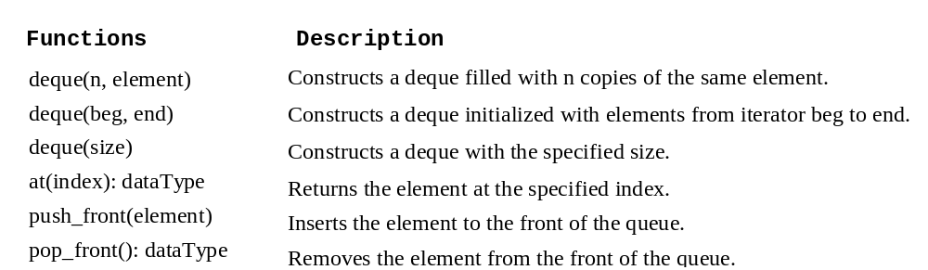
Sequence Containers: deque
DequeDemo
Run

Slide 25
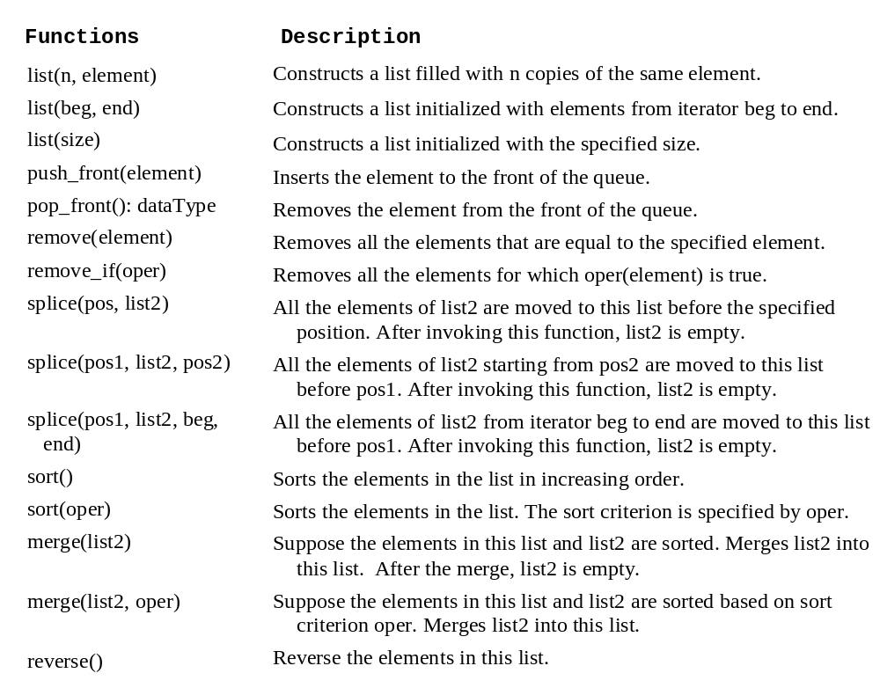
Sequence Containers: list
ListDemo
Run

Slide 26
Associative Containers
The STL provides four associative containers: set, multiset, map, and multimap. These containers provide fast storage and quick access to retrieve elements using keys (often called search keys). Elements in an associative container are sorted according to some sorting criterion. By default, the elements are sorted using the < operator.

Slide 27
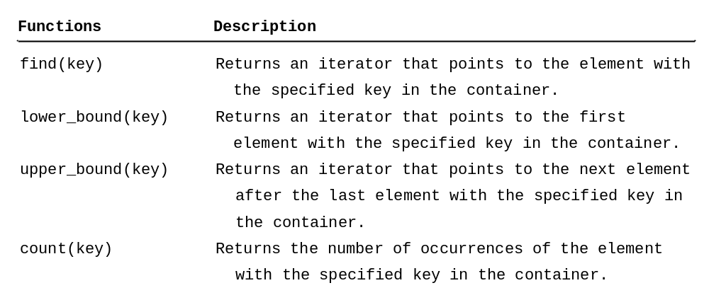
Common Functions in Associative Containers

Slide 28
Associative Containers: set and multiset
SetDemo
Run

Slide 29
Associative Containers: map and multimap
The STL provides four associative containers: set, multiset, map, and multimap. These containers provide fast storage and quick access to retrieve elements using keys (often called search keys). Elements in an associative container are sorted according to some sorting criterion. By default, the elements are sorted using the < operator.
MapDemo
Run

Slide 30
Container Adapters
The STL provides three container adapters: stack, queue, and priority_queue. These containers are called adapters because they are adapted from the sequence containers for handling special cases. The STL enables the programmer to choose an appropriate sequence container for a container adapter. For example, you can create a stack with the underlying data structure vector, deque, or list.

Slide 31
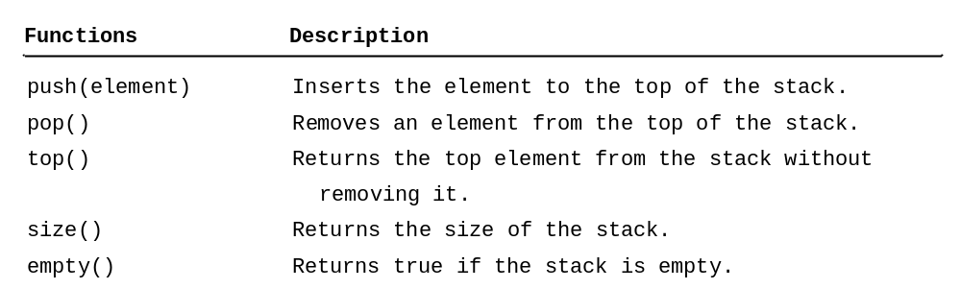
Container Adapter: stack
StackDemo
Run

Slide 32
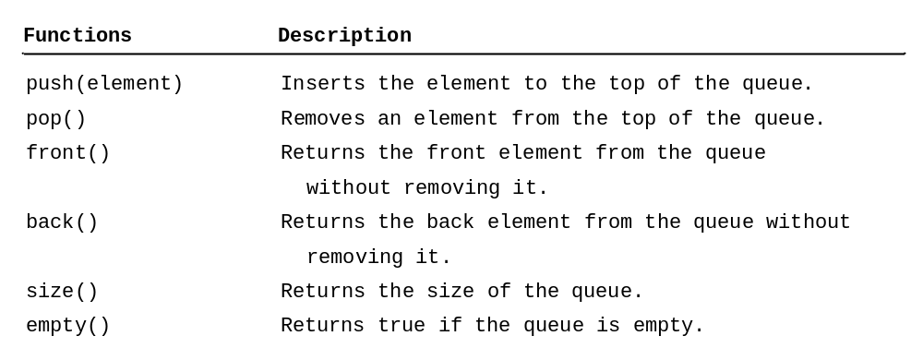
Container Adapter: queue
QueueDemo
Run

Slide 33
Container Adapter: priority_queue
PriorityQueueDemo
Run

