Slide 1
Chapter 23 STL Algorithms

Slide 2
Objectives
To use various types of iterators with the STL algorithms (§§23.1–23.20).
To discover the four types of STL algorithms: nonmodifying algorithms, modifying algorithms, numeric algorithms, and heap algorithms (§23.2).
To use the copy algorithm to copy contents (§23.3).
To use the algorithms fill, fill_n to fill values (§23.4).
To pass functions as parameters (§23.5).
To use the algorithms generate, and generate_n (§23.6).
To use the algorithms remove, remove_if, remove_copy, and remove_copy_if (§23.7).
To use Boolean functions to specify criteria for STL algorithms (§23.8).
To use the algorithms replace, replace_if, replace_copy, and replace_copy_if, find, find_if, find_end, and find_first_of (§§23.8–23.9).
To use the algorithms search, search_n, sort, binary_search, adjacent_find, merge, and inplace_merge (§§23.10–23.12).
To use function objects in STL algorithms (§23.11).
To use the algorithms reverse, reverse_copy, rotate, rotate_copy, swap, iter_swap, and swap_range (§§23.13–23.15).
To use the algorithms count, count_if, max_element, min_element, random_shuffle, for_each, and transform (§§23.16–23.19).
To use set algorithms includes, set_union, set_difference, set_intersection, and set_symmetric_difference (§23.20).
To use numeric algorithms accumulate, adjacent_difference, inner_product, and partial_sum (§23.21).

Slide 3
function and algorithm
The terms operations, algorithms, and functions are interchangeable. Functions are operations and functions are implemented using algorithms.

Slide 4
iterators and pointers
Iterators are a generalization of pointers. Pointers themselves are iterators. So the array pointers can be treated as iterators. Iterators are often used with containers, but some iterators such as istream_iterator and ostream_iterator are not associated with containers at all.

Slide 5
Types of Algorithms
The STL provides approximately 80 algorithms. The algorithms can be classified into four groups:
Nonmodifying Algorithms
Modifying Algorithms
Numeric Algorithms
Heap Algorithms

Slide 6
copy
template <typename InputIterator, typename OutputIterator>
copy(InputIterator beg, InputIterator end,
OutputIterator targetPostition)
CopyDemo
Run

Slide 7
fill and fill_n
template <typename ForwardIterator, typename T>
void fill(ForwardIterator beg, ForwardIterator end, const T& value)
template <typename ForwardIterator, typename size, typename T>
void fill_n(ForwardIterator beg, size n, const T& value)
FillDemo
Run

Slide 8
generate and generate_n
template <typename ForwardIterator, typename function>
void generate(ForwardIterator beg, ForwardIterator end, function gen)
template <typename ForwardIterator, typename size, typename function>
void generate_n(ForwardIterator beg, size n, function gen)
GenerateDemo
Run

Slide 9
remove, remove_if
template <typename ForwardIterator, typename T>
ForwardIterator remove(ForwardIterator beg,
ForwardIterator end, const T& value)
template <typename ForwardIterator, typename boolFunction>
ForwardIterator remove_if(ForwardIterator beg,
ForwardIterator end, boolFunction f)
RemoveDemo
Run

Slide 10
remove_copy, and remove_copy_if
template <typename InputIterator, typename OutputIterator, typename T>
OutputIterator remove_copy(InputIterator beg, InputIterator end,
OutputIterator targetPosition, const T& value)
template <typename InputIterator, typename OutputIterator,
typename boolFunction>
OutputIterator remove_copy_if(InputIterator beg, InputIterator end,
OutputIterator targetPosition, boolFunction f)
RemoveCopyDemo
Run

Slide 11
replace, replace_if
template <typename ForwardIterator, typename T>
void replace(ForwardIterator beg, ForwardIterator end,
const T& oldValue, const T& newValue)
template <typename ForwardIterator, typename boolFunction, typename T>
void replace_if(ForwardIterator beg, ForwardIterator end,
boolFunction f, const T& newValue)
ReplaceDemo
Run

Slide 12
replace_copy, and replace_copy_if
template <typename ForwardIterator, typename OutputIterator,
typename T>
ForwardIterator replace_copy(ForwardIterator beg,
ForwardIterator end, OutputIterator targetPosition,
T& oldValue, T& newValue)
template <typename ForwardIterator, typename OutputIterator,
typename boolFunction, typename T>
ForwardIterator replace_copy_if(ForwardIterator beg,
ForwardIterator end, OutputIterator targetPosition,
boolFunction f, const T& newValue)
ReplaceCopyDemo
Run

Slide 13
find, find_if,
template <typename InputIterator, typename T>
InputIterator find(InputIterator beg, InputIterator end, T& value)
template <typename InputIterator, typename boolFunction>
InputIterator find_if(InputIterator beg, InputIterator end,
boolFunction f)
FindDemo
Run

Slide 14
find_end
template <typename ForwardIterator1, typename ForwardIterator2>
ForwardIterator find_end(ForwardIterator1 beg1, ForwardIterator1 end1,
ForwardIterator2 beg2, ForwardIterator2 end2)
template <typename ForwardIterator1, typename ForwardIterator2,
typename boolFunction>
ForwardIterator find_end(ForwardIterator1 beg1, ForwardIterator1 end1,
ForwardIterator2 beg2, ForwardIterator2 end2, boolFunction f)
FindEndDemo
Run

Slide 15
find_first_of
template <typename ForwardIterator1, typename ForwardIterator2>
ForwardIterator find_first_of(ForwardIterator1 beg1,
ForwardIterator1 end1, ForwardIterator2 beg2,
ForwardIterator2 end2)
template <typename ForwardIterator1, typename ForwardIterator2,
typename boolFunction>
ForwardIterator find_first_of(ForwardIterator1 beg1,
ForwardIterator1 end1, ForwardIterator2 beg2,
ForwardIterator2 end2, boolFunction)
FindFirstOf
Run

Slide 16
search and search_n
template <typename ForwardIterator1, typename ForwardIterator2>
ForwardIterator search(ForwardIterator1 beg1, ForwardIterator1 end1,
ForwardIterator2 beg2, ForwardIterator2 end2)
template <typename ForwardIterator1, typename ForwardIterator2,
typename boolFunction>
ForwardIterator search(ForwardIterator1 beg1, ForwardIterator1 end1,
ForwardIterator2 beg2, ForwardIterator2 end2, boolFunction)
SearchDemo
Run

Slide 17
sort
template <typename RandomAccessIterator>
void sort(RandomAccessIterator beg, RandomAccessIterator end)
template <typename RandomAccessIterator, typename relationalOperator>
void sort(RandomAccessIterator beg, RandomAccessIterator end,
relationalOperator op)
SortDemo
Run

Slide 18
binary_search
template <typename ForwardIterator, typename T>
bool binary_search(ForwardIterator beg,
ForwardIterator end, const T& value)
template <typename ForwardIterator, typename T,
typename strickWeakOrdering>
bool binary_search(ForwardIterator beg,
ForwardIterator end, const T& value, strickWeakOrdering op)

Slide 19
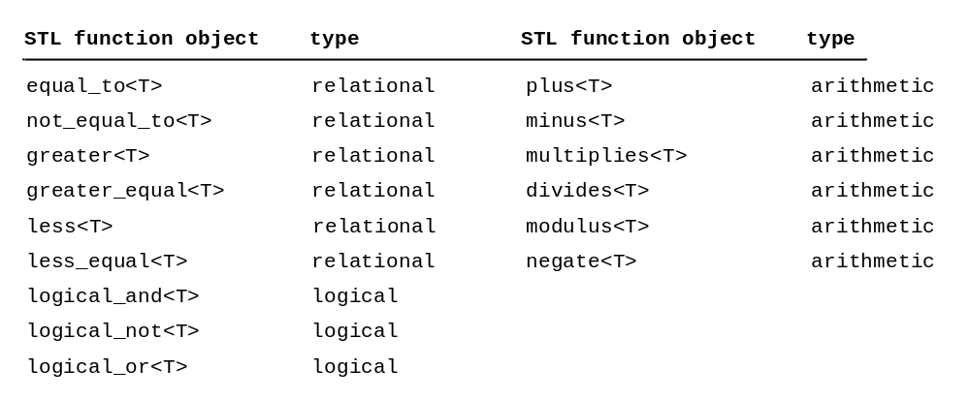
Function Objects

Slide 20
adjacent_find
template <typename ForwardIterator>
ForwardIterator adjacent_find(ForwardIterator beg,
ForwardIterator end)
template <typename ForwardIterator, typename boolFunction>
ForwardIterator adjacent_find(ForwardIterator beg,
ForwardIterator end, boolFunction f)

Slide 21
merge
template <typename bidireationalIterator>
void inplace_merge(BidirectionIterator beg,
BidirectionIterator middle, BidirectionIterator end)
template <typename bidireationalIterator, typename relationalOperator>
void inplace_merge(BidirectionIterator beg,
BidirectionIterator middle, BidirectionIterator end,
relationalOperator)
MergeDemo
Run

Slide 22
reverse and reverse_copy
template <typename bidireationalIterator>
void reverse(BidirectionalIterator beg,
BidirectionalIterator end)
template <typename bidireationalIterator, typename OutputIterator>
OutputIterator reverse_copy(BidirectionalIterator beg,
BidirectionalIterator end, OutputIterator targetPosition)
ReverseDemo
Run

Slide 23
rotate and rotate_copy
template <typename ForwardIterator>
void rotate(ForwardIterator beg, ForwardIterator newBeg,
ForwardIterator end)
template <typename ForwardIterator, typename OutputIterator>
OutputIterator rotate_copy(ForwardIterator beg, ForwardIterator newBeg,
ForwardIterator end, OutputIterator targetPosition)
RotateDemo
Run

Slide 24
swap
template <typename T>
void swap(T& value1, T& value2)
template <typename ForwardIterator1, typename ForwardIterator2>
void iter_swap(ForwardIterator p1, ForwardIterator p2)
template <typename ForwardIterator1, typename ForwardIterator2>
ForwardIterator swap_ranges(
ForwardIterator1 beg1, ForwardIterator1 end1,
ForwardIterator2 beg2)
SwapDemo
Run

Slide 25
count and count_if
template <typename InputIterator, typename T>
int count(InputIterator beg, InputIterator end, const T& value)
template <typename InputIterator, typename boolFunction>
int count_if(InputIterator beg, InputIterator end, boolFunction f)
CountDemo
Run

Slide 26
max_element and min_element
template <typename ForwardIterator>
ForwardIterator max_element(ForwardIterator beg,
ForwardIterator end)
template <typename ForwardIterator>
ForwardIterator min_element(ForwardIterator beg,
ForwardIterator end)
MaxMinDemo
Run

Slide 27
random_shuffle
template <typename RandomAccessIterator>
void random_shuffle(RandomAccessIterator beg,
RandomAccessIterator end)
ShuffleDemo
Run

Slide 28
for_each and transform
template <typename InputIterator, typename function>
void for_each(InputIterator beg, InputIterator end, function f)
template <typename InputIterator, typename OutputIterator,
typename function>
outputIteration transform(InputIterator beg,
InputIterator end, OutputIterator targetPosition, function f)
ForEachDemo
Run

Slide 29
Set Operations
template <typename InputIterator1, typename InputIterator2>
bool includes(InputIterator1 beg1, InputIterator1 end1,
InputIterator2 beg2, InputIterator2 end2)
SetOperationDemo
Run

Slide 30
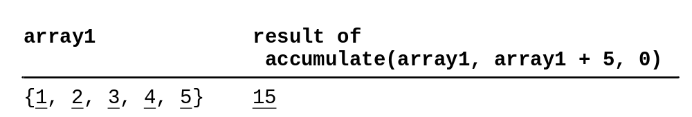
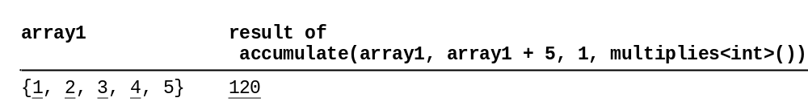
Numeric Operations: accumulate

Slide 31
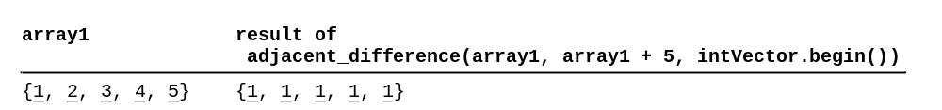
Numeric Operations: adjacent_difference
Creates a sequence of elements in which the first element is the same as the first element in the input sequence, and each subsequent element is the difference between the current element and the previous one.

Slide 32
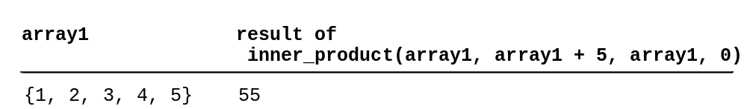
Numeric Operations: inner_product
The inner product of two sequences {a1, a2, ..., ai} and {b1, b2, ..., bi} is defined as
a1 * b1 + a2 * b2 + ... + ai * bi

Slide 33
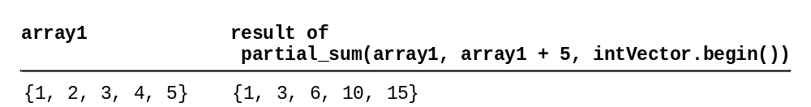
Numeric Operations: partial_sum
Creates a sequence in which each element is the sum of all the preceding elements including this element.
MathOperationDemo
Run

Slide 34
Lambda Expressions
C++11
Many STL algorithms allow you to pass functions as arguments, but you have to first create a function and then pass the function argument. C+11’s lambda expression enables you to define an anonymous function and pass it. Lamdba expressions can greatly simplify coding. Lambda expressions are also known as lambda functions, because the expression is essentially to define a function.
ForEachDemo
Run
ForEachDemoUsingLambdaFunctions
Run
CaptureVariable
Run

Slide 35
C++11 New STL Algorithms
C++11
C++11 provides several useful new STL algorithms: all_of, any_of, copy_if, copy_n, find_if_not, and none_of.

