Slide 1
Chapter 26 Graph Applications

Slide 2
Objectives
To model real-world problems using graphs and explain the Seven Bridges of Königsberg problem (§26.1).
To describe the graph terminologies: vertices, edges, simple graphs, weighted/unweighted graphs, and directed/undirected graphs (§26.2).
To represent vertices and edges using lists, adjacent matrices, and adjacent lists (§26.3).
To model graphs using the Graph class (§26.4).
To represent the traversal of a graph using the Tree class (§26.5).
To design and implement depth-first search (§26.6).
To design and implement breadth-first search (§26.7).
To solve the nine-tail problem using breadth-first search (§26.8).

Slide 3
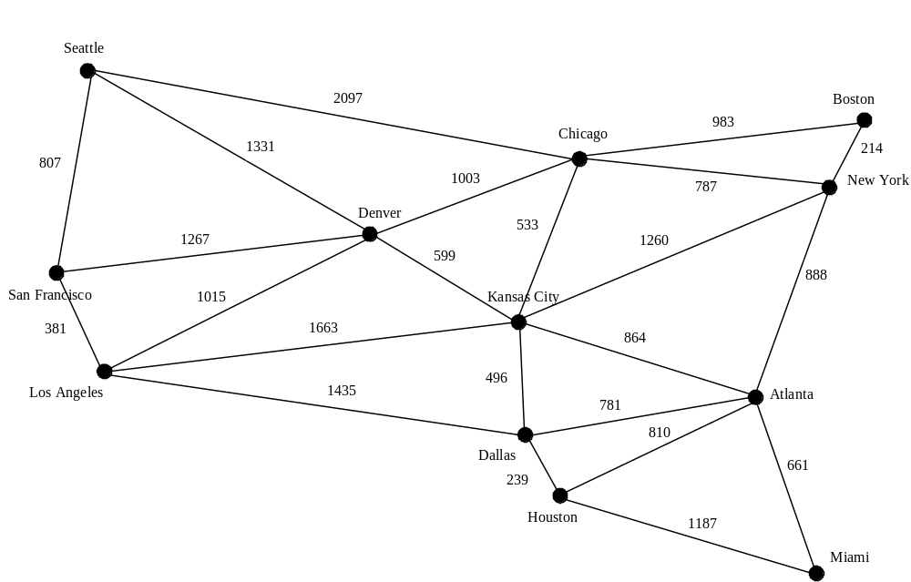
Modeling Using Graphs

Slide 4
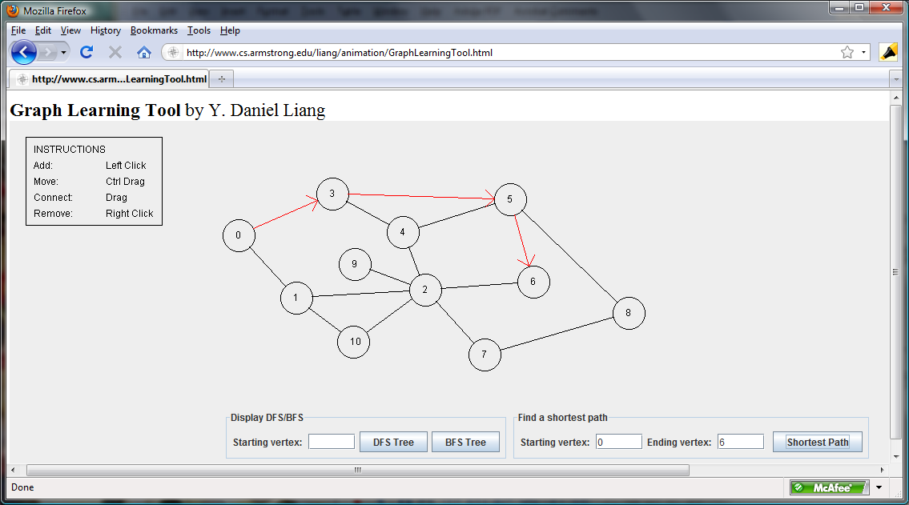
Graph Animation
www.cs.armstrong.edu/liang/animation/web/GraphLearningTool.html

Slide 5
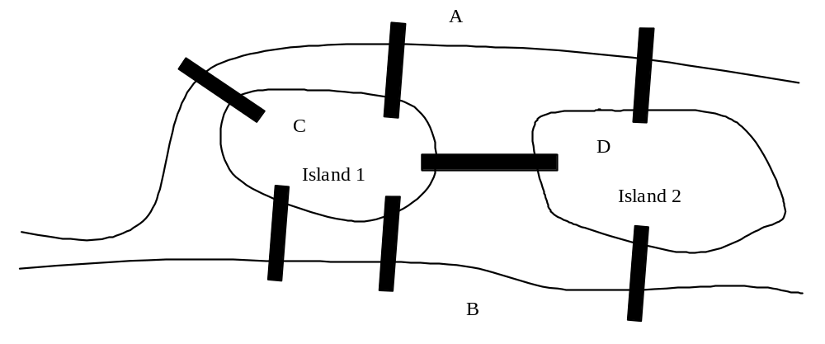
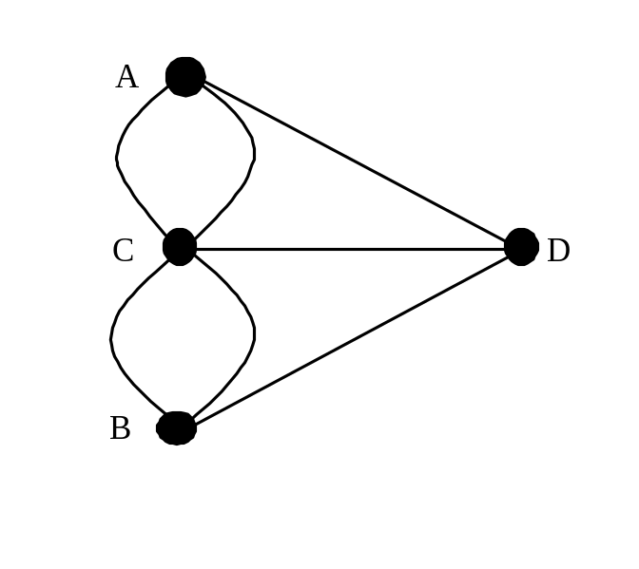
Seven Bridges of Königsberg

Slide 6
Basic Graph Terminologies
What is a graph?
Define a graph
Directed vs. undirected graphs
Weighted vs. unweighted graphs
Adjacent vertices
Incident
Degree
Neighbor
loop

Slide 7
Basic Graph Terminologies
Parallel edge
Simple graph
Complete graph
Spanning tree

Slide 8
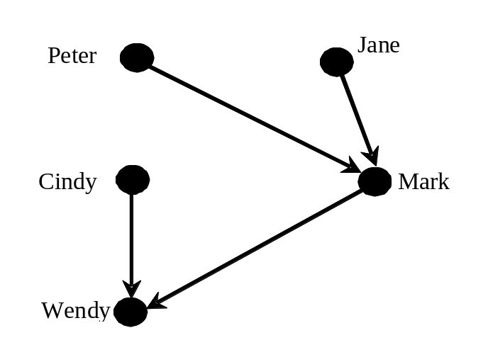
Directed vs Undirected Graph

Slide 9
Basic Graph Terminologies
What is a graph? G=(V, E)
Define a graph
Directed vs. undirected graphs
Weighted vs. unweighted graphs
Adjacent vertices
Incident
Degree
Neighbor
loop

Slide 10
Directed vs Undirected Graph

Slide 11
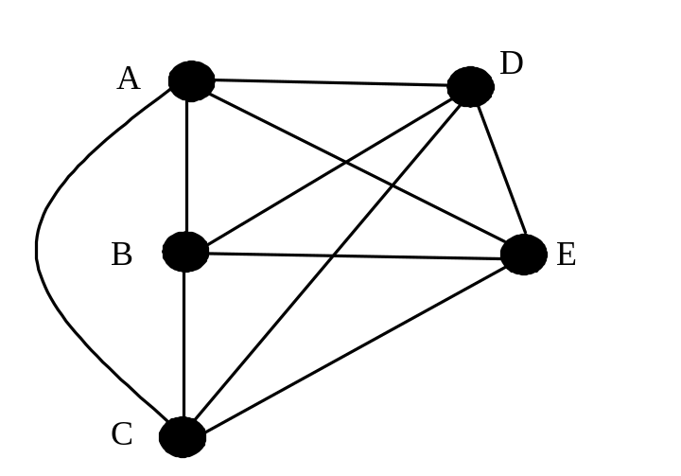
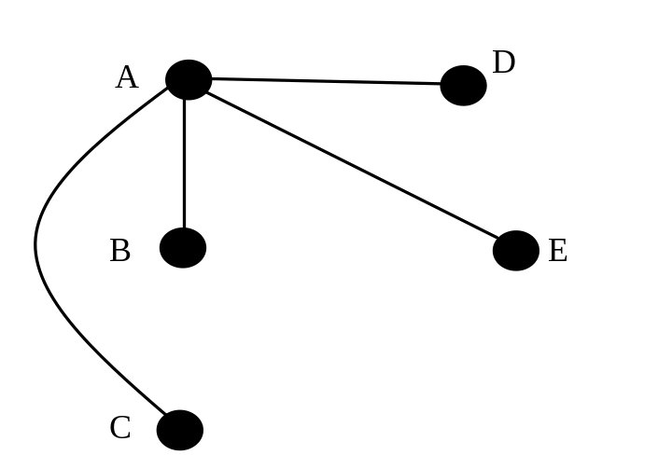
Basic Graph Terminologies
Parallel edge
Simple graph
Complete graph
Spanning tree

Slide 12
Representing Graphs
Representing Vertices
Representing Edges: Edge Array
Representing Edges: Edge Objects
Representing Edges: Adjacency Matrices
Representing Edges: Adjacency Lists

Slide 13
Representing Vertices
String vertices [] = {“Seattle“, “San Francisco“, “Los Angles”, “Denver”, “Kansas City”, “Chicago”, … };
City vertices [] = {city0, city1, … };
class City
{
public:
}
vector<string> vertices;

Slide 14
Representing Edges: Edge Array
int edges[][2] = {
{0, 1}, {0, 3}, {0, 5},
{1, 0}, {1, 2}, {1, 3},
{2, 1}, {2, 3}, {2, 4}, {2, 10},
{3, 0}, {3, 1}, {3, 2}, {3, 4}, {3, 5},
{4, 2}, {4, 3}, {4, 5}, {4, 7}, {4, 8}, {4, 10},
{5, 0}, {5, 3}, {5, 4}, {5, 6}, {5, 7},
{6, 5}, {6, 7},
{7, 4}, {7, 5}, {7, 6}, {7, 8},
{8, 4}, {8, 7}, {8, 9}, {8, 10}, {8, 11},
{9, 8}, {9, 11},
{10, 2}, {10, 4}, {10, 8}, {10, 11},
{11, 8}, {11, 9}, {11, 10}
};

Slide 15
Representing Edges: Edge Object
class Edge
{
public:
int u;
int v;
Edge(int u, int v)
{
this->u = u;
this->v = v;
}
};

Slide 16
Representing Edges: Edge Object
vector<Edge> edgeVector;
edgeVector.push_back(Edge(0, 1));
edgeVector.push_back(Edge(0, 3));
edgeVector.push_back(Edge(0, 5));
...

Slide 17
Representing Edges: Adjacency Matrix
int adjacencyMatrix[12][12] = {
{0, 1, 0, 1, 0, 1, 0, 0, 0, 0, 0, 0}, // Seattle
{1, 0, 1, 1, 0, 0, 0, 0, 0, 0, 0, 0}, // San Francisco
{0, 1, 0, 1, 1, 1, 0, 0, 0, 0, 0, 0}, // Los Angeles
{1, 1, 1, 0, 1, 1, 0, 0, 0, 0, 0, 0}, // Denver
{0, 0, 1, 1, 0, 1, 0, 1, 1, 0, 1, 0}, // Kansas City
{1, 0, 0, 1, 1, 0, 1, 1, 0, 0, 0, 0}, // Chicago
{0, 0, 0, 0, 0, 1, 0, 1, 0, 0, 0, 0}, // Boston
{0, 0, 0, 0, 1, 1, 1, 0, 1, 0, 0, 0}, // New York
{0, 0, 0, 1, 1, 0, 0, 1, 0, 1, 1, 1}, // Atlanta
{0, 0, 0, 0, 0, 0, 0, 0, 1, 0, 0, 1}, // Miami
{0, 0, 1, 0, 1, 0, 0, 0, 1, 0, 0, 1}, // Dallas
{0, 0, 0, 0, 0, 0, 0, 0, 1, 1, 1, 0} // Houston
};

Slide 18
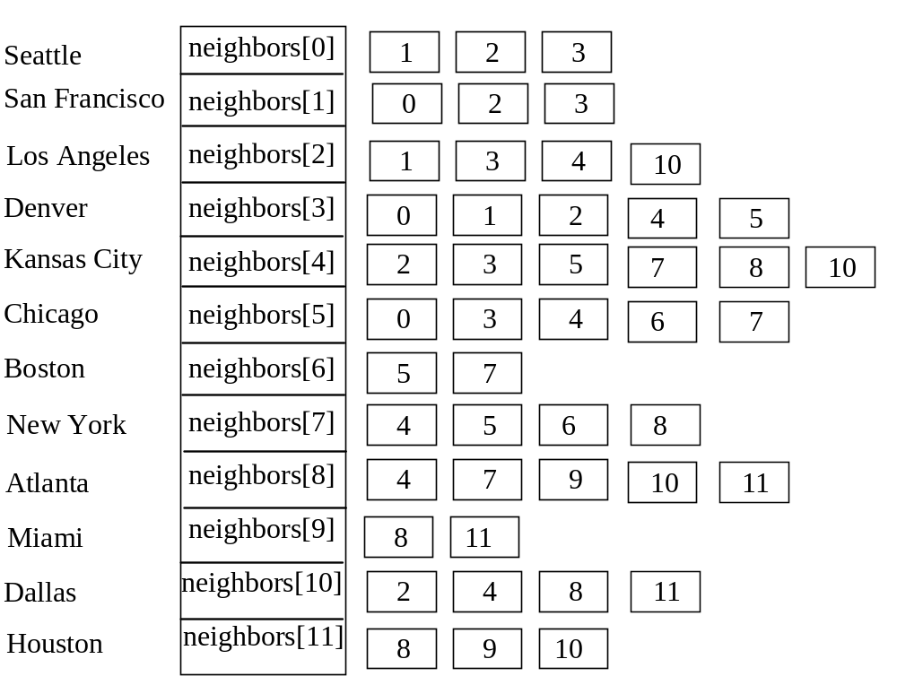
Representing Edges: Adjacency Vertex List
vector<int> neighbors(12);

Slide 19
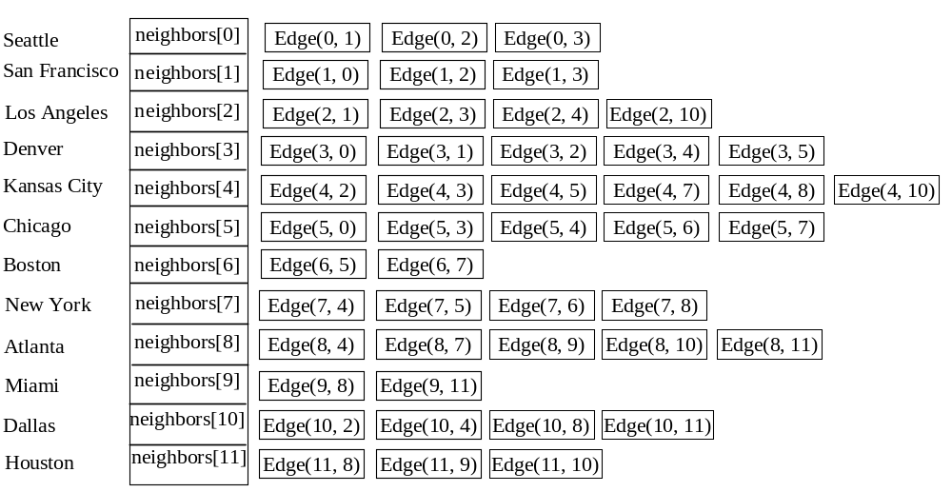
Representing Edges: Adjacency Edge List
vector<Edge> neighbors(12);

Slide 20
Representing Adjacency Edge List Using ArrayList
vector<vector<Edge*>> neighbors(12);
neighbors[0].push_back(new Edge(0, 1));
neighbors[0].push_back(new Edge(0, 3));
neighbors[0].push_back(new Edge(0, 5));
neighbors[1].push_back(new Edge(1, 0));
neighbors[1].push_back(new Edge(1, 2));
neighbors[1].push_back(new Edge(1, 3));
...
...

Slide 21
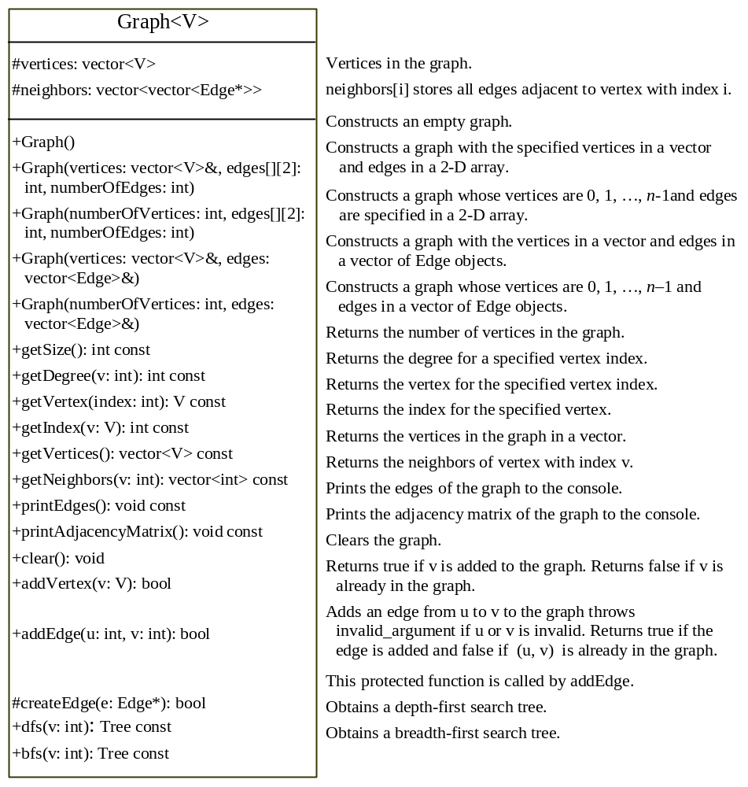
Graph
TestGraph
Run

Slide 22
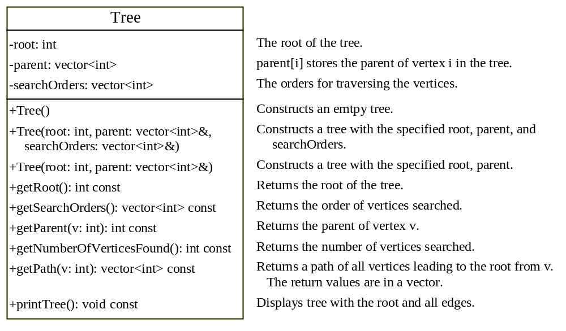
Graph Traversals
Depth-first search and breadth-first search
Both traversals result in a spanning tree, which can be modeled using a class.
Tree

Slide 23
Depth-First Search
The depth-first search of a graph is like the depth-first search of a tree discussed in §21.2.3, “Tree Traversal.” In the case of a tree, the search starts from the root. In a graph, the search can start from any vertex.
dfs(vertex v) {
visit v;
for each neighbor w of v
if (w has not been visited) {
dfs(w);
}
}

Slide 24
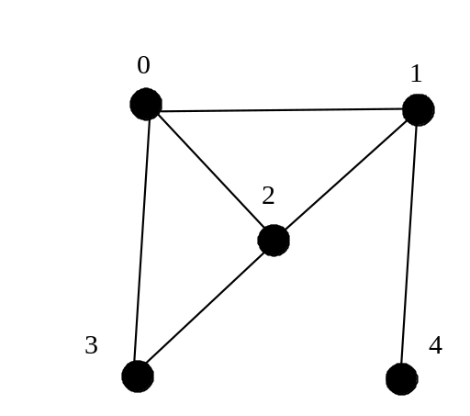
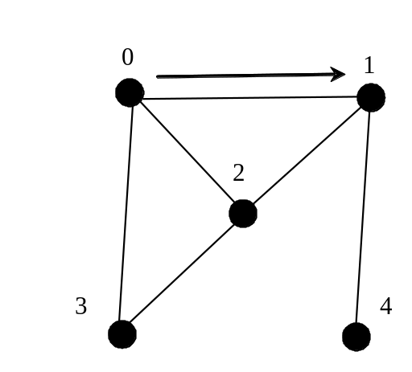
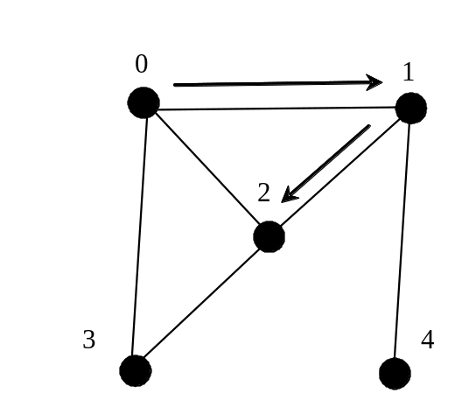
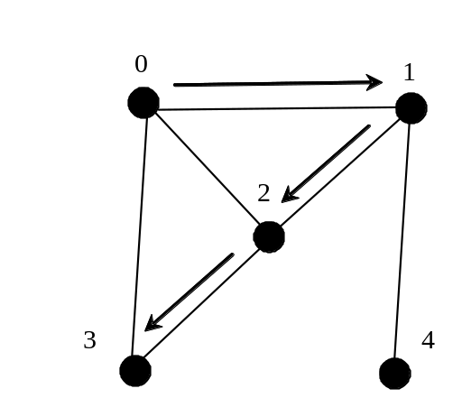
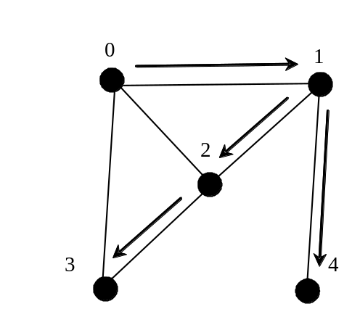
Depth-First Search Example

Slide 25
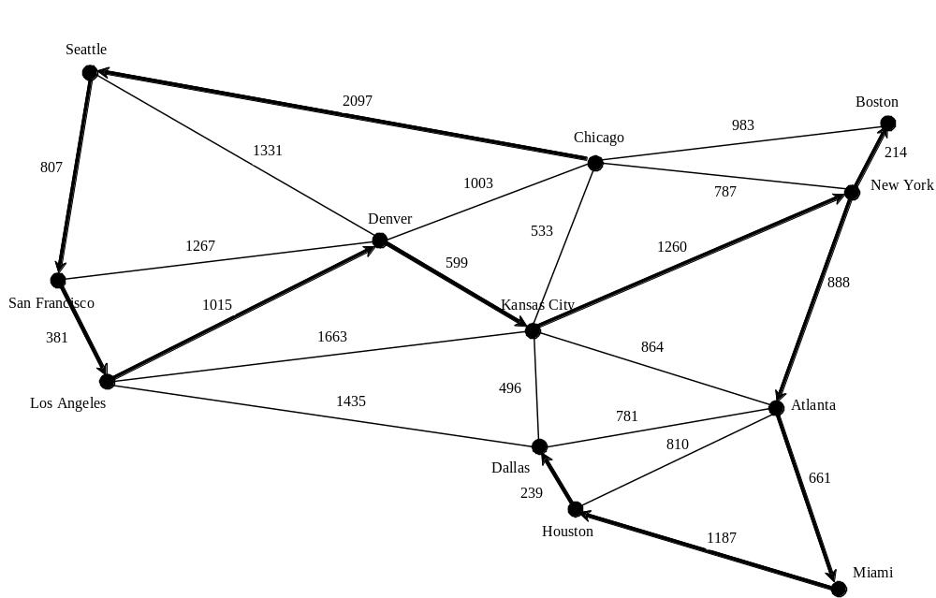
Depth-First Search Example
TestDFS
Run

Slide 26
Applications of the DFS
Detecting whether a graph is connected. Search the graph starting from any vertex. If the number of vertices searched is the same as the number of vertices in the graph, the graph is connected. Otherwise, the graph is not connected (See Exercise 26.2.)
Detecting whether there is a path between two vertices. (See Exercise 26.3)
Finding a path between two vertices. (See Exercise 26.3)
Finding all connected components. A connected component is a maximal connected subgraph in which every pair of vertices are connected by a path. (See Exercise 26.2)
Detecting whether there is a cycle in the graph. (See Exercise 26.4)
Finding a cycle in the graph. (See Exercise 26.5)

Slide 27
Breadth-First Search
The breadth-first traversal of a graph is like the breadth-first traversal of a tree discussed in §21.2.3, “Tree Traversal.” With breadth-first traversal of a tree, the nodes are visited level by level. First the root is visited, then all the children of the root, then the grandchildren of the root from left to right, and so on.

Slide 28
Breadth-First Search Algorithm
bfs(vertex v) {
create an empty queue for storing vertices to be visited;
add v into the queue;
mark v visited;
while the queue is not empty {
dequeue a vertex, say u, from the queue
visit u;
for each neighbor w of u
if w has not been visited {
add w into the queue;
mark w visited;
}
}
}

Slide 29
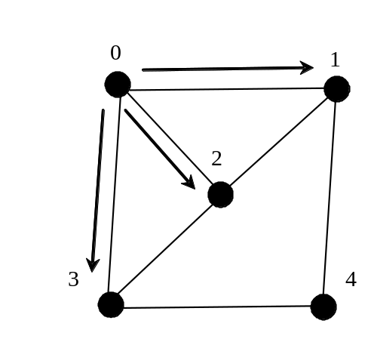
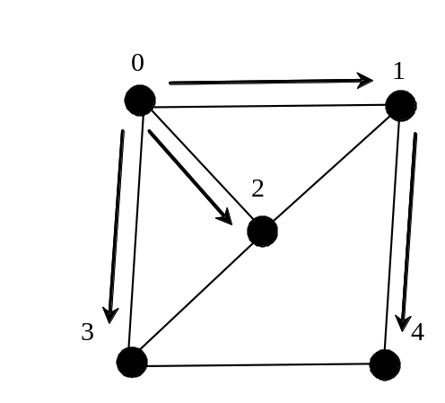
Breadth-First Search Example

Slide 30
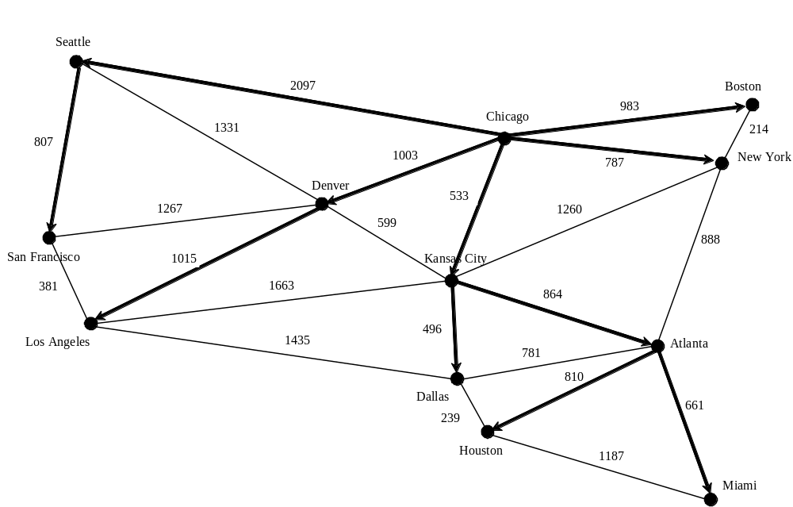
Breadth-First Search Example
TestBFS
Run

Slide 31
Applications of the BFS
Detecting whether a graph is connected. A graph is connected if there is a path between any two vertices in the graph.
Detecting whether there is a path between two vertices.
Finding a shortest path between two vertices. You can prove that the path between the root and any node in the BFS tree is the shortest path between the root and the node (see Review Question 26.10).
Finding all connected components. A connected component is a maximal connected subgraph in which every pair of vertices are connected by a path.
Detecting whether there is a cycle in the graph. (See Exercise 26.4)
Finding a cycle in the graph. (See Exercise 26.5)
Testing whether a graph is bipartite. A graph is bipartite if the vertices of the graph can be divided into two disjoint sets such that no edges exist between vertices in the same set. (See Exercise 26.8)

Slide 32
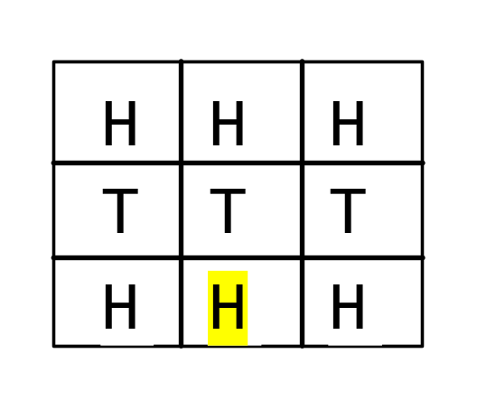
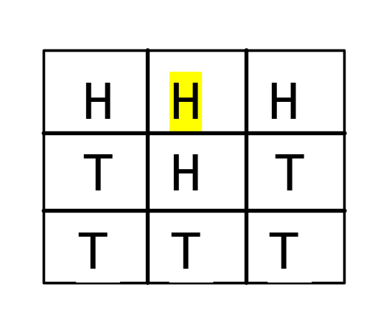
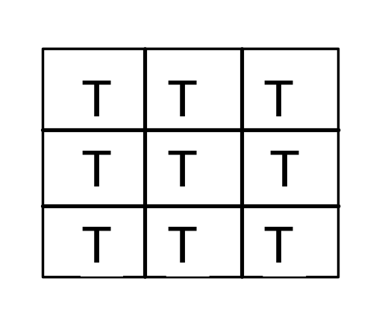
The Nine Tail Problem
The problem is stated as follows. Nine coins are placed in a three by three matrix with some face up and some face down. A legal move is to take any coin that is face up and reverse it, together with the coins adjacent to it (this does not include coins that are diagonally adjacent). Your task is to find the minimum number of the moves that lead to all coins face down.

Slide 33
The Nine Tail Problem
NineTailModel.h
NineTail.cpp
Run

