Slide 1
Chapter 27 Weighted Graph Applications

Slide 2
Objectives
To represent weighted edges using adjacency matrices and priority queues (§27.2).
To model weighted graphs using the WeightedGraph class that extends the Graph class (§27.3).
To design and implement the algorithm for finding a minimum spanning tree (§25.4).
To define the MST class that extends the Tree class (§27.4).
To design and implement the algorithm for finding single-source shortest paths (§27.5).
To define the ShortestPathTree class that extends the Tree class (§27.5).
To solve the weighted nine tail problem using the shortest-path algorithm (§27.6).

Slide 3
Weighted Graph Animation
www.cs.armstrong.edu/liang/animation/web/WeightedGraphLearningTool.html

Slide 4
Representing Weighted Graphs
Representing Weighted Edges: Edge Array
Weighted Adjacency Matrices
Priority Adjacency Lists

Slide 5
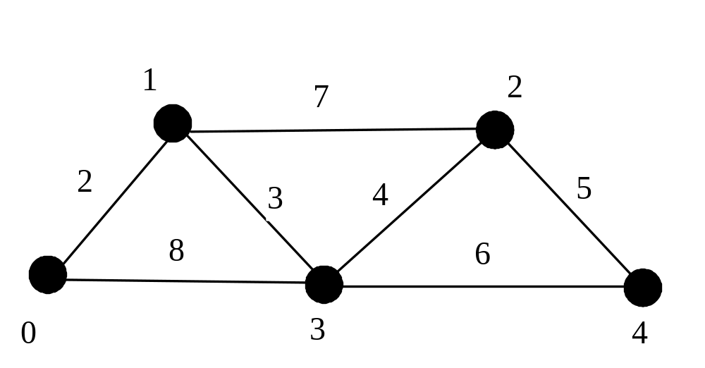
Representing Weighted Edges: Edge Array
int[][3] edges = {{0, 1, 2}, {0, 3, 8},
{1, 0, 2}, {1, 2, 7}, {1, 3, 3},
{2, 1, 7}, {2, 3, 4}, {2, 4, 5},
{3, 0, 8}, {3, 1, 3}, {3, 2, 4}, {3, 4, 6},
{4, 2, 5}, {4, 3, 6}
};

Slide 6
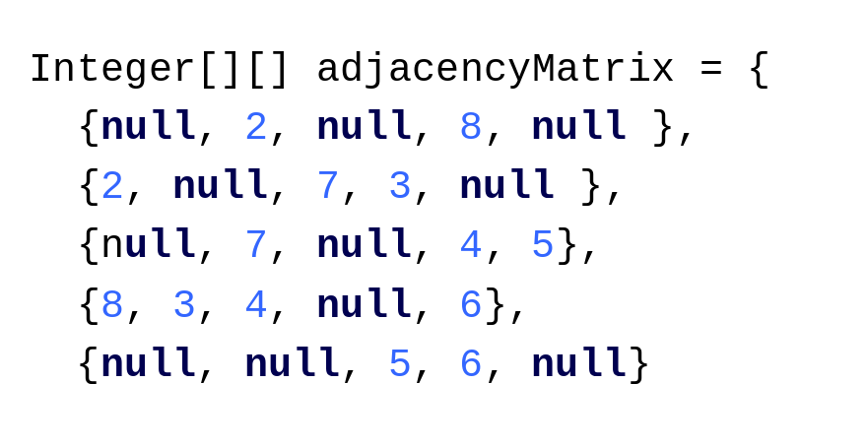
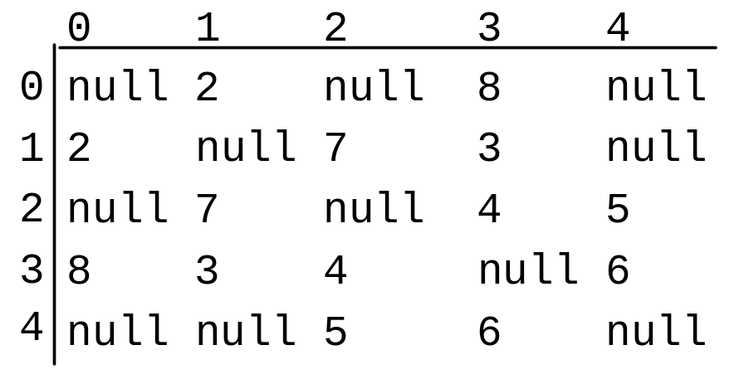
Representing Weighted Edges: Edge Array

Slide 7
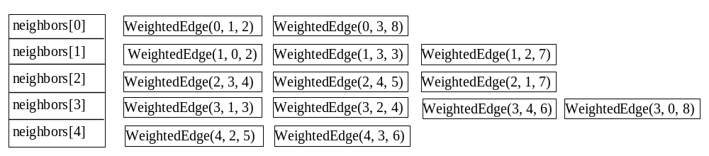
Adjacency Lists

Slide 8
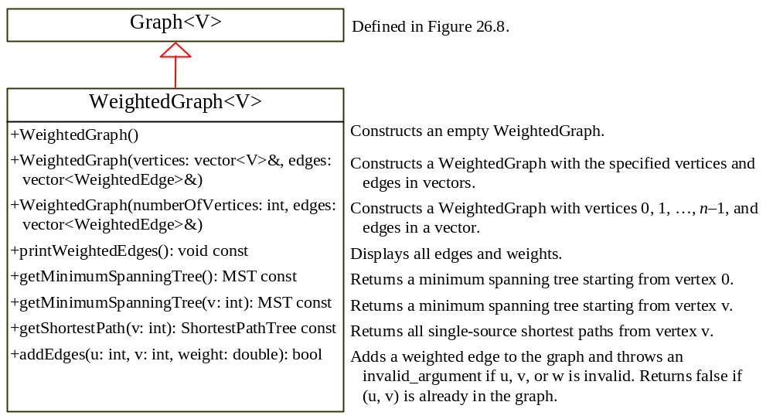
WeightedGraph.h
TestWeightedGraph
Run

Slide 9
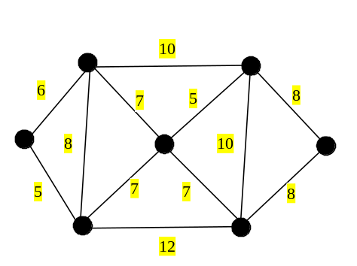
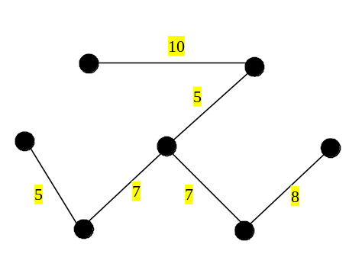
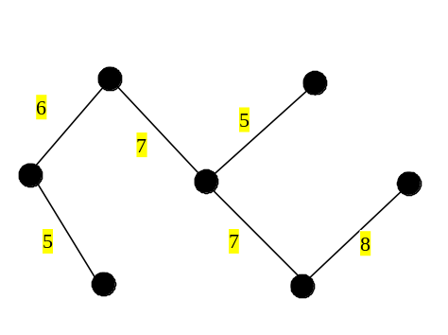
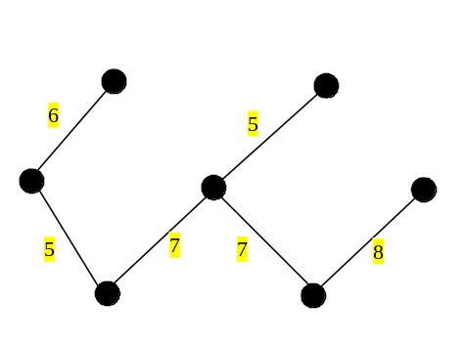
Minimum Spanning Trees
A graph may have many spanning trees. Suppose that the edges are weighted. A minimum spanning tree is a spanning tree with the minimum total weights. For example, the trees in Figures 27.3b, 27.3c, 27.3d are spanning trees for the graph in Figure 27.3a. The trees in Figures 27.3c and 27.3d are minimum spanning trees.

Slide 10
Minimum Spanning Tree Algorithm
Input: A connected undirected weighted G = (V, E)
Output: MST (a minimum spanning tree)
1 MST minimumSpanningTree()
2 {
3 Let T be a set for the vertices in the spanning tree;
4 Set cost[v] = infinity for each vertex v;
5 Pick an arbitrary vertex, say s and set cost[s] = 0 and parent[s] = -1;
6
7 while (size of T < n)
8 {
9 Find u not in T with the smallest cost[u];
10 Add u to T;
11 for (each v not in T and (u, v) in E)
12 {
13 if (cost[v] > w(u, v))
14 cost[v] = w(u, v); parent[v] = u;
15 }
16 }

Slide 11
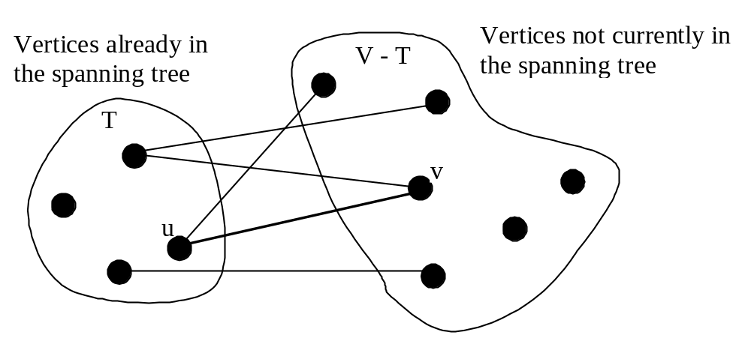
Minimum Spanning Tree Algorithm

Slide 12
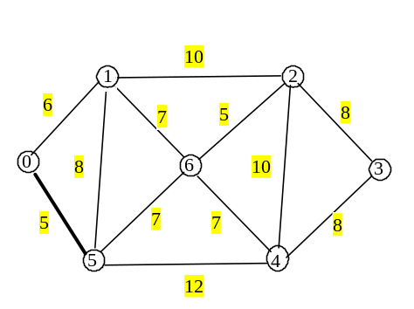
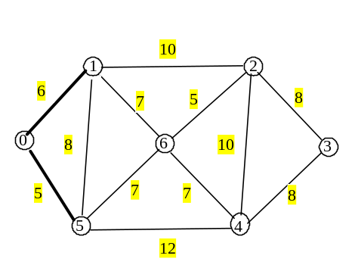
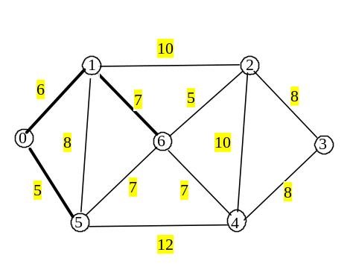
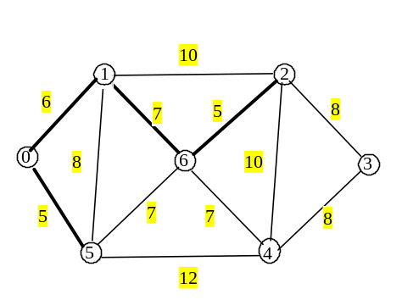
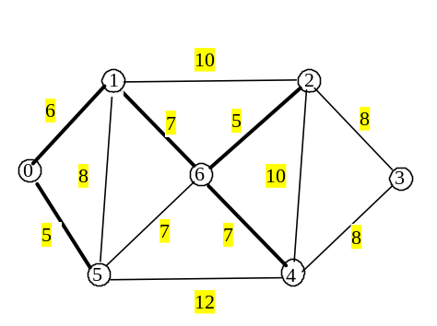
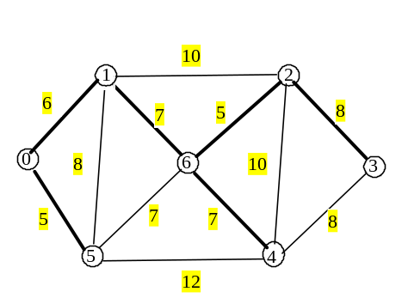
Minimum Spanning Tree Algorithm Example

Slide 13
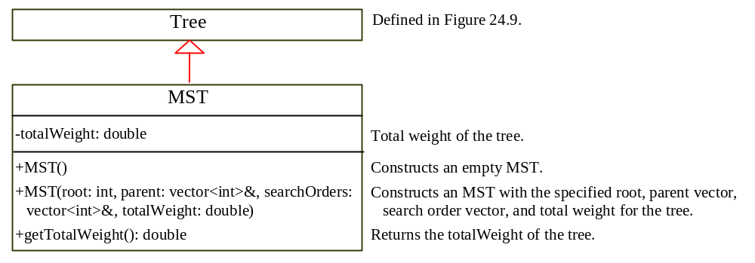
Implementing MST Algorithm

Slide 14
Time Complexity
O(|V|^2)

Slide 15
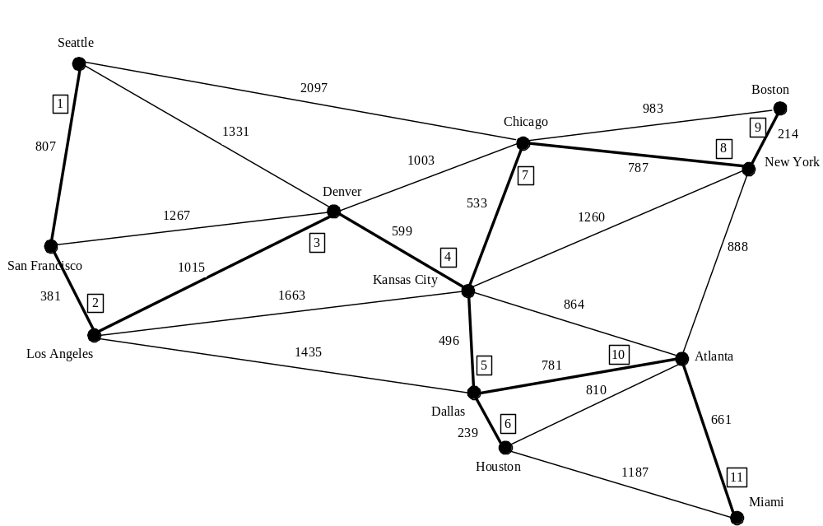
Test MST
TestMinimumSpanningTree
Run

Slide 16
Shortest Path
§24.1 introduced the problem of finding the shortest distance between two cities for the graph in Figure 24.1. The answer to this problem is to find a shortest path between two vertices in the graph.

Slide 17
Single Source Shortest Path Algorithm
Input: a graph G = (V, E) with nonnegative weights and a source vertex s
Output: a shortest path tree with the source vertex s as the root
1 ShortestPathTree getShortestPath(s)
2 {
3 Let T be a set that contains the vertices whose
4 paths to s are known;
5 Set cost[v] = infinity for all vertices;
6 Set cost[s] = 0 and parent[s] = -1;
7
8 while (size of T < n)
9 {
10 Find u not in T with the smallest cost[u];
11 Add u to T;
12 for (each v not in T and (u, v) in E)
13 {
14 if (cost[v] > cost[u] + w(u, v))
15 cost[v] = cost[u] + w(u, v); parent[v] = u;
16 }
17 }

Slide 18
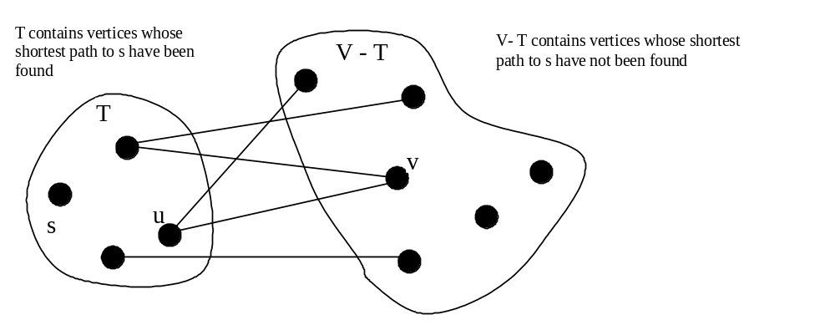
Single Source Shortest Path Algorithm

Slide 19
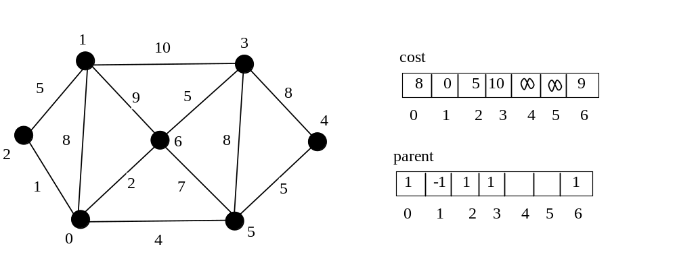
SP Algorithm Example
(Step 1)

Slide 20
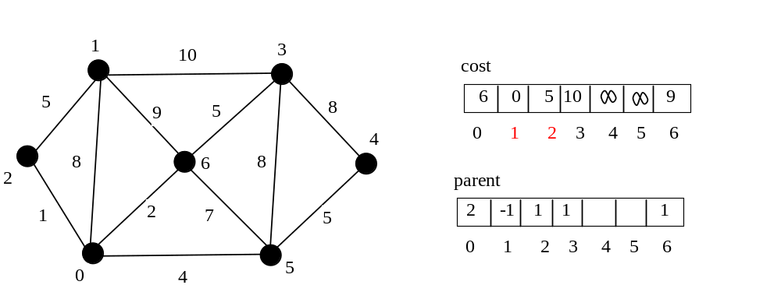
Version 2: SP Algorithm Example (Step 2)

Slide 21
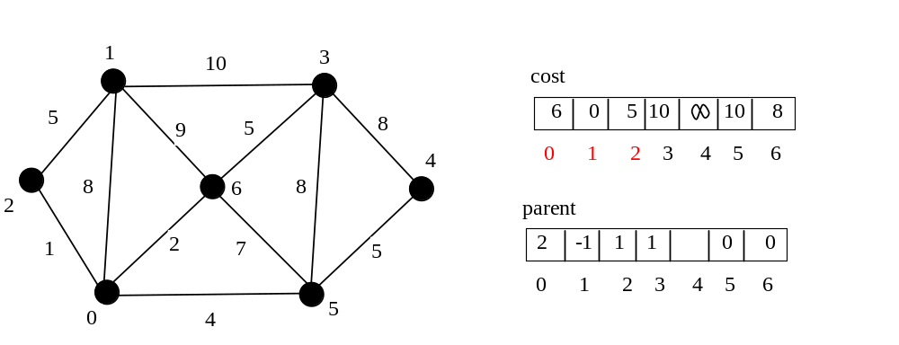
Version 2: SP Algorithm Example (Step 3)

Slide 22
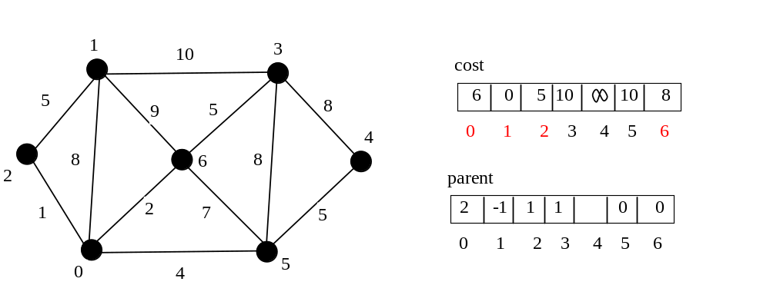
Version 2: SP Algorithm Example (Step 4)

Slide 23
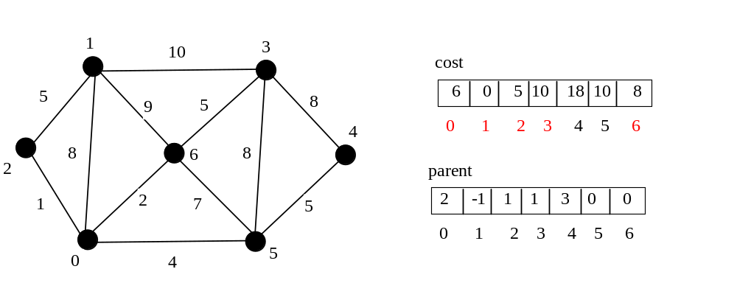
Version 2: SP Algorithm Example (Step 5)

Slide 24

Version 2: SP Algorithm Example (Step 6)

Slide 25

Version 2: SP Algorithm Example (Step 7)

Slide 26
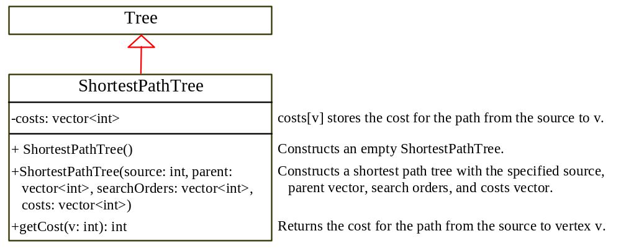
SP Algorithm Implementation
TestShortestPath
Run

Slide 27
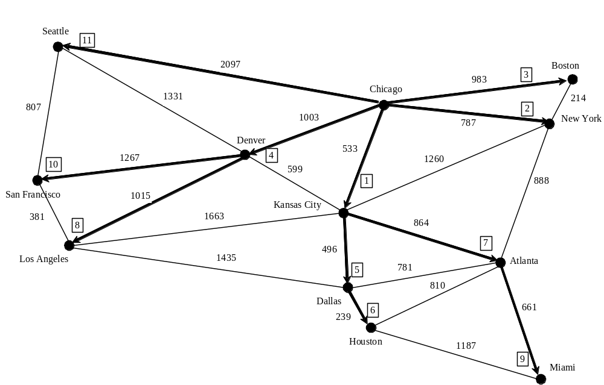
SP Algorithm Example

Slide 28
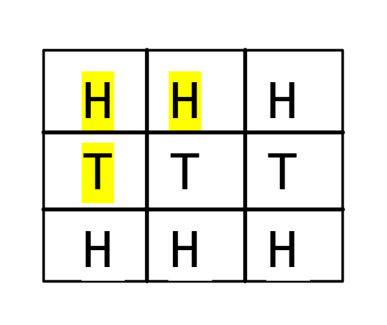
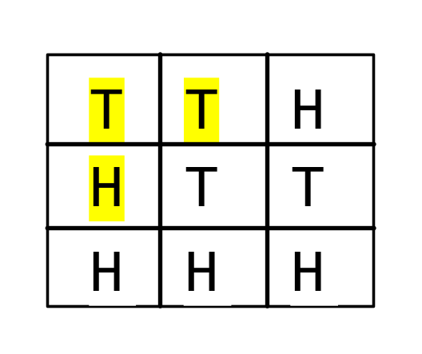
The Weighted Nine Tail Problem
The nine tail problem is to find the minimum number of the moves that lead to all coins face down. Each move flips a head coin and its neighbors. The weighted nine tail problem assigns the number of the flips as a weight on each move. For example, you can move from the coins in the left figure to the right figure by flipping the three coins. So the weight for this move is 3.
WeightedNineTailModel
WeightedNineTail
Run

