Slide 1
Investigating Metal Insulator transition in triangular lattice with using dynamical cluster approximation

Slide 2
Contents
1 Background Physics
- Metal-Insulator transition
- Hubbard model
- Frustration effect.
2 Method & model
- Dynamical cluster approximation.
- Triangular lattice Hubbard model
- Double occupancy & Metal-Insulator transition.
3 Result data
- Metal insulator transition in different temperature
- Metal insulator transition in frustrated system.
- Phase diagram (electron filling VS U/W).

Slide 3
1. Background Physics - Metal-Insulator transition - Hubbard model - Frustration effect.

Slide 4
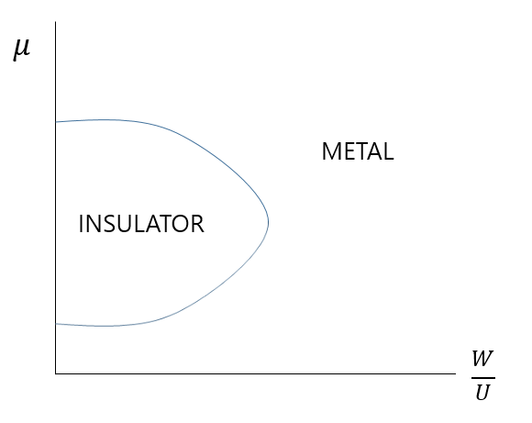
Metal-Insulator transition
Mechanism of Mott-Hubbard type metal-insulator transition
1. Competition between coulomb interaction(U)
and bandwidth(W).
- 2. Doping rate(chemical potential)

Slide 5
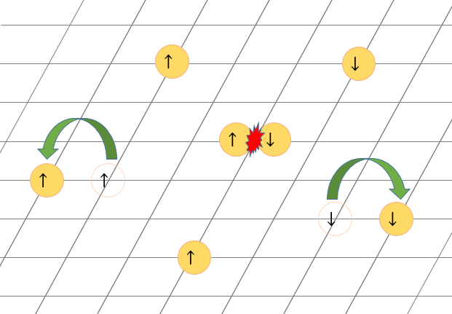

Hubbard model
The Hubbard model have been used to study the metal insulator transition.
$$H=−t\sum_{i,j}{{c_{i}}^{†}c_{j}+h.c}+U\sum_{i}{n_{i↑}n_{i↓}}$$
-t
+U
-t

Slide 6
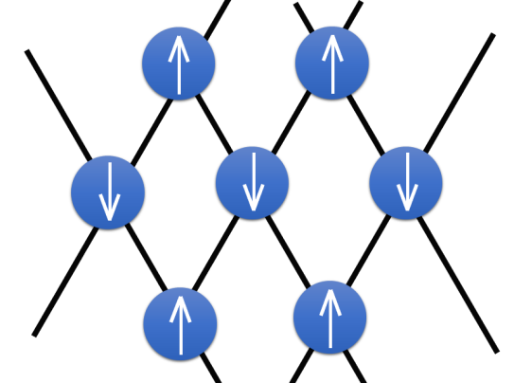
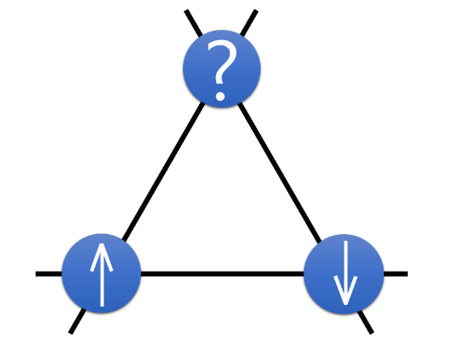
Frustration effect
Ground state of whole system can be govern by Geometric of lattice structure

Slide 7
2. Method & model - Dynamical cluster approximation - Triangular lattice Hubbard model - Double occupancy & Metal- Insulator transition.

Slide 8
Dynamical cluster approximation
Approximation to obtain Green’s function from Hubbard Hamiltonian.
Green’s function contains a information about system. (Energy, phase transition,…)
Dynamical cluster approximation divides a First Brillouin zone to involve a non local correlation effect(Frustration).

Slide 9




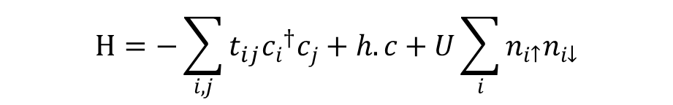
Triangular lattice Hubbard model
Single band Hubbard model are considered.
$$H=−\sum_{i,j}{t_{ij}{c_{i}}^{†}c_{j}+h.c}+U\sum_{i}{n_{i↑}n_{i↓}}$$
$$t_{ij}=t or t′$$
t
t
t’
t
t
t’
t’
Frustration effect in triangular lattice can be modified by tuning a hopping parameter. (Laubach, M., Thomale, R., Platt, C., Hanke, W., & Li, G. Phase diagram of the Hubbard model on the anisotropic triangular lattice. Physical Review B(2015))

Slide 10
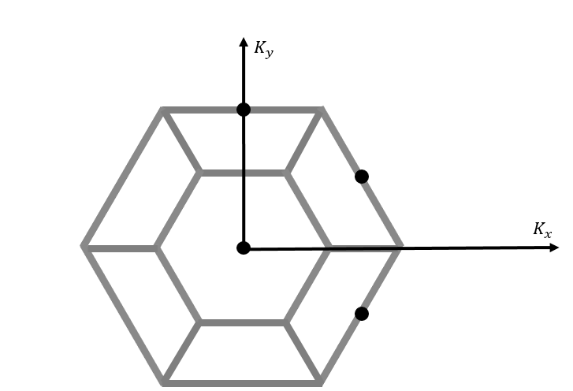
Triangular lattice Hubbard model
Real space
First Brillouin zone of
triangular lattice
Clustering size, 4, is enough to calculate a Green’s function in triangular lattice. (Lee, H., Li, G., & Monien, H. (2008). Hubbard model on the triangular lattice using dynamical cluster approximation and dual fermion methods. Physical Review B, 78(20), 205117.)

Slide 11


Double occupancy & Metal-Insulator transition
In lattice site, there are 4 possible state.
We called average of ‘ ‘ , <$n_{↑}n_{↓}$> , double occupancy rate.

Slide 12
Double occupancy & Metal-Insulator transition
U and t are related with competition.
If t is larger than U, also increased due to the hopping of electrons.
if U is larger than t, decreased to reduce a coulomb interaction energy.
So metal-insulator transition can be examined by observing a behavior of double occupancy

Slide 13
3. Data - Metal insulator transition in different temperature - Metal insulator transition in frustrated system. - Phase diagram (electron filling VS U/W).

Slide 14
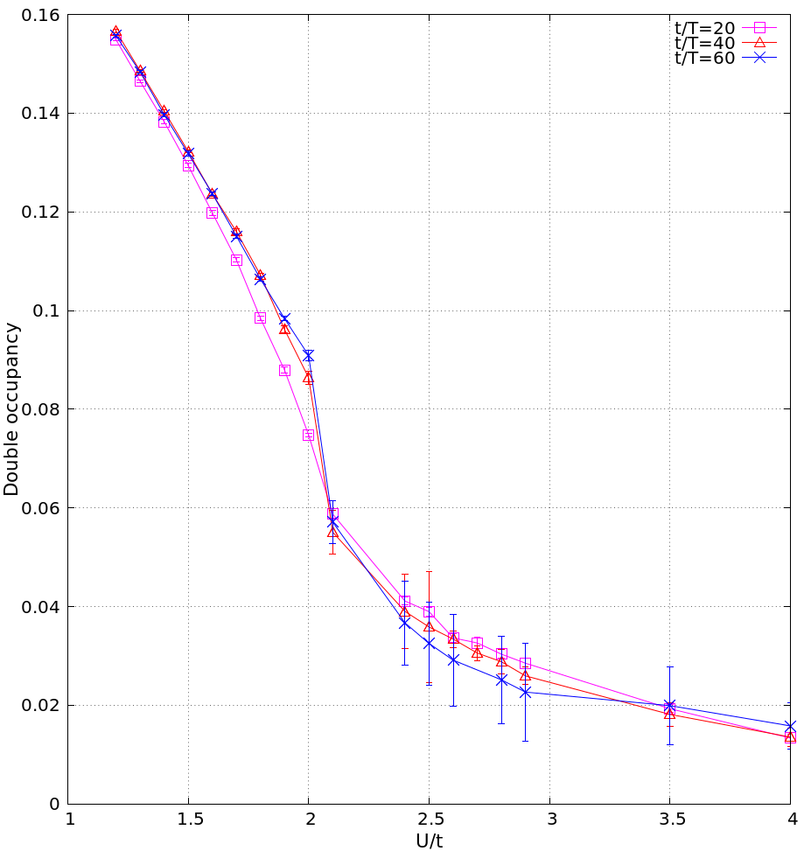

Metal insulator transition in different temperature
Metal–Insulator transition is occurred at U/t=2.0, t/T$≥$40
(Lee, H., Li, G., & Monien, H. (2008). Hubbard model on the triangular lattice using dynamical cluster approximation and dual fermion methods. Physical Review B, 78(20), 205117.)

Slide 15
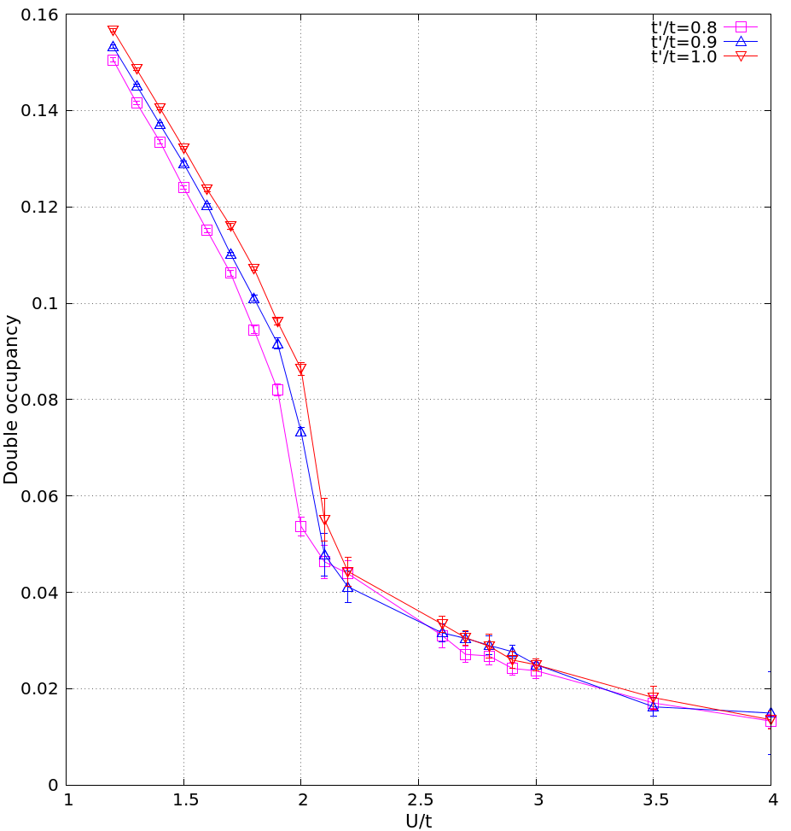
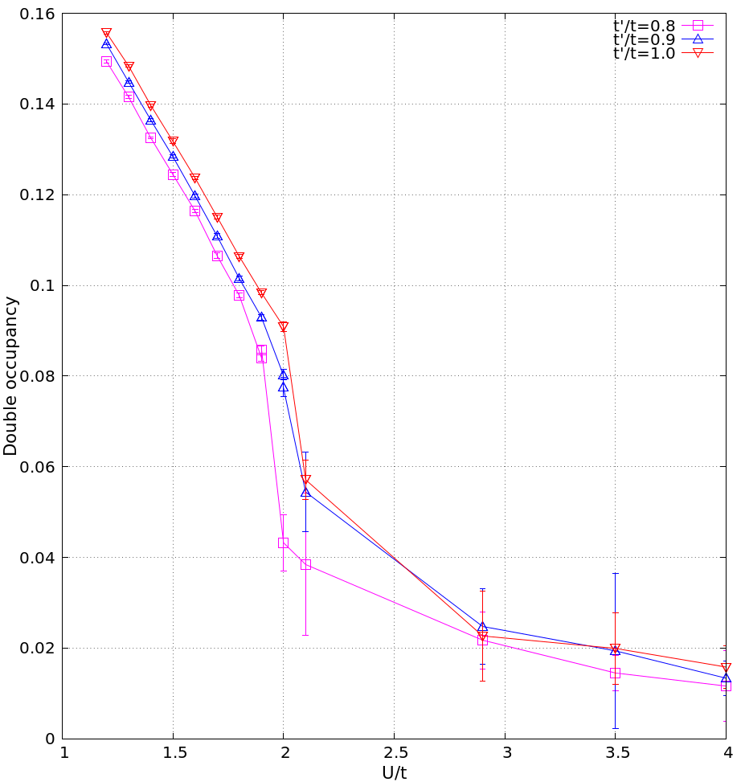
Metal insulator transition in frustrated system.
When frustration effect is increased,
interaction to drive metal-insulator transition is slightly increased
This results corresponds to prior report : phase diagram with t’/t.
Dang, H. T., Xu, X. Y., Chen, K. S., Meng, Z. Y., & Wessel, S. (2015). Mott transition in the triangular lattice Hubbard model: A dynamical cluster approximation study. Physical Review B, 91(15), 155101

Slide 16
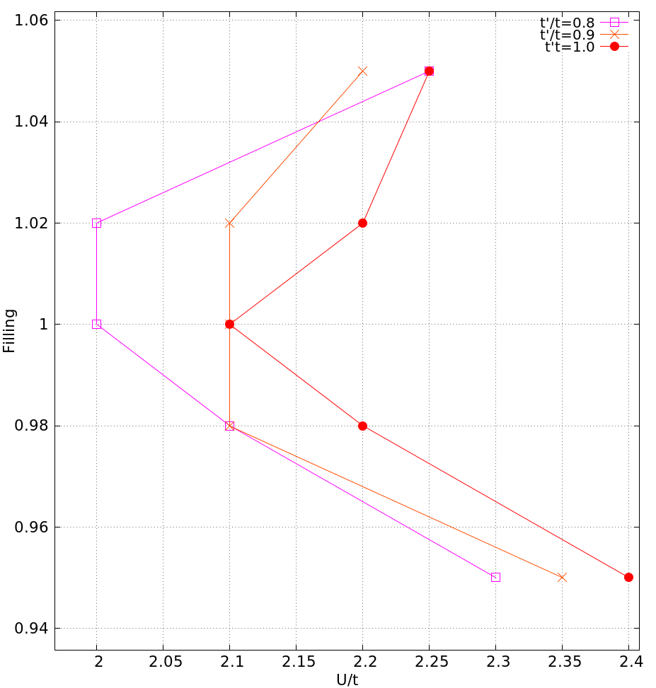
Phase diagram (electron filling VS U/W).
Insulator
Metal

Slide 17
Conclusion
Metal-Insulator transition in triangular lattice can be found with aid of dynamical cluster approximation.
When frustration effect is increased, critical interaction is also increased.
Critical interaction in Half filled state is smaller than non half filled.

Slide 18
Appendix

Slide 19
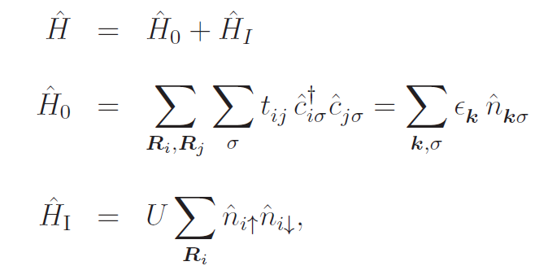
What is the DMFT? What is the meaning of dynamical mean field?
Hubbard model

Slide 20
What is the DMFT? What is the meaning of dynamical mean field?
Self energy is assumed that it only depends on time(frequency).
What physical environments permit above condition?
- High dimensional system.
- DMFT is known as that it gives exact
self energy in infinity dimension..;;(So what?)

Slide 21
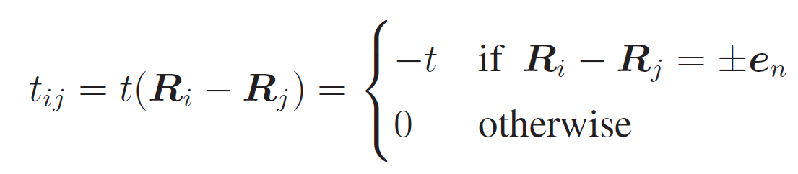
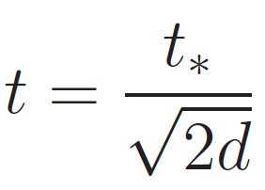
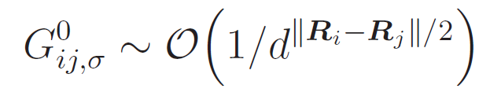
What is the DMFT? What is the meaning of dynamical mean field?
Hopping parameter
Green’s function can be scaled by dimension

Slide 22
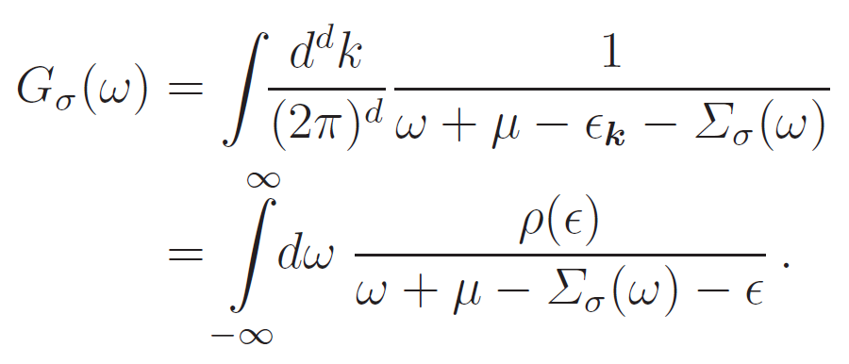
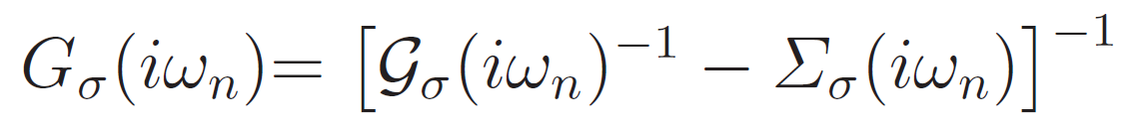
What is the DMFT? What is the meaning of dynamical mean field?
In infinity dimension, local full green function only survive.
By Dyson’s equation, Effective bath green function can be obtained.

Slide 23
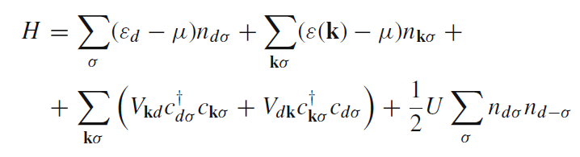
What is the DMFT? Quantum impurity problem.
Quantum impurity model.

Slide 24

What is the DMFT? Quantum impurity problem.
Mapping
- Hubbard model -> Quantum impurity model
- much easier to solve!
(degree of freedom is drastically decreased.)
- self consistent equation is needed.

Slide 25
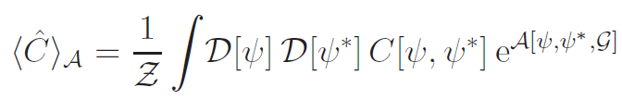
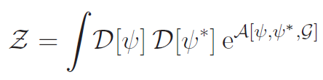
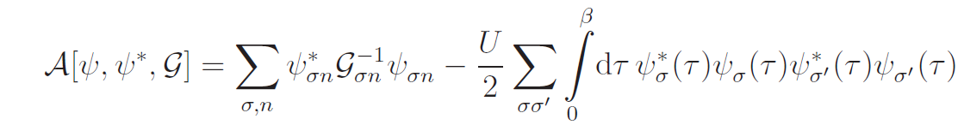
What is the DMFT? Quantum impurity problem.
How can we treat the impurity model?
- Many body path integral formulation.
Effective bath
Green’s function

Slide 26
What is the DMFT? Quantum impurity problem.
Quantum impurity solver.
- Hirsch & Fye QMC (discrete time QMC)
- Continuous time QMC(weak coupling, hybridized type)
- Exact Diagonalization
- NCA
-
- …

Slide 27
What is the DMFT? Self-consistency loop in DMFT.
Self consistency loop
Initialize
self energy
Input a self energy
Full green function
Using Dyson’s eq
Termination criterion
Hubbard model
Quantum Impurity model
Using Dyson’s eq
Solve impurity
Problem.
Mapping to the
Quantum impurity problem

Slide 28
Quantum cluster theory Why we need a clustering approach?
Need of consideration that self energy has k dependency.
- DMFT does not well describe low dimensional
system.
- Self energy has matrix form.
-> Cluster self energy is considered!

Slide 29
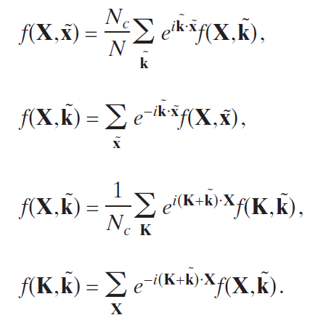
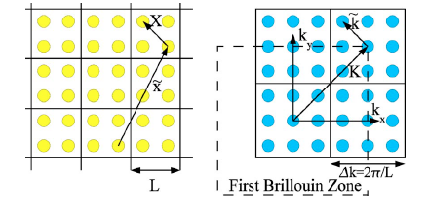
Quantum cluster theory Why we need a clustering approach?
Clustering a lattice

Slide 30
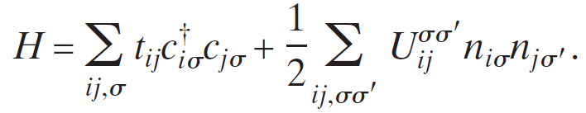
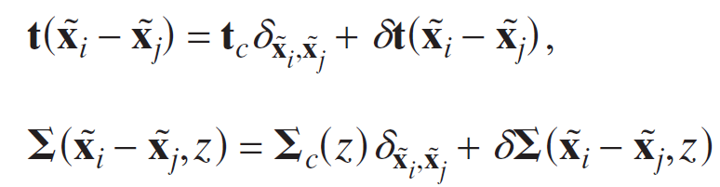
Quantum cluster theory Why we need a clustering approach?
Single Hubbard model.
All the quantities are N_c * N_c matrices.

Slide 31
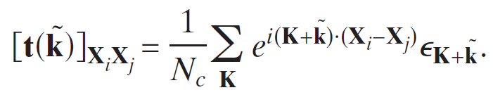
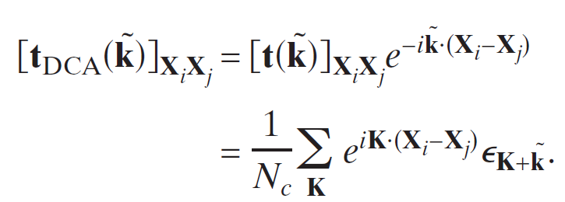
Quantum cluster theory What is the DCA?
DCA(Dynamical Cluster Approximation)
Restore the translational invariance in cluster unit.
->

Slide 32
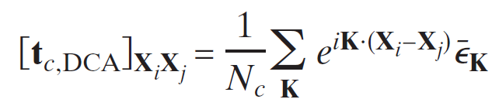
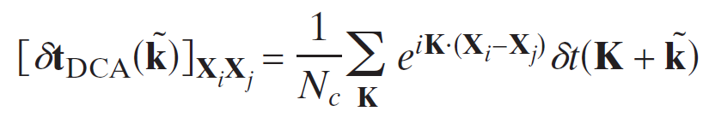
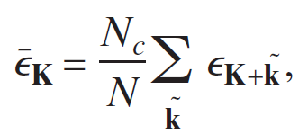

Quantum cluster theory What is the DCA?
Corse grained hopping term.

Slide 33


Quantum cluster theory What is the DCA?
Lattice green function becomes diagonal in cluster Fourier space.

Slide 34
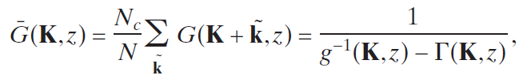
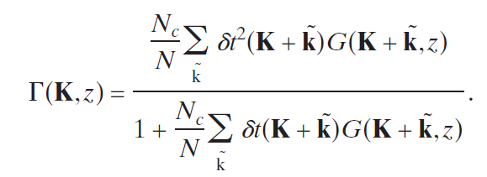
Quantum cluster theory What is the DCA?
Coarse-grained Green’s function,

Slide 35
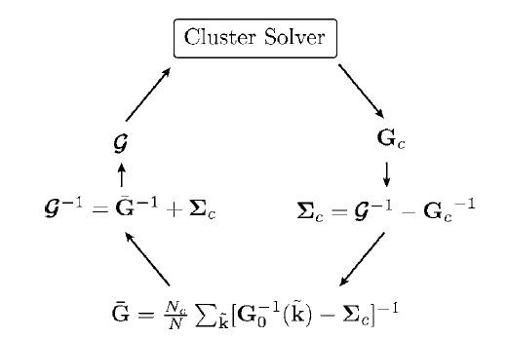
Quantum cluster theory Quantum cluster loop.

