Slide 1
Study of metal-insulator transition in the triangular lattice within the dynamical cluster approximation

Slide 2
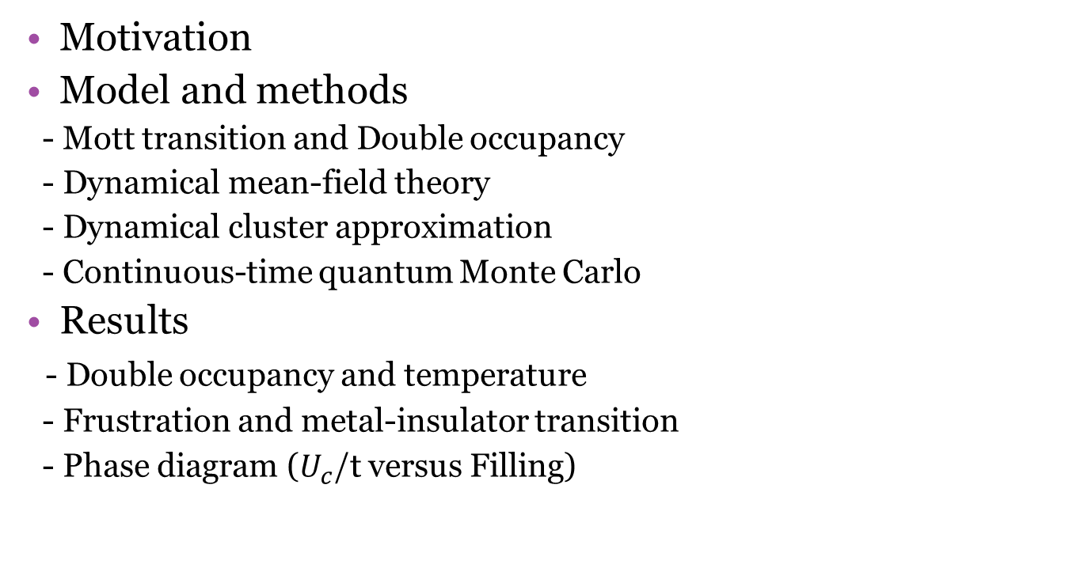
CONTENTS
Motivation
Model and methods
- Mott transition and Double occupancy
- Dynamical mean-field theory
- Dynamical cluster approximation
- Continuous-time quantum Monte Carlo
Results
- Double occupancy and temperature
- Frustration and metal-insulator transition
- Phase diagram ($U_{c}$/t versus Filling)

Slide 3
Motivation

Slide 4
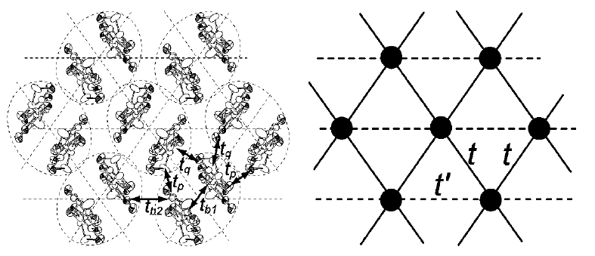
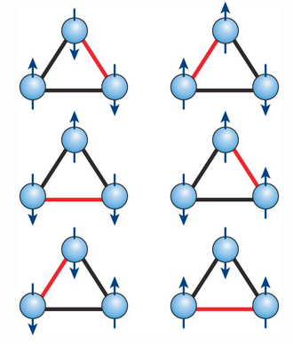

Why should we study the triangular lattice?
$κ−(BEDT−TTF)_{2}CU_{2}(CN)_{3}$
- Two-dimensional isotropic triangular lattice. (Half-filliling)
- Mott insulator
- No magnetic ordering under 32 mK → Quantum spin liquid
Y. Shimizu, K. Miyagawa, K. Kanoda, M. Maesato, and G. Saito
Phys. Rev. Lett. 91, 107001 (2003)

Slide 5
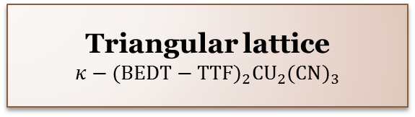
Why should we study the triangular lattice?
Quantum spin liquid
(Frustration)
+
Mott insulator
→
Triangular lattice
$$κ−(BEDT−TTF)_{2}CU_{2}(CN)_{3}$$
Question.
Can we simulate Mott transition in triangular lattice?
2. What is the relation between Frustration and Mott insulator ?
3. What is the phase diagram beyond half-filling ?

Slide 6
Model and methods

Slide 7
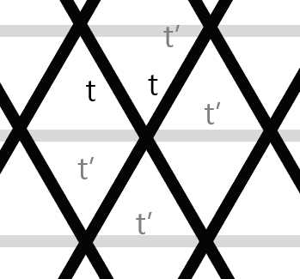
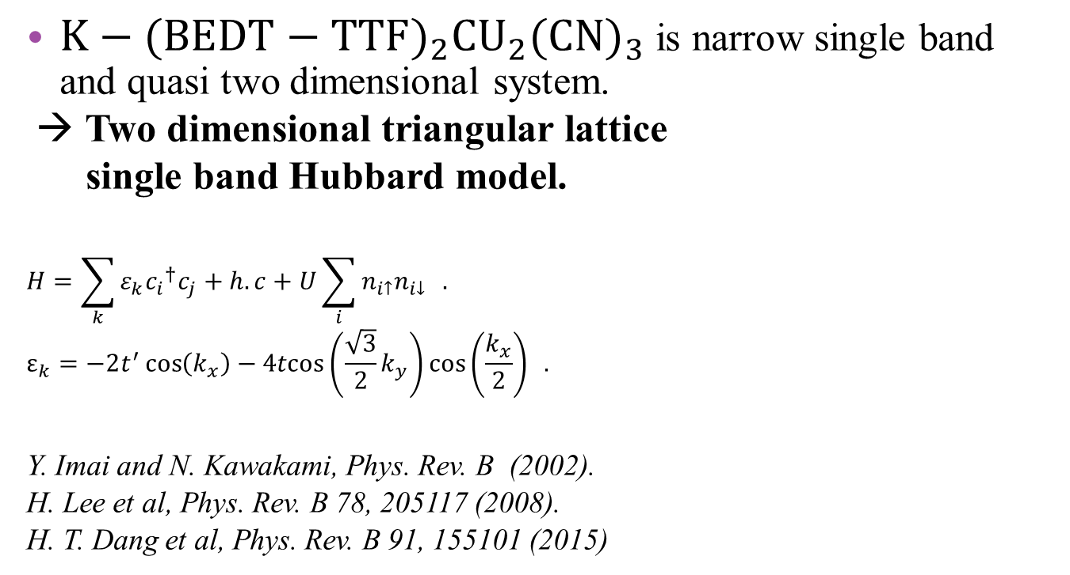
Modelling
$Κ−(BEDT−TTF)_{2}CU_{2}(CN)_{3}$ is narrow single band and quasi two dimensional system.
→ Two dimensional triangular lattice
single band Hubbard model.
$$H=\sum_{k}{{{ε_{k}c}_{i}}^{†}c_{j}+h.c}+U\sum_{i}{n_{i↑}n_{i↓}} .$$
$$ε_{k}=−2t^{′}\cos\left(k_{x}\right)−4tcos\left(\frac{\sqrt{3}}{2}k_{y}\right)\cos\left(\frac{k_{x}}{2}\right) .$$
Y. Imai and N. Kawakami, Phys. Rev. B (2002).
H. Lee et al, Phys. Rev. B 78, 205117 (2008).
H. T. Dang et al, Phys. Rev. B 91, 155101 (2015)

Slide 8
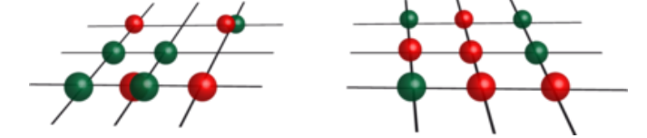

Mott transition and double occupancy
How can we examine Mott transition within many body theory?
→ Double occupancy $≡ <n_{↑}n_{↓}>$
Metal
Insulator

Slide 9
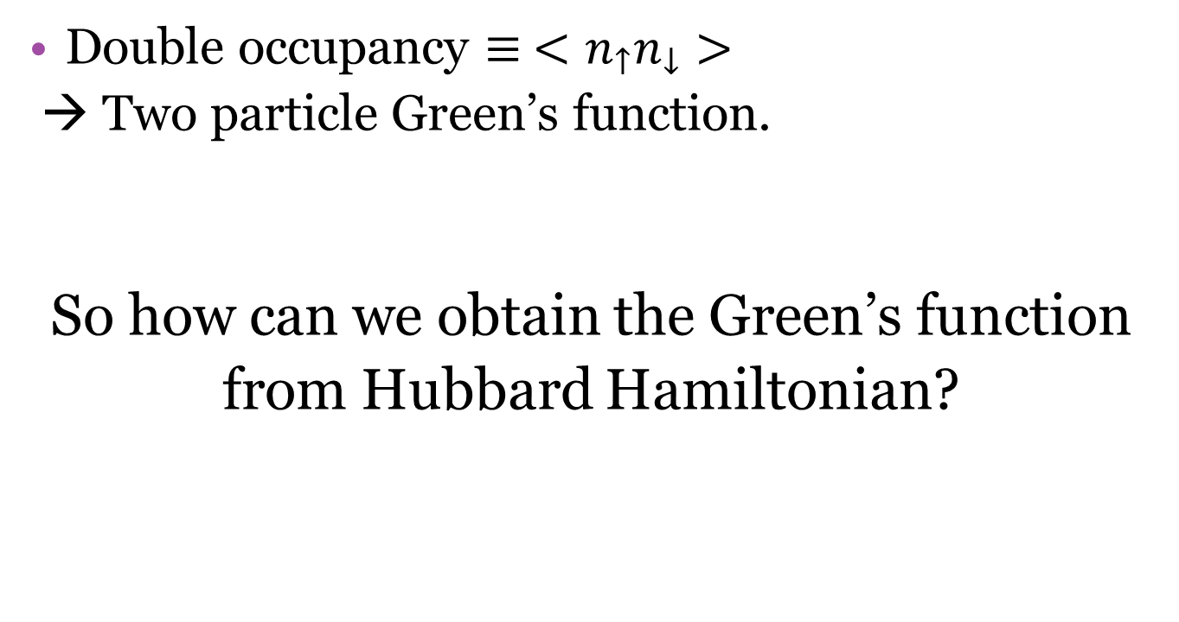
Mott transition and double occupancy
Double occupancy $≡ <n_{↑}n_{↓}>$
→ Two particle Green’s function.
So how can we obtain the Green’s function
from Hubbard Hamiltonian?

Slide 10
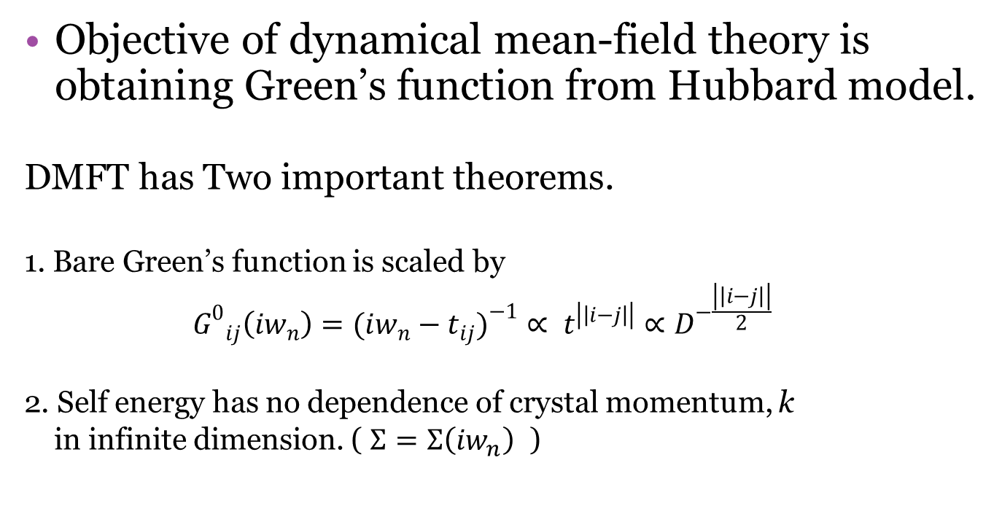
Dynamical mean-field theory
Objective of dynamical mean-field theory is obtaining Green’s function from Hubbard model.
DMFT has Two important theorems.
1. Bare Green’s function is scaled by
$${G^{0}}_{ij}\left({iw}_{n}\right)=({iw_{n}−t_{ij})}^{−1}∝ t^{\left|\left|i−j\right|\right|}∝D^{−\frac{\left|\left|i−j\right|\right|}{2}}$$
2. Self energy has no dependence of crystal momentum, k
in infinite dimension. ( $Σ=Σ\left({iw}_{n}\right)$ )

Slide 11
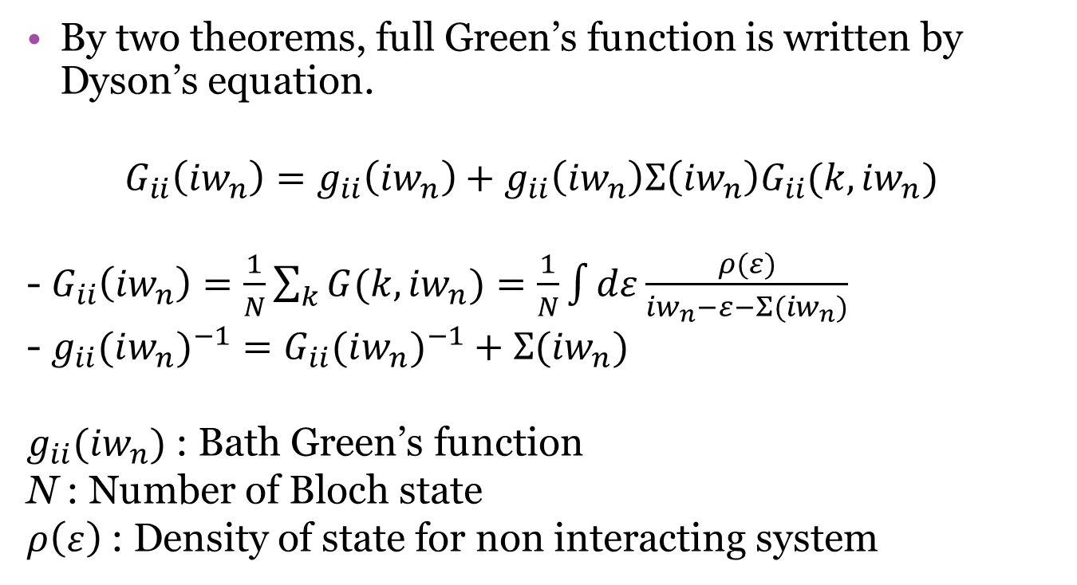
Dynamical mean-field theory
By two theorems, full Green’s function is written by Dyson’s equation.
$$G_{ii}\left({iw}_{n}\right)=g_{ii}\left({iw}_{n}\right)+g_{ii}\left({iw}_{n}\right)Σ\left({iw}_{n}\right)G_{ii}(k,{iw}_{n})$$
- $G_{ii}\left({iw}_{n}\right)=\frac{1}{N}\sum_{k}{G(k,{iw}_{n})}=\frac{1}{N}\int{dε\frac{ρ(ε)}{{iw}_{n}−ε−Σ({iw}_{n})}}$
- $g_{ii}(iw_{n})^{−1}=G_{ii}(iw_{n})^{−1}+Σ({iw}_{n})$
$g_{ii}({iw}_{n})$ : Bath Green’s function
N : Number of Bloch state
$ρ\left(ε\right)$ : Density of state for non interacting system

Slide 12
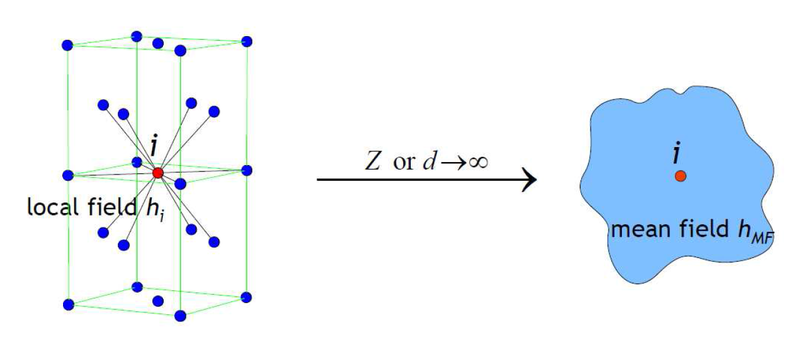
Dynamical mean-field theory
To calculate self-energy, Hubbard model is mapped to Anderson’s impurity model.
How?

Slide 13

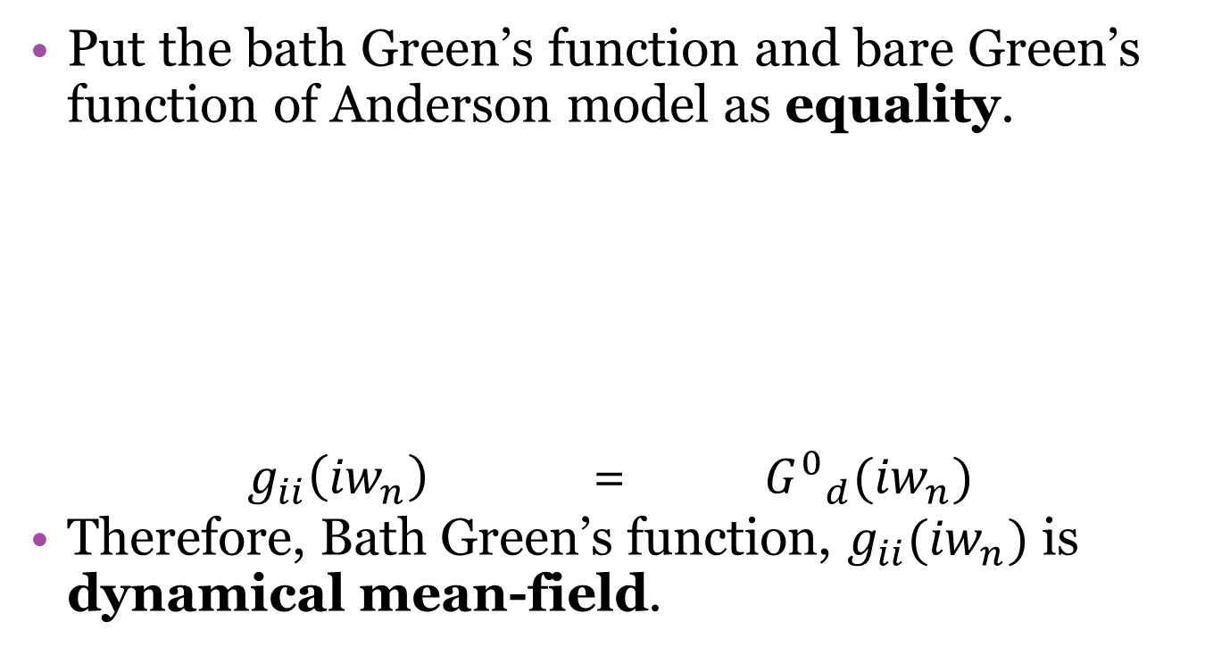
Dynamical mean-field theory
Put the bath Green’s function and bare Green’s function of Anderson model as equality.
$g_{ii}\left({iw}_{n}\right)$ = ${G^{0}}_{d}({iw}_{n})$
Therefore, Bath Green’s function, $g_{ii}({iw}_{n})$ is dynamical mean-field.

Slide 14
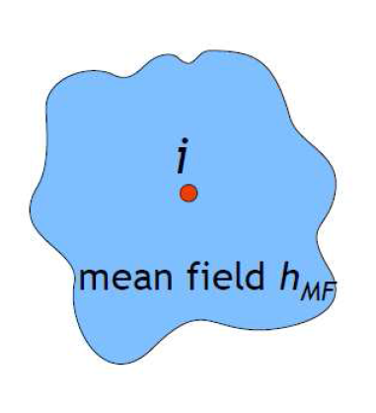
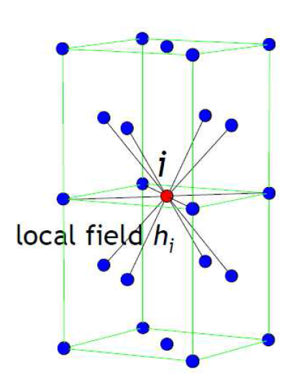

Dynamical mean-field theory
$${G^{0}}_{d}(iw_{n})^{−1}−G_{d}(iw_{n})^{−1}=Σ_{d}({iw}_{n})$$
$$Σ_{d}\left({iw}_{n}\right) → Σ({iw}_{n})$$

Slide 15
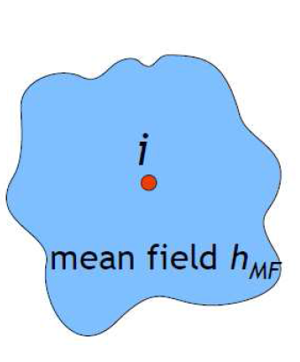
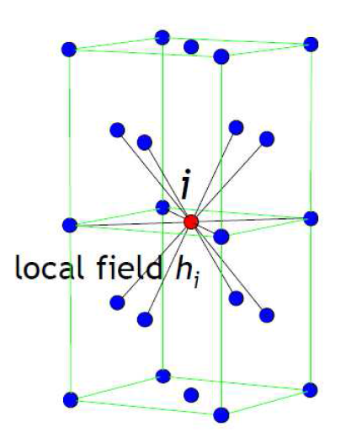







Dynamical mean-field theory
Self-consistent loop
Prepare initial self-energy.
$$Σ({iw}_{n})$$
1.Calculate Full Green’s function.
$$G_{ii}\left({iw}_{n}\right)= \frac{1}{N}\int{dε\frac{ρ(ε)}{{iw}_{n}−ε−Σ({iw}_{n})}}$$
2. Calculate bath Green’s function.
$$g_{ii}(iw_{n})^{−1}=G_{ii}(iw_{n})^{−1}+Σ({iw}_{n})$$
Solving impurity model
$${G^{0}}_{d}({iw}_{n})^{−1}−G_{d}({iw}_{n})^{−1}$$
$$= Σ_{d}({iw}_{n})$$
$Σ_{old}\left({iw}_{n}\right)$ ← $Σ_{new}({iw}_{n})$
$Σ_{new}\left({iw}_{n}\right)$ ← $Σ_{d}({iw}_{n})$
self-energy
$$Σ({iw}_{n})$$
${G^{0}}_{d}({iw}_{n})$ ← $g_{ii}\left({iw}_{n}\right)$
Mapping

Slide 16
Dynamical mean-field theory
However, since triangular lattice is two dimensional and has spin fluctuation, non-local self energy should be considered.
→ Dynamical mean-field theory (X)
The cluster dynamical mean-field theory that include local fluctuation is needed.
→ Dynamical cluster approximation (O)

Slide 17
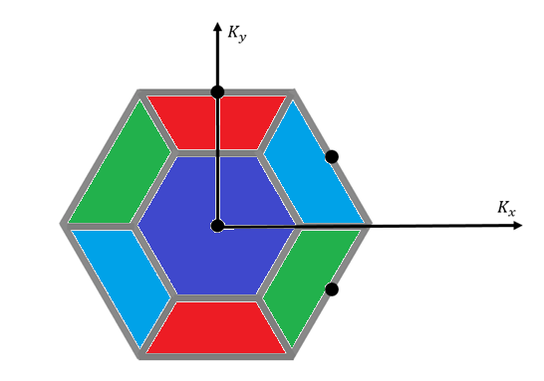

Dynamical cluster approximation
Dynamical cluster approximation divides first Brillouin zone into clusters
Hexagonal , $N_{c}=4$
1. $G\left(K,iw_{n}\right)=\frac{N_{c}}{N}\sum_{k∈1}{\frac{1}{iw_{n}−ε_{k+K}−Σ(K,{iw}_{n}) }}$
2. $G\left(K,iw_{n}\right)=\frac{N_{c}}{N}\sum_{k∈2}{\frac{1}{iw_{n}−ε_{k+K}−Σ(K,{iw}_{n}) }}$
3. $G\left(K,iw_{n}\right)=\frac{N_{c}}{N}\sum_{k∈3}{\frac{1}{iw_{n}−ε_{k+K}−Σ(K,{iw}_{n}) }}$
4. $G\left(K,iw_{n}\right)=\frac{N_{c}}{N}\sum_{k∈4}{\frac{1}{iw_{n}−ε_{k+K}−Σ(K,{iw}_{n}) }}$
2
1
4
3
Y. Imai and N. Kawakami, Phys. Rev. B (2002).

Slide 18
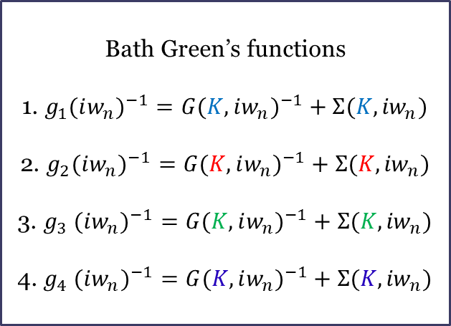
Dynamical cluster approximation
Bath Green’s functions
1. $g_{1}(iw_{n})^{−1}=G(K,iw_{n})^{−1}+Σ(K,{iw}_{n})$
2. $g_{2}(iw_{n})^{−1}=G(K,iw_{n})^{−1}+Σ(K,{iw}_{n})$
3. $g_{3} (iw_{n})^{−1}=G(K,iw_{n})^{−1}+Σ(K,{iw}_{n})$
4. $g_{4} (iw_{n})^{−1}=G(K,iw_{n})^{−1}+Σ(K,{iw}_{n})$
2
1
4
3
Y. Imai and N. Kawakami, Phys. Rev. B (2002).

Slide 19








Dynamical cluster approximation
$${G^{0}}_{d}({iw}_{n})$$
$${G^{0}}_{d}({iw}_{n})$$
$$g_{2}(k,{iw}_{n})$$
2
$$g_{1}(k,{iw}_{n})$$
1
4
$$g_{4}(k,{iw}_{n})$$
3
$$g_{3}(k,{iw}_{n})$$
$${G^{0}}_{d}({iw}_{n})$$
$${G^{0}}_{d}({iw}_{n})$$

Slide 20
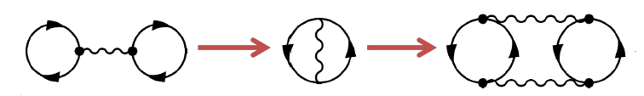
Continuous-time quantum Monte Carlo
Method for solving Anderson’s impurity model.
Generate diagrams stochastically.(Markov chain)
- Each diagram is created within continuous time

Slide 21
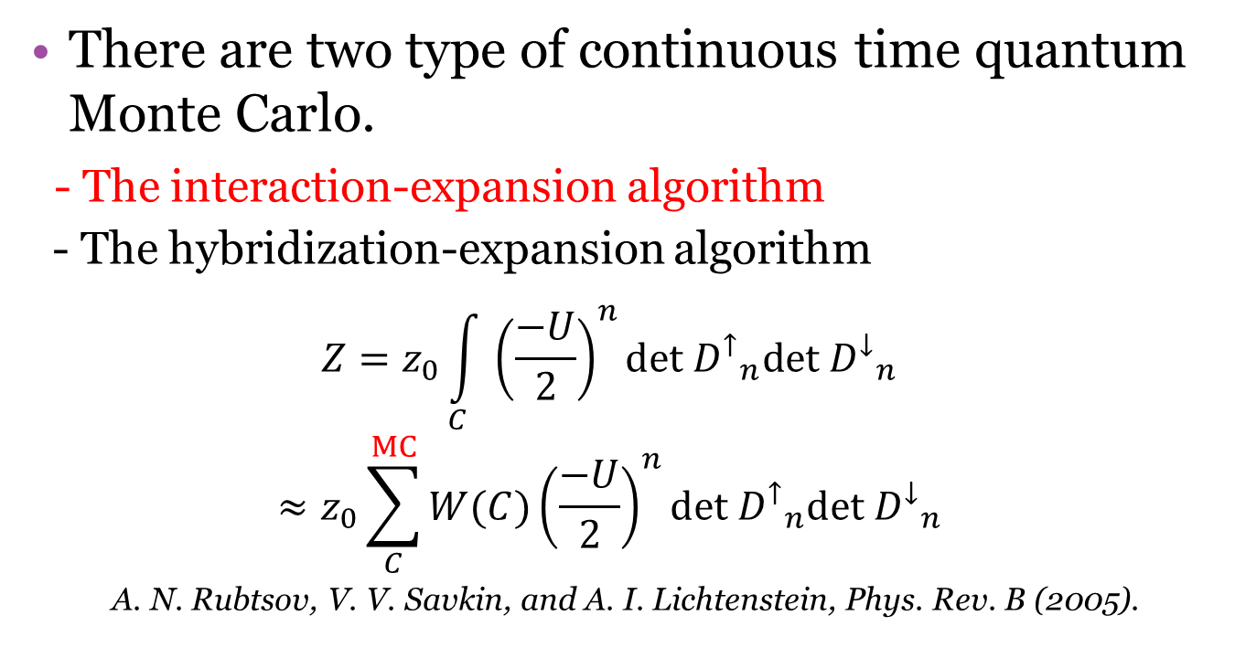
Continuous-time quantum Monte Carlo
There are two type of continuous time quantum Monte Carlo.
- The interaction-expansion algorithm
- The hybridization-expansion algorithm
$$Z=z_{0}\int_{C}{{\left(\frac{−U}{2}\right)}^{n}}det{{ D}^{↑}}_{n}det{{ D}^{↓}}_{n}$$
$$≈z_{0}\sum_{C}^{MC}{W(C){\left(\frac{−U}{2}\right)}^{n}det{{ D}^{↑}}_{n}det{{ D}^{↓}}_{n}}$$
A. N. Rubtsov, V. V. Savkin, and A. I. Lichtenstein, Phys. Rev. B (2005).

Slide 22
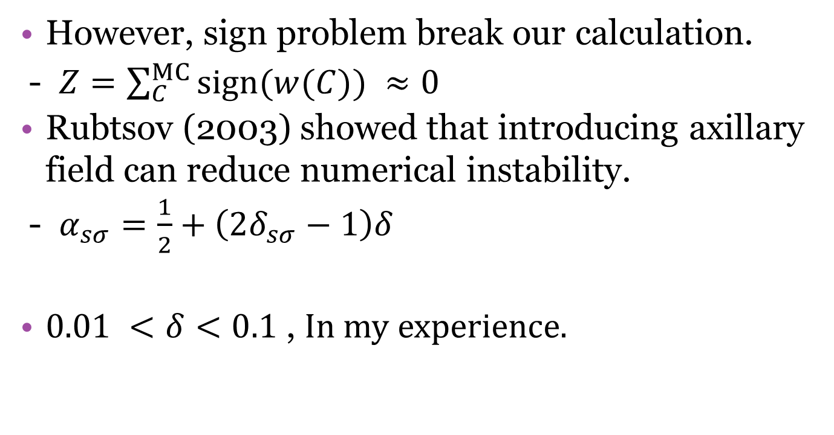
Continuous-time quantum Monte Carlo
However, sign problem break our calculation.
- $Z=\sum_{C}^{MC}{sign(w(C))} ≈0$
Rubtsov (2003) showed that introducing axillary field can reduce numerical instability.
- $α_{sσ}=\frac{1}{2}+\left(2δ_{sσ}−1\right)δ$
$0.01 <δ<0.1$ , In my experience.

Slide 23
Results

Slide 24
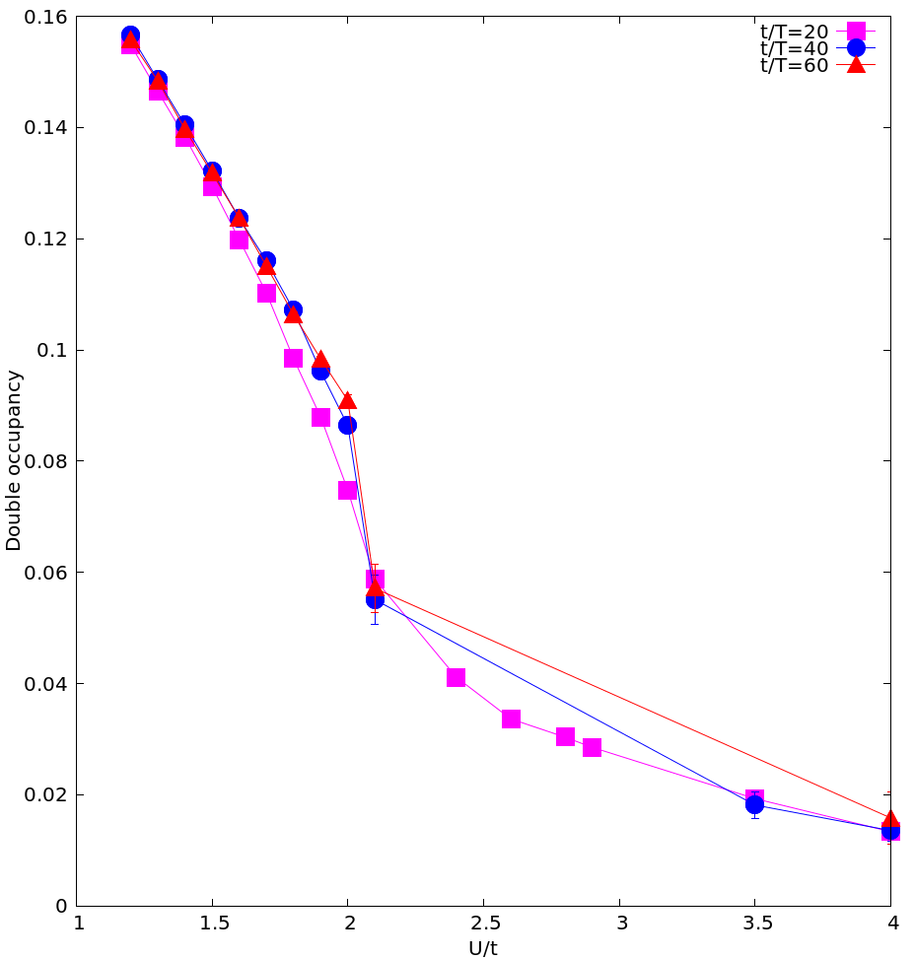
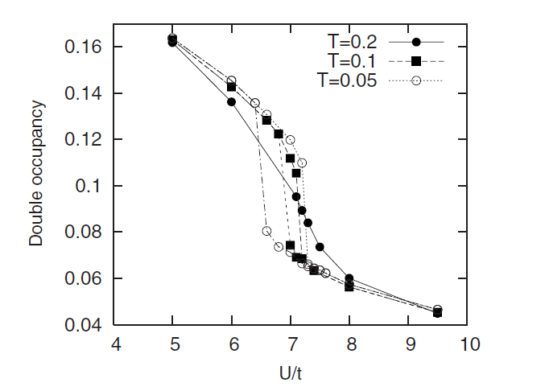
Double occupancy and temperature
DCA-CTQMC (t’/t=1, filling=1.0)
Filling=1.0
t=t’=0.25
L. Hunpyo , L. Gang,
and M. Hartmut,
Phys. Rev. B (2008)

Slide 25
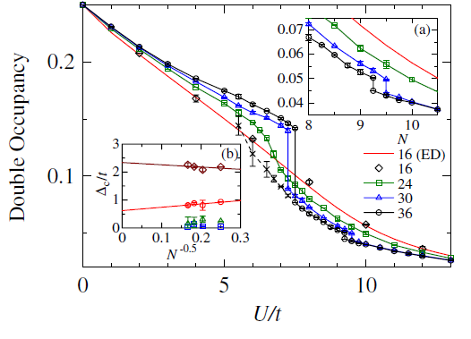
Double occupancy and temperature
PIRG (t’/t=1, filling=1.0)
Filling=1.0
t=t’=0.25
T. Yoshioka, A. Koga, and N. Kawakami
Phys. Rev. Lett (2009)

Slide 26
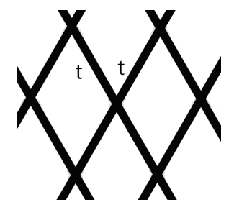
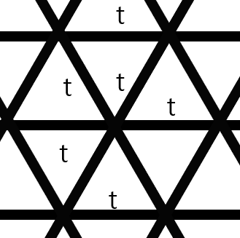

Frustration and metal-insulator transition
Lattice structure can be tuned by $t^{′}/t$
Bipartite
Anisotropy
Isotropy

Slide 27
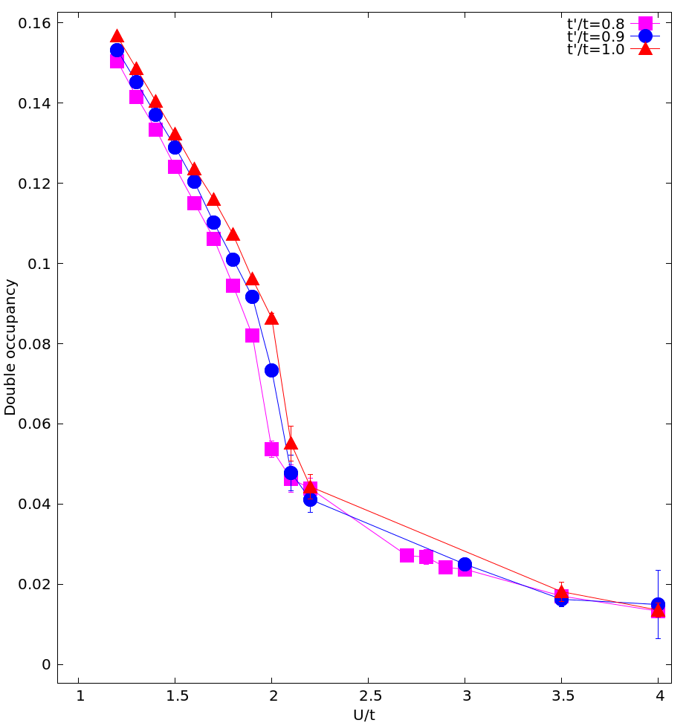
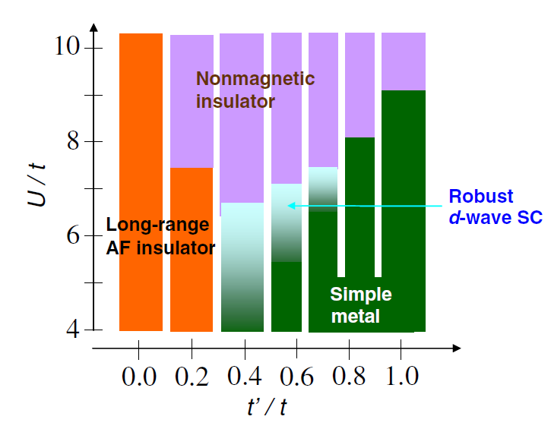
Frustration and metal-insulator transition
VMC (Filling =1.0)
Filling=1.0
t/T=40
t=0.25
T . Watanabe, H. Yokoyama, Y. Tanaka, & J. I. Inoue,J. Phy. Soc. Jpn (2006).

Slide 28
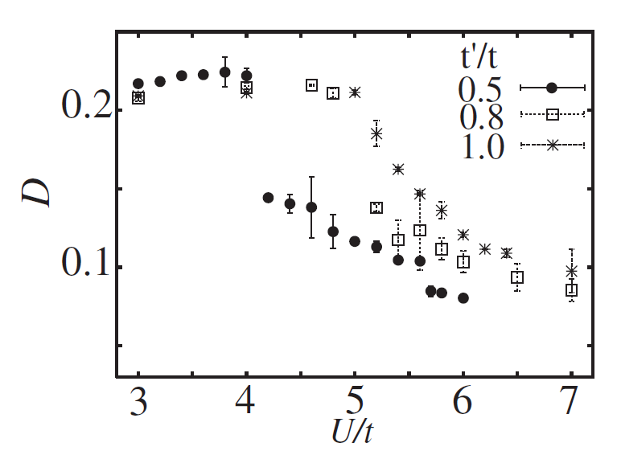
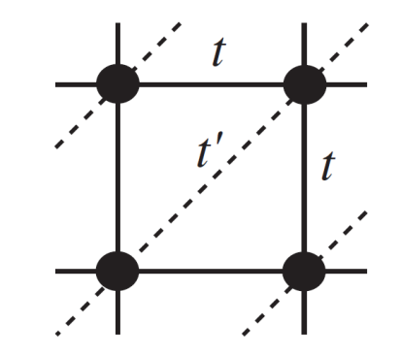
Frustration and metal-insulator transition
PIRG (Filling =1.0)
Filling=1.0
t/T=40
t=0.25
H. MORITA, S. WATANABE and M. IMADA, J.Phy. Soc. Jpn (2002).

Slide 29
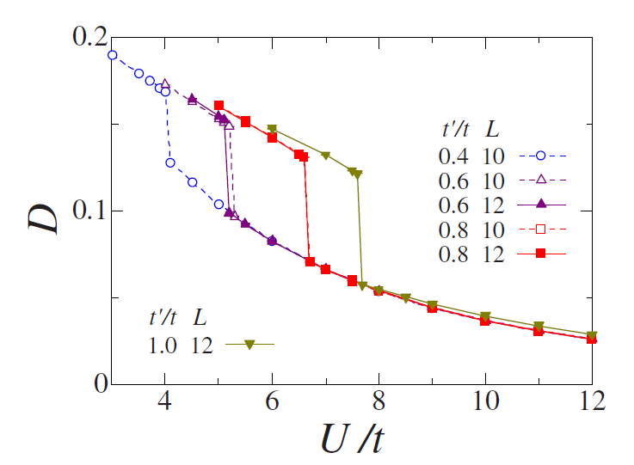
Frustration and metal-insulator transition
VMC (Filling =1.0)
Filling=1.0
t/T=40
t=0.25
T. Watanabe, H. Yokoyama, Y. Tanaka, and J. Inoue Phys. Rev. B (2008)

Slide 30
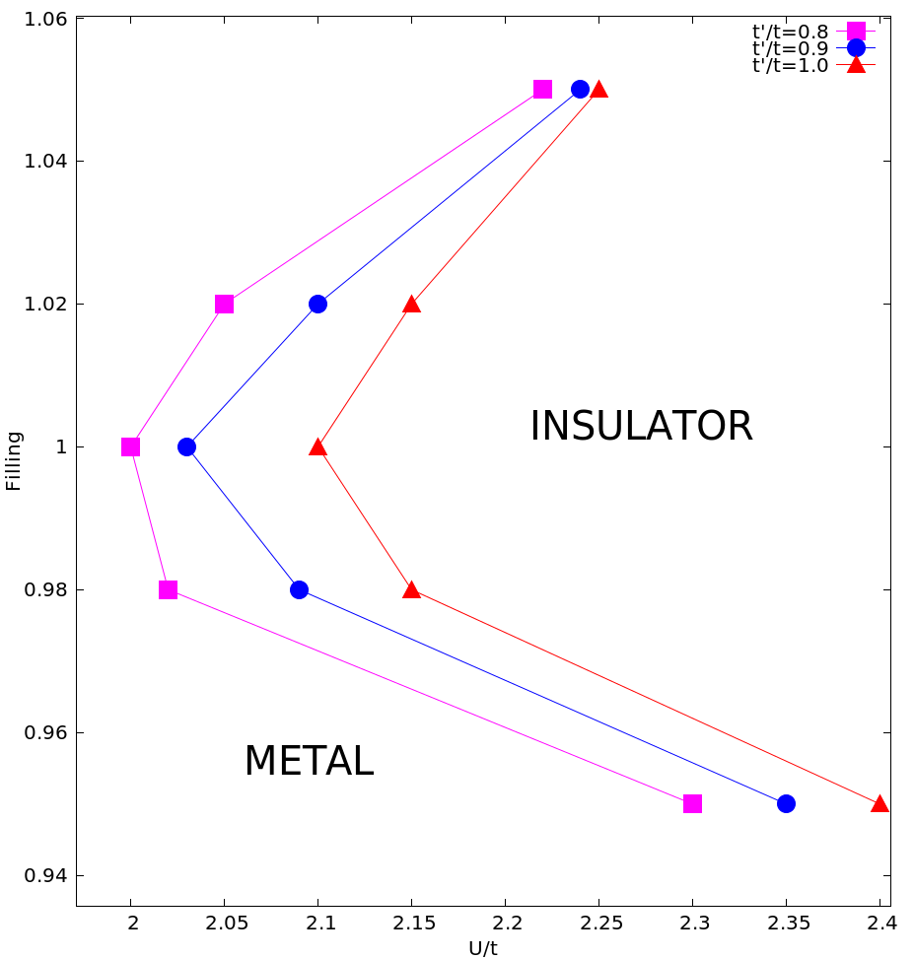
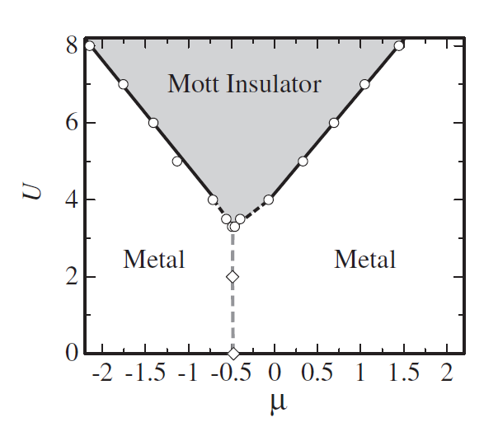
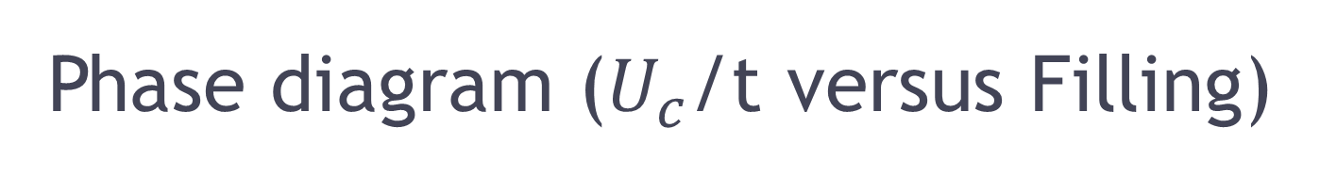
Phase diagram ($U_{c}$/t versus Filling)
PIRG (t’/t= -0.2)
t/T=40
t=0.25
S. WATANABE and M. IMADA
J. Phy. Soc. Jpn (2004).

Slide 31
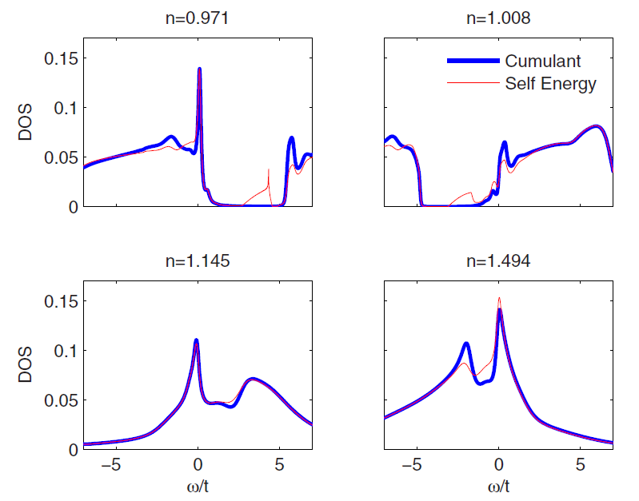
Phase diagram ($U_{c}$/t versus Filling)
CDMFT-NCA (U/t=12, t/T=10,t’/t=1.0)
t/T=40
t=0.25
D. Galanakis, T. D. Stanescu, and P. Phillips, Phys. Rev. B (2009).

Slide 32
Conclusion
Metal-Insulator transition in triangular lattice can be found with aid of dynamical cluster approximation.
When frustration effect is increased, critical interaction is also increased.
Critical interaction in half-filling is smaller than non half-filling.

