Slide 1

SmartBid Auction Platform
March1, 2025
Kailong duan, Anushka Chaudhari, Manuel Garcia
WOW (Every Saturday/5pm,Zoom)
Notes:
September 2010
1

Slide 2


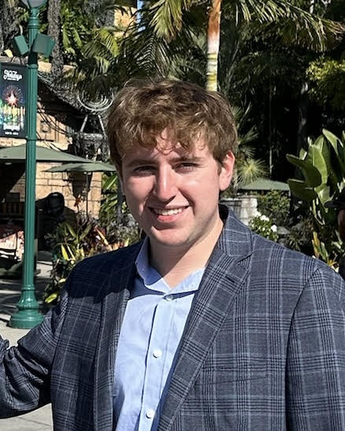
Team Profile Page
Kailong Duan
Henan, China
Project Management
Graduate Student in CS
Worked as software engineer for 3 years.
Anushka Arvind Chaudhari
Project Management
Graduate Student in CS
Participated In Various Technical College events during undergrad
Manuel Garcia
Irving, TX
CS Undergrad Commercial Real Estate Broker for over 4 years
Notes:
Individual Picture of each member
Hometown (city, state)
Primary focus area or desired focus area
Current internship position or job position (company is not needed)
One interesting fun fact about the person

Slide 3
SmartBid Auction
Project Status is Yellow
Criteria to Green resolve resource challenge
Summary Project Status Financial Status
SmartBid is developing a secure, web-based auction platform that facilitates
transparent buying and selling of products through real-time bidding.
Key features include secure user authentication, detailed buyer
and seller profiles, auction listing and management tools, and a live bidding system with
instant notifications.The platform will support secure transactions through
a payment gateway and escrow system, offer comprehensive transaction history tracking,
and include a rating and review system. An admin dashboard
will enable management of users, listings, and fraud detection for overall platform integrity.
We are currently at the halfway point of the project timeline, with 58% of the work completed. This includes requirements, arch design, test case, and front-end development. The remaining tasks are progressing steadily. The team is stable and collaborating effectively. We have several risks but we have the confidence to resolve them.
Contract Price: $ 2.7M
Cost (Baselined):2M
Actual Spend: $ 2M
ETC: 1.8
EAC: 500k
Current Margin ￥546,517
Key Achievements
Planned Activities
Risks
Major Milestones
Completed SOW – 3/3/25
Completed Stakeholder – 3/5/25
Completed Req Specification – 3/10/25
Completed Site Map – 3/4/25
Completed Wireframes- 3/6/25
Complete High Level Design of Arch –3/28/25
Complete the Arch Design for both FE BE -7/10/25
Arch Infrastructure & BOM - 4/21/25
Dev Implement logging and Code review and bug fix -6/18/26
Testing from Developers- 7/30/26
Testing Execution –03/24/2025
Product Release and preparation of the collection and gather analysis 03/12/2026
Deploy project –03/13/2026
SOW Signed 3/3/25
Create Final Stakeholder template(3/5/25)
FE Req Document(3/1O/25
BE Req Document(3/1O/25)
Sign-off on final Wireframe doc(6/24/25
Complete high-level arch design –3/28/25
Complete detailed arch design –-7/10/25
Complete Infra & BOM Plan –2/9/27
HW/SW ordered and received –Infrastructure set up – 1/20/27
Dev & test environment set up – 6/19/25
Complete Test Cases – 1/11/27
Complete coding – 7/29/26
Code is ready for testing –7/30/26
Complete UAT -9/25/2026
Complete Integration Testing – 3/3/27
Deployed solution approved –Complete deploy project – 5/7/27
Task 295 UAT test execution with users might be late because the client is uncertain about the UAT schedule. This could delay the start of Task 296 Defecting Fixing from UAT
Task 385, The purchase of software and hardware will be delayed because NVIDIA's latest GPUs are in extremely high demand and are very difficult to obtain. This may affect the Tasks 386 and test process of the entire AI bidding system.
Notes:
4/28/20252011-10-19
3
CRICKET_HOUSTON_CDMA_LTE_MEETING
3
3
CDMA_LTE_STEERING_MEETING
2012-06-13

Slide 4
Cost Comparison Slide Summary
Top-Down Cost
Req : $100,000.00
Arch : $430,000.00
Code $600,000.00
Test: $400,000.00
Deploy:$400,000.00
PM : $ 60,000
Total Cost: $1,930,000.00
Margin: $482,500.00
Price $2,412,500.00
Bottom-up Cost
Req: $$125,400.00
Arch : $418,888
Code: $717,120.00
Test: $460,040.00
Deploy:$401,960.00
PM : $ 63,200
Total Cost: $2,186,068.00
Margin:25% $546,517
Price: $2,732,585.00
Variance
Our Bottom-Up (BU) cost comes out to be $320,085, which is a 13% increase when compared to the Top-Down (TU) cost. mainly due to the coding phase, which took more time and resources than expected. We need better planning or parallel multitasking to accelerate the progress.

Slide 5
Major Milestones
Critical Path / Key Milestones
Milestone | Status | % Done | Start Date | End Date | Comments
SOW Signed | C | 100% | 3/3/25 | 3/3/25
Create Final Stakeholder Template | C | 100% | 7/14/25 | 7/14/25
FE Req Document | C | 100% | 3/3/25 | 9/19/25
BE Req Document | C | 100% | 8/8/25 | 9/19/25
Final Wireframe Doc | C | 100% | 9/8/25 | 10/28/25
Final App Map | C | 100% | 3/3/25 | 3/6/25
Notes:
Status is Blue for Complete, Red for in trouble, Yellow for almost in trouble, Green for no challenges
Color of box should be shaded to Blue, Red, Yellow, or Green, Letter in box should be C for complete in the Blue box, the others are RYG.
%Done should reflect the project schedule % complete and must contain the percent sign.

Slide 6
Major Milestones
Critical Path / Key Milestones
Milestone | Status | % Done | Start Date | End Date | Comments
Complete Coding | Y | 75% | 03/04/2025 | 06/18/2026 | The backend code is taking more time than expected due to the complexity of the functionalities. There may be a risk of delays.
Code is ready for testing | G | 0% | 06/19/2025 | 07/30/2026 | The frontend part of the code is basically complete, while some functionalities in the backend still require time to be implemented.
Complete Integration Testing | Y | 28% | 03/24/2025 | 03/03/2027 | Currently, only some features and pages have been tested. The remaining parts are still waiting for the code to be completed and deployed before testing can begin.
Complete UAT | Y | 0% | 08/24/2026 | 09/25/2026
Deployed solution approved | G | 0% | 05/05/2027 | 05/05/2027
Complete deploy project | G | 0% | 05/07/2027 | 05/11/2027
Notes:
Status is Blue for Complete, Red for in trouble, Yellow for almost in trouble, Green for no challenges
Color of box should be shaded to Blue, Red, Yellow, or Green, Letter in box should be C for complete in the Blue box, the others are RYG.
%Done should reflect the project schedule % complete and must contain the percent sign.

Slide 7
Project Key Risks-updated
# | Risk | Mitigation | Contingency | Owner | Due Date | Comments
7 | Multiple critical Front-End Testing tasks are assigned to only Tester2 and Tester3. If either tester faces unexpected issues (such as illness, personal emergencies, or task backlog), it could cause significant testing delays, impacting the Integration Testing timeline and project delivery milestones. | Distribute the testing workload among (1) Reassign less critical tasks to available testers (e.g., Tester4, Tester5) to reduce Tester2 and Tester3's workload. (2) Closely monitor daily testing progress via stand-up meetings, and perform early detection of bottlenecks. available testers (e.g., Tester4, Tester5) if necessary. Monitor daily progress to detect delays early. | (1) Maintain a standby list of trained backup testers who can immediately take over specific testing modules if needed. (2) Implement a priority-based testing plan to ensure the most critical modules are completed first if delays occur. | Kailong duan | August 31st
8 | The User Management System (User Authentication API and Login/Register API) development is solely assigned to back-end-dev2 with very tight timelines (7 days each). If back-end-dev2 encounters technical challenges, unexpected leave, or delivery delays, it could block critical user login and registration functionalities, severely impacting system integration and downstream testing schedules. | (1) Assign a secondary developer (e.g., back-end-dev3) to shadow and support back-end-dev2 during development. (2) Conduct early code reviews (after 2-3 days of development) to detect potential issues sooner rather than later. | (1) In case of developer unavailability, reassign a trained backup developer immediately to continue work based on latest commit/codebase. (2) Prioritize minimal viable functionality (basic login, basic registration) to unblock integration even if full features are delayed. | Kailong duan | August 10th | This risk is critical as user authentication and registration are foundational functionalities for all system modules.

Slide 8
Project Key Actions-updated
# | Description | Originator (Student Name) | Owner | Date Assigned | Date Needed | Date Closed | Comments
A1 | Assign a secondary developer to shadow back-end-dev2 during the development of User Authentication API and Login/Register API. Conduct early code reviews to detect issues by Day 3. | Kailong Duan | Kailong Duan | August 1st | August 1st |  | This action helps mitigate the risk of development delays impacting critical system functionality.
A2
A3
A4
A5
A6

Slide 9
Project Decisions-updated
# | Description | Owner (Student Name) | Decision Date | Comments
D-1 | Assign a backup developer to support critical User Management System API development (User Authentication and Login/Register) to mitigate risks associated with single developer dependency. | Kailong Duan | August 1st | Agreed upon during the Internal Project Risk Review. Attendees included Project Manager, Backend Development Lead, and Testing Lead.
D-2
D-3
D-4

Slide 10
SmartBid Auction Platform
March1, 2025
Kailong duan, Anushka Chaudhari, Manuel Garcia
WOW (Every Saturday/5pm,Zoom)
Notes:
September 2010
10

Slide 11
Team Profile Page
Kailong Duan
Henan, China
Project Management
Graduate Student in CS
Worked as software engineer for 3 years.
Anushka Arvind Chaudhari
Project Management
Graduate Student in CS
Participated In Various Technical College events during undergrad
Manuel Garcia
Irving, TX
CS Undergrad Commercial Real Estate Broker for over 4 years
Notes:
Individual Picture of each member
Hometown (city, state)
Primary focus area or desired focus area
Current internship position or job position (company is not needed)
One interesting fun fact about the person

Slide 12
SmartBid Auction
Project Status is Yellow
Criteria to Green resolve resource challenge
Summary Project Status Financial Status
SmartBid is developing a secure, web-based auction platform that facilitates
transparent buying and selling of products through real-time bidding.
Key features include secure user authentication, detailed buyer
and seller profiles, auction listing and management tools, and a live bidding system with
instant notifications.The platform will support secure transactions through
a payment gateway and escrow system, offer comprehensive transaction history tracking,
and include a rating and review system. An admin dashboard
will enable management of users, listings, and fraud detection for overall platform integrity.
We are currently at the halfway point of the project timeline, with 58% of the work completed. This includes requirements, arch design, test case, and front-end development. The remaining tasks are progressing steadily. The team is stable and collaborating effectively. We have several risks but we have the confidence to resolve them.
Contract Price: $ 2.7M
Cost (Baselined):2M
Actual Spend: $ 2M
ETC: 1.8
EAC: 500k
Current Margin ￥546,517
Key Achievements
Planned Activities
Risks
Major Milestones
Completed SOW – 3/3/25
Completed Stakeholder – 3/5/25
Completed Req Specification – 3/10/25
Completed Site Map – 3/4/25
Completed Wireframes- 3/6/25
Complete High Level Design of Arch –3/28/25
Complete the Arch Design for both FE BE -7/10/25
Arch Infrastructure & BOM - 4/21/25
Dev Implement logging and Code review and bug fix -6/18/26
Testing from Developers- 7/30/26
Testing Execution –03/24/2025
Product Release and preparation of the collection and gather analysis 03/12/2026
Deploy project –03/13/2026
SOW Signed 3/3/25
Create Final Stakeholder template(3/5/25)
FE Req Document(3/1O/25
BE Req Document(3/1O/25)
Sign-off on final Wireframe doc(6/24/25
Complete high-level arch design –3/28/25
Complete detailed arch design –-7/10/25
Complete Infra & BOM Plan –2/9/27
HW/SW ordered and received –Infrastructure set up – 1/20/27
Dev & test environment set up – 6/19/25
Complete Test Cases – 1/11/27
Complete coding – 7/29/26
Code is ready for testing –7/30/26
Complete UAT -9/25/2026
Complete Integration Testing – 3/3/27
Deployed solution approved –Complete deploy project – 5/7/27
Task 295 UAT test execution with users might be late because the client is uncertain about the UAT schedule. This could delay the start of Task 296 Defecting Fixing from UAT
Task 385, The purchase of software and hardware will be delayed because NVIDIA's latest GPUs are in extremely high demand and are very difficult to obtain. This may affect the Tasks 386 and test process of the entire AI bidding system.
Notes:
4/28/20252011-10-19
12
CRICKET_HOUSTON_CDMA_LTE_MEETING
12
12
CDMA_LTE_STEERING_MEETING
2012-06-13

Slide 13
Cost Comparison Slide Summary
Top-Down Cost
Req : $100,000.00
Arch : $430,000.00
Code $600,000.00
Test: $400,000.00
Deploy:$400,000.00
PM : $ 60,000
Total Cost: $1,930,000.00
Margin: $482,500.00
Price $2,412,500.00
Bottom-up Cost
Req: $$125,400.00
Arch : $418,888
Code: $717,120.00
Test: $460,040.00
Deploy:$401,960.00
PM : $ 63,200
Total Cost: $2,186,068.00
Margin:25% $546,517
Price: $2,732,585.00
Variance
Our Bottom-Up (BU) cost comes out to be $320,085, which is a 13% increase when compared to the Top-Down (TU) cost. mainly due to the coding phase, which took more time and resources than expected. We need better planning or parallel multitasking to accelerate the progress.

Slide 14
Major Milestones
Critical Path / Key Milestones
Milestone | Status | % Done | Start Date | End Date | Comments
SOW Signed | C | 100% | 3/3/25 | 3/3/25
Create Final Stakeholder Template | C | 100% | 7/14/25 | 7/14/25
FE Req Document | C | 100% | 3/3/25 | 9/19/25
BE Req Document | C | 100% | 8/8/25 | 9/19/25
Final Wireframe Doc | C | 100% | 9/8/25 | 10/28/25
Final App Map | C | 100% | 3/3/25 | 3/6/25
Notes:
Status is Blue for Complete, Red for in trouble, Yellow for almost in trouble, Green for no challenges
Color of box should be shaded to Blue, Red, Yellow, or Green, Letter in box should be C for complete in the Blue box, the others are RYG.
%Done should reflect the project schedule % complete and must contain the percent sign.

Slide 15
Major Milestones
Critical Path / Key Milestones
Milestone | Status | % Done | Start Date | End Date | Comments
Complete Coding | Y | 75% | 03/04/2025 | 06/18/2026 | The backend code is taking more time than expected due to the complexity of the functionalities. There may be a risk of delays.
Code is ready for testing | G | 0% | 06/19/2025 | 07/30/2026 | The frontend part of the code is basically complete, while some functionalities in the backend still require time to be implemented.
Complete Integration Testing | Y | 28% | 03/24/2025 | 03/03/2027 | Currently, only some features and pages have been tested. The remaining parts are still waiting for the code to be completed and deployed before testing can begin.
Complete UAT | Y | 0% | 08/24/2026 | 09/25/2026
Deployed solution approved | G | 0% | 05/05/2027 | 05/05/2027
Complete deploy project | G | 0% | 05/07/2027 | 05/11/2027
Notes:
Status is Blue for Complete, Red for in trouble, Yellow for almost in trouble, Green for no challenges
Color of box should be shaded to Blue, Red, Yellow, or Green, Letter in box should be C for complete in the Blue box, the others are RYG.
%Done should reflect the project schedule % complete and must contain the percent sign.

Slide 16
Project Key Risks
# | Risk | Mitigation | Contingency | Owner | Due Date | Comments
1 | .Task 362 Purchase hardware and software may be delayed due to procurement issues impacting task 363 CPU, GPU, Memory, Server, Network, Ram Ins | Initiate hardware & software purchase at project kick-off or during early planning stages | Use cloud infrastructure (AWS, Azure, GCP) to begin setup until physical hardware arrives | Anushka | 4/19/25
2 | Task 379 Review Deploy Plan with Client may be delayed due to Misunderstanding or scope mismatch impacting task 381 Infrastructure setup | Involve the client in preliminary planning stages to align expectations early. | Schedule an additional meeting or follow-up session with the client to discuss any remaining questions or adjustments. | Anushka | 5/28/25

Slide 17
Project Key Risks
# | Risk | Mitigation | Contingency | Owner | Due Date | Comments
3 | Task 110 Creating The Architecture For Federal Compliance: HIPPA, FDA, PHI. Agencies may require much more intricate solutions | Ensure all engineers on the project are well informed and provided with detailed specifics of what is required by agencies | Create Architecture ahead of schedule to allow ample time for review. | Manny | Oct 7 | Adhering to agencies will always have its intricacies and challenges.
4 | Task 104 Creating API architecture. Vendors may require that API’s to access our service adhere to their standard which may significantly vary from company to company. | Communicate the importance of reviewing all requirements. Every Architecture section has a dedicated review date to ensure no requirements are forgotten nor looked over | Have Arch leads review the API’s and assess that all requirements are made before delivering to the development team. | Manny | Nov 4 | Given multiple vendors will use our platform we need to ensure their data and ours is accessible via well engineered API with all the proper security features and functionality.

Slide 18
Project Key Risks
# | Risk | Mitigation | Contingency | Owner | Due Date | Comments
5. | Task 206 - ​Complex Authentication System: Implementing secure user authentication with proper verification processes may take longer than anticipated. It includes Identification, Credential Verification, Access Control, Session Management, etc. The code complexity is relatively high, which may lead to delays. | M1:Use ​pre-built auth solutions (Firebase Auth, Auth0) to speed up development. M2: Implement ​modular verification steps (email → phone → document upload). | 1. If verification takes too long, ​launch with basic email auth first and add advanced verification in Phase2 2.Assign more developers to participate in this project. | Kailong duan | March 4th
6. | Task 173- When users upload high-resolution images of medical supplies, they often experience painfully slow upload speeds that get stuck halfway. If multiple users upload images simultaneously, it can easily overwhelm the server. Add unstable mobile connections into the mix, and you get frequent upload failures halfway through - it seriously ruins the user experience. | M1:We'll use AWS S3 with CloudFront CDN to turbocharge image delivery. medical supply photos get stored in Amazon's secure cloud. CloudFront automatically distributes them to servers worldwide. Users always download from the nearest location M2: Built-in image optimization (auto-format conversion, sizing). Scales instantly during traffic spikes | 1.If uploads fail, provide ​manual upload via email as a temporary workaround. 2. can call customer service to help customers upload pictures | Kailong duan | May 6th

Slide 19
Project Key Risks
# | Risk | Mitigation | Contingency | Owner | Due Date | Comments
7 | Task294-we need define auction testing scenarios. There may not be enough defined scenarios and insufficient coverage. | M1:​ Develop and provide code coverage reports (≥80% required),Include as many test scenarios and test cases as possible M2: Use AI to generate supplementary test cases (such as Postman Automation), normalize and scale to include almost all test scenarios. | 1. Implement gradual feature rollout (canary release) with real-user behavior monitoring for post-launch testing and add it to the testing environment. 2. ​ Ensure that most test scenarios can be tested if time is insufficient. | Kailong duan | August 31st
8 | Task 253 - The test environment is unstable or crashes due to environment configuration errors or data contamination. | M1: Add containerized test environment with advanced environment configuration technology (Docker+K8s one-click reset) M2: Add the automatic rollback function. Add triggers automatic rollback immediately after an environment crash (based on previous day's environment backup) | 1. Allow direct testing of pre-production environments during emergency repair 2. Provide local testing sandbox to developers for emergency use. | Kailong duan | August 10th

Slide 20
Project Key Actions
# | Description | Originator (Student Name) | Owner | Date Assigned | Date Needed | Date Closed | Comments
A1 | Conduct a security survey with the backend team to verify that user authentication and role-based access control meet McKesson standards | Anushka | PM | 2/27/25 | 3/4/25
A2 | Setup up frequent meetings with the Customer during the Database system Architecture phase reducing the chance of any changes, | Anushka | PM | 2/25/25 | 3/1/25
A3 | Held meetings with the company's algorithm development engineers to define the optimization and testing deployment of the AI-based Bidding System's large model. | Development Lead | Kailong Duan | 5/23/2025 | 6/1/2025 |  | All algorithm engineers attended the meeting to finalize the optimization and deployment plan for the large model.
A4 | Regarding UAT testing, arrange meetings between the test team and customers to discuss the design of test examples and user test scenarios. | Test Lead | Kailong Duan | 8/24/2026 | 8/30/2026 |  | The PM needs to ensure that the test scenarios and test cases meet the customer's daily usage needs.
A5
A6

Slide 21
Project Decisions
# | Description | Owner (Student Name) | Decision Date | Comments
D-1 | Development team with use a microservices architecture for the backend to support scalability | Anushka | March 2 | Agreed upon during the Architecture Design Review . Attendees were Architecture Leads, Development Leads and Testing Leads
D-2 | Security features will include multi-factor authentication to align with McKesson security designs . | Anushka | Oct 15 | Agreed upon during Security Requirements Review . Attendees were Development Leads and Architecture leads
D-3 | Outsourced the Integration Testing to an external vendor. The vendor charged $30,000, helping the company save $20,100. | kailong duan | Aug 28 | Agreed Upon During Weekly Client VP meeting Attendees were CEO, CTO, CFO,VPs, managers, Client VPs and Team Leads
D-4 | Approve the purchase of a large number of NVIDIA GPUs and CPUs for training the next-generation AI-based Bidding System. | kailong duan | Aug 22 | Agreed upon during Technical Meeting on April 1th . Attendees were CTO, VP, PM,CFO,COO, PM, Testing Lead.

Slide 22
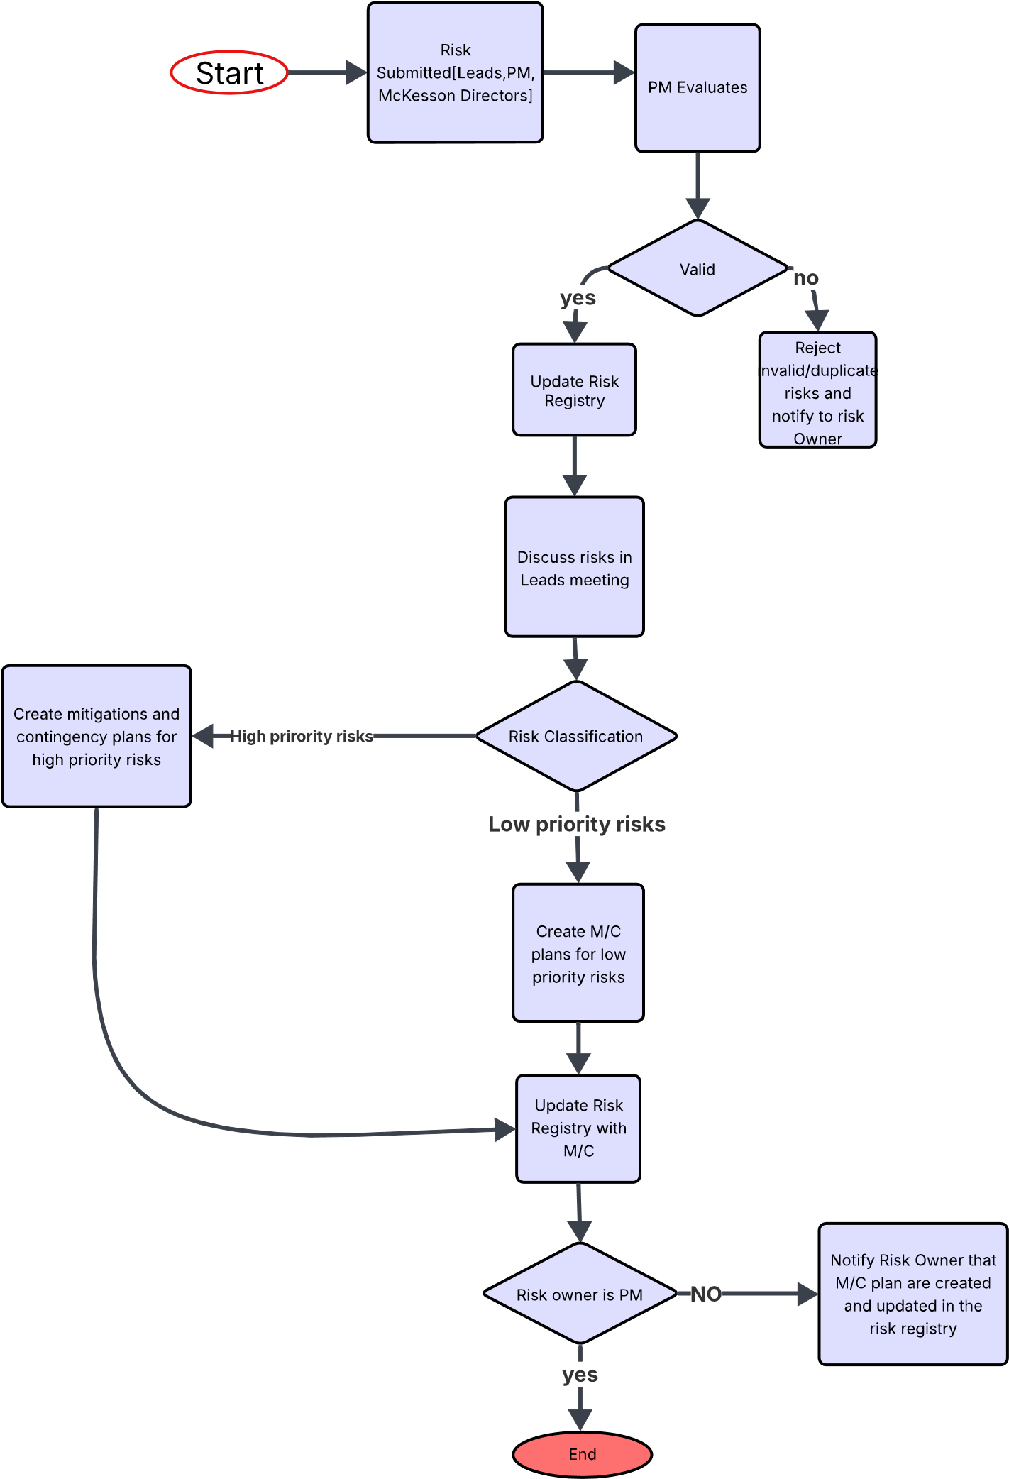
RISK Management Chart

Slide 23
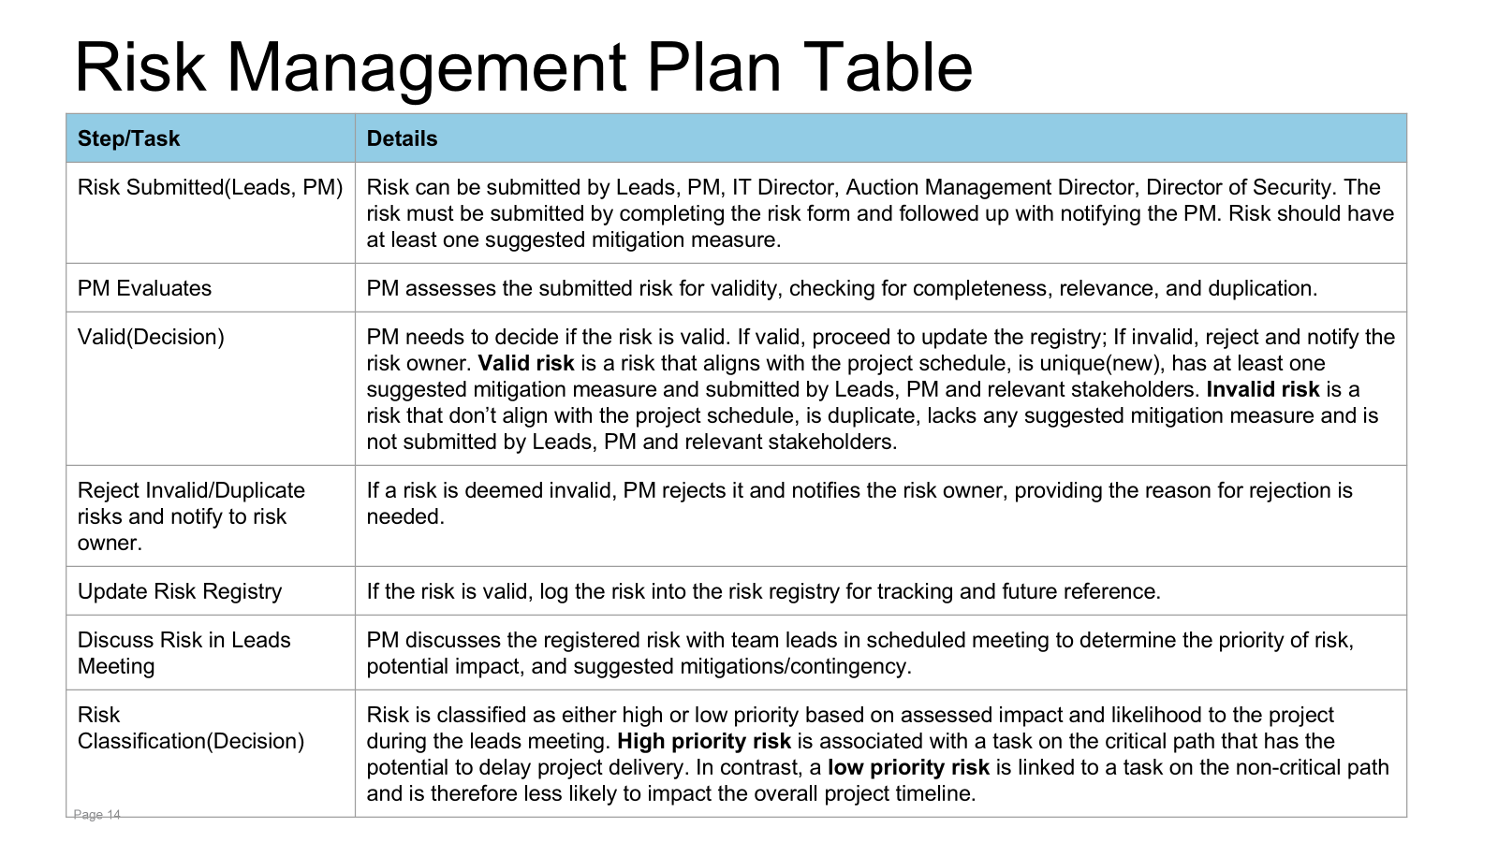

Slide 24
