Slide 1

SmartBid Auction Platform
75% in the Future Date
July 18th 2025
Kailong duan, Anushka Chaudhari, Manuel Garcia
WOW (Every Saturday/5pm,Zoom)
Notes:
September 2010
1

Slide 2



Team Profile Page
Kailong Duan
Henan, China
Project Management
Graduate Student in CS
Worked as software engineer for 3 years.
Anushka Arvind Chaudhari
Project Management
Graduate Student in CS
Participated In Various Technical College events during undergrad
Manuel Garcia
Irving, TX
CS Undergrad Commercial Real Estate Broker for over 4 years
Notes:
Individual Picture of each member
Hometown (city, state)
Primary focus area or desired focus area
Current internship position or job position (company is not needed)
One interesting fun fact about the person

Slide 3
SmartBid Auction
Project Status is Yellow
Criteria to Green resolve resource challenge
Summary Project Status Financial Status
SmartBid is developing a secure, web-based auction platform that facilitates
transparent buying and selling of products through real-time bidding.
Key features include secure user authentication, detailed buyer
and seller profiles, auction listing and management tools, and a live bidding system with
instant notifications.The platform will support secure transactions through
a payment gateway and escrow system, offer comprehensive transaction history tracking,
and include a rating and review system. An admin dashboard
will enable management of users, listings, and fraud detection for overall platform integrity.
We are currently at the halfway point of the project timeline, with 82% of the work completed. This includes requirements, arch design, test case, and coding development. The remaining tasks are progressing steadily. The team is stable and collaborating effectively. We have several risks but we have the confidence to resolve them.
Contract Price: $ 2.7M
Cost (Baselined):2M
Actual Spend: $ 2M
ETC: 1.8
EAC: 500k
Current Margin ￥546,517
Key Achievements
Planned Activities
Risks
Major Milestones
Completed SOW – 3/3/25
Completed Stakeholder – 3/5/25
Completed Req Specification – 3/10/25
Completed Site Map – 3/4/25
Completed Wireframes- 3/6/25
Complete High Level Design of Arch –8/5/26
Complete Coding for both FE BE -7/30/26
Testing from Developers- 7/30/26
Testing finished –04/07/27
Initial the development plan 4/8/27
Deploy project –10/19/27
SOW Signed 3/3/25
Create Final Stakeholder template(3/5/25)
FE Req Document(3/1O/25
BE Req Document(3/1O/25)
Sign-off on final Wireframe doc(6/24/25
Complete high-level arch design –3/28/25
Complete detailed arch design –-7/10/25
HW/SW ordered and received –Infrastructure set up – 6/11/27
Dev & test environment set up – 6/19/26
Complete Test Cases – 1/11/27
Complete coding – 7/30/26
Code is ready for testing –7/30/26
Complete Integration Testing – 3/3/27
Complete UAT - 9/25/2026
Deployed solution approved –9/16/27
Complete deploy project – 10/19/27
Task 295 UAT test execution with users might be late because the client is uncertain about the UAT schedule. This could delay the start of Task 296 Defecting Fixing from UAT
Task 385, The purchase of software and hardware will be delayed because NVIDIA's latest GPUs are in extremely high demand and are very difficult to obtain. This may affect the Tasks 386 and test process of the entire AI bidding system.
Notes:
5/1/20252011-10-19
3
CRICKET_HOUSTON_CDMA_LTE_MEETING
3
3
CDMA_LTE_STEERING_MEETING
2012-06-13

Slide 4
Cost Comparison Slide Summary
Top-Down Cost
Req : $ 100,000.00
Arch : $120,000
Code $30,000.00
Test: $10,000.00
Deploy:$20,000.00
PM : $63,200.00
Total Cost: $349,200.00
Margin: $69,840.00
Price $419,040.00
Bottom-up Cost
Req: $202,529
Arch : $427,648
Code: $717,120
Test: $386,440
Deploy:$437,280
PM : $ 63,200
Total Cost: $2,224,208
Margin:25% $ 741,402.67
Price: $ 2,965,610.67
Variance
Our bottom-up cost totaled $2,224,208 compared with the top-down budget of $349,200, an overrun of $1,875,008 or a 537% increase. Coding climbed from $30,000 to $717,120, Architecture rose from $120,000 to $427,648, Testing increased from $10,000 to $386,440, Deployment jumped from $20,000 to $437,280. Project management held steady at $63,200. This major difference was caused by sheer inexperience and lack of knowledge on what each software life cycle phase entailed, the size of teams, and sheer man hours required to create a project.

Slide 5
Major Milestones
Critical Path / Key Milestones
Milestone | Status | % Done | Start Date | End Date | Comments
SOW Signed | C | 100% | 3/3/25 | 3/3/25
Create Final Stakeholder Template | C | 100% | 7/14/25 | 7/14/25
FE Req Document | C | 100% | 3/3/25 | 9/19/25
BE Req Document | C | 100% | 8/8/25 | 9/19/25
Final Wireframe Doc | C | 100% | 9/8/25 | 10/28/25
Final App Map | C | 100% | 3/3/25 | 3/6/25
Notes:
Status is Blue for Complete, Red for in trouble, Yellow for almost in trouble, Green for no challenges
Color of box should be shaded to Blue, Red, Yellow, or Green, Letter in box should be C for complete in the Blue box, the others are RYG.
%Done should reflect the project schedule % complete and must contain the percent sign.

Slide 6
Major Milestones
Critical Path / Key Milestones
Milestone | Status | % Done | Start Date | End Date | Comments
Architecture Plans Approved | Complete | 100% | 3/3/25 | 3/3/25 | Allows Architecture team to start working.
Completing Core Architecture Design | Complete | 100% | 7/14/25 | 7/14/25 | Allows for separate Architecture phases to commence and run in parralel.
Bidding System Architecture Sign-off | Complete | 100% | 3/3/25 | 9/19/25 | Enables Coding to commence building out the the bidding bidding/auction system
Payment Processing Architecture Approved | Complete | 100% | 8/8/25 | 9/19/25 | Enables Coding to bein integrating the payment architecture into the bidding system
User Architecture Fully Approved | Complete | 100% | 9/8/25 | 10/28/25 | Allows for coding to begin building both the buyer and user dashboard/functionality/features
Final Architecture Approval | Complete | 100% | 3/3/25 | 3/6/25 | Architecture is completely done and can pass this all onto coding
Notes:
Status is Blue for Complete, Red for in trouble, Yellow for almost in trouble, Green for no challenges
Color of box should be shaded to Blue, Red, Yellow, or Green, Letter in box should be C for complete in the Blue box, the others are RYG.
%Done should reflect the project schedule % complete and must contain the percent sign.

Slide 7
Major Milestones
Critical Path / Key Milestones
Milestone | Status | % Done | Start Date | End Date | Comments
Complete Coding | C | 100% | 03/04/2025 | 07/30/2026 | The backend code is taking more time than expected due to the complexity of the functionalities. There may be a risk of delays.
Code is ready for testing | GC | 100% | 07/30/2026 | 07/30/2026 | The frontend part of the code is basically complete, while some functionalities in the backend still require time to be implemented.
Complete Integration Testing | Y | 87% | 03/24/2025 | 03/03/2027 | Currently, most features and pages have been tested. The remaining parts are still in progress.
Complete UAT | G | 0% | 08/24/2026 | 09/25/2026
Deployed solution approved | G | 0% | 05/05/2027 | 05/05/2027
Complete deploy project | G | 0% | 05/07/2027 | 05/11/2027
Notes:
Status is Blue for Complete, Red for in trouble, Yellow for almost in trouble, Green for no challenges
Color of box should be shaded to Blue, Red, Yellow, or Green, Letter in box should be C for complete in the Blue box, the others are RYG.
%Done should reflect the project schedule % complete and must contain the percent sign.

Slide 8
Project Key Risks
# | Risk | Mitigation | Contingency | Owner (Student Name) | Due Date | Comments
R1 | Task 246: Security Testing might be delayed because there may be unexpected defects or bugs in the encryption module, requiring additional time for debugging and fixes, which will in turn delay the start of Task 247:Synthesize test results to solve problems | M1: Involve the development team immediately to address the identified bugs and apply necessary patches or fixes. M2: Prioritize the most critical bugs that directly affect the security testing and address them first to minimize delays. M3: Communicate the issues and their impact on the schedule to stakeholders, adjusting the timeline if necessary to accommodate the additional debugging time. | C1: If defects are found in the Security module, allocate additional resources (such as extra developers or encryption specialists) to work on resolving the issues quickly, ensuring that debugging does not hold up other tasks. C2: Extend the Security testing phase and adjust the project schedule to allow more time for resolution, ensuring that the delay doesn’t push back Task. C3: If critical bugs cannot be fixed immediately, implement temporary workarounds to allow the Security testing to proceed with partial or alternate methods, ensuring the overall testing process continues. | Anushka | 7//26

Slide 9
Project Key Risks
# | Risk | Mitigation | Contingency | Owner (Student Name) | Due Date | Comments
R2 | Task 191 Database for medical supplies might be delayed due to inadequate disk space, loading the database can be delayed as the database size exceeds the available storage capacity, which will in turn delay the start of Task 192 Review Schema | M1: Test the database loading process on a staging environment with similar storage constraints to identify and resolve potential issues ahead of time. M2: Conduct a thorough analysis of the database size and ensure adequate disk space is provisioned well before the loading process begins. M3: Upgrade the disk storage capacity of the server to handle the current database size and account for future growth. | If the risk of inadequate disk space occurs, load the database in chunks and simultaneously push each loaded chunk to the cloud to ensure that Task 192 Review Schema can begin without delay. | Anushka | 6/21/25
R2

Slide 10
Project Key Risks
# | Risk | Mitigation | Contingency | Owner (Student Name) | Due Date | Comments
R3 | Task 394: If the Dry-Run of all system has any major error or failures in the software or hardware this would delay the start of deployment and delay the delivery of the project but specifically delay task 408 | M1: Order additional software license in the event of faulty code and Order additional server components (Ram, Drives, etc) M2: Implement a buffer in between the pre deployment phases and actual deployment. In the event that delays occur we mitigate delivering the project late or deploying critical components of the software | If the hardware or software is faulty ensure one IT person is on call to help in process of setting up to aid SWE’s. Extra software and hardware should be set up and tested in the pre deployment phase as-well. | Manny Garcia | 5/5/26
R4 | Task 381: If the purchasing of hardware based on the BOM is not delivered on-time deployment will not be able to proceed and start the process of rolling out the product. This would cause a delay to task 397 due to AI needing a lot of compute | Discuss availability with multiple vendors and confirm availability and shipping times daily from the point of order to the point of delivery. Reserve funds to rent GPUs on the cloud from companies like snowflake to test models on the same GPU’s ordered. | Ensure that snowflake, AWS, and other cloud providers can support the resources needed to test in the event GPU shipments are delayed and pre load the model onto the cloud. | Manny Garcia | 5/19/27

Slide 11
Project Key Risks-updated
# | Risk | Mitigation | Contingency | Owner | Due Date | Comments
7 | Multiple critical Front-End Testing tasks are assigned to only Tester2 and Tester3. If either tester faces unexpected issues (such as illness, personal emergencies, or task backlog), it could cause significant testing delays, impacting the Integration Testing timeline and project delivery milestones. | (1) Reassign less critical tasks to available testers (e.g., Tester4, Tester5) to reduce Tester2 and Tester3's workload. (2) Closely monitor daily testing progress via stand-up meetings, and perform early detection of bottlenecks. | (1) Maintain a standby list of trained backup testers who can immediately take over specific testing modules if needed. (2) Implement a priority-based testing plan to ensure the most critical modules are completed first if delays occur. | Kailong duan | August 31st | This risk affects multiple modules simultaneously and could cascade into broader project delays.
8 | The User Management System (User Authentication API and Login/Register API) development is solely assigned to back-end-dev2 with very tight timelines (7 days each). If back-end-dev2 encounters technical challenges, unexpected leave, or delivery delays, it could block critical user login and registration functionalities, severely impacting system integration and downstream testing schedules. | (1) Assign a secondary developer (e.g., back-end-dev3) to shadow and support back-end-dev2 during development. (2) Conduct early code reviews (after 2-3 days of development) to detect potential issues sooner rather than later. | . (1) In case of developer unavailability, reassign a trained backup developer immediately to continue work based on latest commit/codebase. (2) Prioritize minimal viable functionality (basic login, basic registration) to unblock integration even if full features are delayed. | Kailong duan | August 10th | This risk is critical as user authentication and registration are foundational functionalities for all system modules.

Slide 12
Project Key Actions-updated
# | Description | Originator (Student Name) | Owner | Date Assigned | Date Needed | Date Closed | Comments
A1 | Proactively contact the IT infrastructure team or external vendors to arrange additional disk space or temporary storage solutions well before the database design begins, ensuring sufficient capacity for the load and preventing delays | Anushka | Deployment lead | 6/8/25 | 6/21/25
A2 | Assign a secondary developer to shadow back-end-dev2 during the development of User Authentication API and Login/Register API. Conduct early code reviews to detect issues by Day 3. | Kailong Duan | Kailong Duan | August 1st | August 1st |  | This action helps mitigate the risk of development delays impacting critical system functionality.
A3 | Within the Pre-Deployment phase I implemented a dry run to ensure no delays to deployment were caused by faulty software this included validation of all licenses and systems were working. | Manny Garcia
A4
A5
A6

Slide 13
Project Decisions-updated
# | Description | Owner (Student Name) | Decision Date | Comments
D-1 | Agreed to allocate $15K to purchase or rent additional disk storage or cloud resources (e.g., cloud storage services, server upgrades, or external storage vendors) to ensure sufficient capacity for the database design process and prevent delays. | Anushka | 6/19/25 | Agreed upon during Technical Meeting Attendees were all the leads
D-2 | Assign a backup developer to support critical User Management System API development (User Authentication and Login/Register) to mitigate risks associated with single developer dependency. | Kailong Duan | August 1st | Agreed upon during the Internal Project Risk Review. Attendees included Project Manager, Backend Development Lead, and Testing Lead.
D-3 | Approved and allocated up $70,000 to implement a pre-deployment phase. This includes ensuring all hardware is functional, software licenses are check to mitigate delays and dry run all systems to mitigate the risk of delays during live deployment. | Manny Garcia | September 30th | Agreed upon during a technical meeting post completion of coding where the coding lead, deployment lead, PM, and CTO were present
D-4

Slide 14
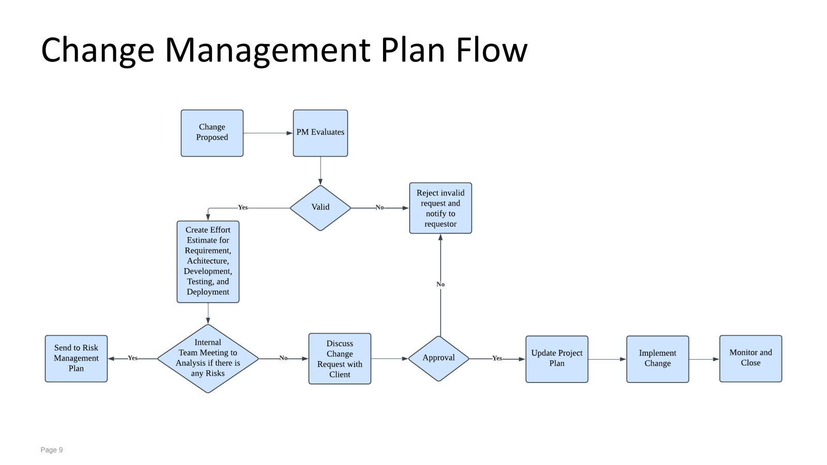

Slide 15
Change Management Plan Table
Step/Task | Details
Change Proposed | Changes can be proposed by Leads, PM, IT Director, Director of Security, Director of Affaires, Director of Legality and Customer. The request should be submitted by completing the change request form and include details on what needs to change and why it is necessary.
PM Evaluates | PM assesses the request for validity, ensuring it aligns with project goals, is feasible, and contains adequate details.
Valid(Decision) | PM decides whether the change is valid. Valid changes align with project objectives and are feasible. Invalid changes lack clarity or conflict with project goals and not submitted by leads, PM and relevant stakeholders.
Reject invalid request and notify to requestor | If deemed invalid, PM rejects the change and provides feedback to the requestor, explaining why the change cannot proceed.
Create Effort Estimate for Requirement, Architecture, Development, Testing, and Deployment | If valid, the team creates an effort estimate for requirements, architecture, development, testing, and deployment to assess the change impact and feasibility, and how the proposed change affects the project’s scope, budget, timeline, and resources.
Internal Team Meeting to Analysis if there is any Risks | The internal team conducts a meting to analyze the change request further and identify any potential risks associated with its implementation.
Send to Risk Management Plan | If risks are identified, the change request is forwarded to the Risk Management Plan for further assessment and mitigation planning.

Slide 16
Change Management Plan Table(Con.)
Step/Task | Details
Discuss Change Request with Client | If no major risks are found, the team discusses the change request with the client to review the proposed change, considering the impact analysis, and decides whether to approve or reject it.
Approval (Decision) | The client and relevant stakeholders decide whether to approve the change.
Update Project Plan | Upon approval, the project plan is updated to incorporate the change, including timelines, deliverables, and resource allocation adjustments.
Implement Change | Execute the approved change according to the updated project plan.
Monitor and Close | The implemented change is monitored to ensure it meets objectives and is functioning as intended. Once confirmed, the change request is closed.

Slide 17
Meeting Minutes (Assignment 4)
Group Number: 2 |  | Project Name: Online Auction Platform
Project Manager (s): Anushka
Meeting Date | Attendees | Absent | Topic Discussed / Work Assigned
29 April | Manny , Kailong , Anushka | None | TOPIC Discussed: Went through previous Schedule Feedback Discussion Improvements Project 4 overview Next meeting Work Assigned : Anushka : Requirement Schedule fix Kailong : ,test ,dev Schedule fix Manny : Archi fix , Deployment Everyone : Work On the Project Schedule Assigned Deployment To Manny
3O April | Manny , Kailong , Anushka | None | Topic Discussed : Schedule Risks Work Assigned: Change Management Diagram, table : Anushka Major Milestones : All Everyone : Work On Schedule

Slide 18
Meeting Minutes (Assignment 4)
Group Number: 2 |  | Project Name: Online Auction Platform
Project Manager (s): Anushka
Meeting Date | Attendees | Absent | Topic Discussed / Work Assigned
1 May | Manny , Kailong , Anushka | None | TOPIC Discussed: Project Overview MPP Done Risks Discuss Work on PPT Video Shoot Work Assigned : Everyone work on PPT

Slide 19
Who Delivered What Assignment 4?
Group Number: 2
Assignment | Deliverable
1 | Profile Page Input – All SOW Ideas – All SOW Slide – Anushka Cost Slide-Manny
2 | RAID Everyone SOW - everyone MPP:- everyone Anushka : Req Manny : Archi , deployment Kailong : Coding , testing
3 | Change Management Table , Flowchart: Anushka Costing: Manny Major Milestones: Kailong

Slide 20
Project Name
Project Dashboard Template
March1, 2025
Kailong duan, Anushka Chaudhari, Manuel Garcia
WOW (Every Saturday/5pm,Zoom)
Notes:
September 2010
20

Slide 21
Team Profile Page
Kailong Duan
Henan, China
Project Management
Graduate Student in CS
Worked as software engineer for 3 years.
Anushka Arvind Chaudhari
Project Management
Graduate Student in CS
Participated In Various Technical College events during undergrad
Manuel Garcia
Irving, TX
CS Undergrad Commercial Real Estate Broker for over 4 years
Notes:
Individual Picture of each member
Hometown (city, state)
Primary focus area or desired focus area
Current internship position or job position (company is not needed)
One interesting fun fact about the person

Slide 22
SmartBid Auction Platform
Project Status is Yellow
Criteria to Green resolve resource challenge
Summary Project Status Financial Status
SmartBid Auction Platform is an advanced bidding system designed to optimize online auctions, particularly for businesses and procurement processes. It uses AI-powered automation, real-time analytics, and competitive bidding strategies to enhance efficiency and transparency
Project has started gathering requirements for the stakeholder template after getting the SOW signed. Team is in a good spirit to start the next tasks.
Contract Price: $ 1.5M
Cost (Baselined): $800k
Actual Spend: $ $ 13,440
ETC: $ $535,360.00
EAC: $ $548,800
Current Margin: 63.25%
Key Achievements
Planned Activities
Risks
Major Milestones
•Completed SOW – Mar 3
•Completed documenting stakeholders objectives – Mar 6
•Finalize stakeholder template - Mar 7
•Start gathering frontend requirements - Mar 8
Task No. 35 – Payment Processing Might be delayed due to integration issues with third-party payment gateways, which could impact the start of Task No. 37 – Secure Escrow System
M1: Select a payment gateway with strong API support and conduct early integration testing.
M2 :Implement a sandbox environment for testing transactions before live deployment.
•SOW Signed
•Complete requirements specification document - Mar 11
•Complete coding- July 23
•Code ready for testing- July 24
•Complete Testing -Aug 27
deploy -Aug 29
Notes:
3/4/20252011-10-19
22
CRICKET_HOUSTON_CDMA_LTE_MEETING
22
22
CDMA_LTE_STEERING_MEETING
2012-06-13

Slide 23
Governance Plan Overview
The governance plan for the Smart Bid Auction project is designed to encourage close collaboration between the Technical leadership Team and Stakeholders, which ensures technical progress is closely tied with user needs and risk management. Stakeholders will actively contribute by giving feedback on functionality and user experience by meeting with Leads on regular basis. The senior leadership stakeholders will participate in key recurring meetings to ensure the project stays aligned with strategic goals and approve major decisions.
➔What are the challenges?
While this plan involves a balanced approach between technical details and Stakeholders feedback and strategic oversight, potential challenges such as coordinating feedback from different groups without delaying development could arise. Additionally, getting busy senior leaders to adhere to regular meeting schedules may also be difficult.

Slide 24
Governance Plan Table
Governance Type | Day / Time | Purpose | Input | Output | Attendees (Owner)
Weekly Internal Status Meeting | M/W 9am-10am | Review schedule, RAID (Risks, Assumptions, Issues, Dependencies), resource allocation, financials | Project Plan, RAID Log, Change Request (CR) Log, Current Status, Dashboard | Updated Project Plan, RAID Log, CR Log, Dashboard | Project Manager (PM), Team Leads, Technical Managers
Weekly External Client Status Meeting | Friday 11:00am-11:30am | Review project progress, address risks, gather feedback | Updated dashboard, RAID log, Client concerns & feedback | Updated RAID log, Action Plan for Client Requests | PM, Client, Project Team Leads
Weekly Internal Technical Meeting | Thursday 11:00am-11:30am | Discuss and resolve technical issues, bug tracking, enhancements | Technical reports, bug reports, system logs | Technical upgrades, bug fixes, development plan | Team Leads, Architecture Leads, Requirement Leads
Weekly Internal Manager/Director Status Meeting | Thursday 3:00 am-4:30am | Review project progress, customer feedback, and resource allocation | Customer feedback, project reports, financial updates | Executive decisions on resource allocation, risk mitigation | PM, VPs, Managers, CFO, COO, CTO
Monthly Internal department meeting | Friday 10:00am-11:00am | Align departmental objectives, handle legal & financial risks | Resource delivery reports, legal & financial risk analysis | Updated RAID, adjusted resource allocation, legal approvals | PM, VPs, CFO, CTO, COO, Chief Legal Officer

Slide 25
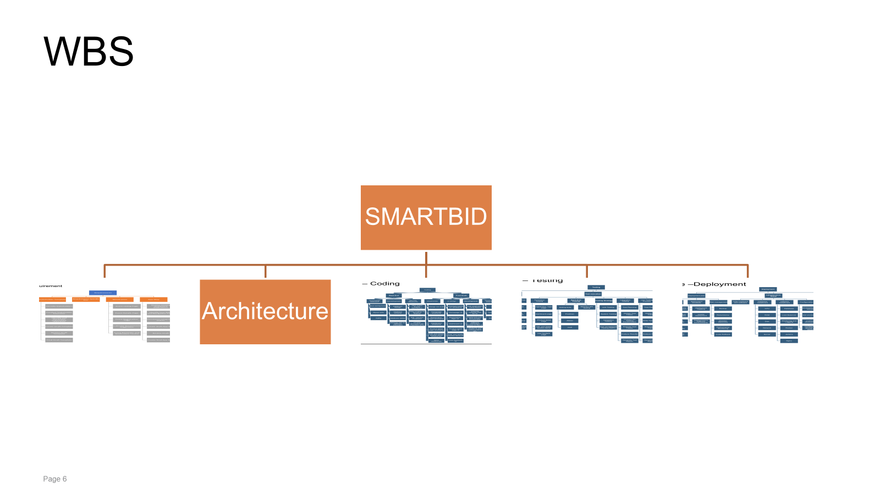
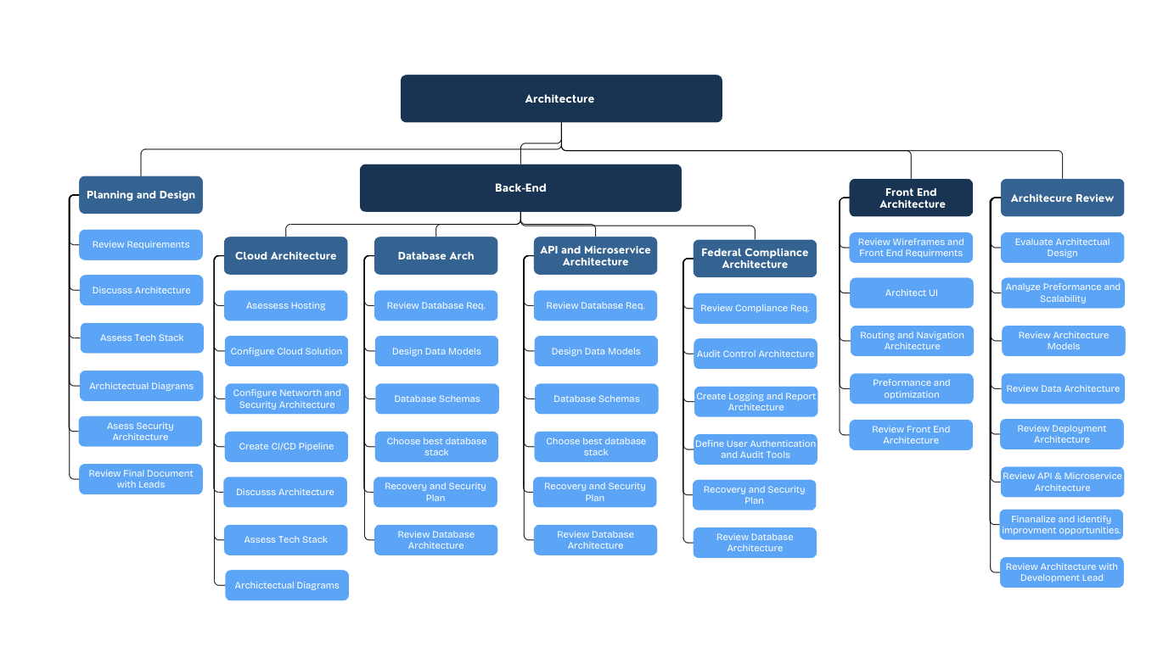

Slide 26
WBS Requirement - updated
Requirements
Stakeholder Template
Identify Stakeholders
Conduct Stakeholder Interview
Identify and document stakeholder objectives
Create Draft Template
Review Draft Template
Final Draft Template
Requirement Specific Doc
Wireframes
App Map
Technical Req
Front end
Backend
Auction Listing Page
Auction Details Page
Auction Registration Page
Bid Management Page
Supplier Verification page
Transaction & Order History Page
Notification & Alerts Page
Review Wireframes with Leads
Update Wireframes
Review Wireframes with client and get signoff
Task Name
Review exisiting dashboard applications
Identify User Roles and Navigation Paths
Document Integration Points
Create a Draft App Map
Review Draft App Map with leads
Update App Map and create final App Map

Slide 27
Technical Req
Frontend
User Authentication
Create Registration Page
Create Login Page
User Profiles
Buyers
Create profile
Track bid
Manage Watchlist
Sellers
List Medical Supplies for auction
Upload Pictures & set starting bids
Define Auction Duration
Auction Listing & Management
Create auction listings with detailed medical supply descriptions, images, and specifications
Set minimum bid amounts and reserve prices
Automated auction closing upon expiry
Real-Time Bidding System
Live bid updates, email, and push notifications
Compliance Verification
Payment Processing
Secure payment gateway with multiple methods (Credit/Debit, Digital Wallets)
Secure escrow system for transaction protection
Transaction & Order History
Rating & Reviews
Admin Dashboard
Manage user accounts, auction listings, transaction reports
Fraud detection and user verification features
Backend Req
Authentication & Authorization
Secure user authentication
Role-based access control (Admin, Buyer, Seller)
Database Management
Relational database to store user profiles, auction listings, bids, transactions, and reviews
Ensure data integrity and normalization
Auction Management System
CRUD operations for auction listings
Automated auction expiration and winner selection
Get signoff from Leads on the technical requirements
Admin Panel Features
Dashboard for monitoring user activity
Fraud detection and account suspension mechanisms
Review technical Req doc with Client and get signoff
WBS REQUIREMENT

Slide 28
WBS Architecture

Slide 29
WBS Slide – Coding-Updated
Coding
Back-End
database design
User, Medical Supplies schema
Medical Supplies, schema
Develop CRUD operations
Security Measures
Front-End
Rating & Reviews, schema
Real-Time Bidding System
Automatic Price Update
email notification
Payment
Add support for various credit card payments
Add PayPal support.
Payment Gateway Integration
payment Confirmation
Payment History
Payment Status Tracking
UI design
Rating & Reviews UI
User Authentication UI
User Profiles UI
Admin Dashboard UI
Edit, and delete auction items UI
User feedback UI
Development
User Profiles
User Login, Register,
Review / Verification
Medical Supplies Auction Settings
Detailed Description
Function List
Image Upload
Price Settings
Auction Time Settings
Payment
redit/Debit Card,
Digital Wallets, paypal
Feedback
Comment
Rating
Customer Support & Complaint Resolution
Dispute Resolution
Admin Dashboard
User Account Mang
Medical Supplies Approval
Generate Medical Supplies Quality
Transaction Report
Transaction Approval
Auction Status Tracking
Proxy Bidding
auction item management
Real-Time Bidding Data
Historical Bidding Records
AI-based Bidding Algorithms
Model selection
Data collection
Data preprocessing
Reinforcement learning
Objective function
Optimize the bidding strategy
Model evaluation
Anti-Cheating System
Rate Limiting
IP and Device Tracking
Behavioral Analysis
Blacklist and User Restrictions
Manual Review System

Slide 30
WBS Slide – Testing-updated
Testing
Test planning
UAT testing
Front-end Testing
User Authentication
registration, login
Payment testing
Feedback
Back-end Testing
User Management Service
Medical Supplies Online Service.
Feedback and Rating Service.
Medical Supplies Product Review and Verification Service.
Real-Time Bidding System Service.
API Integration
other Testing.
Security Testing.
Performance Testing.
Scalability Testing.
Usability Testing.
Test execution
UAT testing
prepare UAT evnironment
define testing scenarios
get feedback from UAT team
sign off and documents
Integration Testing
prepare testing evnironment
add testing Cases
Front-end page Testing
Back-end API Testing
Performance Testing
Test reporting and defect tracking
bug logging
Search for Bug Logs
Classify Bug Logs
Organize Bug Report
Send to Developers for Handling
Bug tracking
Add Bug Report Progress Tracking
Display Report After Handling, Further Testing
Bug Issue Resolution Completed
Determine Test Objects
Define Test Scope
Resource Preparation
Schedule Time
identification Risk and mitigation
AI-based Bidding Algorth Testing
Define experimental
Monitoring indicators:
Add Main indicators
auction success rate
Deploying new algorithms
data analysis
Algorithm update
Test process
Continuous monitoring
Iterative optimization

Slide 31
WBS Slide –Deployment-uploaded
Infrastructure Setup
Deployment
deployment target/ requirement
deployment schedule
weekly deployment
Risk management
Backup
Connect to the code repository
Pull the latest code changes
Build the application
Verify functionality
Deploy the application
deployment meeting
Deployment in Different Environments
Redundancy
Disaster Recovery
Performance Monitoring
Code Rollback
Deployment plan
order hardware and software
Hardware installment
CPU
RAM
Disk
Network
Server
software installment
Database
Load Balancer
Monitoring and Logging
Docker
Jenkins
Nginx
Configuration
development environment
test environment
production environment
configure the network and firewall and security
deployment Solution
deployment tools
Jenkins
Kubernetes
Helm
product released
release process
release management
Validate Feedback collection
gather and analysis
AI-based Bidding Deploy
Model Export
Inference Service
Monitoring & Optimization
Version Control
Continuous Updates (CI/CD)

Slide 32
Cost Comparison Slide Summary
Top-Down Cost
Req : $ 100,000.00
Arch : $120,000
Code $30,000.00
Test: $10,000.00
Deploy:$20,000.00
PM : $63,200.00
Total Cost: $349,200.00
Margin: $69,840.00
Price $419,040.00
Bottom-up Cost
Req: $ 129,960.00
Arch : $243,800
Code: $320,800.00
Test: $137,920.00
Deploy:$490,400.00
PM : $63,200.00
Total Cost: $1,322,880.00
Margin: $237,992.000
Price: $1,427,952.00
Variance
Our Bottom-Up (BU) cost comes out to be $1,264,387, which is a 63% increase when compared to the Top-Down (TU) cost. The price difference between BU and TU shows a significant underestimation of resources and duration in the TU estimation. Major cost differences were observed across all project phases, with coding costs rising by 147%, testing costs increasing by $103,027, and project management costs nearly tripling to $316,800.The duration for each phase has doubled or more than doubled.Each phase has increased resources by 15%.Many review tasks (PM tasks) were included in BU, which were not part of TU estimation.More comprehensive testing phases were needed, leading to increased time and cost.Higher complexity in architecture design led to greater effort estimates.

Slide 33
Cost Comparison Slide Requirements
Top-Down Cost
$100,000.00
Bottom-up Cost
$129,960.00
What changed in the Bottom-Up Estimate ?
High total effort and extended duration: The BU factors In real durations that extend beyond what was estimated for the TU. For example in TU, backend requirements was estimated to take 10 days where as in the BU is it estimated to take 56 days which is more than double. Because of the extended duration and more efforts from resources the cost for the BU is high.
More resources utilized: The BU estimate includes more Requirement Engineers(7) working in parallel or together sometimes depending on the tasks. The BU has more time-intensive tasks than the TU and allocates more time to do requirements review.
Detailed task breakdown: The BU estimate comes from a more granular breakdown of tasks. Instead of just high-level categories, each task is broken down into more detailed requirement gathering and reviews tasks. Because of the breakdown of tasks, the BU reflects the true work involved.
What is real for the BU ?
The BU involves Stakeholder Template, Wireframes and App Map Requirements gathering that will add more time when compared to the TU.
The BU estimates 88 days for Technical requirements gathering which is more than double of what TU estimates(19 days)
The BU total days comes up to be 102 days which is significantly bigger than the original TU estimate which is 29 days.
The cost differences between the Top-Down (TD) estimate, which was set at $ 100,000.00
shows a significant underestimation when compared to the Bottom-Up (BU) estimate
, which amounts to $ 129,960.00
Assumption for the Top-Down Estimate
Simplified Resource utilization assumption The TD estimate assumes that two Requirements
Engineers working with a Requirement Lead suffices for the project. In addition the TD allocates
less time to review requirements and focuses more on gathering requirements.
Simplified task breakdown: The TD estimate focused on major categories(Tech Stack, Frontend
, Backend) without taking accounting for the granularity of the actual tasks required under
each category.

Slide 34
Cost Comparison Slide - Architecture
Top-Down Cost
$120,000
Bottom-up Cost
$243,000.00
Variance
What were some of the big changes. Duration, hourly cost, etc
Roles not accounted for
Regulations we need to adhere to given we are making software for a medical company
Additional requirements
The cost differences between the Top-Down (TD) estimate, which was set at $169,200,
shows a significant underestimation when compared to the Bottom-Up (BU) estimate
, which amounts to $243,000.000
Assumption for the Top-Down Estimate
Simplified Resource utilization assumption The TD estimate assumes that 2 architecture engineers. a lead and a PM. We did not consider the cloud solutions, database intricacies, and overall sheer volume of work required. When broken down into steps and researched further we discovered various agencies which have requirements of their own for medical software.
Simplified task breakdown: The TD estimate focused on major categories(Tech Stack, Frontend
, Backend) without taking accounting for the granularity of the actual tasks required under
each category.

Slide 35
Cost Comparison Slide – Coding-Kailong Duan
Top-Down Cost
Based on the SOW, the Development total estimate cost is $300,000, with the following breakdown for each deliverable:
Front-end part: 30%, $90,000,
Back-end part: 70%, $21,000
Bottom-up Cost
Based on the MPP, the total coding cost is $320，800, with the following breakdown for same deliverable:
Front-end part: 20%, $63,840,
Back-end part: 80%, $256,960
Variance
The total cost exceeds the estimate by $20,800
The main cost difference is that for The backend has more functional requirements, leading to increased time and cost.
.

Slide 36
Cost Comparison Slide –Testing-Kailong Duan
Top-Down Cost
Based on the SOW, the Development total estimate cost is $100,000, with the following breakdown for each deliverable:
Testing plan:5%, 5,000
UAT Testing:20% 20,000
Other test: 15%, $15,000
Test execution: 20% $20,000
Al-bidding test:10%,10,000
Testing reporting: 30%,30,000
Bottom-up Cost
Based on the MPP, the total coding cost is $137，920, with the following breakdown for same deliverable:
Testing plan:3%, 4,800
UAT Testing:25% 35,200
Other test: 8%, $11,200
Test execution: 20% $27,520
Al-bidding test:14%,18,880
Testing reporting: 30%,40,320
Variance
The total cost exceeds the estimate by $37,920
The main cost difference is that UAT testing and Testing execution, The UAT testing scope exceeded initial expectations, resulting in higher-than-anticipated time expenditures.
Integration testing was incorporated during the testing execution phase, leading to increased operational costs.

Slide 37
Cost Comparison Slide – Deployment Kailong Duan
Top-Down Cost
Based on the SOW, the Development total estimate cost is $300,000, with the following breakdown for each deliverable:
Deploy plan:10%, 30,000
Infras Setup:15%, 45,000
Configuration: 10%, $30,000
AI-based Bidding deploy: 15%,45,000
Deploy Solution:50% 188,400
Bottom-up Cost
Based on the MPP, the total coding cost is $347,600 with the following breakdown for same deliverable:
Deploy plan:7%, 24,800
Infras Setup:13%, 46,400
Configuration: 11%, $40,000
AI-based Bidding deploy: 14%,48,000
Deploy Solution:55% 188,400
Variance
The total cost exceeds the estimate by $47,600
The main cost difference is Deploy Solution, During the Gather and Analysis phase, Business Impact Analysis and Continuous Improvement processes were implemented to enhance project control, resulting in additional cost expenditures

