Slide 1
DPT 100 Final project

Slide 2
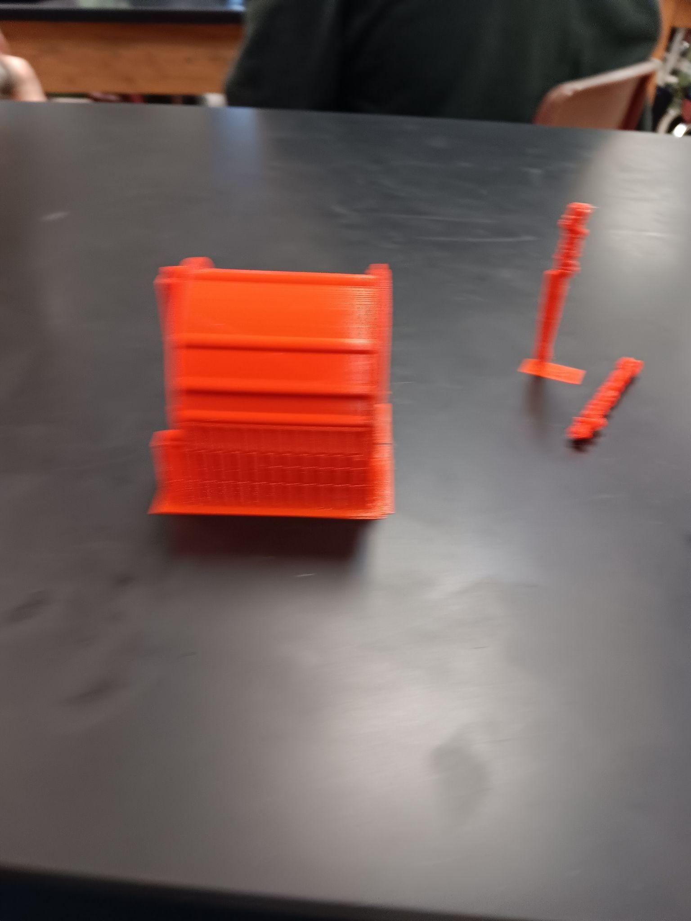
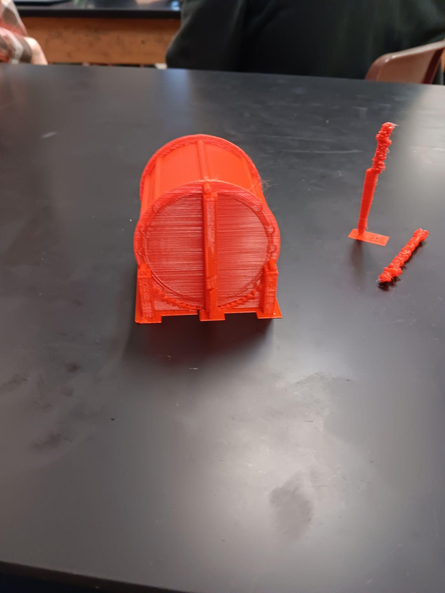
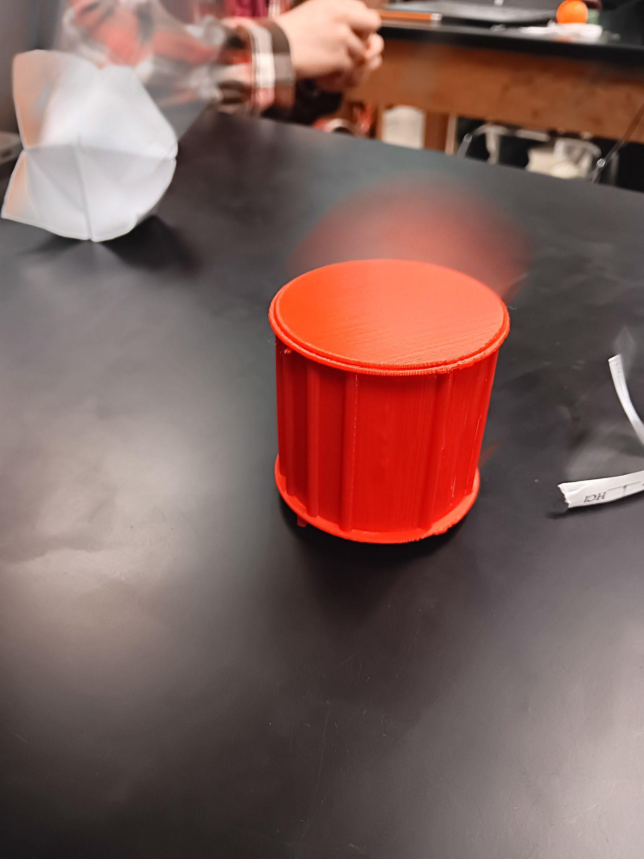
Drum

Slide 3
What I made
Using Inventor I 3D modeled and printed a snare drum and drumsticks.

Slide 4
What i learned
During the process of creation i learned how difficult it can be to create thing in proportions to the rest of the parts, also i learned that Inventor doesn't like to save things very well, also i learned the printer doesn't to well with printing vertically but it does well with circles standing. In the end after the lessons i learned alot about different types of printing material, printers and applications of printed parts for automotive industry, labor industry, and lots of other thing.

Slide 5
Thank you
Thanks for giving me the opportunity to learn about 3D printing and its applications.

