Slide 1

Discoveries Found in DoorDash Dataset
By: Darren Lim

Slide 2
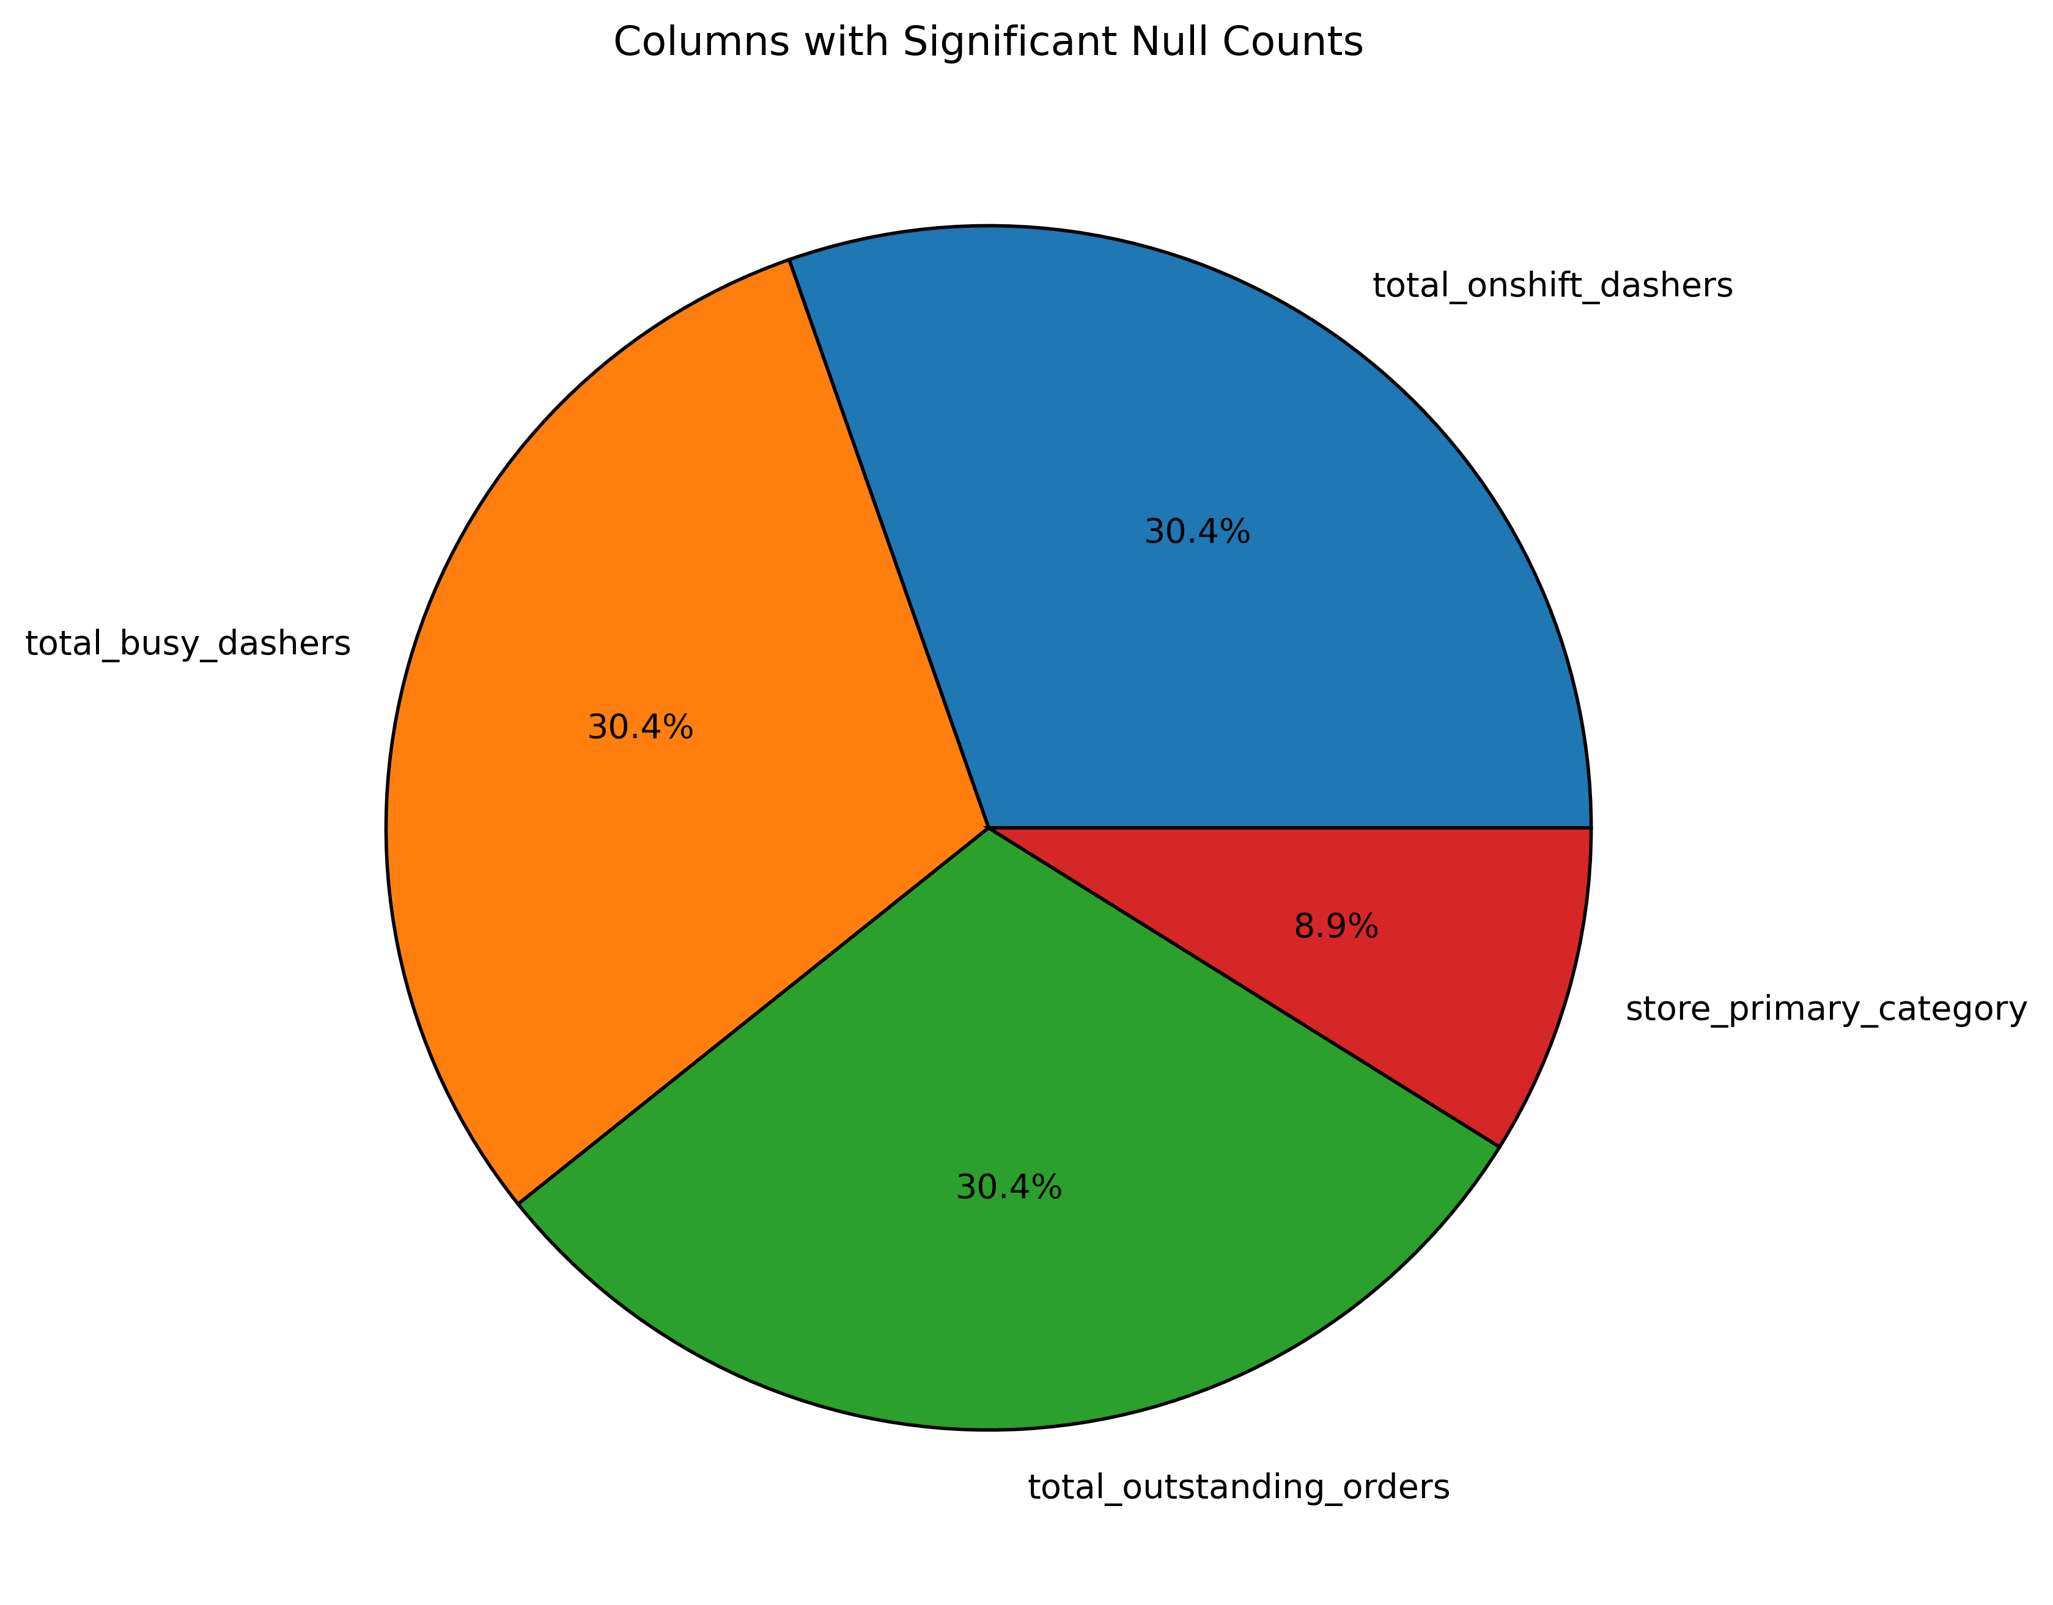
Significant Null Counts
total_onshift_dashers, total_onshift_dashers, and total_outstanding_orders have the same number of null counts, there is a possibility that the columns are experiencing the same issue.
store_primary_category null counts may be caused by merchants not labelling their restaurant, but I’m unsure if this prevents them from going online.
There were 4 more columns will null counts, but the amount is insignificant (<1% of dataset).

Slide 3
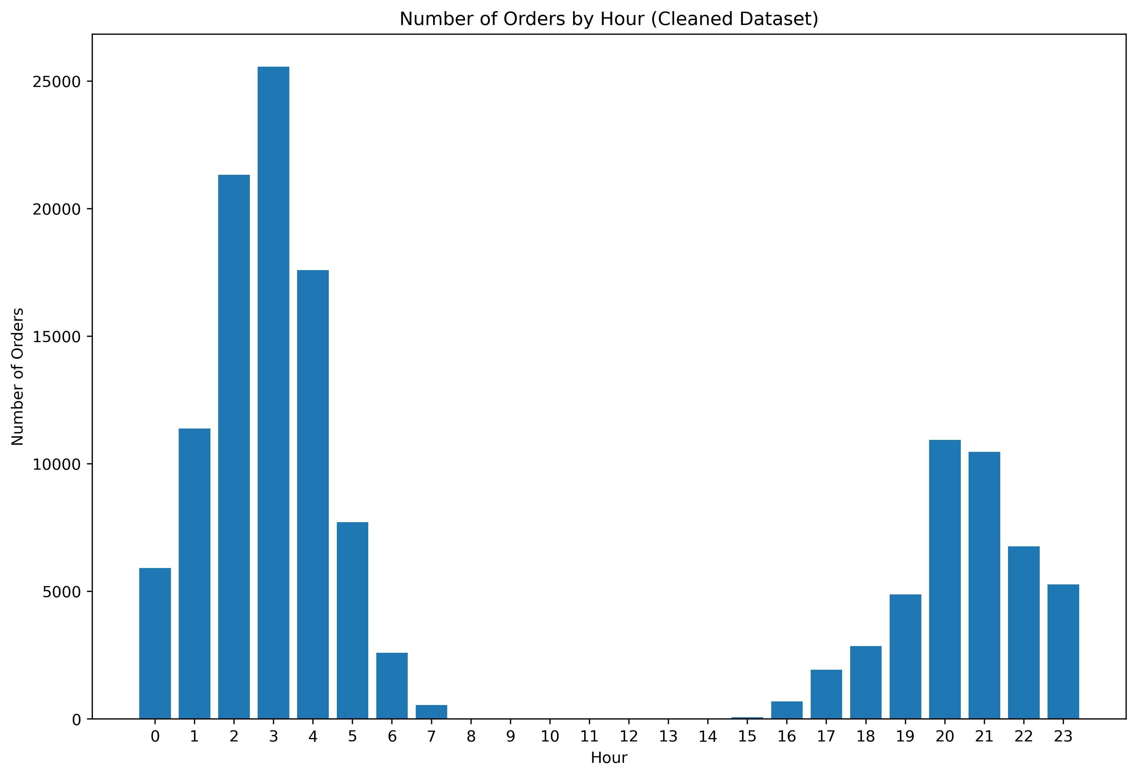
Order Count By Hour
Hours 9-14 did not have any orders in the cleaned dataset.
I’m a bit skeptical about this, there are 130k entries and there are no orders during these hours.
The location of the orders may help in understanding the gap, but noise was added to obfuscate business details.

Slide 4
Negative Values Found
Negative values were found in 4 columns (total_busy_dashers, total_onshift_dashers, total_outstanding_orders, and min_item_price).
min_item_price
Negative values may represent free items received through promotions or coupon deals, thus negative values being meaningful.
The restaurant may have accidently inputted the wrong price for their items.
There may be an error in the collection of this data.
Disproportionate number of orders originated from fast food restaurants.
“total_...”
I was not able to figure out why there were negative values in these three columns, project description makes no note of this; more inquiry is needed.
High occurrence of market IDs 1 and 3 (see next slide).

Slide 5
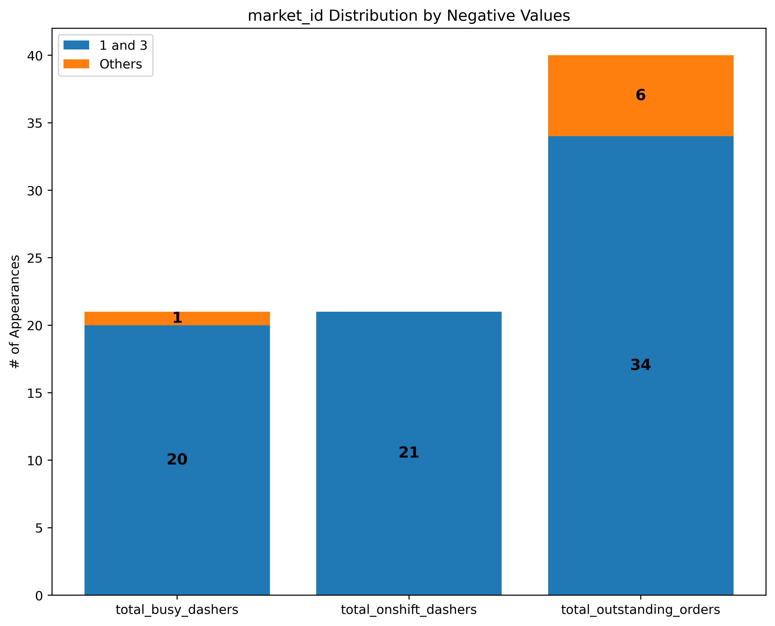
Market ID Distribution
These three columns were found to have negative values and were moved into their own dataframe.
~90% of these orders originated from market IDs 1 and 3.

