Slide 1

“Happiest Cities in America”
How Can Data Science Substantiate a Study Using Additional Data Points

Slide 2
Team 6
Benjamin Eck
David Kling
Michael Magliaro
Krunal Panchal

Slide 3
Topic | Presenter | Time (Minutes)
Project Intro & Survey | Mike | 1
Using Yelp Restaurant Data | Ben | 2
Using data.gov Census Data | Dave | 2
Using weather Data | Krunal | 2
Using Yelp Bar Data | Mike | 2
Conclusion | ?? | 1

Slide 4

Our Question….
How Can Data Science Substantiate the “Happiest Cities in America” Study By Using Additional Data Points?
Using Pandas to clean and format our data set(s)
Creating a Jupyter Notebook describing the data exploration and cleanup process
Creating a Jupyter Notebook illustrating the final data analysis
Using Matplotlib to create visualizations of our data
Using API’s to find data pertinent to your primary research questions

Slide 5
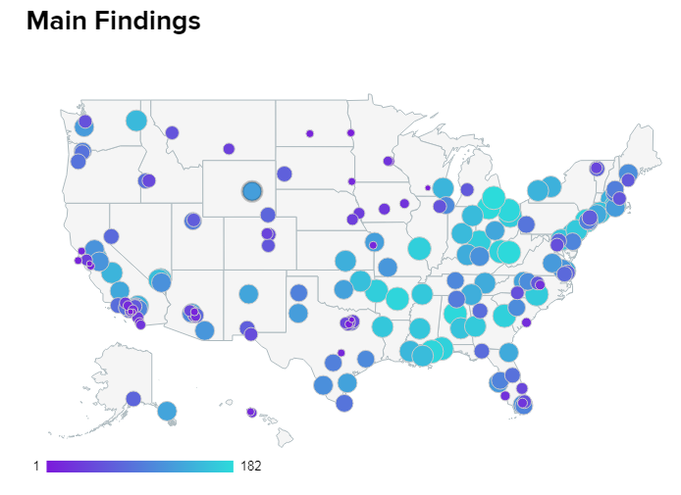
The Baseline - Happiest Cities in America Survey Mar 11, 2019 | Adam McCann, Financial Writer
WalletHub drew upon the various findings in order to determine which among more than 180 of the largest U.S. cities is home to the happiest people in America including the 150 most populated U.S. cities, plus at least two of the most populated cities in each state.
Three key dimensions were analyzed: 1) Emotional & Physical Well-Being, 2) Income & Employment and 3) Community & Environment and 31 key indicators of happiness, ranging from depression rate to income-growth rate to average leisure time spent per day.
https://wallethub.com/edu/happiest-places-to-live/32619/#methodology

Slide 6
The Details - Happiest Cities in America Survey Mar 11, 2019 | Adam McCann, Financial Writer
Emotional & Physical Well-Being
Life-Satisfaction Index
Emotional-Health Index
Depression Rate
Suicide Rate
Adequate-Sleep Rate
Physical-Health Index
Sports-Participation Rate
Marijuana usage
Opioid Prescriptions Dispensed
Illness & Disability Index
Life Expectancy
Food-Insecurity Rate
Income & Employment
Income-Growth Rate
Households Earnings
Poverty Rate
Job Satisfaction
4+ Star Job Opportunities
Job Security
Unemployment Rate
Underemployment Rate
Bankruptcy Rate
Weekly Work Hours
Commute Time
Community & Environment
Strength of Social Ties
WalletHub’s Most Caring Cities Ranking
Separation & Divorce Rate
Ideal Weather
Acres of Parkland
Average Leisure Time Spent per Day
Well-Being “Community” Rank

Slide 7
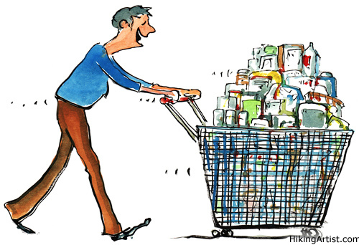


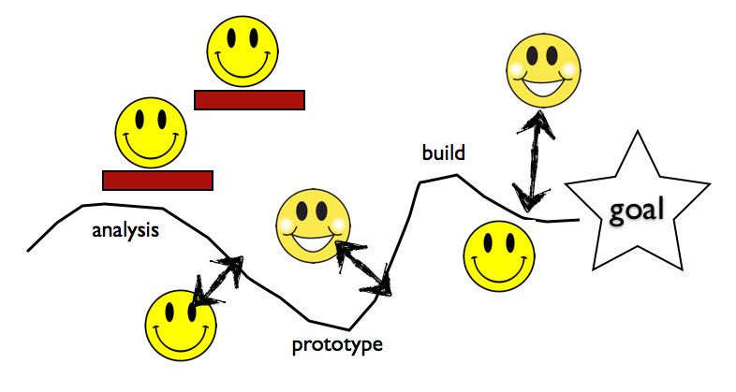
Are People Happier Because of Bars & Cannabis….
Data Acquisition
Data Source(s): Yelp API, Wikipedia (CSV), survey (CSV)
Data Requirements: Survey results, Bars & Cannabis within 5M radius, listing of states with legal cannabis
Data Sourced: ~10K records with names, state, city, ratings, reviews
Data Exploration
Validating YELP records pulled versus YELP Web query
Bars with multiple categories (Restaurant, Bar, etc)
YELP categorization of Cannabis
Data Cleansing
Data Cleansing was minimal as predominance came from YELP
City/State naming conventions (St. vs Saint)
Sparsity of cannabis data
Data Analysis
Detailed and Summarized analysis on Yelp data joined with Survey by City and State legality
Groupings by mileage radius

Slide 8
Are People Happier Because of Cannabis….
How Can Data Science Substantiate the “Happiest Cities in America” Study Using Additional Data Points

Slide 9
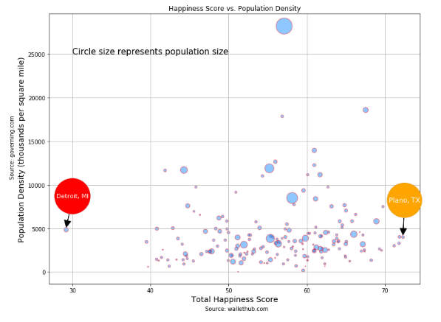

Are People Happier If They Live in less Populated Areas?

Slide 10
You will also be responsible for preparing a 10 minute presentation.
This will be a formal presentation.
One in which you explain in detail:
The questions you and your group found interesting, and what motivated you to answer them
Where and how you found the data you used to answer these questions
The data exploration and cleanup process (accompanied by your Jupyter Notebook)
The analysis process (accompanied by your Jupyter Notebook)
Your conclusions. This should include a numerical summary as well as visualizations of that summary
Discuss the implications of your findings. This is where you get to have an open-ended discussion about what your findings "mean".

