Slide 1

“Happiest Cities in America”
How Can Data Science Substantiate a Study Using Additional Data Points

Slide 2
Team 6
Benjamin Eck
David Kling
Michael Magliaro
Krunal Panchal

Slide 3

Topics | Data Scientist
Project Intro & Survey | Mike
Using Yelp Restaurant Data | Ben
Using Census Data | Dave
Using Weather Data | Krunal
Using Yelp Bar Data | Mike
Conclusion | Mike

Slide 4

Our Question….
How Can Data Science Substantiate the “Happiest Cities in America” Study By Using Additional Data Points?
Can Restaurant Reviews Indicate Happiness?
Can Population Density and Population Growth/Decline Indicate Happiness?
Can Weather indicate Happiness?
Can Bar & Cannabis Shop Reviews Indicate Happiness?

Slide 5
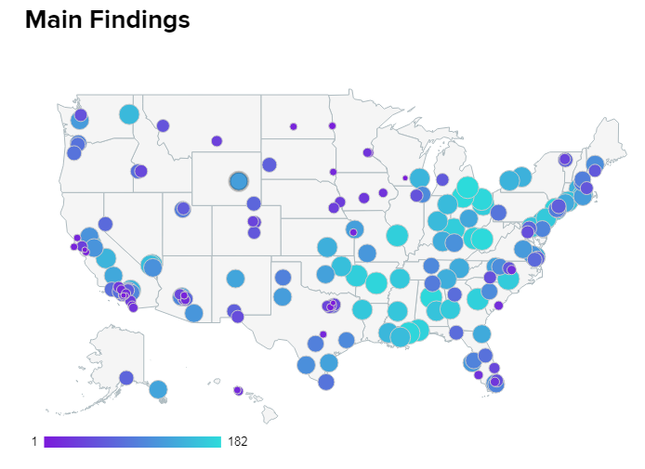
The Baseline - Happiest Cities in America Survey Mar 11, 2019 | Adam McCann, Financial Writer
WalletHub drew upon the various findings in order to determine which among more than 180 of the largest U.S. cities is home to the happiest people in America including the 150 most populated U.S. cities, plus at least two of the most populated cities in each state.
Three key dimensions were analyzed: 1) Emotional & Physical Well-Being, 2) Income & Employment and 3) Community & Environment and 31 key indicators of happiness, ranging from depression rate to income-growth rate to average leisure time spent per day.
https://wallethub.com/edu/happiest-places-to-live/32619/#methodology

Slide 6
The Details - Happiest Cities in America Survey Mar 11, 2019 | Adam McCann, Financial Writer
Emotional & Physical Well-Being
Life-Satisfaction Index
Emotional-Health Index
Depression Rate
Suicide Rate
Adequate-Sleep Rate
Physical-Health Index
Sports-Participation Rate
Marijuana usage
Opioid Prescriptions Dispensed
Illness & Disability Index
Life Expectancy
Food-Insecurity Rate
Income & Employment
Income-Growth Rate
Households Earnings
Poverty Rate
Job Satisfaction
4+ Star Job Opportunities
Job Security
Unemployment Rate
Underemployment Rate
Bankruptcy Rate
Weekly Work Hours
Commute Time
Community & Environment
Strength of Social Ties
WalletHub’s Most Caring Cities Ranking
Separation & Divorce Rate
Ideal Weather
Acres of Parkland
Average Leisure Time Spent per Day
Well-Being “Community” Rank

Slide 7
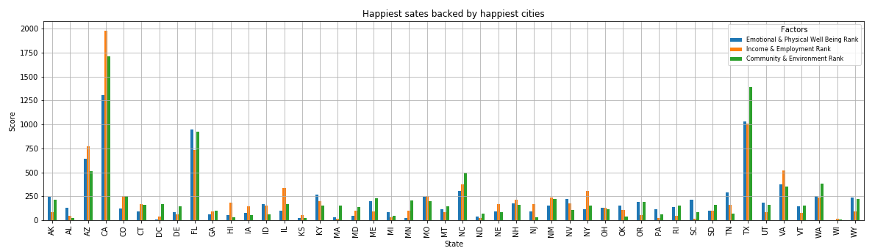
What makes us happy???

Slide 8
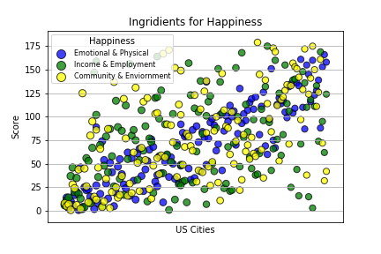
What makes us happy???

Slide 9



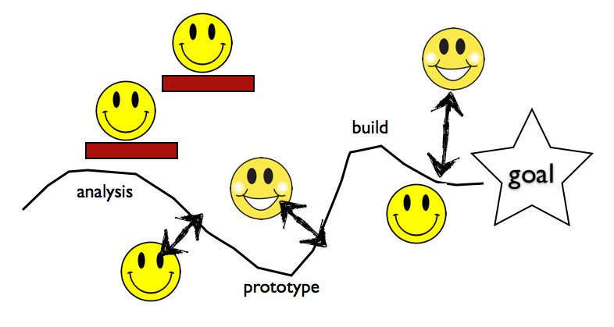
Can Restaurant Reviews Indicate Happiness?
Data Acquisition
Data Source(s): Yelp API, survey (CSV)
Data Requirements: Survey results, Restaurants within 2M radius
Data Sourced: ~41K records with restaurant names, state, city, ratings, price, number of reviews
Data Exploration
Gathering all restaurant records instead of max of 50
Converting Price ($) column to usable format
Data Cleansing
Data Cleansing was minimal as predominance came from Yelp
Only pulled full records from Yelp
Price column had unusable data (Euros)
Data Analysis
Visualized data with scatter plots to see patterns
Visualized the aggregation of happy vs unhappy cities
Used a Student’s T-test to show significance of comparison

Slide 10
The Data Says…
Slight upward trends in all categories:
Happier cities have higher average ratings
Happier cities have higher average prices
Happier cities have more total review counts
However, terrible correlation coefficients leave us without results:
R^2 = 0.01164
R^2 = 0.00257
R^2 = 0.02948
Student’s T-test on 15 Happiest Cities vs. 15 Least Happy Cities:
Average Rating: p-value= 0.21846
Average Price: p-value= 0.56396
Total Review Count: p-value= 0.11460

Slide 11
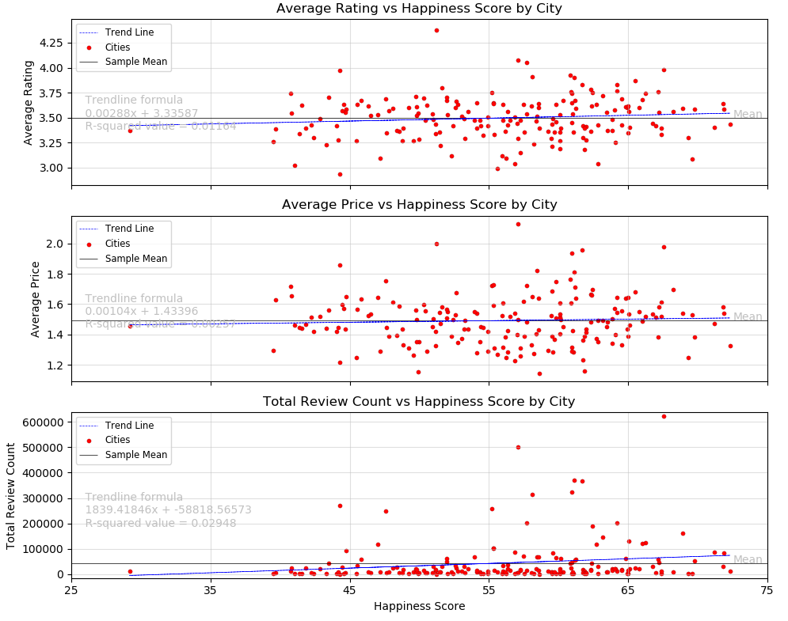
The Data Shows…

Slide 12
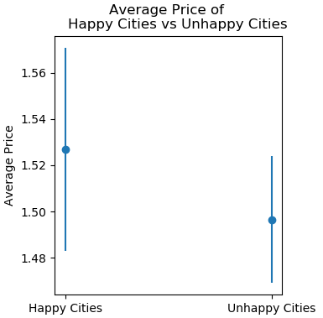
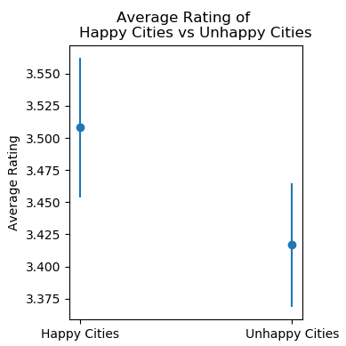
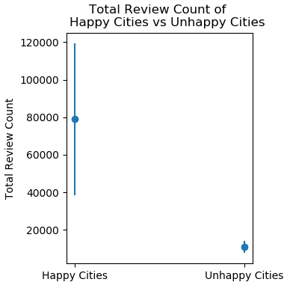
The Data Shows…

Slide 13
Can Population Density and Population Growth/Decline Indicate Happiness?
Data Acquisition
Data Source(s): governing.com, wallethub.com, census.gov
Data Requirements: Survey results, population density of cities, population data for cities from 2010 - 2017
Data Sourced: Cities, Population Density, Populations
Data Exploration
Found missing data in population and population density pull. Added missing data.
Data Cleansing
Data Cleansed: wallethub.com survey - split out city and state. From population density created state abbreviations and key for merging. For migration data, created key for merging, deleted unused columns, transposed and re-indexed data.
Data Analysis
Detailed and Summarized analysis on population density data joined with survey by city and population migration with survey by city.
Showed statistics on population density and migration.

Slide 14
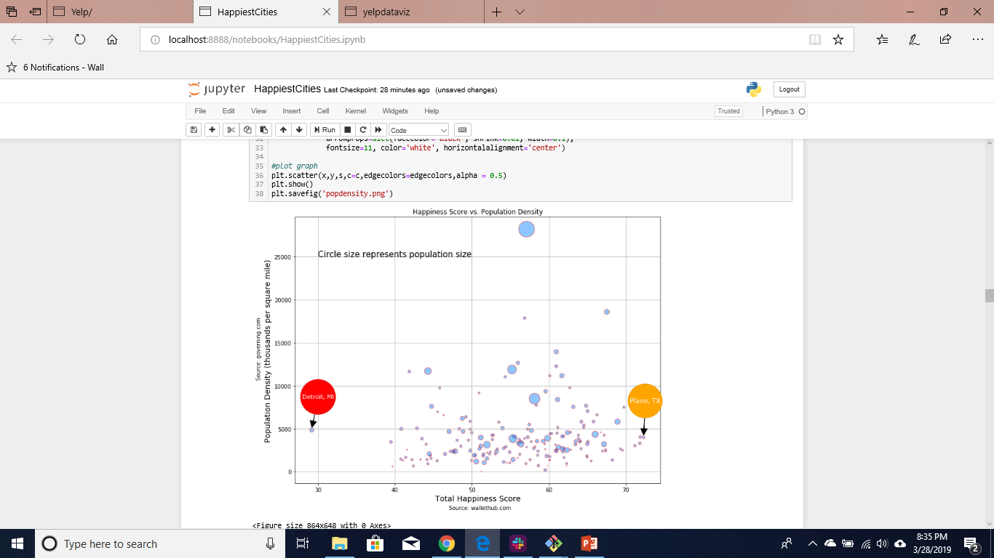

Are People Happier If They Live in less Populated Areas?

Slide 15
Answer: No, people are not happier when they live in less densely populated cities.
Are People Happier If They Live in less Populated Areas?
Assumption: People are happier when they live in less densely populated cities.
Statistical Evidence: Grouped the happiest places by density (in groups of 10) and ran an ANOVA test. The p value was: 0.42091575267505493, so I had to reject my assumption.

Slide 16
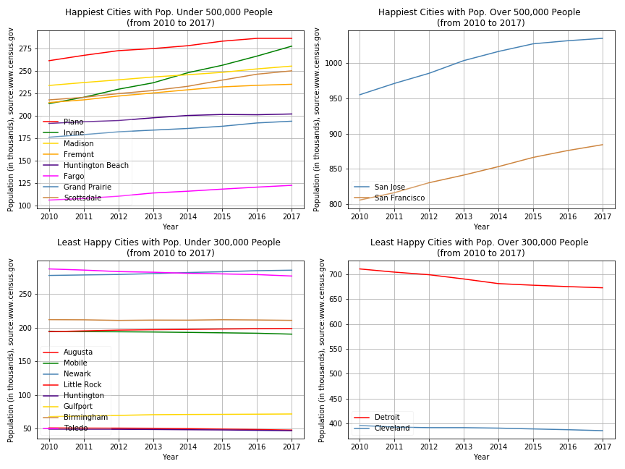
Are people moving into Happy Cities and Moving out of Unhappy Cities?

Slide 17
Answer: Yes, people are moving into happy cities and leaving unhappy cities.
Are people moving into Happy Cities and Moving out of Unhappy Cities?
Assumption: People would move into happy cities and leave unhappy cities.
Statistical Evidence: Took the top and bottom 10 happiest cities and calculated their population change in percent, from 2010 to 2017. Ran an independent t-test. The p value was 0.0016833696636540342, so my assumption was correct.

Slide 18
Happiness = Sunshine, Rain and some $$$
Data Acquisition
Data Source(s): https://www.currentresults.com, https://wallethub.com/edu/happiest-places-to-live
Data Requirements: States with Avg Temp, Avg Rainfall, Happiness scores
Data Sourced: States, Cities, Sunniest cities, Rainfall, Happiest cities and factors for the same.
Data Exploration
Validating data obtained with survey and finding patterns within the same
What other factors or existing factors validate the survey/study.
Data Cleansing
Major ETL done with conversion of metrics and joining of multiple csv’s into one.
City/State naming conventions (St. vs Saint)
Sparsity of historical weather data available for free.
Also finding accurate weather data for list of cities mentioned in Wallethub study. (As the cities described are not capital or major cities but strictly cities that meet the criteria of the study)
Data Analysis
Detailed and Summarized analysis on of survey data and weather data.
Groupings done by states, populations, temperatures etc to present the point and initiate the study and objective discussion.

Slide 19
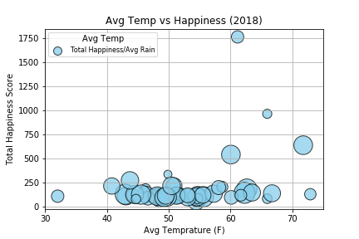
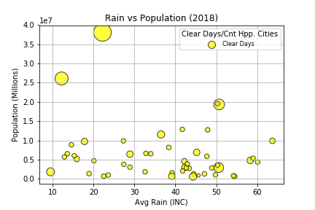
I can see clearly now the rain is gone….

Slide 20
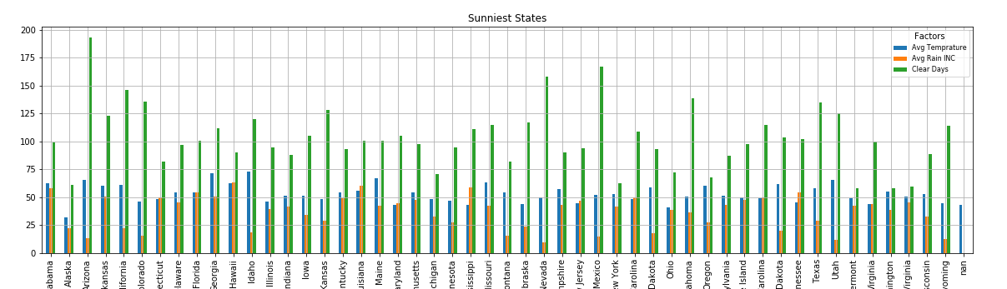
Sunniest State of mind…

Slide 21
Avg Temp vs Happiness and Rain vs Population
Rain and Happiness are inversely related.
Happiness and warmer weather as positively corelated.
When compared the state level Avg Temperatures, Precipitation and Happiness score. What we observed that states with lower avg rain fall tend to have more satisfied and happier people compared other states.
Lower Avg rain and warmer weather attracts more population.
Similar effect is seen when number of clear days were compared from each state with avg temperatures and results were positive. Most populous state tend to have lower than avg rain and higher than avg clear days and temperatures.

Slide 22
Can Bar & Cannabis Shop Reviews Indicate Happiness?
Data Acquisition
Data Source(s): Yelp API, Wikipedia (CSV), survey (CSV)
Data Requirements: Survey results, Bars & Cannabis within 5M radius, listing of states with legal cannabis
Data Sourced: ~10K records with names, state, city, ratings, reviews
Data Exploration
Validating YELP records pulled versus YELP Web query
Bars with multiple categories (Restaurant, Bar, etc)
YELP categorization of Cannabis
Mileage radius experimentation for significant data
Data Cleansing
Data Cleansing was minimal as predominance came from YELP
City/State naming conventions (St. vs Saint)
Sparsity of cannabis data
Data Analysis
Detailed and Summarized analysis on Yelp data joined with Survey by City and State legality
Groupings by mileage radius
Groupings by legal versus illegal
Radius brought in cities outside of “happy city”

Slide 23
The Data Says…
Assumptions:
Happier cities have higher average ratings
Happier cities have more total review counts
Happier cities have more bars and dispensaries per city
Student’s T-test on 15 Happiest Cities vs. 15 Least Happy Cities:
Average Rating: p-value = 0.30493
Total Review Count: p-value = 0.04348
Total Bar Count: p-value = 0.35412
Results:
Happier cities have slightly lower average ratings
Happier cities have more total review counts
Happier cities have slightly less bars per city

Slide 24
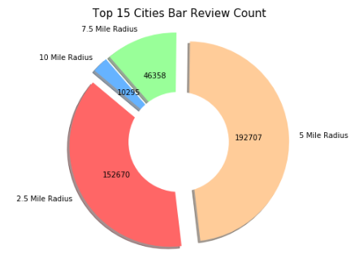
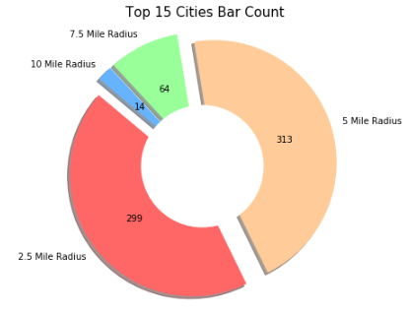
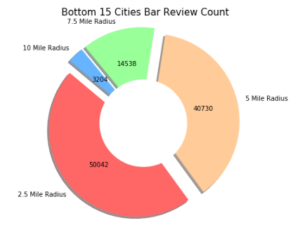
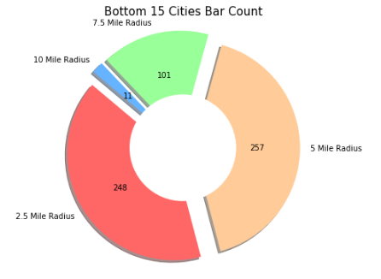
The Data Says
Type | Top-Bottom 15 | Review Count | Bar/Dispensary Count | Rating Average
Bar | Top | 347K | 610 | 3.84
 | Bottom | 124K | 637 | 3.88
Cannabis | Top | 2K | 34 | 4.20
 | Bottom | 0.1K | 3 | 4.00
Cannabis is legal for recreational use in 6 of the Top 15 happiest cities and 1 of the Bottom 15 happiest cities.

Slide 25
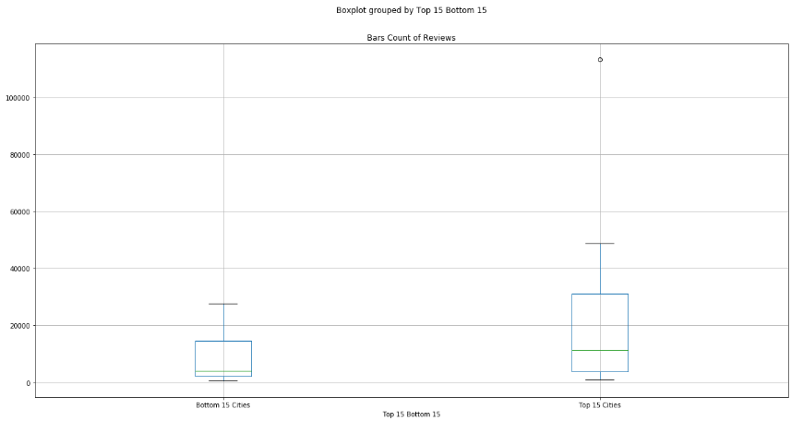
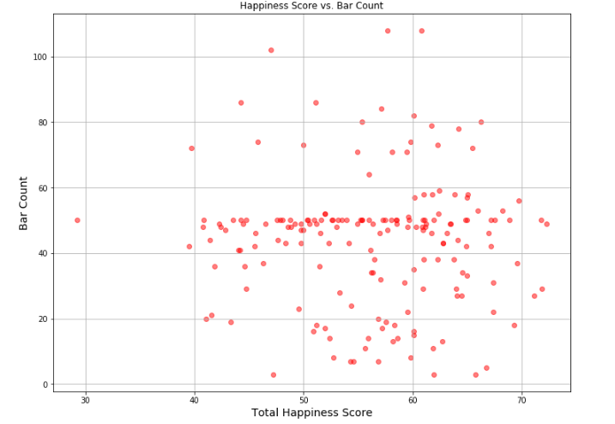
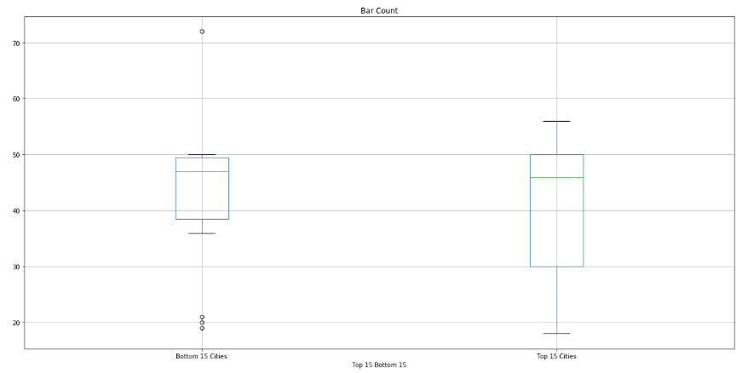
The Data Shows
Bar Reviews Count Top 15 Versus Bottom 15
Happiness Score Versus Bar Count
Bar Count Reviews Top 15 Versus Bottom 15

Slide 26
The Conclusion
The data sets acquired and analyzed for the project can neither substantiate of disprove the “Happiest Cities in America” survey
The data we analyzed shows that no one data measure can independently substantiate or disprove the survey results due to the fact that within the survey each state has a unique combination of the three key dimensions with weightings being incorporate into the overall ranking.

Slide 27
Ingredients for Happiness Mar 11, 2019 | Adam McCann, Financial Writer
Income and Employment > Community & Environment > Emotional and Physical
Emotional and Physical Well Being:
People place consistently higher importance on Emotional and Physical wellbeing but undermined by urbanized population compared to rural.
Urban population tend to put least emphasis on emotional and physical well being and most on Income and Employment Rank.
Income and Employment Rank:
The states that fared high on this score tend to be states from north eastern and north western United States.
Urban population tend to put more emphasis on income and employment rather than emotional and physical well being.
Community and Environment:
People across country place higher priority on Community and Environment. Or in other words happiest cities are those that place more priority on building better community and create positive environment.
The sates that mostly in tandem with this sentiments are from southern, mid-western and western United States.
The states that have unique combination of these three cultural heritage of community and where emotional support system is available for people are the happiest cities which make up happiest states.

