Slide 1
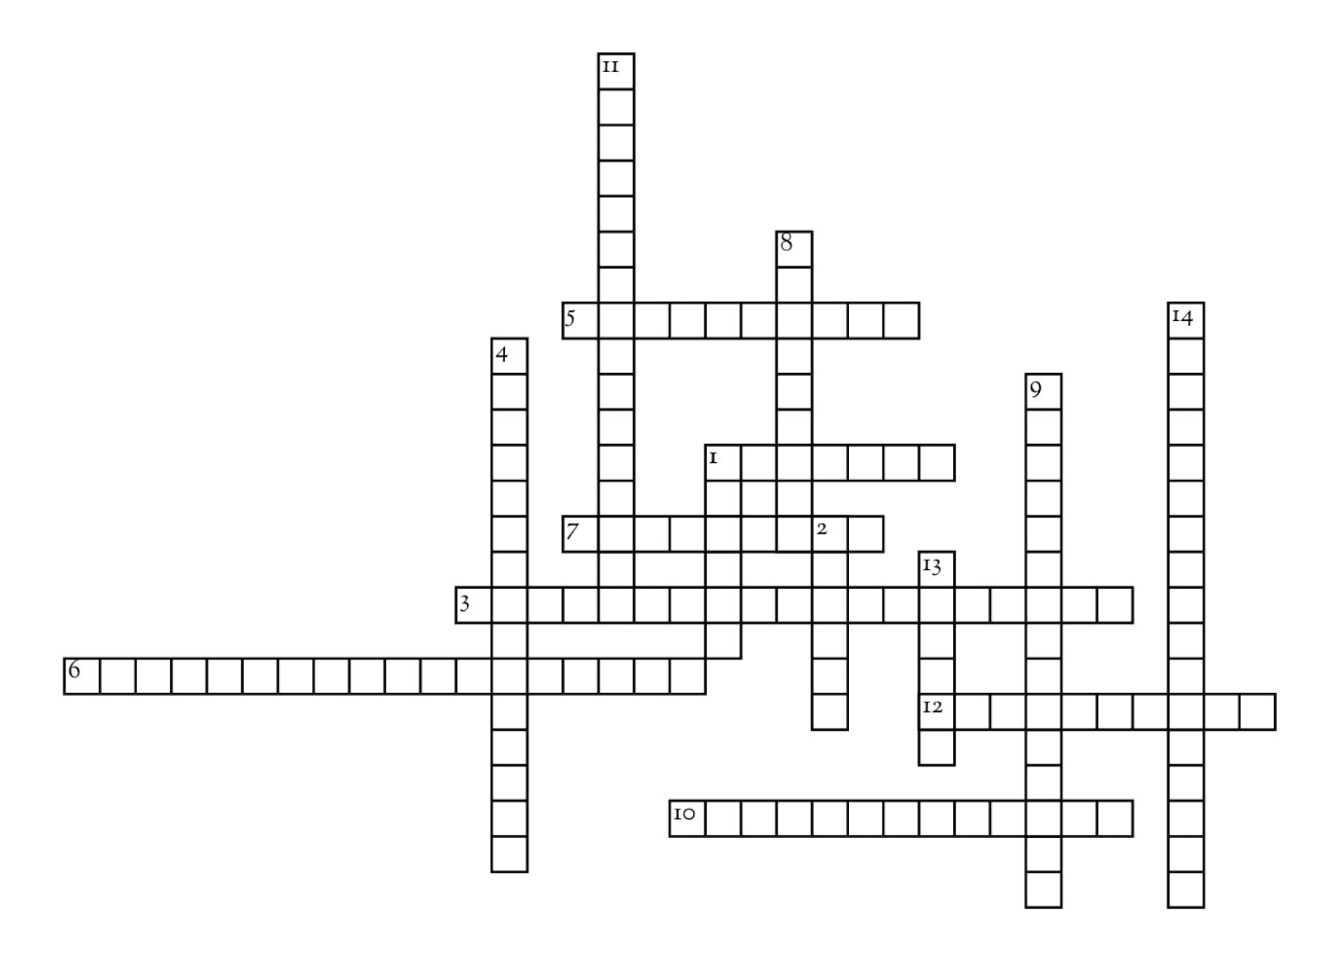
Down
1. In deep learning, this is is the collection of text, audio, images, or other source organized into a dataset. Items like newspapers, videos, music, voice recordings, books, tweets, and even recipes can make up the body of information. Once gathered, it can be used to train a model. If an AI use case requires a specific problem or objective to address, it will require a collection of data specific to the use case (e.g., medical journals) to achieve the desired machine learning or natural language output.
2. A large language model developed by Anthropic designed to generate conversational outputs that are helpful, sophisticated, harmless, and honest. It can assist with a variety of use cases that include summarization, creative writing, general Q&A, software development, and search.
4. Generative models focused on creating novel images by adding and removing noise to input images repeatedly over a series of iterations. The final image ends up looking similar to the images used as part of the training dataset.
8. An open source language framework project that combines your application with LLMs and other sources of data to deliver feature-rich capabilities in a generative AI tool.
9. A sub-field of artificial intelligence (AI) and computer science that focuses on the use of data and algorithms to imitate the way that humans learn.
11. This type of inference is a form of in-context learning that enables a model to make predictions about new classes after being trained on a single example of that class.
13. The text input supplied to large language models to allow it to generate novel text.
14. Guiding a model towards providing the best output is the goal of this type of engineering.
Across
1. Software program used in AI that simulates human conversation using text or voice interactions.
3. Ability for a given application to access info about the physical environment, anticipate changes, and automatically adapt its behavior using real time responses. Ex. generating emergency-based responses due to pattern changes in the weather that detects thunderstorms.
5. Technique where a model that is trained on a generic dataset, has additional conditions applied in order to gain more specific capabilities, for example using this technique for a specific domain or a private dataset. The process of using this technique is more cost effective than retraining a model from scratch.
6. Also known as ‘base models’ trained using large datasets, and suitable for a broad range of generative AI use cases. Creating one is time consuming, requiring numerous training cycles, and expensive, due to the amount of compute resources required. GPT, BERT, Titan, and Midjourney are a few examples.
7. The process of running data points within an ML model to produce or calculate a desired output (‘prediction’).
10. A basic concept of artificial intelligence that enables the generation of outputs based on massively trained datasets, deep learning algorithms, and input prompts from users.
12. Different variables that developers tune when they are training a ML model that helps it set up patterns for how it will perform on new data.
Generative AI Crossword Puzzle

