Slide 1
SensoDx Software Diagram
Feb. 27, 2018

Slide 2
SensoDx Software
Instrument User Interface
Database Dashboard Application
Web Applications (future)
Instrument Diagnostic Application
Presentation Layer
SensoDx Business Logic
Instrument Operations
Middle Tier Layer
Camera
Interface
SQL Database
Diagnostic Algorithms
Instrument Machine Control Firmware
Low Level Layer

Slide 3
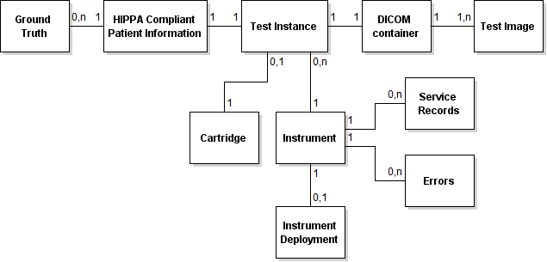
SensoDx Database Design

Slide 4
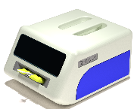
Instrument Software Architecture (near term)
User Interface
Instrument Diagnostic Application
Instrument Test Processing Logic
Instrument Task Management
Submit job with
Cartridge information
and test images
Camera
Interface
Algorithms receive test images. Algorithms return score result.
JDBC interface via URL
Diagnostic Algorithms
SQL Database (deployed locally, on a LAN, or in cloud)
Diagnostic Algorithms
Instrument Interface Control Board (IICB) and Firmware

Slide 5
Instrument Software Architecture
User Interface
Instrument Diagnostic Application
1. Is Cartridge Valid?
2. Submit job with
Cartridge (cartridge ID or
“Trust Me”) information
and test images
Instrument Test Processing Logic
Instrument Task Management
Camera
Interface
Algorithms receive test images. Algorithms return score result.
JDBC interface via URL
SQL Database (deployed locally, on a LAN, or in cloud)
Diagnostic Algorithms
Instrument Interface Control Board (IICB) and Firmaware

Slide 6

Feb. 27, 2018 Demo
User Interface
Instrument Test Processing Logic
Simulate Machine Control
Press built in test job
Drop XML into AppWatchFolder
AppWatchFolder
MC_Watchfolder
JDBC interface via URL
SQL Database (deployed locally, on a LAN, or in cloud)
DiagAlg_ Watchfolder
Simulate Diagnostic Results Component
Receive request
Generate result (random number between 0 … 1

Slide 7
isCartridgeValid Communication
Request
Response
<?xml version="1.0" encoding="utf-8"?>
<SensoDx>
<isCartridgeValid>1234567890</isCartridgeValid>
<InfoPanel1>
Request to know if Cartridge is Valid
</InfoPanel1>
</SensoDx>
<?xml version="1.0" encoding="utf-8"?>
<SensoDx>
<isCartridgeValid_response cartridgeID="1234567890"> false
</isCartridgeValid_response>
</SensoDx>

Slide 8
Submit Job example
<?xml version="1.0" encoding="utf-8"?>
<SensoDx>
<Test>
<Instrument InstrumentID="2017040300001" />
<Cartridge CartridgeID="TrustMe">
<AssayType>2</AssayType>
</Cartridge>
<TestImages>
<Image>./20180116_276.tif</Image>
<Image>./ 20180116_277.tif </Image>
<Image>./ 20180116_278.tif </Image>
</TestImages>
<Timestamp>20171107_093559001</Timestamp>
</Test>
<InfoPanel1>Processing a Test</InfoPanel1>
<InfoPanel2>Executed xyz in module abc</InfoPanel2>
</SensoDx>

Slide 9
Diagnostic Test Communication
Response
Request
<?xml version="1.0" encoding="utf-8"?>
<SensoDx>
<RequestDiagResult>
<TestID>2496</TestID>
<AssayType>2</AssayType>
<TestImages>
<ImagePath>.\1234.tif</ImagePath>
<ImagePath>.\1235.tif</ImagePath>
<ImagePath>.\1236.tif</ImagePath>
</TestImages>
<Timestamp>2018-02-20 10:33:37.111
</Timestamp>
</RequestDiagResult>
</SensoDx>
<?xml version="1.0" encoding="utf-8"?>
<SensoDx>
<DiagTestResult>
<TestID>2496</TestID>
<ResultScore>0.9894127432802498
</ResultScore>
<Timestamp>2018-02-20 10:33:37.393
</Timestamp>
</DiagTestResult>
</SensoDx>

Slide 10
To Run the Application SW on an Instrument
Download and install Java Runtime Environment for operating system
http://www.oracle.com/technetwork/java/javase/downloads/jre8-downloads-2133155.html
Run jar from batch file
java -jar .\dist\Instrument_GUI.jar
Done if system is configured to connect to cloud database
If local database required, then
Download and install MySQL database, https://www.mysql.com/downloads/
Run SQL script to load database tables, (sensodx_sql_db.sql)

Slide 11
Next Steps
Create the SensoDx database in Amazon Web Services (AWS)
In application
At start-up, connect to AWS database
Allow user to select local database
Future
At start-up, connect to AWS database
If successfully connected to AWS database, check if there’s any local data in local database
If yes, move local data to AWS database (sync up the cloud database)
If unable to connect to AWS database
Advise user that WIFI connection needed to use cloud database
Advise user that a data sync is required within TBD days (configurable duration for standalone operation)

