Slide 1

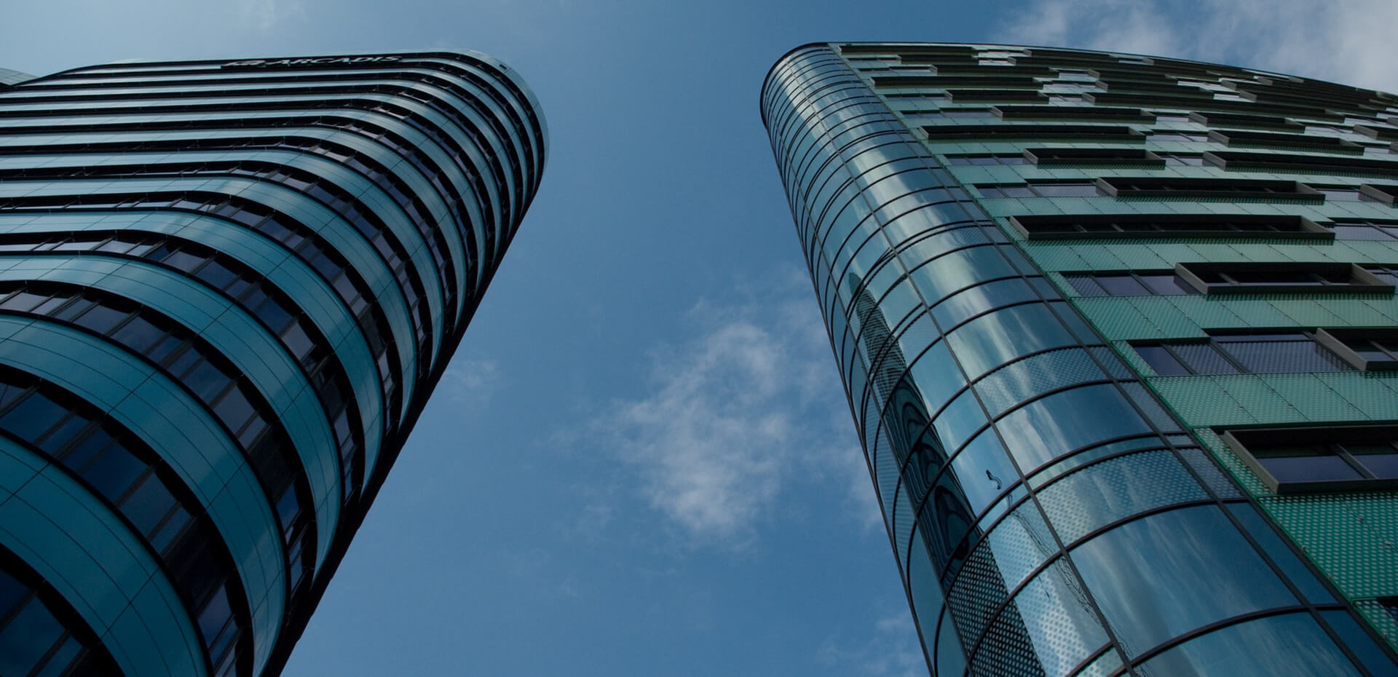
MONAGAK
Home
About
Facilities
Portal
More
WELCOME TO MONAGAK HIGH SCHOOL
MOTTO: A CENTER OF EXCELLENCE
We Offer Quality & Affordable Training. We Transform the Society through Education

Slide 2
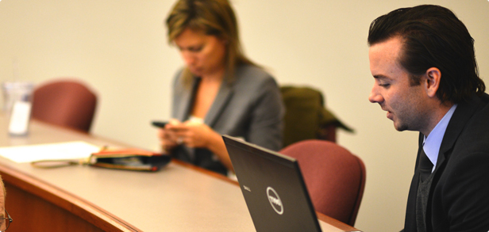
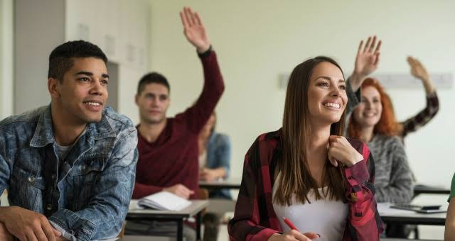

MONAGAK
Home
About
Facilities
Portal
More
ABOUT MONAGAK HIGH SCHOOL
MONAGAK High School is found in Nakuru County in Njoro Sub county. It has a population of 1500 students & 150 teachers. We are a Christian Based school & uphold moral values in all our Training. Our school was founded in 1929 by Dr. DKMNA, It was then made a National school in 2008.
We are the best preforming school in Central & Rift Valley ranked 13 in the last KCSE results

Slide 3
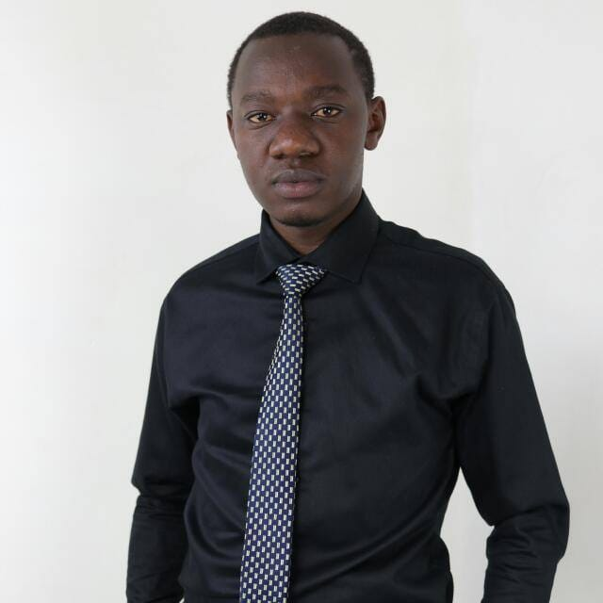
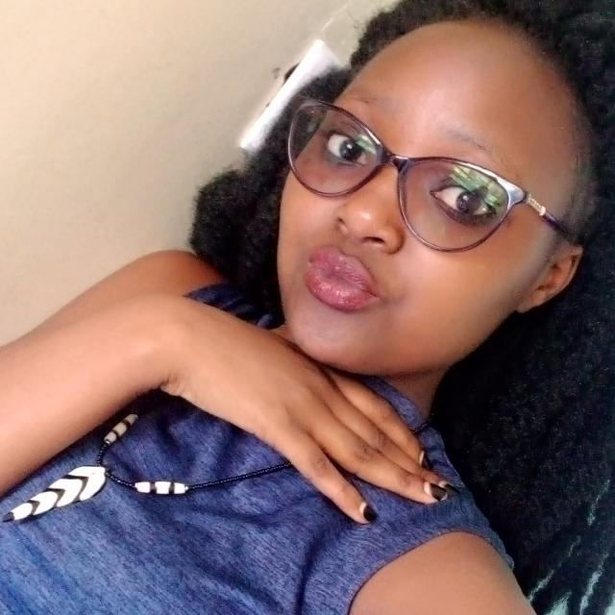
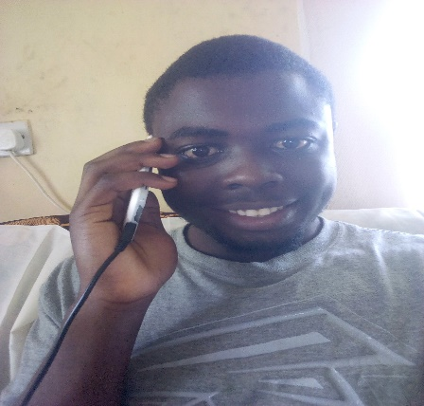
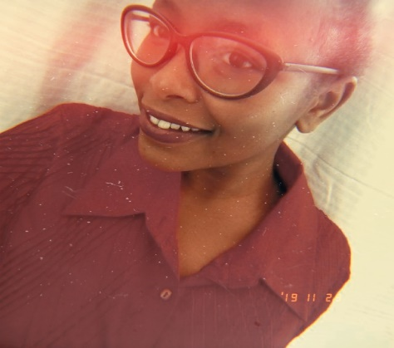
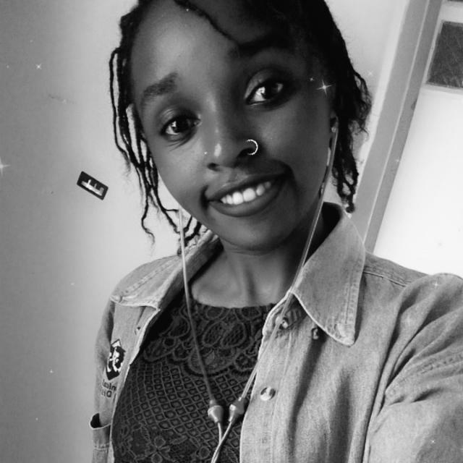

MONAGAK
About
Facilities
Portal
More
Our Administration
All
BoM(7)
SECRETARIES(5)
ACCOUNTANTS(5)
LAB TECHNICIANS(12)
OTHERS(51)
Profile
Profile

Slide 4
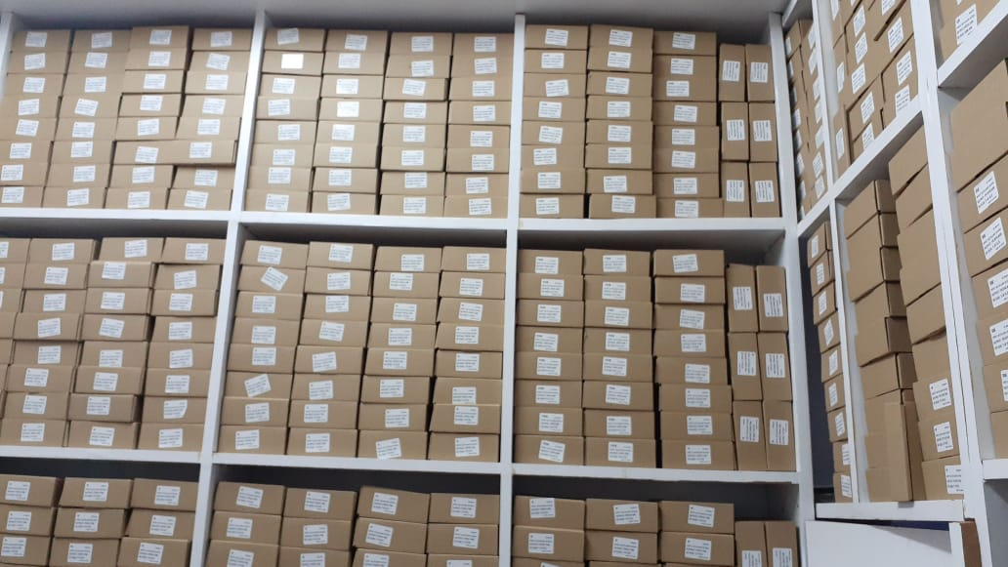

MONAGAK
Home
About
Facilities
Portal
More
Our Library
We Have the state of the Art Library with Over 5 Million books. The Library is sponsored by Oxford & Longhorn Publishers. It has a capacity of 1000 students. You can download our Library Card Here. We have 23 friendly Librarians to help students around and a back up lighting system

Slide 5


MONAGAK
Home
About
Facilities
Portal
More
Our Classrooms
We have Five Streams from Form One to Four namely:-
RED
YELLOW
BLUE
GREEN
WHITE
Our Classrooms are well maintained and student to teacher ratio is 35:1

Slide 6
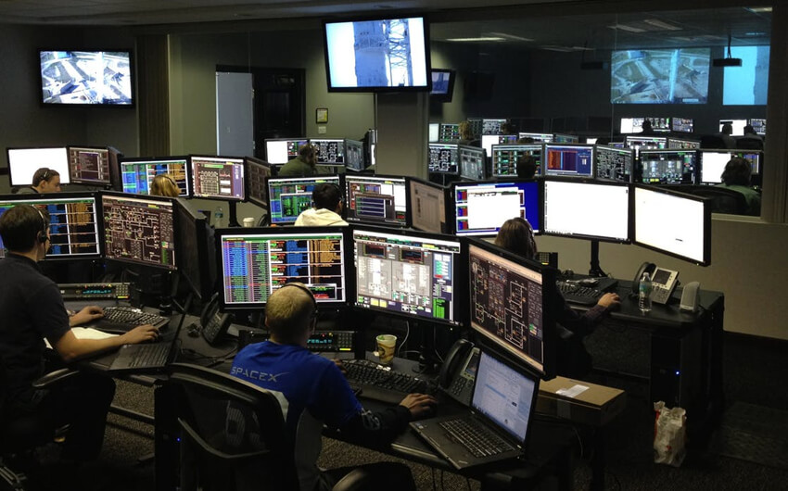

MONAGAK
Home
About
Facilities
Portal
More
Our Computer Lab
We have a Modern Computer lab with 107+ Desktop Computers, access to Wi-Fi, 12 Laser Printers and 5 computer Experts. We teach our Students computer skills, Networking, Programming, IT and Computer Packages. We’re Microsoft Partners and offer 5 Annual Scholarships to the top students to study in Netherlands

Slide 7


MONAGAK
Home
About
Facilities
Portal
More
Science Labs
We have Four Science Labs; each for Biology, Physics, Home Science and Chemistry. The labs are well equipped and maintained. This is where Scientists and Engineers are bred

Slide 8
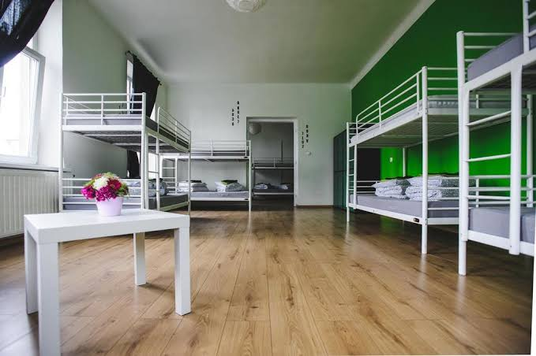
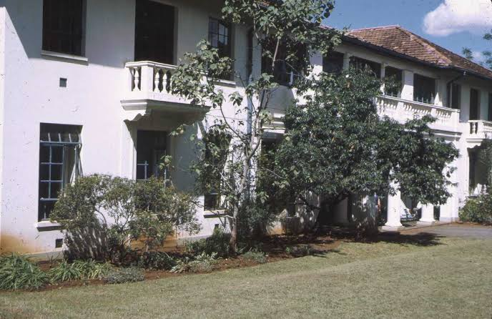
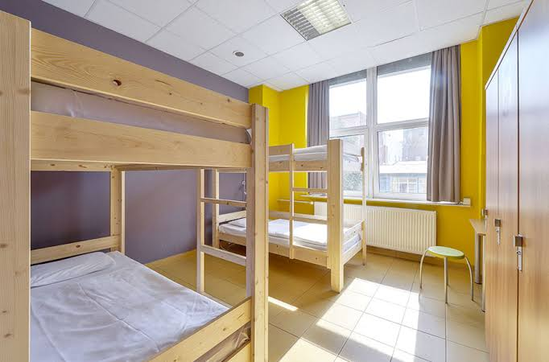
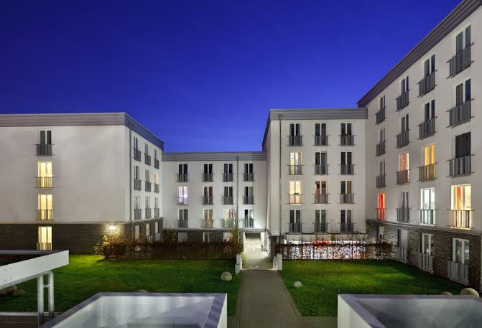
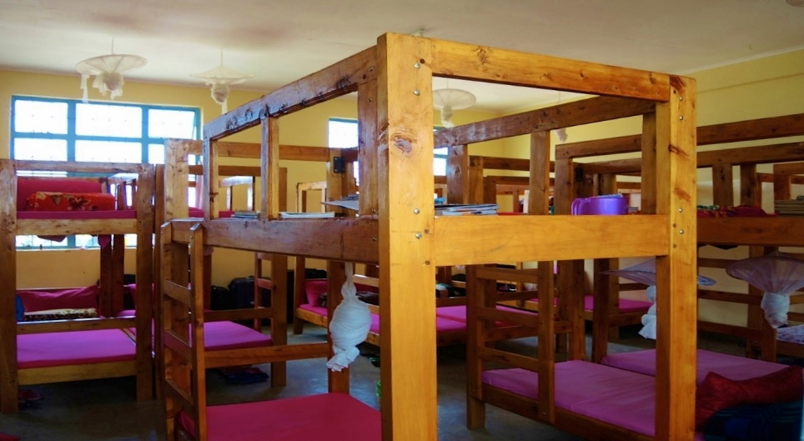
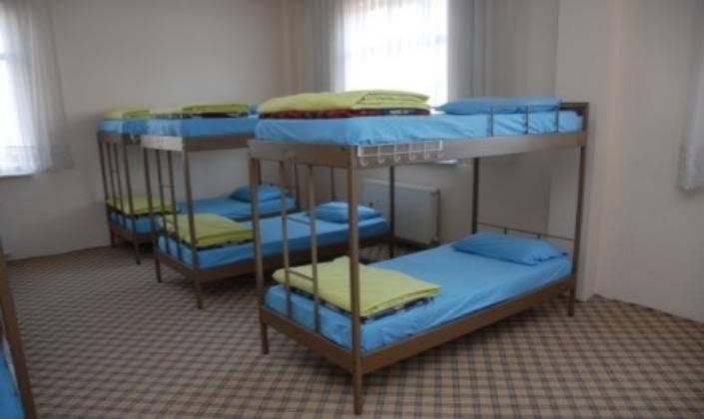
MONAGAK
Home
About
Facilities
Portal
More
Our Dormitories
We have 12 State of the Art Dormitories. We offer Mattresses and Duvets on Admission.

Slide 9
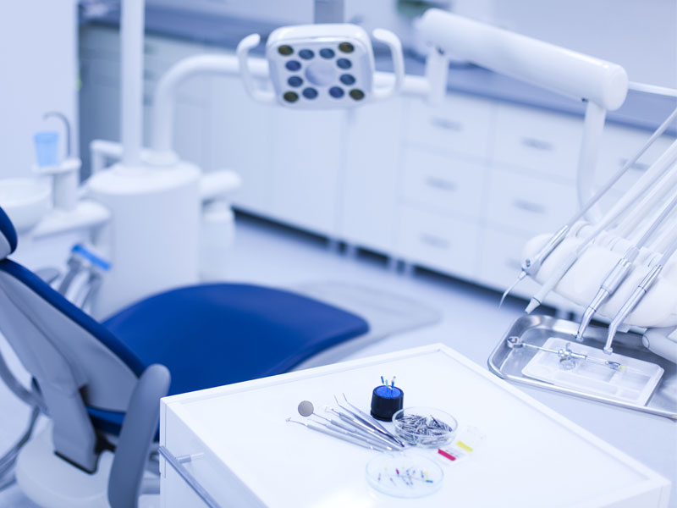

MONAGAK
Home
About
Facilities
Portal
More
Our Medical
We have highly Trained Medical Personnel & an Ambulance to respond to any Students who need Medical Attention. We also perform Regular Check ups for all our Students every Two Months
All Students are Requested to report any cases of illnesses & incase of Emergencies call 0719184534

Slide 10




MONAGAK
Home
About
Facilities
Portal
More
Games & Sports
We have a variety of Indoor and Outdoor games, namely :- Football,Tennis,Rugby,VolleyBall, Cricket, Hockey and Athletics. We have Gymnastics too! Come enjoy with us.

Slide 11

MONAGAK
Home
About
Facilities
Portal
More
Clubs
The School Recognizes & Supports the following clubs:-
      Drama
      Music
      Journalism
      Scouting
      C.U./C.A.
      I.T.
      Environment
      Science
      Muslim
      Elites

Slide 12


MONAGAK
Home
About
Facilities
Portal
More
Our Student Leaders
SCHOOL TOP PREFECTS
Every Stream has a representative. We then have Games Captain, DH Captain, Library Prefect, Academics Captain and the School’s Captain. Monagak Trains Future Leaders

Slide 13
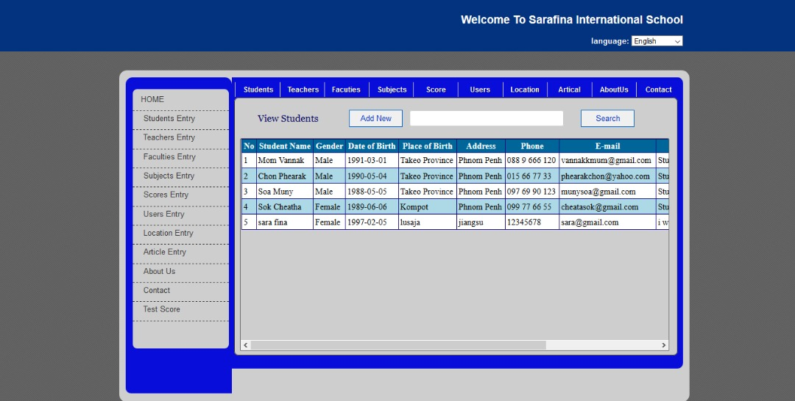
MONAGAK
Home
About
Facilities
Portal
Portal
More

Slide 14
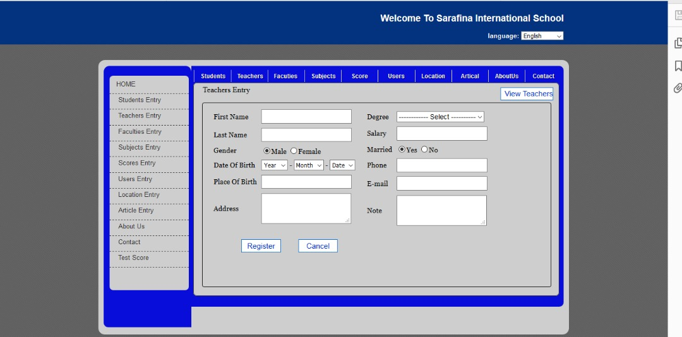
MONAGAK
Home
About
Facilities
Portal
More

Slide 15
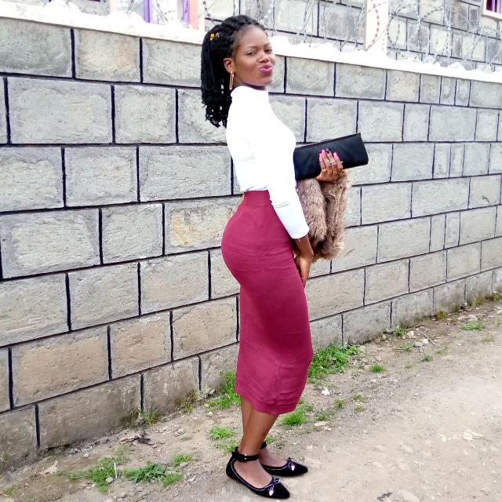
MONAGAK
Home
About
Facilities
Portal
More
Testimonials
“
Hello,
My Name is Mercy. Am an Alumni of Monagak High School class of 05
Am the Ambassador of Sydney and Dean School of Business in USIU.
This school is my choice. If you ever dream of being a Hero in Life, then this is a place for you.
Looking forward to seeing you in the forthcoming Prize Giving!
,,

Slide 16

MONAGAK
Home
About
Facilities
Portal
More
Our Blog
NEWS
COMPLAINTS
NOTICES
SCHOOL RULES
AWARDS
FAQs

Slide 17

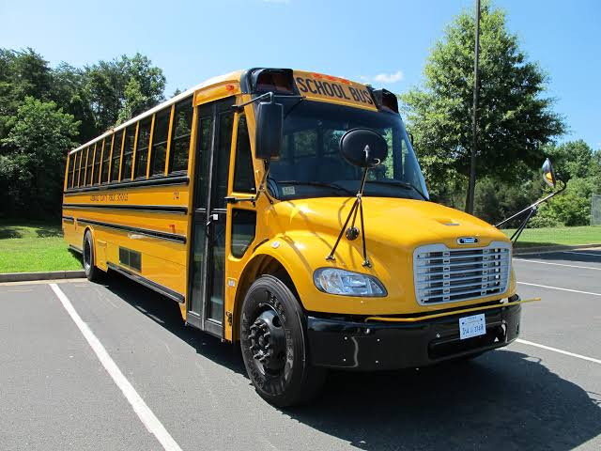
MONAGAK
Home
About
Facilities
Portal
More
CONTACT MONAGAK HIGH SCHOOL
LOCATION
EMAIL
PHONE/FAX
POSTAL ADRESS

Slide 18

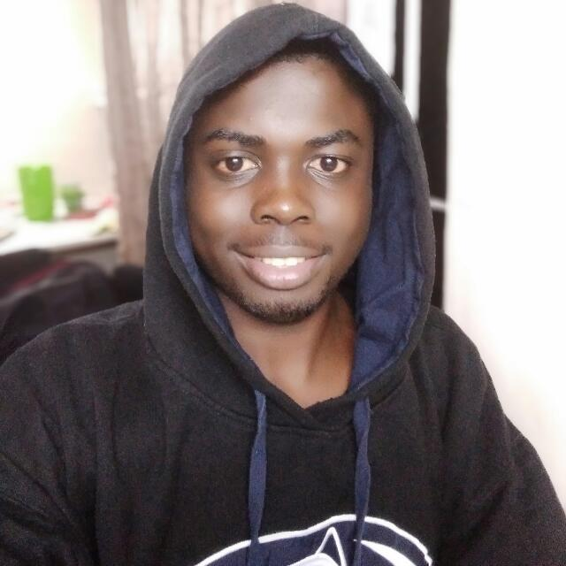
MONAGAK
Home
About
Facilities
Portal
More
DESIGNED BY:
DOMINIC KATA
0795440349
katadominic007@gmail.com
MONAGAK 2020
C

