Slide 1
Generate Gaussian samples

Slide 2
Thank you
Prof Merialdo
Buu
Giau
Bao

Slide 3
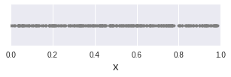
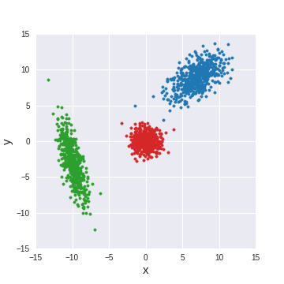
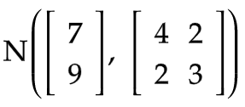
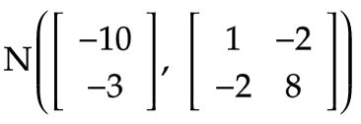
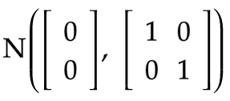


Outline
Given: Uniform random generator (numpy.random.uniform, runif)
Goal: "Generate artificial data for 2 classes, where each class is a Gaussian in the plane, N data points for each class"
For each class, generate iid (indpendent & identically distributed) points in which X and Y are independent N(0, 1)
Modify mean, variance, and covariance for the samples in each class
Repeat step 1 & 2 for the other class
②
③
①
N(0, 1)
N(0, 1)
mean vector
covariance matrix

Slide 4
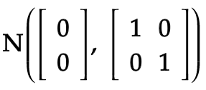
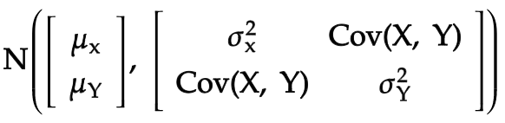
Outline
How to generate N(0, 1) from Unif(0, 1)
Inversion sampling
Box-Muller transform
"Mystery method"
How the N(0, 1) generators are implemented in R and Python
How to transform into
Applications of Gaussian sampling

Slide 5
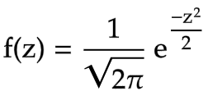
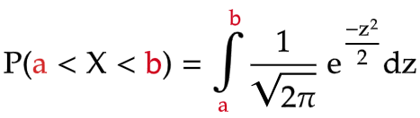
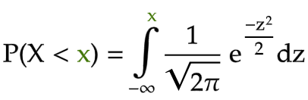
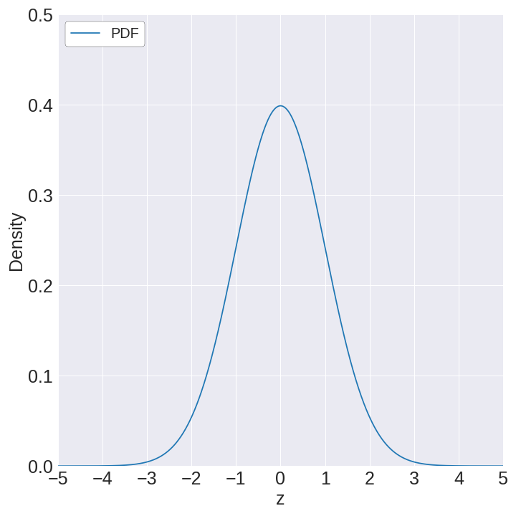
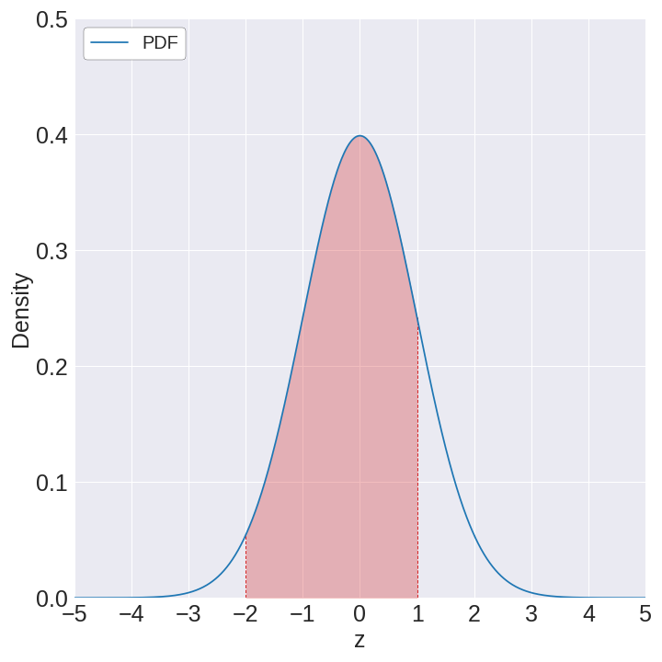
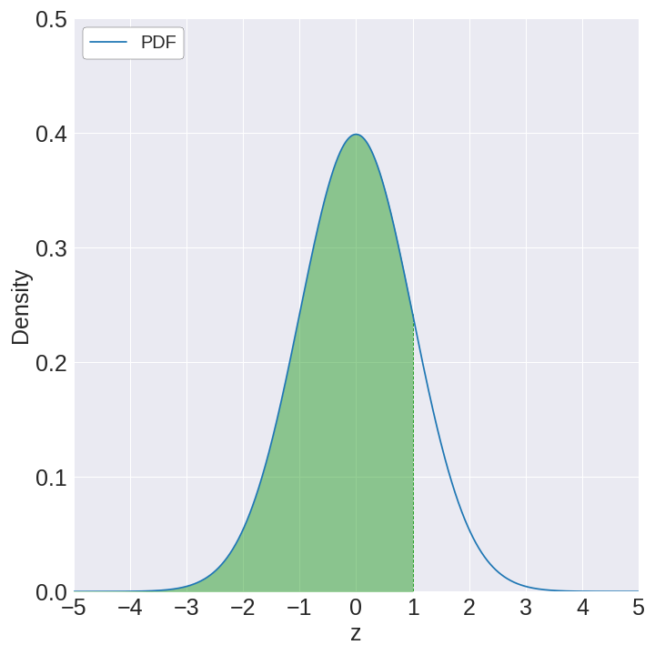
Inversion sampling
Probability density function of X ~ N(0, 1)
Cumulative probability = Area to left of x
Function that maps
Position (x) ⇨ Area
a
b
x

Slide 6
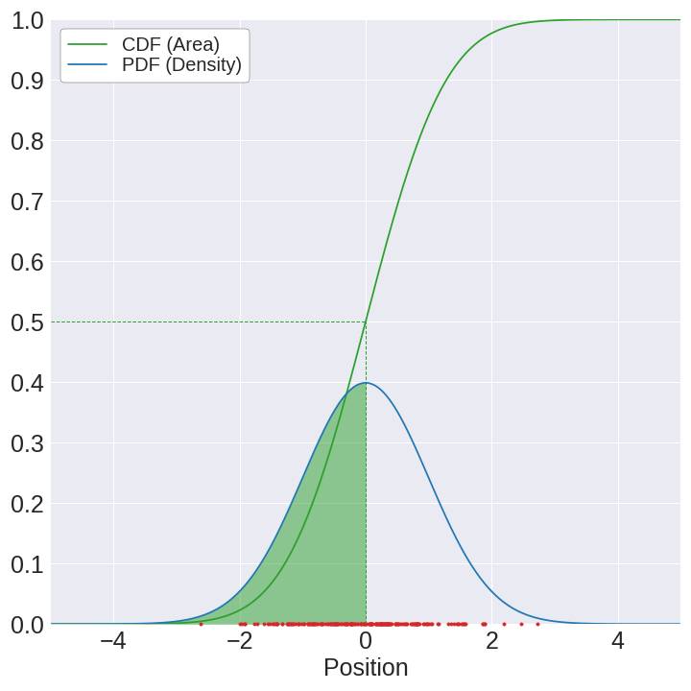
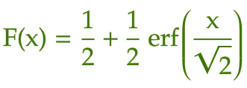
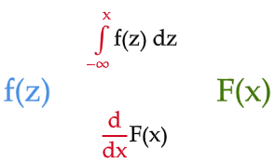
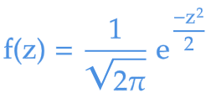
Cumulative distribution function
Converts position at a point into cumulative probability (area to the left of that point)
… the steeper the CDF is at that point
The higher the PDF is at some position ...
… the denser the samples are around it

Slide 7
For any distribution, the cumulative probability (left-side area) is always uniformly-distributed!

Slide 8
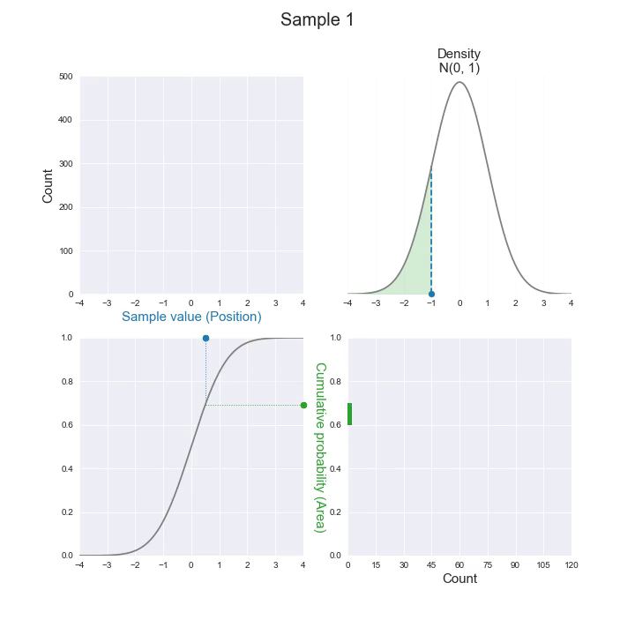

Slide 9
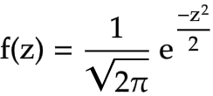
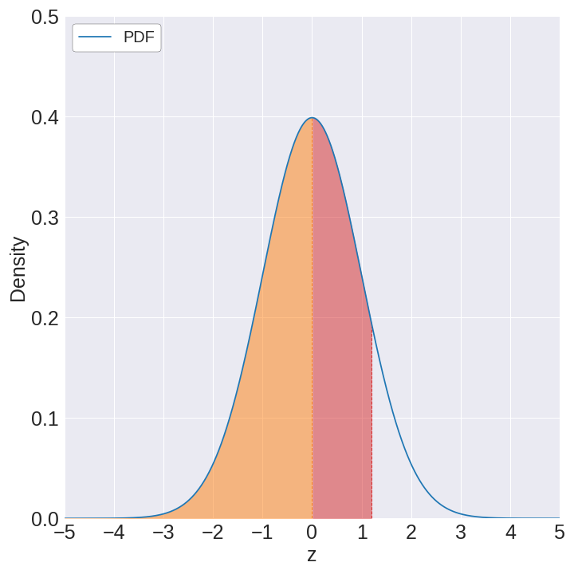
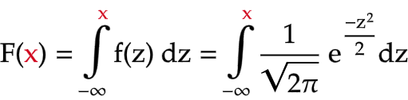
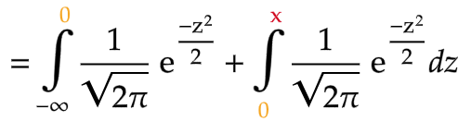
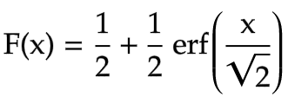

PDF of N(0, 1)
CDF of N(0, 1)
x
1/2
Common formula for CDF of N(0, 1)

Slide 10
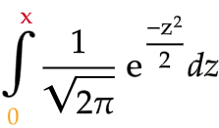

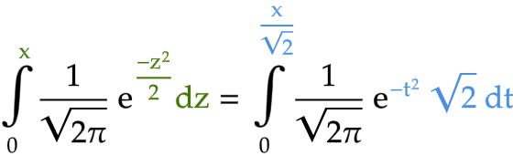
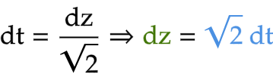




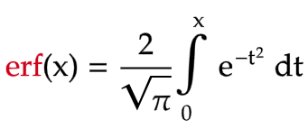



$$⟹$$

Slide 11
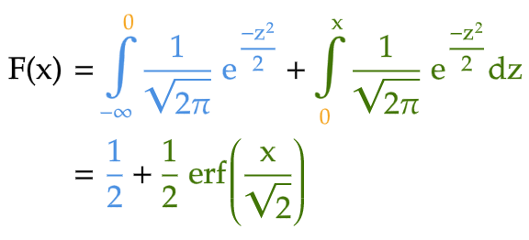
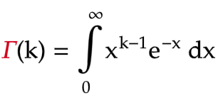
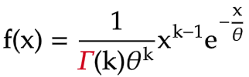

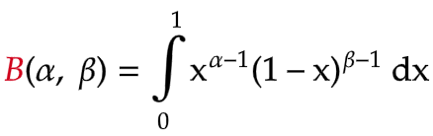
CDF of N(0, 1)
Don't be scared of strange notations in math!
Gamma distribution
Gamma function
Beta distribution
Beta function

Slide 12
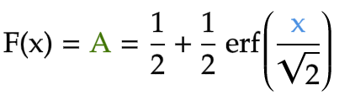
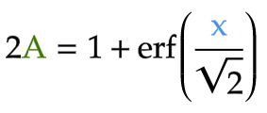
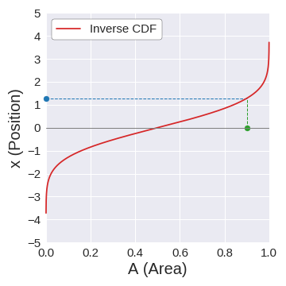

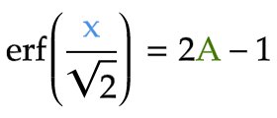
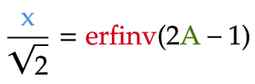





Find inverse CDF of N(0, 1)
$$⟹$$
$$⟹$$
inverse function of erf
$$⟹$$
$$⟹$$

Slide 13
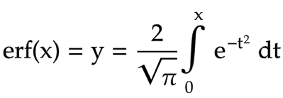

Evaluate erfinv
There's no expression for erfinv!
⇒ The only thing we can write:

Slide 14
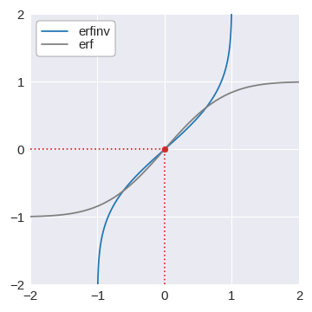
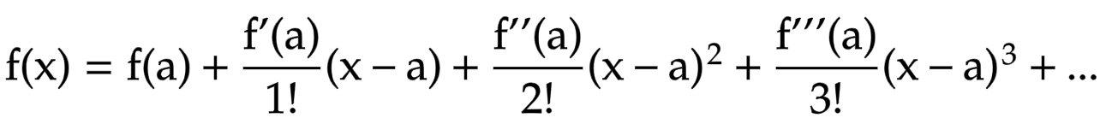
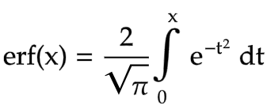
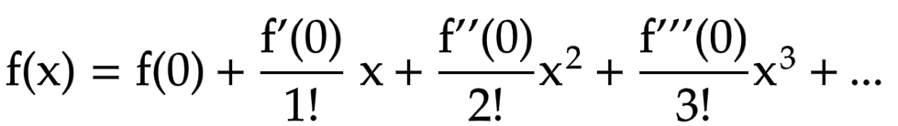
Approximate erfinv
Taylor series approximation of f(x) around x=a
Taylor series approximation of f(x) around x=0
⇓
0

Slide 15

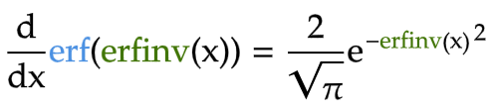
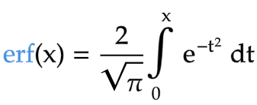
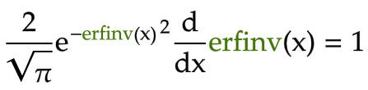
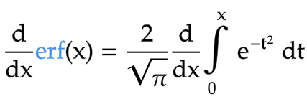
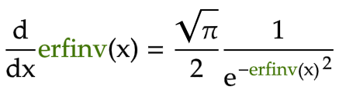
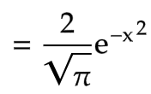
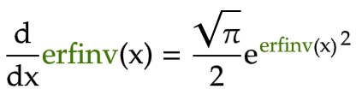
Find derivatives of erfinv

Slide 16




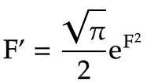


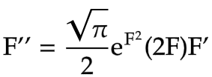





Higher derivatives of erfinv

Slide 17




Update P (polynomial of F)
p = [0, 2]
def update_p(p, n):
fp = [0] + p
two_nfp = [2*n*coeff for coeff in fp]
dp = [power*coeff for power, coeff in enumerate(p)][1:]
updated_p = [two_nfp_coeff + dp_coeff
for two_nfp_coeff, dp_coeff
in zip_longest(two_nfp, dp, fillvalue=0)]
return updated_p
p = [2, 0, 8]
fp = [0, 2, 0, 8]​
two_nfp = [0, 12, 0, 48]​
p = [2, 0, 8] ⇒ dp = [0, 0, 16]
two_nfp = [0, 12, 0, 48]​
dp = [0, 16, 0, 0]​

Slide 18
First few terms of Taylor series approximation of erfinv

Slide 19


Slide 20


Slide 21


Slide 22


Slide 23


Slide 24


Slide 25









