Slide 1
pyCuda
Young-Min Kang

Slide 2
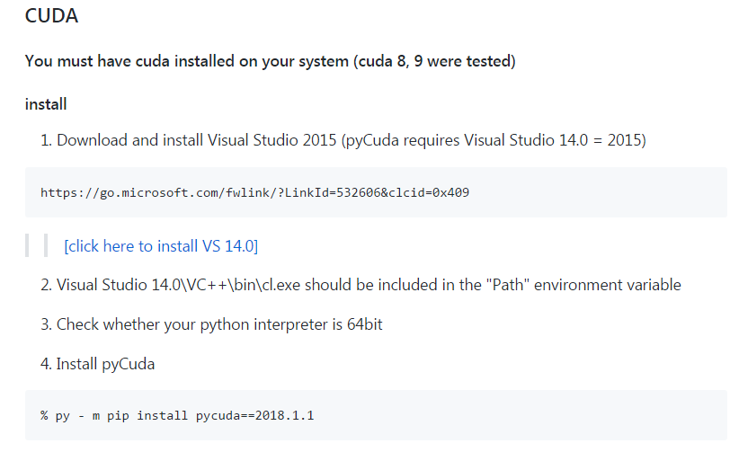
installation
Refer to
https://wiki.tiker.net/PyCuda/Installation
Old versions
Current versions
https://github.com/dknife/201802_GPUProgramming/wiki/2018GPU_CUDA_Page

Slide 3

Import and initialize
autoinit
Initialization, context creation, cleanup
Manual operations are also available
Import source module
To deal with cuda source codes

Slide 4

Transferring data
Numpy is handy
Numpy default: double precision
NVIDIA gpus: usually single precision
GPU memory
Memory copy

Slide 5
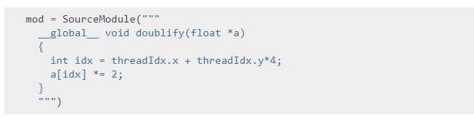

Kernel execution
SourceModule class
pycuda.compiler.SourceModule
Takes source code string as a argument of constructor
Execute the kernel

Slide 6
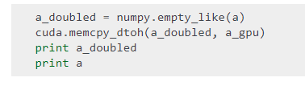
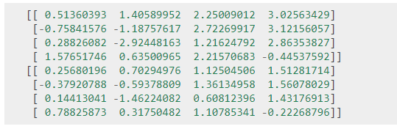
Data from device to host
Memory cpy from dev. to host
Result

