Slide 1
PyBullet Tutorial
강영민
동명대학교

Slide 2
PyBullet
물리 시뮬레이션 엔진
실제 로봇 제작으로 연결되는 것에 주안점을 둔 정확성 높은 엔진
기계학습과의 연동도 용이
지원하는 파일 포맷
URDF, SDF, MJCF
물리 계산 기능
Forward dynamics
Inverse dynamics
Forward and inverse kinematics
충돌 처리
피킹(PICKING)

Slide 3
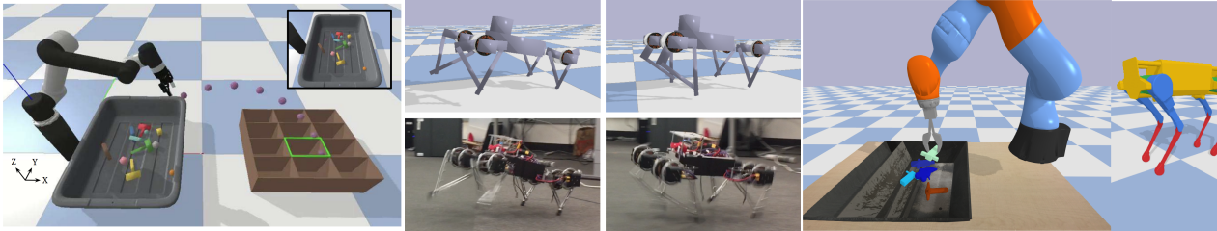
다른 기능
다양한 렌더링 기능
CPU renderer
TinyRenderer
OpenGL Visualization
Support for VR headsets
HTC Vive, Oculus Rift
Built-in client-server support

Slide 4
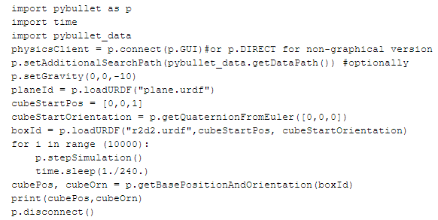
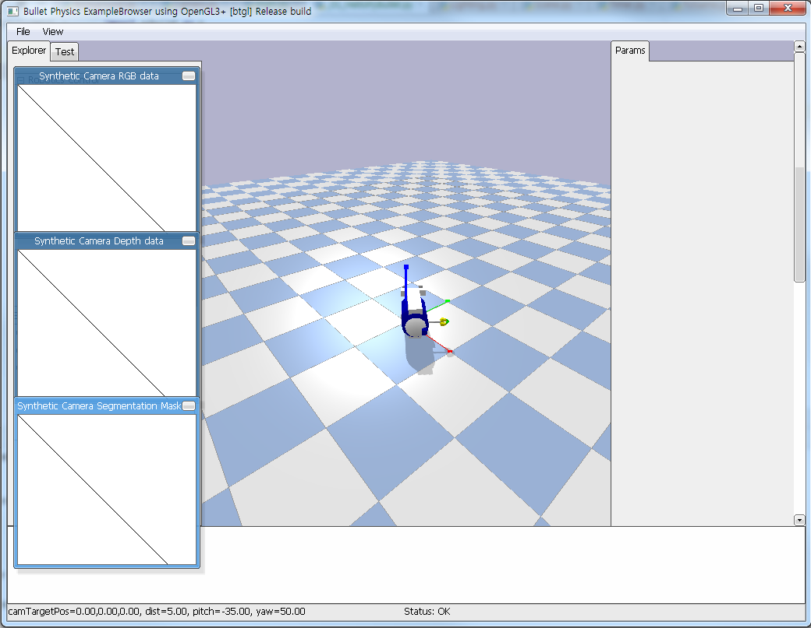
Hello PyBullet World
Pybullet 사용예

Slide 5
Connect, disconnect
처음 할 일
물리 시뮬레이션 서버에 연결
PyBullet
클라이언트-서버 기반 API
클라이언트가 명령을 보내면 서버가 이를 처리한 결과를 반환함
Built-in Physics servers
DIRECT
GUI
DIRECT
OpenGL이나 VR hardware 기능을 사용하지 못 함
getCameraImage API를 이용한 내장 CPU 렌더러 사용 가능
getConnectionInfo
주어진 클라이언트(physicsClientId)에 대해 [isConnected, connectionMethod] 반환

Slide 6
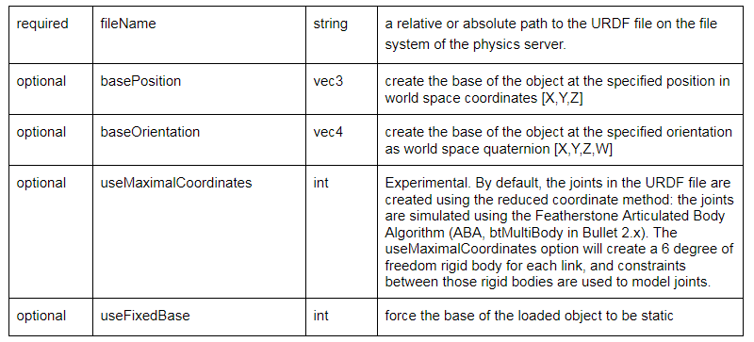
loadURDF, loadSDF, loadMJCF
loadURDF
“a universal robot description format”
Robot Operating System (ROS)에서 사용하는 포맷
Created by WillowGarage and the Open source robotics foundation (OSRF)
Most joints have motors enabled by default preventing free motion
인자들
+ optional arguments: flag, globalScaling, physicsclientId

Slide 7
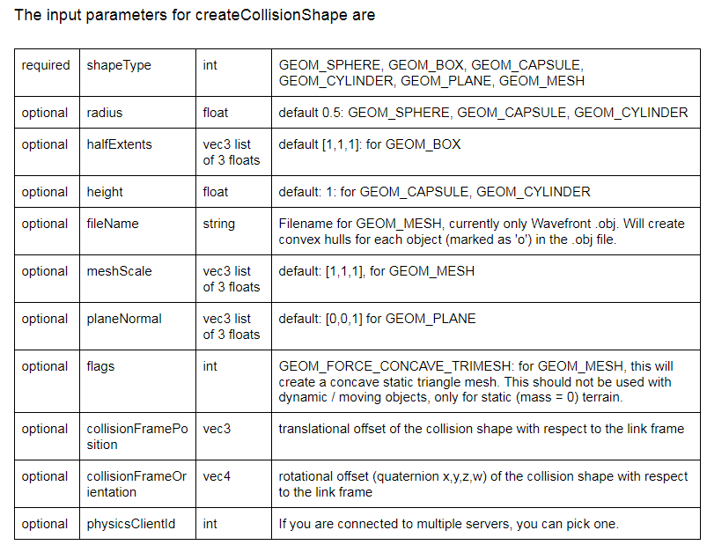
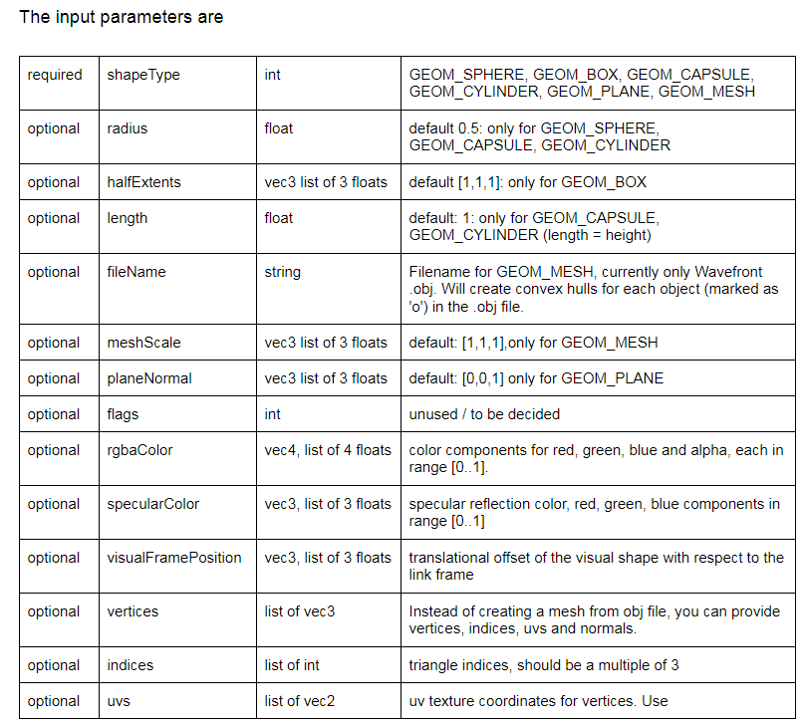
Save and restore / Collision shapes
저장과 불러오기
saveWorld
saveState
saveBullet
restoreBullet
충돌 형태
동적 객체의 외형 생성
Loading functions (urdf, sdf, mjcf, bullet)
createCollisionshape
createVisualShape

Slide 8
stepSimulation
한 단계 시뮬레이션 실시
제한조건 풀기와 수치 적분 실행
기본 시간 간격
1/240 sec
setTimeStep나 setPhysicsEngineParameterAPI로 시간간격 변경 가능
setRealTimeSimulation
실시간 시계를 이용한 시뮬레이션
이 기능이 설정되면 stepSimulation은 호출할 필요 없음

Slide 9
변환
Position
Expressed in Cartesian world space coord
Orientations
Quaternions
Euler angles
3x3 matrices
Functions
getQuaternionFromEuler
getEulerFromQuaternion
getMatrixFromQuaternion
multiplyTransforms, invertTransform
Coordinate transformation

Slide 10
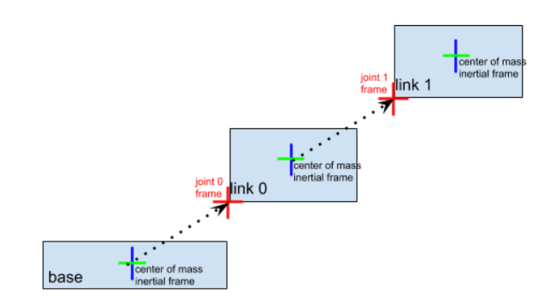
Controlling a robot
Base, joints, links
Urdf has a base
Links are optional
Connected by joints
getNumJoints
getJointInfo

Slide 11
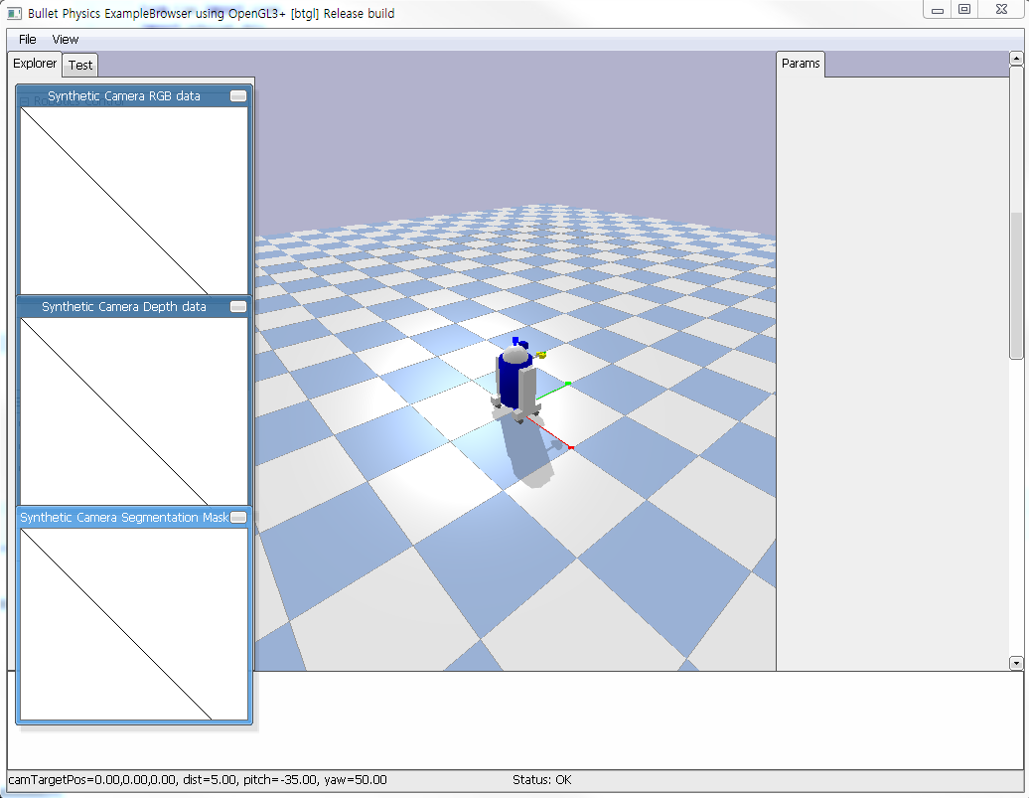
간단한 시뮬레이션 코드
import pybullet as p from time import sleep import pybullet_data physicsClient = p.connect(p.GUI) p.setAdditionalSearchPath(pybullet_data.getDataPath()) #optionally p.setGravity(0, 0, -10) planeId = p.loadURDF("plane.urdf") cubeStartPos = [0, 0, 1] cubeStartOrientation = p.getQuaternionFromEuler([0, 0, 0]) boxId = p.loadURDF("r2d2.urdf", cubeStartPos, cubeStartOrientation) cubePos, cubeOrn = p.getBasePositionAndOrientation(boxId) useRealTimeSimulation = 0 if (useRealTimeSimulation): p.setRealTimeSimulation(1) while 1: if (useRealTimeSimulation): p.setGravity(0, 0, -10) sleep(0.01) # Time in seconds. else: p.stepSimulation()
sleep(0.01) # Time in seconds.

Slide 12
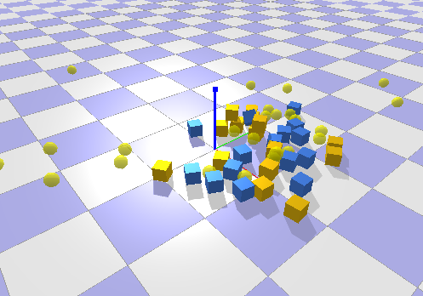
임의의 객체
import pybullet as p import time import random class World : def __init__(self): self.sphereRadius = 0.1 self.colSphereId = p.createCollisionShape(p.GEOM_SPHERE, radius=self.sphereRadius) self.colBoxId = p.createCollisionShape(p.GEOM_BOX, halfExtents=[self.sphereRadius,self.sphereRadius,self.sphereRadius]) self.mass = 1.0 self.visualShapeId = p.createVisualShape(shapeType=p.GEOM_SPHERE, radius=self.sphereRadius, rgbaColor=[1, 1, 0, 0.75]) def initPos(self): for _ in range(10) : basePosition = [random.random(), random.random(), random.random() + 1] p.createMultiBody(self.mass, self.colSphereId, self.visualShapeId, basePosition, p.getQuaternionFromEuler([0.0, 0.0, 0.0])) basePosition = [random.random(), random.random(), random.random() + 1] baseOrientation = p.getQuaternionFromEuler([random.random(), random.random(), random.random()]) p.createMultiBody(self.mass, self.colBoxId, -1, basePosition, baseOrientation) def main(): p.connect(p.GUI) planeId = p.createCollisionShape(p.GEOM_PLANE) p.createMultiBody(0.0, planeId) world = World() world.initPos() p.setGravity(0, 0, -10) p.setRealTimeSimulation(1) while (1): keys = p.getKeyboardEvents() if(keys=={32:3}) : world.initPos() time.sleep(0.01) if __name__ == '__main__': main()
충돌 형태와 시각적 형태를 설정
Multibody를 생성하여 물리 시뮬레이션 적용
(질량, 충돌 형태, 시각적 형태, 위치, 방향)
질량이 0이면 static object가 됨

Slide 13
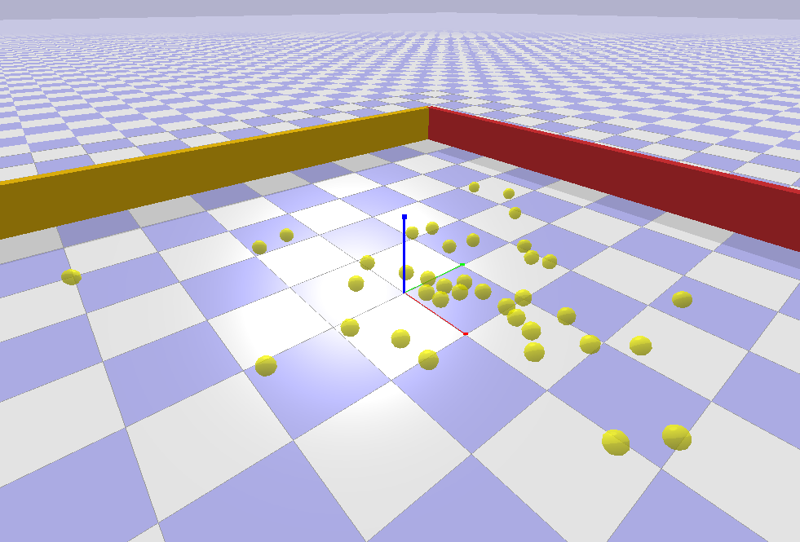
정적 객체
import pybullet as p import time import random import numpy as np class World : def __init__(self): self.sphereRadius = 0.1 self.colSphereId = p.createCollisionShape(p.GEOM_SPHERE, radius=self.sphereRadius) self.mass = 1.0 self.visualShapeId = p.createVisualShape(shapeType=p.GEOM_SPHERE, radius=self.sphereRadius, rgbaColor=[1, 1, 0, 0.75]) wallId = p.createCollisionShape(p.GEOM_BOX, halfExtents=[5.0, 0.1, 0.5]) p.createMultiBody(0, wallId, -1, [ 0, 5, 0.25], p.getQuaternionFromEuler([0.0, 0.0, 0.0])) p.createMultiBody(0, wallId, -1, [ 0,-5, 0.25], p.getQuaternionFromEuler([0.0, 0.0, 0.0])) p.createMultiBody(0, wallId, -1, [ 5, 0, 0.25], p.getQuaternionFromEuler([0.0, 0.0, 3.14/2.0])) p.createMultiBody(0, wallId, -1, [-5, 0, 0.25], p.getQuaternionFromEuler([0.0, 0.0, 3.14/2.0])) self.paddleColId = p.createCollisionShape(p.GEOM_BOX, halfExtents=[0.5, 0.1, 0.1]) self.paddle = p.createMultiBody(10.0, self.paddleColId, -1, [ 0, 0, 0.05], p.getQuaternionFromEuler([0.0, 0.0, 0.0])) def initPos(self): for _ in range(10) : basePosition = [random.random(), random.random(), random.random() + 1] p.createMultiBody(self.mass, self.colSphereId, self.visualShapeId, basePosition, p.getQuaternionFromEuler([0.0, 0.0, 0.0]))

Slide 14
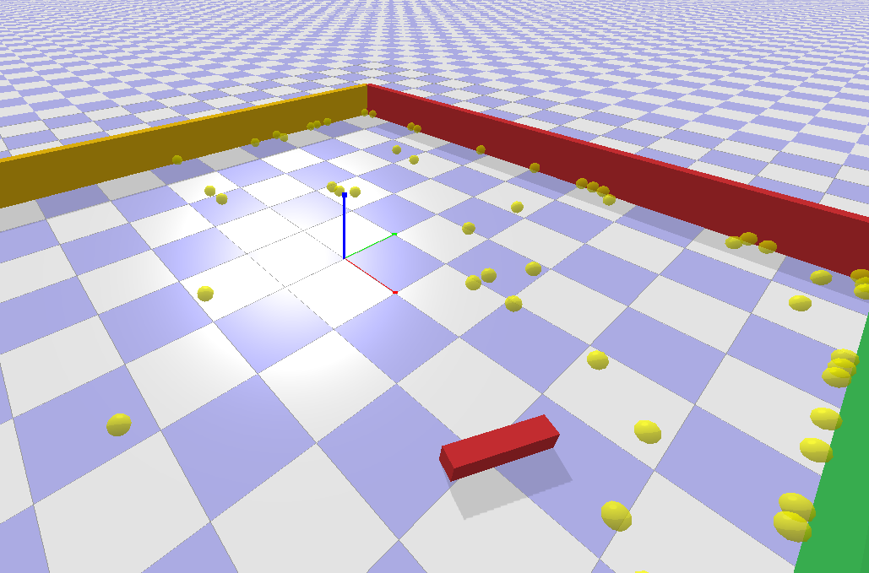
힘을 가하기
class World:
…
def force(self, dir=1.0): paddlePos, boxOrn = p.getBasePositionAndOrientation(self.paddle) p.applyExternalForce(objectUniqueId=self.paddle, linkIndex=-1, forceObj=dir*np.array([100,0,0]), posObj=paddlePos, flags=p.WORLD_FRAME) p.stepSimulation() def initPos(self): for _ in range(10) : basePosition = [random.random(), random.random(), random.random() + 1] p.createMultiBody(self.mass, self.colSphereId, self.visualShapeId, basePosition, p.getQuaternionFromEuler([0.0, 0.0, 0.0])) def main(): p.connect(p.GUI) planeId = p.createCollisionShape(p.GEOM_PLANE) p.createMultiBody(0.0, planeId) world = World() world.initPos() p.setGravity(0, 0, -10) #p.setRealTimeSimulation(1) while (1): keys = p.getKeyboardEvents() if(keys=={32:3}) : world.initPos() if (keys == {102: 1}): world.force(1) if (keys == {100: 1}): world.force(-1) p.stepSimulation() print(keys) time.sleep(0.01)

Slide 16
Links
Balancing Bot
https://backyardrobotics.eu/2017/11/29/build-a-balancing-bot-with-openai-gym-pt-ii-the-robot-and-environment/

