Slide 1
gRPC
Dekan KILIÇ

Slide 2
RPC Frameworks
Java RMI
gRPC
Apache Avro
Apache Thrift
Dekan KILIÇ

Slide 3
What is RPC
Remote Procedure Call is a protocol that one program can use to request a service from a program located on another computer in a network. RPC is used for client-server based applications, where multiple devices need to communicate with each other.
Server - 1
ABC Service
Server - 2
XYZ Service
RPC
Dekan KILIÇ

Slide 4
Features of RPC
Synchronous Communication: Typically, the client sends a request to the server and waits for a response making RPCs synchronous in nature.
Data Serialization: Data sent over the network needs to be serialized (converted into a stream of bytes) and then deserialized on the receiving end.
Dekan KILIÇ

Slide 5
What is gRPC
Open-source framework developed by Google for building high-performance, scalable, and efficient distributed systems
Modern and Lightweight communication protocol
Based on Remote Procedure Call model and uses protocol buffers data serialization format to define the structure of messages and service interfaces
Dekan KILIÇ

Slide 6
Why gRPC
Microservices: gRPC is designed for low latency and high throughput communication. gRPC is great for lightweight microservices where efficiency is critical.
Point-to-point real-time communication: gRPC has excellent support for bi-directional streaming. gRPC services can push messages in real-time without polling.
Network constrained environments: gRPC messages are serialized with Protobuf, a lightweight message format. A gRPC message is always smaller than an equivalent JSON message.
Dekan KILIÇ

Slide 7
Communication Patterns
Unary RPC
The most basic pattern used by gRPC is the Unary RPC, which allows a client to send a single request to a server and receive a single response in return.
single request
Server 1
Server 2
HTTP/2
single response

Slide 8
Server Streaming RPC
Server Streaming RPC allows a client to send a request to a server and receive a bunch of streams of responses in return. This is useful for cases where the server needs to send a bunch of data to the client.
single request
Server 1
Server 2
HTTP/2
stream of response

Slide 9
Client Streaming RPC
Client Streaming RPC allows a client to send a stream of requests to a server and receive a single response. This pattern is useful if the client needs to send a stream of data to the server.
stream of request
Server 1
Server 2
HTTP/2
single response

Slide 10
Bidirectional Streaming RPC
Bidirectional RPC allows a client to send a stream of requests to a server and receive a stream of responses. This is useful if the client needs to send to a server and receive a bunch of data from server.
stream of request
Server 1
Server 2
HTTP/2
stream of response

Slide 11
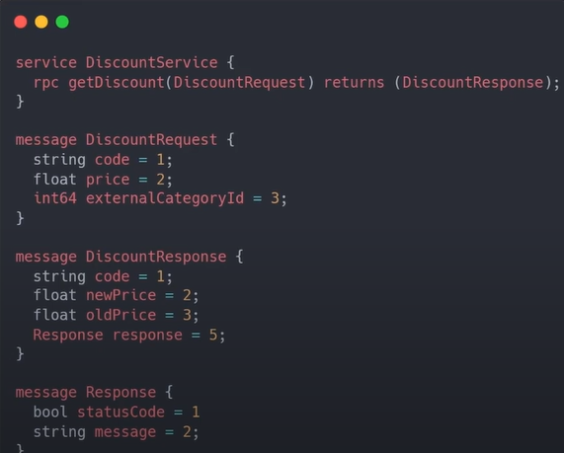
Service Definition

Slide 12
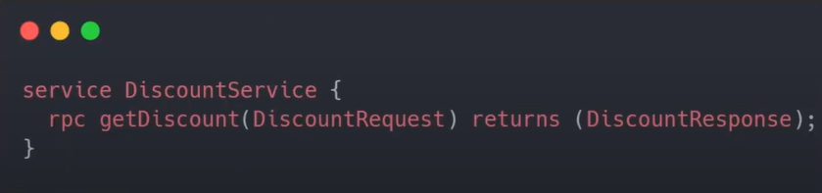
Unary RPC Service Definition
Unary RPCs where the client sends a single request to the server and gets a single response back

Slide 13
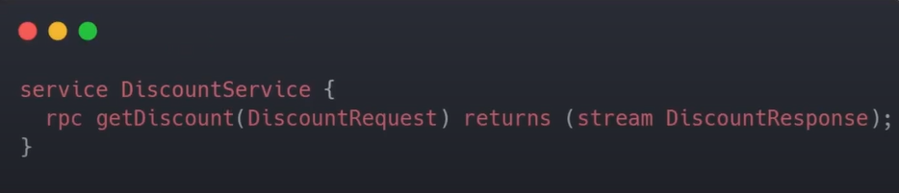
Server Streaming RPC Service Definition
Server streaming RPCs where the client sends a request to the server and gets a stream to read a sequence of messages back. The client reads from the returned stream until there are no more messages.

Slide 14
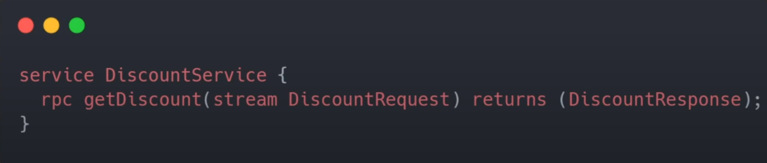
Client Streaming RPC Service Definition

Slide 15
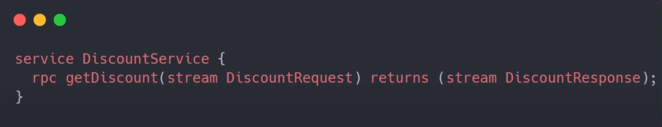
Bi-directional RPC Service Definition

Slide 16
Protocol Buffers
Protocol Buffers are a language-neutral, platform-neutral extensible mechanism for serializing structured data.
Dekan KILIÇ

Slide 17
Working with Protocol Buffers
Protocol Buffers is open source mechanism for serializing structured data provided by Google
Define your data structure in a proto file. This data is structured as messages
Uses protocol buffer compiler, protoc, to generate data access classes in preferred language
You can also define your services in proto file to expose them to user
Dekan KILIÇ

Slide 18
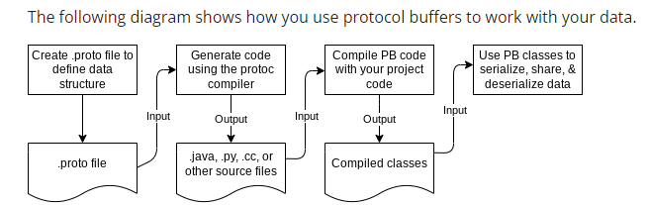
How Protocol Buffer works
Dekan KILIÇ

Slide 19
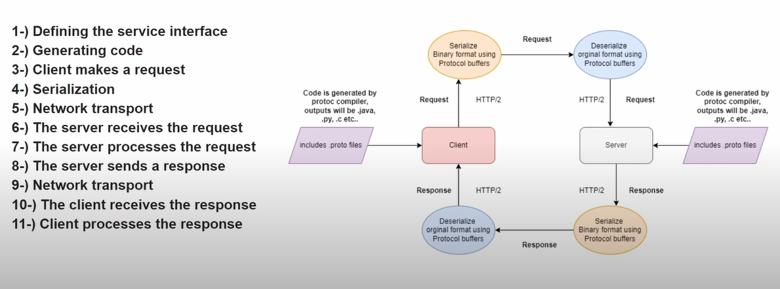
How gRPC works

Slide 20
gRPC Client-Server Example
gRPC
Stub
Java Client
Proto Request
gRPC Server
Go Service
Proto Response
Proto Request
gRPC
Stub
C++ Client
Proto Response
Dekan KILIÇ

Slide 21
Message
scalar types including various data types like double, int32, etc…
message LoginRequest {
string username = 1;
string password = 2;
}
unique field number used to identify field within message binary format
Dekan KILIÇ

Slide 22
Message Advanced Example
message CreateProductRequest{
reserved 2
reserved “price”;
required string title = 1;
repeated Recommendation = 3; // There can be 0 to n recommendation for this product
enum Color {
BLUE = 1;
RED = 2;
GREEN = 3;
}
optional Color color = 4 [ default = RED];
}
message Recommendation {
int32 product_id = 1;
string product_url = 2;
string title = 3;
string image_url = 4;
}
Dekan KILIÇ

