Slide 1
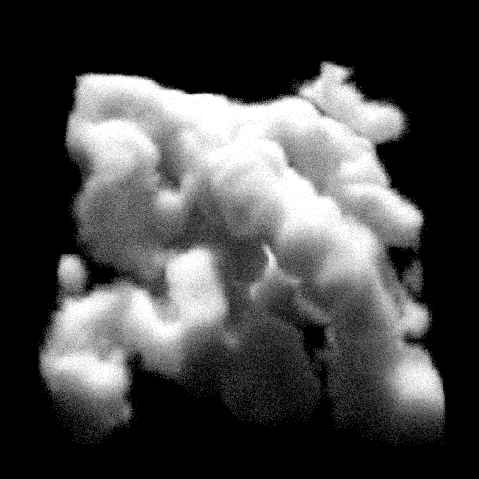
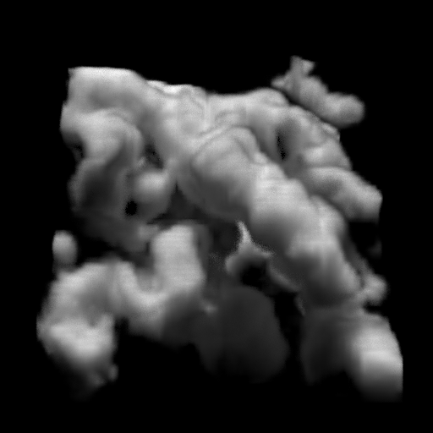
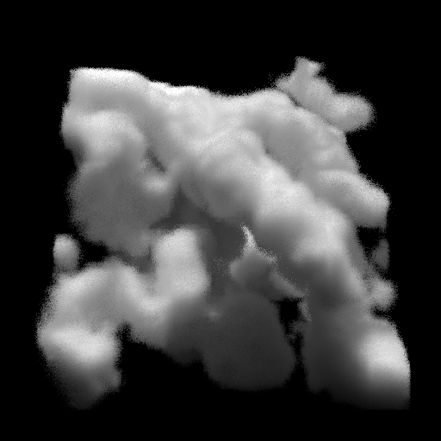

PN-Method for Multiple Scattering in Participating Media
David Koerner¹, Jamie Portsmouth² and Wenzel Jacob³
¹Visualization Research Center, University of Stuttgart ²Solid Angle ³ École polytechnique fédérale de Lausanne (EPFL)
^{Path Tracing}
^{P5}
^{FLD}

Slide 2
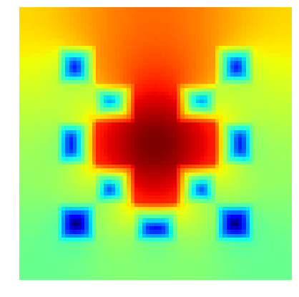
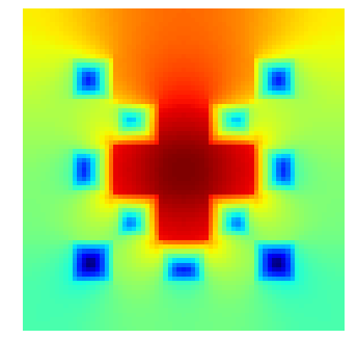
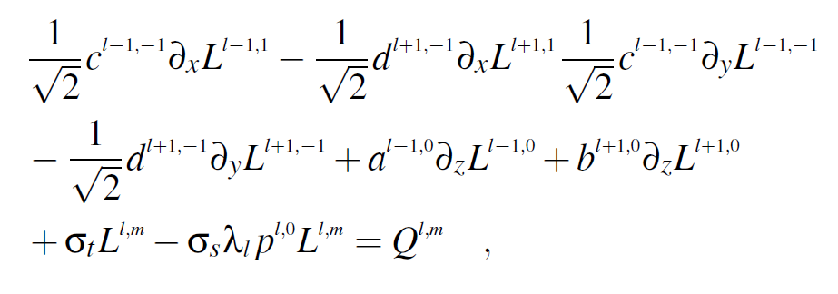
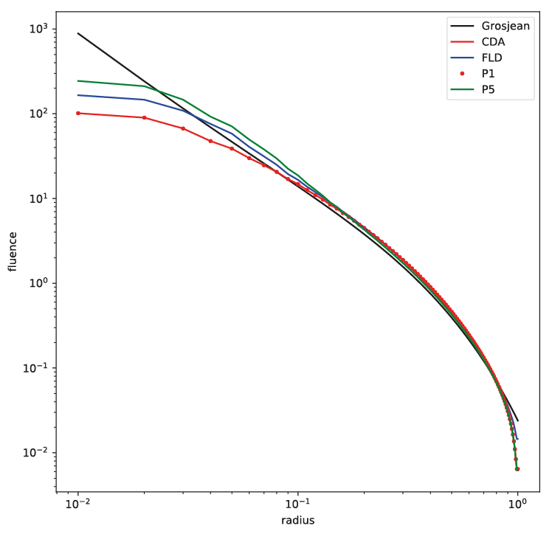
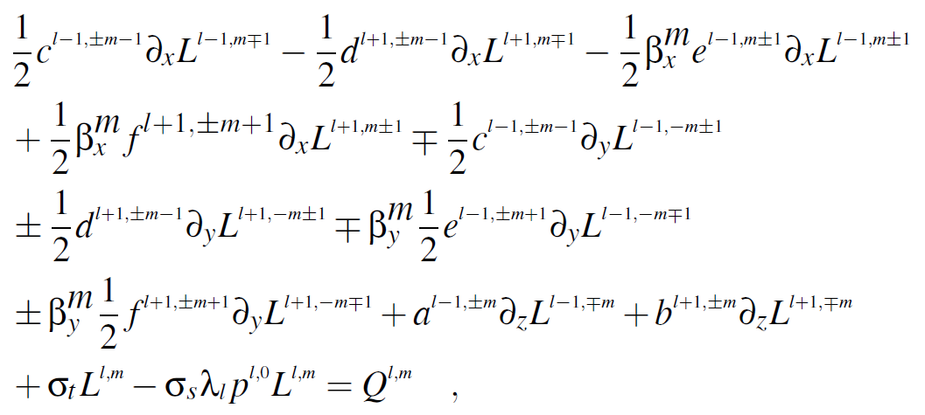

Contributions
PN-Equations
Solver
$$\vec{u}$$

Slide 3
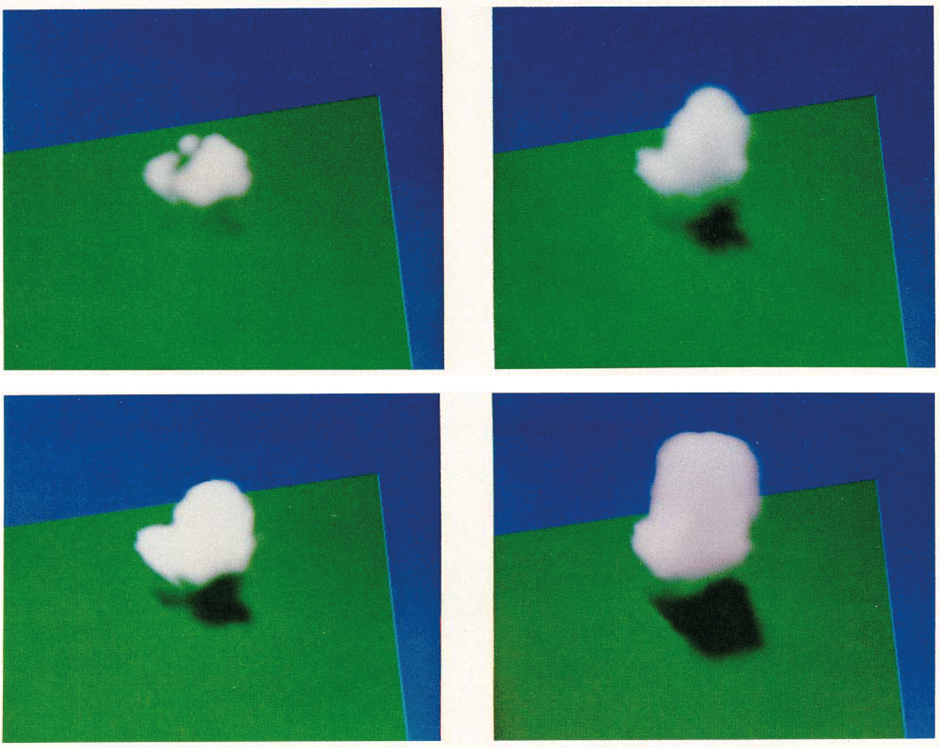
Previous Work
[Kajiya 1984]

Slide 4

PN-Equations
$$\left(ω⋅∇\right)L\left(\vec{x},ω\right)=−σ_{t}L\left(\vec{x},ω\right)+σ_{s}\int_{Ω^{′}}{ρ\left(\vec{x},ω^{′}→ω\right)L\left(\vec{x},ω′\right)dω′}+Q\left(\vec{x},ω\right)$$
$$𝒯\left(L\right)=−𝒞\left(L\right)+𝒮\left(L\right)+Q$$
Notes:
-explain the idea behind deterministic methods

Slide 5






PN-Equations
$$L\left(\vec{x},ω\right)$$
$$\vec{u}$$
Discretization
$$Q\left(\vec{x},ω\right)$$
$$\vec{q}$$
$$𝒯\left(L\right)=−𝒞\left(L\right)+𝒮\left(L\right)+Q$$
$$A\vec{u}=\vec{q}$$
Notes:
-explain the idea behind deterministic methods

Slide 6
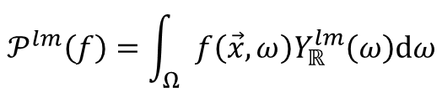
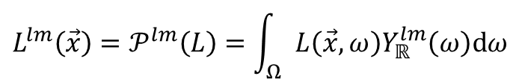
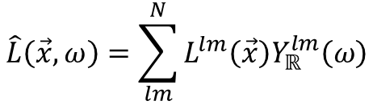
PN-Equations
$$𝒫^{lm}\left(f\right)=\int_{Ω}{f\left(\vec{x},ω\right)Y_{ℝ}^{lm}\left(ω\right)dω}$$
$$L^{lm}\left(\vec{x}\right)=𝒫^{lm}\left(L\right)=\int_{Ω}{L\left(\vec{x},ω\right)Y_{ℝ}^{lm}\left(ω\right)dω}$$
$$\hat{L}\left(\vec{x},ω\right)=\sum_{lm}^{N}{L^{lm}\left(\vec{x}\right)Y_{ℝ}^{lm}\left(ω\right)}$$
Notes:
-discretization of angular domain using spherical harmonics

Slide 7


PN-Equations
$$𝒯\left(L\right)=−𝒞\left(L\right)+𝒮\left(L\right)+Q$$
$$𝒯\left(\hat{L}\right)=−𝒞\left(\hat{L}\right)+𝒮\left(\hat{L}\right)+Q$$
$$𝒫^{lm}∘𝒯\left(\hat{L}\right)=−𝒫^{lm}∘𝒞\left(\hat{L}\right)+𝒫^{lm}∘𝒮\left(\hat{L}\right)+𝒫^{lm}\left(Q\right)$$
Notes:
-derivation of the pn-equations has two steps
1.replacing L with its SH reconstruction
2.Applying the projection operator to the RTE after replacement
-results in a coupled system of PDEs. The number of equations is driven by the truncation order N

Slide 8
PN-Solver
Notes:
-number of equations of the system depends on user parameter N and not known in advance
-number of equations increases exponentially with N. Going through the steps manually is laborious, time consuming and prone to errors
-modifications and other closures DN, FPN, LSPN, etc.

Slide 9

PN-Solver
$$…\frac{∂}{∂x}φ\left(\vec{x}\right)$$
Partial differential equation (PDE)

Slide 10



PN-Solver
$$…\frac{∂}{∂x}φ\left(\vec{x}\right)$$
...
Partial differential equation (PDE)
...
$$∂_{x}$$
$$φ$$
$$\vec{x}$$

Slide 11
PN-Solver
$$…\frac{∂}{∂x}φ\left(\vec{x}\right)$$
...
Partial differential equation (PDE)
Apply discretization
...
$$∂_{x}$$
$$φ$$
$$\vec{x}$$

Slide 12








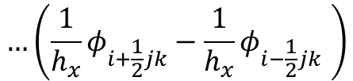
PN-Solver
$$…\left(\frac{1}{h_{x}}φ_{i+\frac{1}{2}jk}−\frac{1}{h_{x}}φ_{i−\frac{1}{2}jk} \right)$$
...
Partial differential equation (PDE)
Apply discretization
...
-
*
*
.
.
.
$$φ$$
.
$$φ$$
1
$$h_{x}$$
$$i$$
$$\frac{1}{2}$$
1
$$h_{x}$$
$$i$$
$$\frac{1}{2}$$
$$−$$
$$+$$

Slide 13
PN-Solver
$$…\left(\frac{1}{h_{x}}φ_{i+\frac{1}{2}jk}−\frac{1}{h_{x}}φ_{i−\frac{1}{2}jk} \right)$$
...
Partial differential equation (PDE)
Apply discretization
Bring into canonical form
...
-
*
*
.
.
.
$$φ$$
.
$$φ$$
1
$$h_{x}$$
$$i$$
$$\frac{1}{2}$$
1
$$h_{x}$$
$$i$$
$$\frac{1}{2}$$
$$−$$
$$+$$

Slide 14







PN-Solver
$$+\frac{1}{h_{x}^{2}}φ_{i+1jk}+…=q_{ijk}$$
$$+…$$
+
Partial differential equation (PDE)
Apply discretization
Bring into canonical form
...
*
...
.
.
$$φ$$
1
$$h_{x}^{2}$$
$$+$$
$$1$$
$$i$$

Slide 15
PN-Solver
$$+\frac{1}{h_{x}^{2}}φ_{i+1jk}+…=q_{ijk}$$
$$+…$$
+
Partial differential equation (PDE)
Apply discretization
Bring into canonical form
Stencil code crafting
...
*
...
.
.
$$φ$$
1
$$h_{x}^{2}$$
$$+$$
$$1$$
$$i$$

Slide 16

PN-Solver
$$+\frac{1}{h_{x}^{2}}φ_{i+1jk}+…=q_{ijk}$$
$$+…$$
+
Partial differential equation (PDE)
Apply discretization
Bring into canonical form
Stencil code crafting
...
*
...
.
.
$$φ$$
1
$$h_{x}^{2}$$
$$+$$
$$1$$
$$i$$

Slide 17
PN-Solver
Partial differential equation (PDE)
Apply discretization
Bring into canonical form
Stencil code crafting
Propagate A and b and apply boundary conditions

Slide 18



PN-Solver
Stencil
Scene
VoxelGrid
Partial differential equation (PDE)
Apply discretization
Bring into canonical form
Stencil code crafting
Propagate A and b and apply boundary conditions
PNSystemBuilder
$$A$$
$$\vec{u}$$
$$\vec{b}$$

Slide 19

PN-Solver
Stencil
Scene
VoxelGrid
Partial differential equation (PDE)
Apply discretization
Bring into canonical form
Stencil code crafting
Propagate A and b and apply boundary conditions
Solve Au=b for u
PNSystemBuilder
$$A$$
$$×$$
$$\vec{u}$$
=
$$\vec{b}$$

Slide 20
Results

Slide 21
Results – Point Source Problem

Slide 22

Results – Nebulae
^{Path Tracing}
^{Classical Diffusion}

Slide 23
Results – Nebulae
^{Path Tracing}
^{P5}

Slide 24
Results – Nebulae
^{Path Tracing}
^{P5}
^{Flux-limited Diffusion}

Slide 25
Outlook
Multigrid
Variations: Simplified-PN, Filtered-PN, Diffusion-PN, Least Squares-PN

Slide 26
Thanks
https://github.com/dkoerner/PN-Method

