Slide 1
Classification of Space Debris
Daniel Kolosa

Slide 2
Introduction
What is space debris and why is it an issue?
Dataset and Methods
Statistical learning method and resutls
Conclusion and future work

Slide 3
Space Debris Problem
Debris currently orbits around Earth in GEO (35,000 km) and LEO (5,000 km)
Debris in LEO may re-enter the atmosphere and burn up but many remain
With continued buildup, space travel can become too dangerous

Slide 4
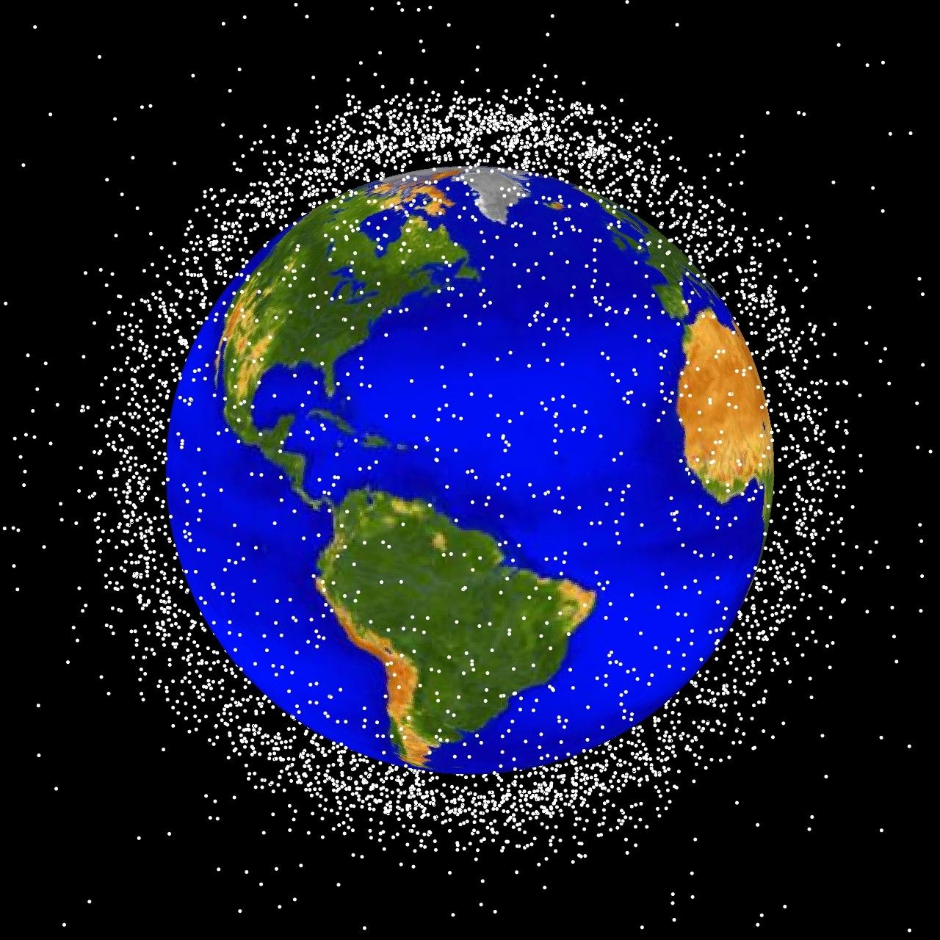
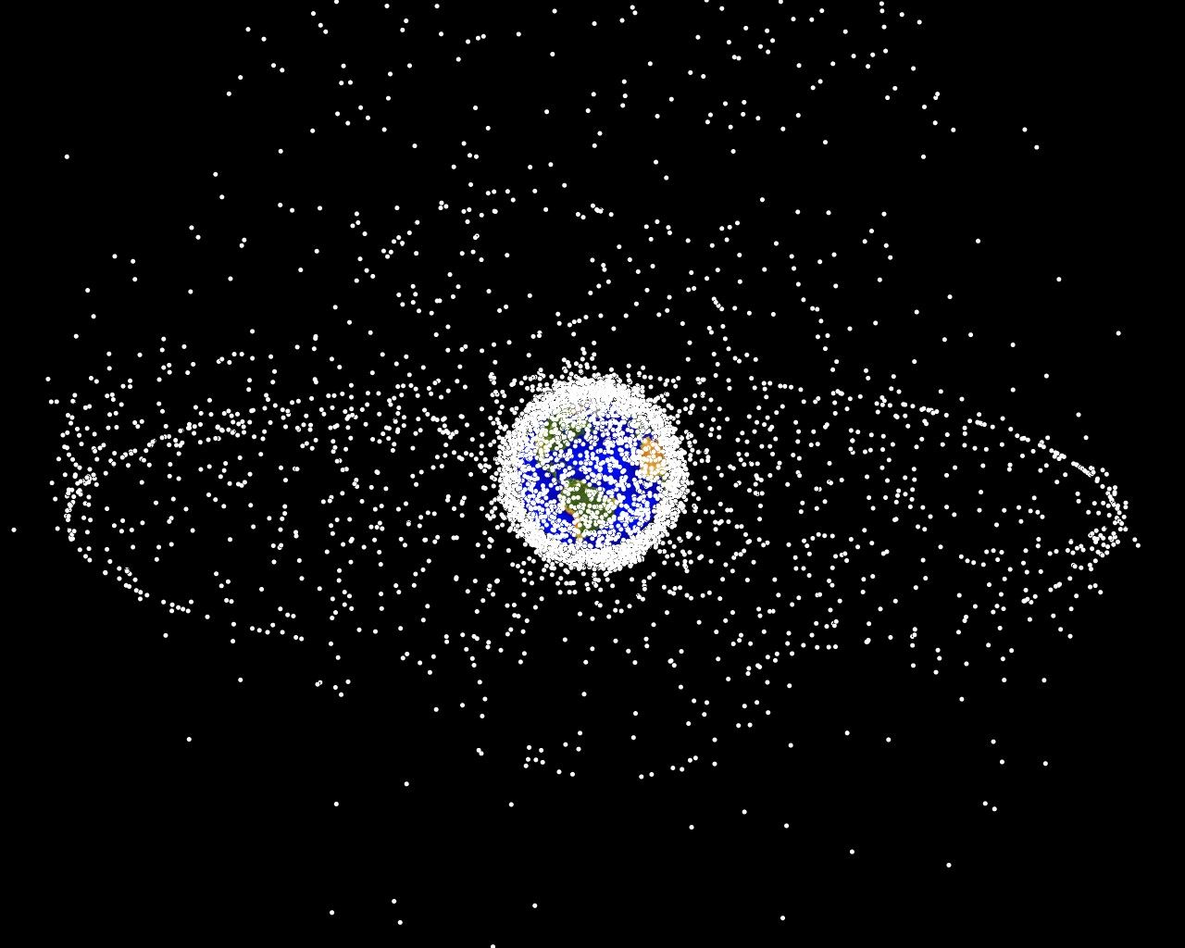
State of Debris

Slide 5
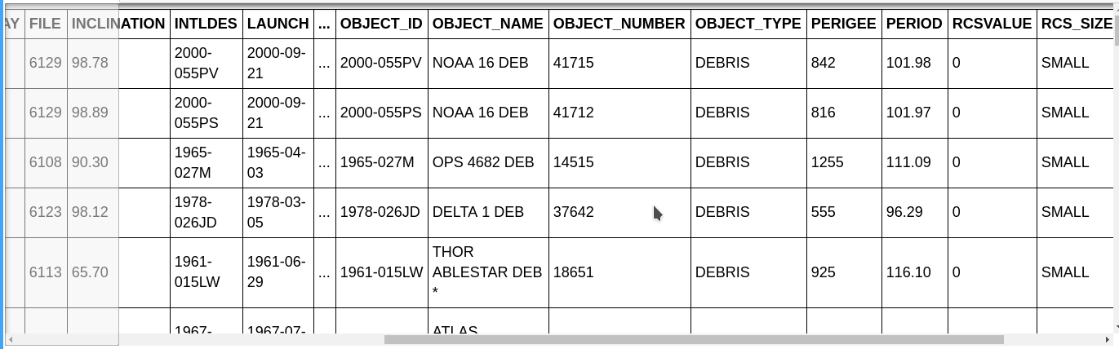
Dataset and Features
Data is collected by NORAD and cataloged by NASA and DoD.
Objects are tracked using ground stations and satellites

Slide 6
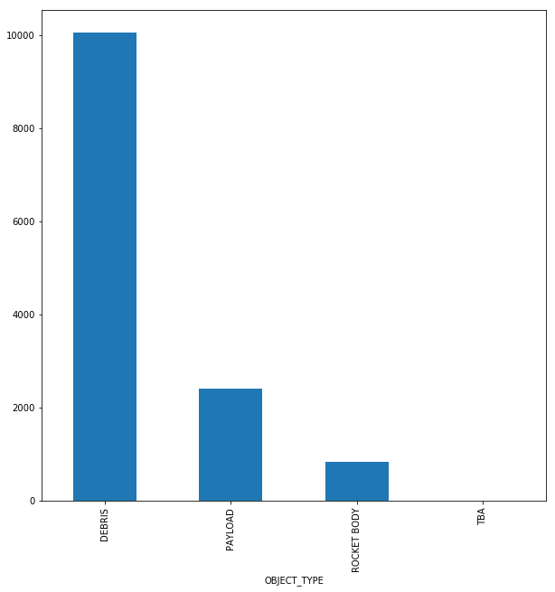
Debris and other Objects

Slide 7
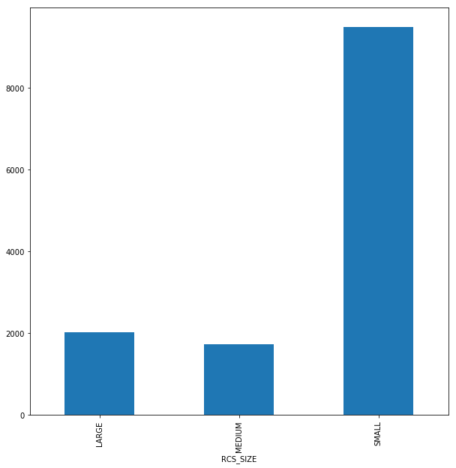
Debris Sizes
Small: <.1m2
Medium: .1m2 - 1m2
Large: >1m2

Slide 8
Mean Orbit Speed
Average speed of an object in orbit

Slide 9
Statistical Model
K-means clustering
Classify objects based on size and mean orbit speed
Classify objects based on object type and size

Slide 10
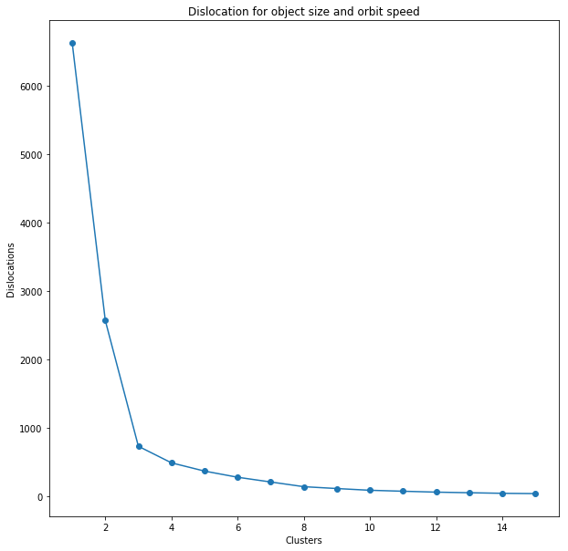
Dislocation
Estimates how many clusters to select for k-means

Slide 11
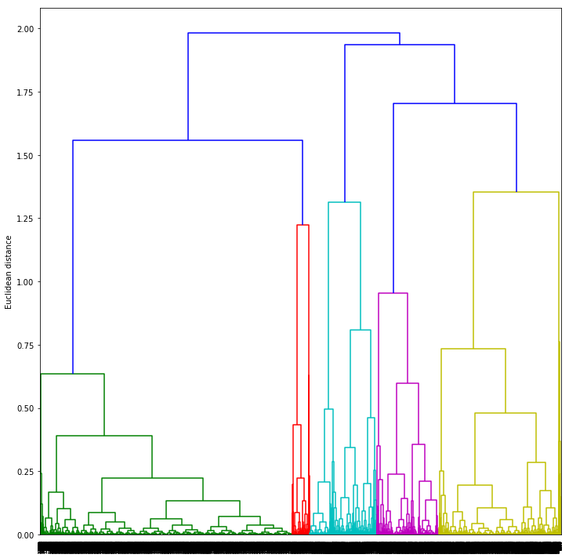
Dendrogram

Slide 12
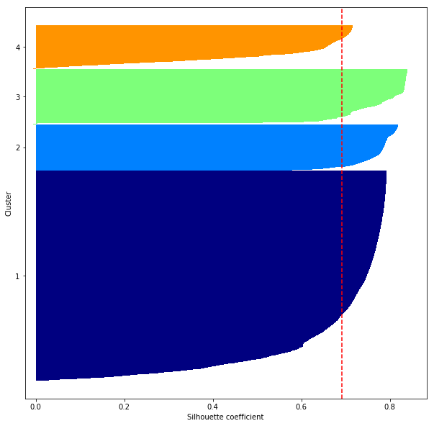
Silhouette

Slide 13
Future Debris Midigation
Change atmospheric drag to cause re-entry
Restriction on satellite disposal methods
Reusable launch vehicles

