Slide 1
Kafka – Keycloak IDP integration
Objectives for Integration & Discovery Phase
Objective
provides real time, end-to-end developed in-house IA Management for real-time information on Kafka Messaging/Streaming and other Azure/AKS services.
Integration:
1. Keycloak integration by Updating REALM Schema (Scripts + JSON format)
2. KCAdm API integration with Bash scripts
3. Docker images (Keycloak + Update Scripts + remote access )
Outcome
Cost Estimates:
Open Source, Open API, Identity and Access Management. It Provides Strong Authentication, User Federation, Fine-grained authorization, etc.
1. Docker Image update
2. Create Sccripts
3.Create REALM/Ldap Provider Templates/ Java based Validators/updaters
4. Kubernetes Deployment Strategy
5. Standard pipeline mechanism
Scope for Integration

Slide 2

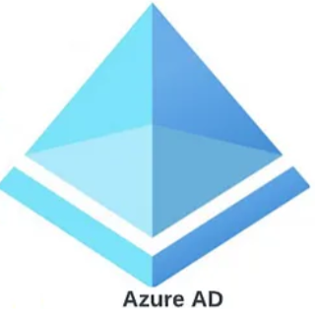
Authentication Flow Integration
Docker Update
Run
Scripts
Kafka (cloud)
Run
Scripts
Discovery Phase
REALM schema upgrade
Integrate LDAP Users
Map Groups/Users
1
2 Docker containers
KC + Scripts
Run
Scripts
Run
Scripts
2
Integrate LDAP Provider
Integrate LDAP Users
Map Groups/Users
Kafka (cloud)
Run
Scripts
Integrate LDAP Provider
Run
Scripts
3
Docker
Integrate LDAP Users
Map Groups/Users
Kafka (cloud)
Target states
App
IDP Keycloak
App
API Gateway
Keycloak
Users
Connect to app
Kafka services (cloud)
Request sign-in
Redirect to IDP ( Azure is optional)
Additional challenges
Challenge response
Provide tokens and sign in
Provide access token
to retrieve data
Keycloak
M2M communication
App
Keycloak
Azure IDP
Users
Azure LDAP Provider
User Access
Redirect to Keycloak
User Sync scheduled
Login displayed
Return to App page
USB Kafka (cloud)
User login with creds
login forwarded to IDP
Forward to Azure client creds
Forward login details for
group membership
returns response with
access token, id token,
refresh token with
scope: groups
return OIDC group claims
return matching group ids
displayed /
login error
maps app roles to group claims

Slide 3
Integration Flow
Integration: KCAdm API integration with Bash scripts
Creating Scripts:
  Create LDAP Provider Script Azure - Keycloak connection by Using KCAdmin API
    (JSON/CSV format config data)
  Create Apply LDAP User Sync Script
  Create LDAP User Group Mapping
  Create Healthcheck for Keycloak
  Create clear DB Users
  Create LDAL User/Group Mapper
  Create Master REALM Schema (JSON)
  KCAdm API integration with Bash scripts
  LdapToKeycloakGroupSync (Java)
  Create JKS Keystore Validator (Javaj)

