Slide 1
Neural Structured Learning
CS 512 Advanced Machine Learning
Final Project Presentation
Team:
Dheeraj Kondaparthi (dkonda2)
Nishank Lakkakula (nlakka2)
Sudheer Kumar Reddy Beeram (sbeera2)
Abhinav Raju Nadimpally (anadim4)

Slide 2
Problem Statement:
Current Deep Learning models face diverse number of problems.
We wish to address three main problems among them.
Less labelled data / no labelled data
Blackbox adversarial attacks on pre-trained models.
Not utilizing the structure between inputs.

Slide 3
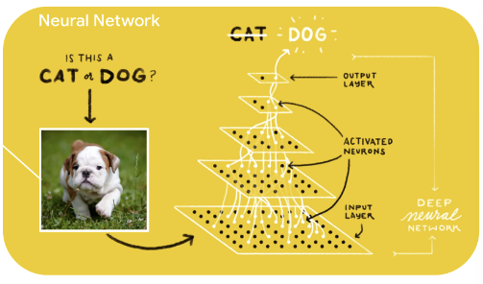
How a Typical Neural Network work?

Slide 4
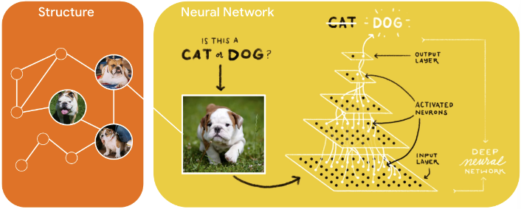
Understanding Structure in Input

Slide 5
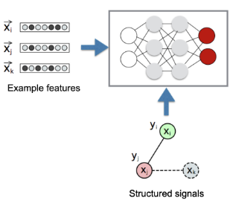
Neural Structure Learning (NSL)
NSL ~ Structured Signals + Neural Nets
Jointly optimize both features and structured signals for better models.

Slide 6
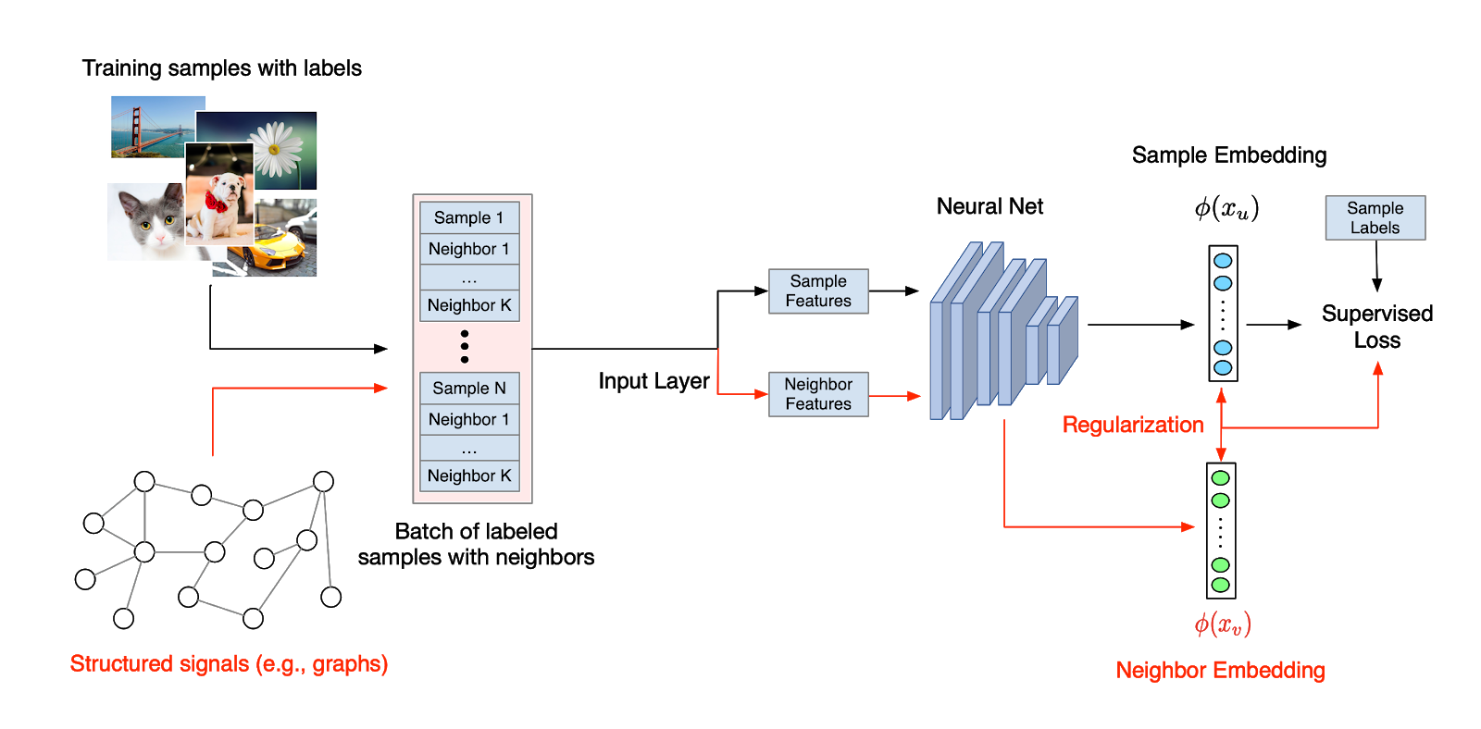
Regularizing with Structured Signals

Slide 7
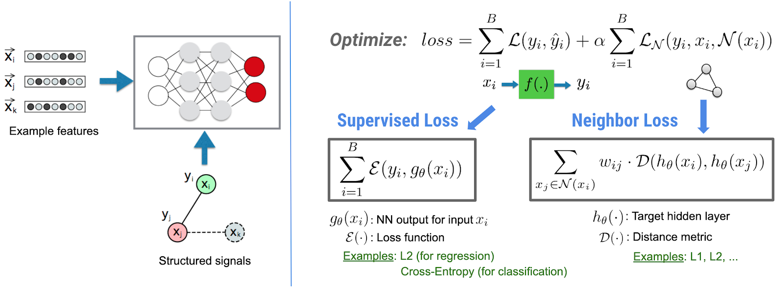
Loss formulation in NSL

Slide 8
Experiments and Results

Slide 9
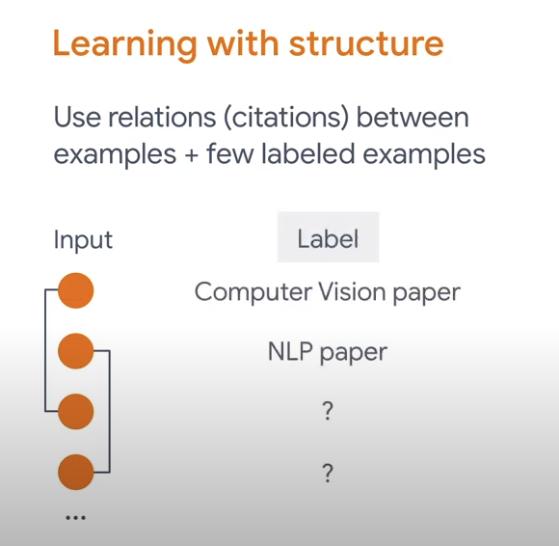
Graph regularization for document classification using Natural Graphs

Slide 10
Graph regularization for document classification using Natural Graphs
Dataset: Cora Dataset + Citation Graph
Task: To classify each paper into 7 categories.
Base Model: FFNN with 2 hidden layers with dropout between them.
Test Accuracy with base model : 78%
Test Accuracy with base model + graph regularization: 80%

Slide 11
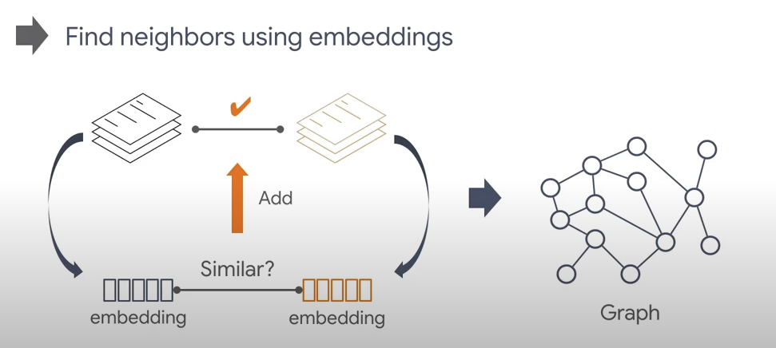
Graph regularization for sentiment classification using synthesized graphs

Slide 12
Graph regularization for sentiment classification using synthesized graphs
Dataset: IMDB dataset
Task: To classify a movie review into positive and negative sentiment.
Base model: Bi-directional LSTM with swivel embeddings trained on 30% labeled data.
Test Accuracy with base model: 85%
Graph is built based on similarity of reviews
Test Accuracy with base model + graph: 84.24%

Slide 13
Graph regularization for sentiment classification using synthesized graphs
Dataset: Yelp Polarity Reviews
Task: To classify a review into positive and negative sentiment.
Base model: Bi-directional LSTM with swivel embeddings trained on 30% labeled data.
Test Accuracy with base model: 88.8%
Graph is built based on similarity of reviews
Test Accuracy with base model + graph: 88.9%

Slide 14
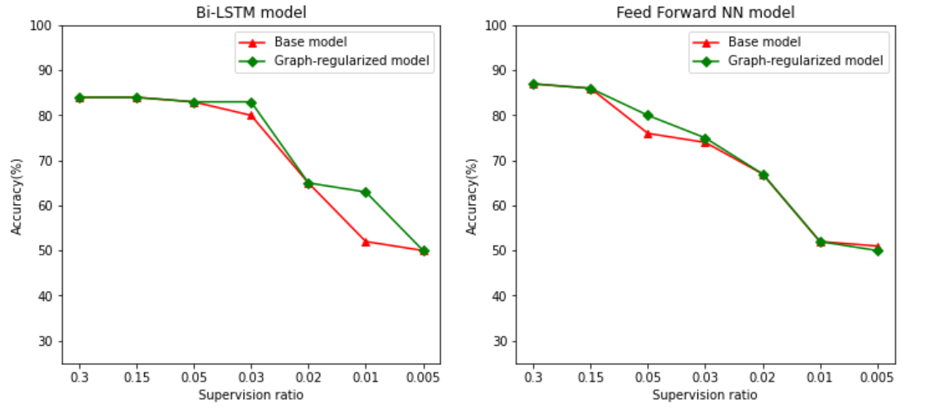
Power of Semi-Supervised Learning(IMDB Dataset)

Slide 15
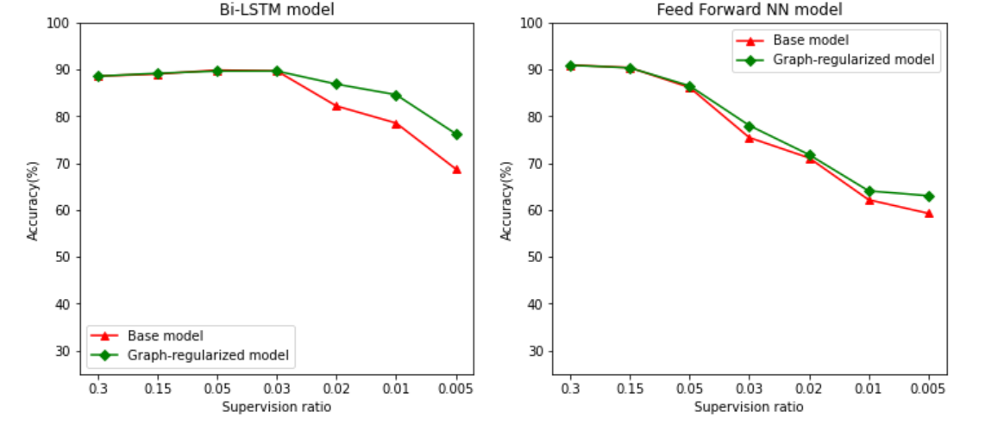
Power of Semi-Supervised Learning(Yelp dataset)

Slide 16
Adversarial regularization for image classification
Dataset | Base Model | Test accuracy of Base Model |  | Test accuracy of Adversarial Regularized Model
 |  | Without Perturbation | With Perturbation | Without Perturbation | With Perturbation
MNIST | CNN + FFNN | 99% | 45.1% | 99.2% | 94.7%
Fashion MNIST | CNN + FFNN | 90% | 62.9% | 89.8% | 74.3%
CIFAR10 | CNN + FFNN + Dropout | 69.3% | 21.1% | 68.7% | 44.1%

Slide 17
Lessons Learnt
Training models with structure signals help the models to become robust and accurate.
The base models for any project can be built using NSL.
The projects can be on :
Supervised Data
Semi-Supervised Data

Slide 18
Future Works
The adversarial attack training proposed in this paper is FGSM. Much better defense have been proposed recently.
We computed Graph using a simple similarity metric. Better metrics can be used to produce the graph.
We intend to upgrade base models to benchmarks available in market.
Computation efficiency to generate structure(graph) can be improved.

Slide 19
References
Neural Graph Machines
https://storage.googleapis.com/pub-tools-public-publication-data/pdf/bbd774a3c6f13f05bf754e09aa45e7aa6faa08a8.pdf
Explaining and Harnessing Adversarial Examples:
https://arxiv.org/pdf/1412.6572.pdf

Slide 20
Thank you!

