Slide 1
Docker

Slide 2


Why containerization is needed? Example 1
Deploys 11.5 s
Runs 1000 microservices

Slide 3
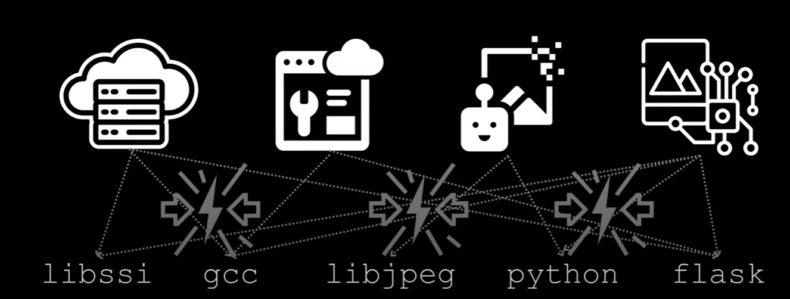
Why containerization is needed? Example 2
This is a micro-services application.
Each service has its own dependencies and there can be an issue
if both services are using the same dependency but with different versions

Slide 4
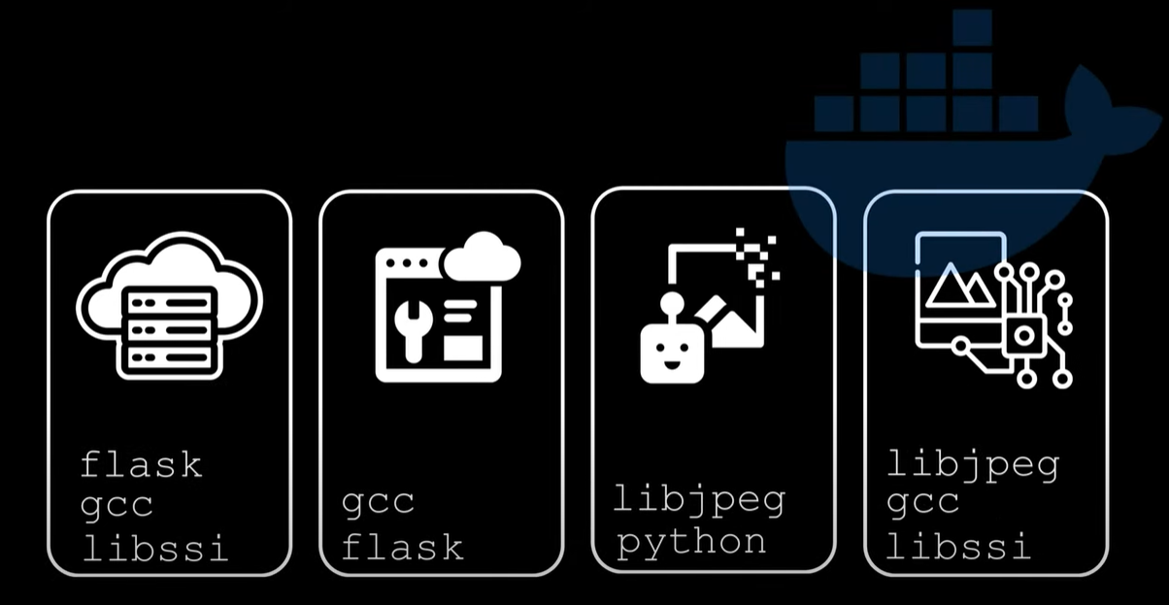
Why containerization is needed? Example 2
Dependencies problems can be simply fixed with Docker as each service can be deployed as isolated application

Slide 5
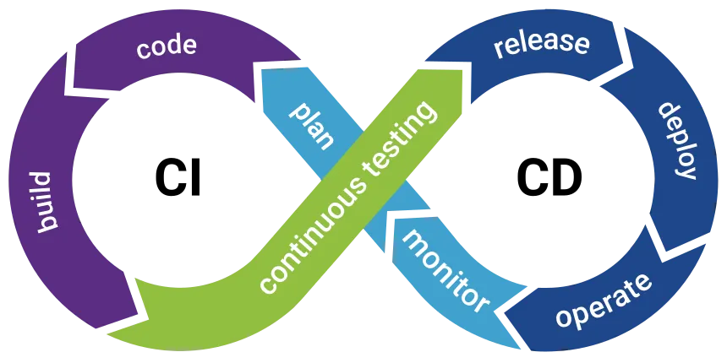
Why containerization is needed? Example 3
Build, test, whatever things is needed to do with the source code
and the binary application

Slide 6
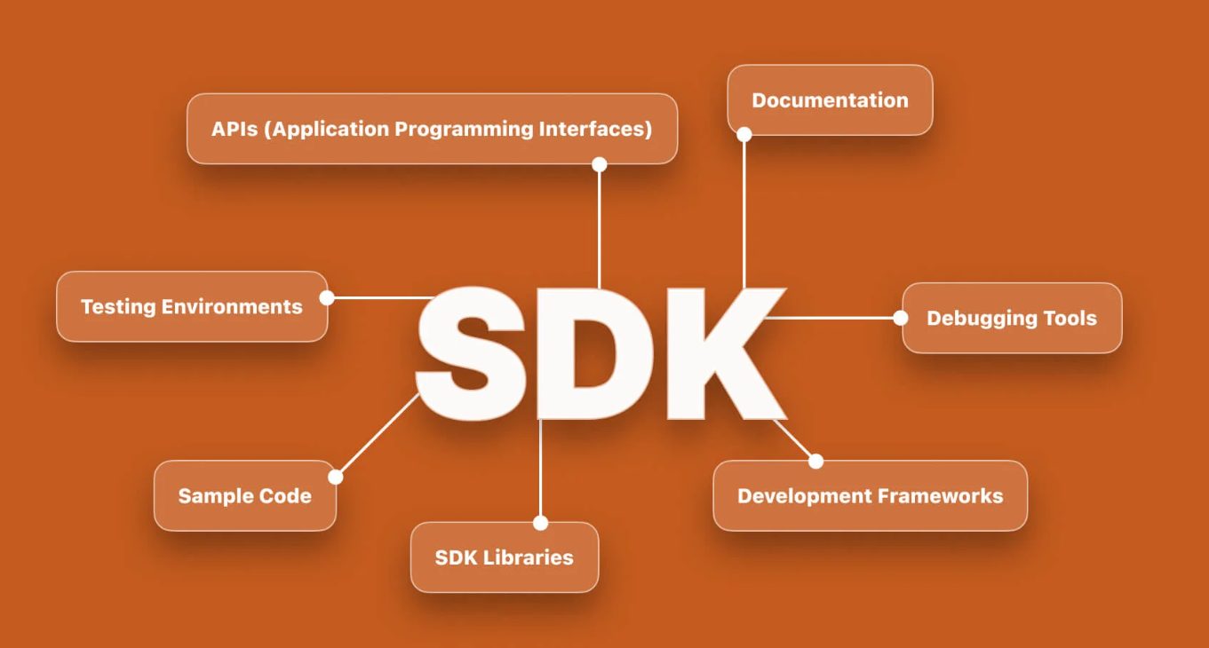
Why containerization is needed? Example 3
Mercedes-Benz SDK size is 12 Gb – contains the whole dev enviroment tools:
Cmake, gcc, clang-tidy, clang-format, etc.
Other services and libraries dependencies

Slide 7
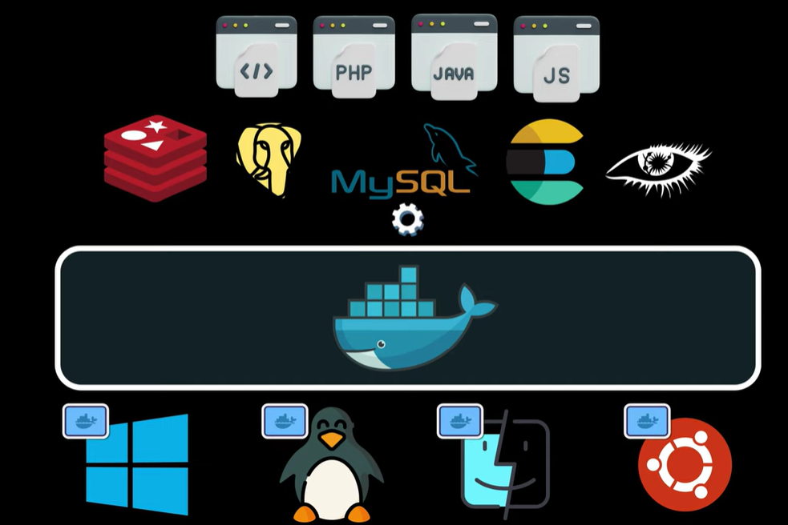
Why containerization is needed? Example 5
Reproducible builds

Slide 8



Why containerization is needed? Example 4
WSL
Native Windows audio used
From Python
LLM running on Linux

Slide 9
