Slide 1

Cmake tutorial

Slide 2
Cmake tutorial
Part 1: CMake Basics and Overview
Part 2: Cmake syntax

Slide 3
Part 1 CMake Basics and Overview

Slide 4
CMake Basics and Overview
Introduction to Cmake
Build process and cmake tools
CMake generators
CTest – Running Tests
CPack – Creating Installers or Packages

Slide 5
Introduction to CMake
CMake (short for Cross-Platform Make) is a tool that helps automate the build process of software from source code.
It is cross-platform, meaning it works on Linux, Windows, and macOS.
CMake takes a text file with build instructions as input and generates appropriate build files as output, depending on the platform:
On Linux: it generates a Makefile
On Windows: it can generate Visual Studio projects and solutions (.vcxproj, .sln)
On macOS: it can generate Xcode projects

Slide 6
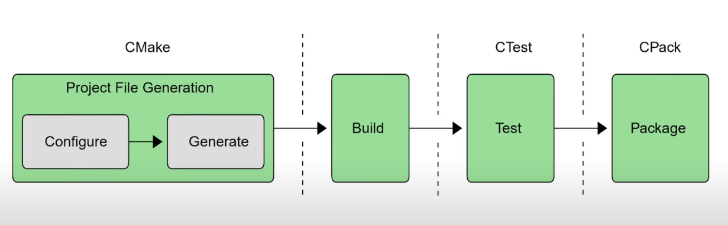
Build process and cmake tools
Root folder: |- CmakeLists.txt |- build/
|- cmake ..
cmake --build .

Slide 7
List all available CMake generators
Run this command in your terminal or command prompt:
cmake –help
Near the top of the output, you’ll see a section like:
Generators
The following generators are available on this platform:
Visual Studio 17 2022 = Generates Visual Studio 2022 project files.
Visual Studio 16 2019 = Generates Visual Studio 2019 project files.
Visual Studio 15 2017 = Generates Visual Studio 2017 project files.
...
Ninja = Generates build.ninja files.
MinGW Makefiles = Generates MinGW makefiles.
Unix Makefiles = Generates standard Unix makefiles.
Run CMake with a specific Visual Studio generator
For example, to generate project files for Visual Studio 2022 (version 17), run:
cmake -G "Visual Studio 17 2022" ..

Slide 8
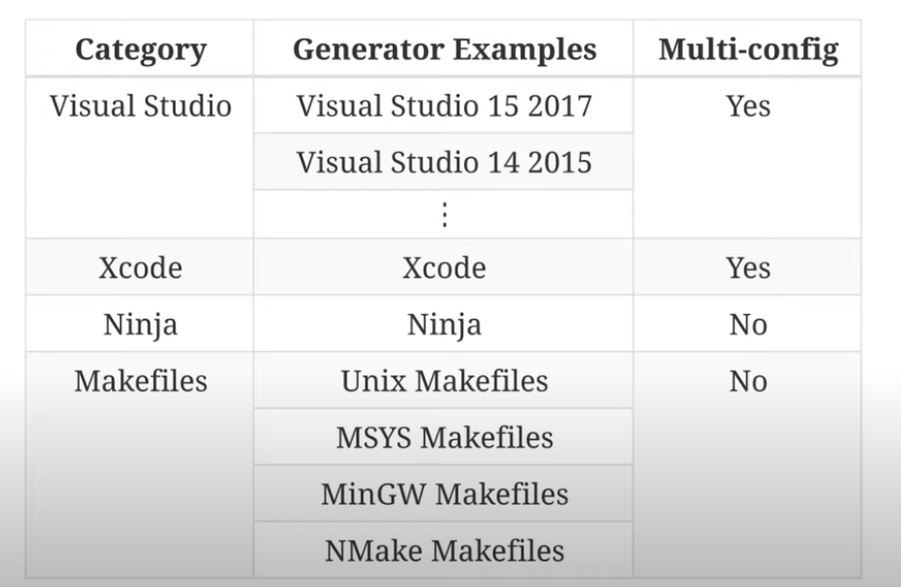

Slide 9
GCC (and makefile or Ninja generators used with GCC) does not support multi-configuration builds in Cmake.
Explanation:
Multi-config generators (like Visual Studio or Xcode) allow you to generate one set of build files that support multiple configurations (e.g., Debug, Release, RelWithDebInfo) in the same project folder. You can switch configurations inside the IDE or build system without regenerating.
Single-config generators (like Unix Makefiles, Ninja) generate build files for one configuration only. To switch between Debug and Release, you must re-run CMake with a different configuration flag (-DCMAKE_BUILD_TYPE=Debug or Release) and usually build in separate folders.
So for GCC (usually used with Unix Makefiles or Ninja):
You specify the build type at configuration time:
cmake -DCMAKE_BUILD_TYPE=Debug ..
Or
cmake -DCMAKE_BUILD_TYPE=Release ..
To build another configuration, create a separate build directory and reconfigure.

Slide 10
CTest – Running Tests
CTest is a testing tool that comes with CMake. It helps you run unit tests for your project.
✅ What it does: Finds and runs tests defined in your CmakeLists.txt. Shows which tests passed or failed. Can be used for automation (CI/CD)
🛠️ How to use:
First, add tests to your CMakeLists.txt using:
enable_testing()
add_executable(my_test test.cpp)
add_test(NAME MyTest COMMAND my_test)
Then build your project:
cmake -S . -B build
cmake --build build
Now run tests with:
cd build
ctest
You’ll see output showing the test results.

Slide 11
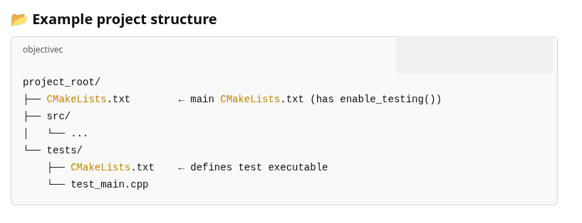

Slide 12
CPack – Creating Installers or Packages
CPack is a packaging tool that also comes with CMake. It lets you create installers or archive packages for your software.
✅ What it does:
Creates .zip, .tar.gz, .deb, .rpm, .exe, or .dmg files
Useful for delivering your program to users
🛠️ How to use:
In your CMakeLists.txt, add:
include(InstallRequiredSystemLibraries)
set(CPACK_GENERATOR "ZIP") # or DEB, RPM, NSIS, etc.
include(CPack)
Then run these commands:
cmake -S . -B build
cmake --build build
cpack --config build/CPackConfig.cmake

Slide 13
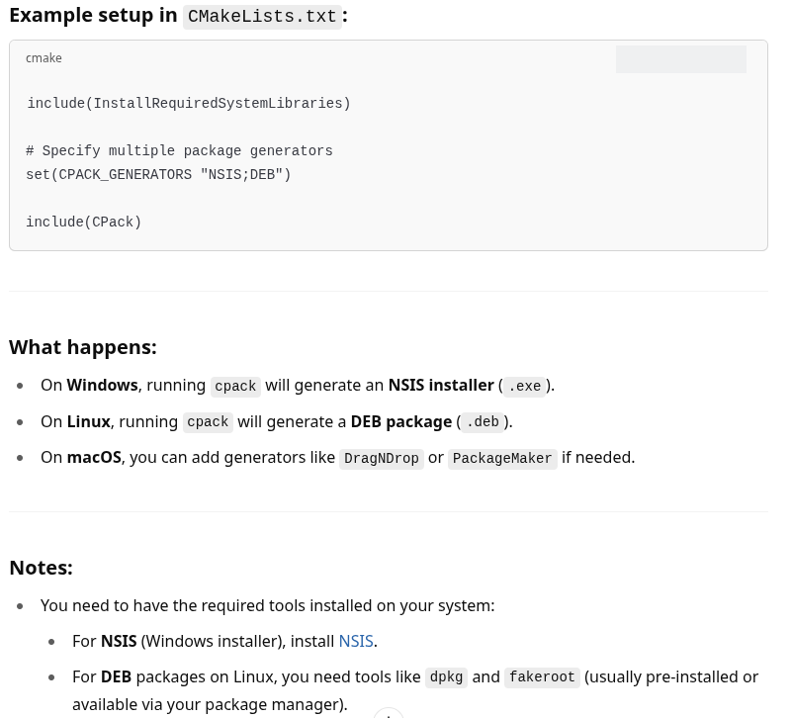

Slide 14
Part 2 Cmake syntax

Slide 15
CMake Syntax
CMake Syntax Basics
Variables in Cmake
How CMake Handles Arguments
Cmake variable types
Single String vs List
Boolean Handling in Cmake
Integers and Arithmetic
Comments

Slide 16
CMake Syntax Basics
All instructions in CMake are written using its own scripting language.
Commands follow this format:
command(args …)
Example:
set(MY_VAR “Hello World”)
CMake commands are not case-sensitive:
set, SET, and Set are all the same. But the common pratice - lowercase

Slide 17
Variables in Cmake
You can define a variable using the set() command:
set(VAR_NAME a b c)
This creates a list of strings: a, b, and c are stored in VAR_NAME
To access the variable:
${VAR_NAME}
Example usage:
message(${VAR_NAME}) # prints: a b c

Slide 18
How CMake Handles Arguments
CMake commands typically work with:
Strings
Lists of strings
Example:
set(SRC one.cpp two.cpp three.cpp)
add_executable(my_app ${SRC})
This is the same as:
add_executable(my_app one.cpp two.cpp three.cpp)

Slide 19
Cmake variable types
CMake does not have strong typing like traditional programming languages. All CMake variables are essentially strings. However, CMake interprets these strings in certain contexts as booleans or numbers.
✅ CMake Variable "Types" (effectively how they are interpreted)
String - The default type; all variables are strings unless interpreted otherwise.
Boolean - Interpreted as TRUE or FALSE in conditionals.
List - A string with semicolon-separated elements.
Path/File - Treated like strings, but sometimes interpreted specially in commands.
Integer - Not a real type, but strings that look like integers can be interpreted as numbers in expressions.
Cache Entry Types - Used in set(... CACHE ...), these can act like types (e.g., BOOL, STRING, FILEPATH, etc.) but they are for the CMake GUI and cache system only.

Slide 20
Single String vs List
Strings are separated by spaces
If you want to store a single string with spaces, use quotes:
set(VAR1 a b c) # List: a, b, c
set(VAR2 "a b c") # Single string: "a b c"
Use quotes when you need to preserve spaces inside the string.

Slide 21
📌 Boolean Handling in CMake
CMake interprets
the following strings as TRUE: "1", "ON", "YES", "TRUE", "Y", "TRUE"
And the following as FALSE: "0", "OFF", "NO", "FALSE", "N", "", "NOTFOUND"
Case-insensitive.
Example:
set(MY_FLAG ON)
if(MY_FLAG)
message("It's true!")
endif()

Slide 22
Integers and Arithmetic
There's no real integer type, but you can do arithmetic with strings that look like numbers using the math() command:
set(A 5)
math(EXPR B "${A} + 3")
message("B = ${B}") # Outputs: B = 8

Slide 23
Comments
# Some function description
function(say_hello name)
message("Hello, ${name}!")
endfunction()
say_hello("World") # Outputs: Hello, World!

Slide 24
Build:
mkdir build — to keep the project folder clean. This folder will contain system-dependent build files and scripts, so it is usually added to .gitignore.
cd build
cmake ..
cmake - -build . - -config Release - -target helloWorld
targets
Run:
cd Release
./helloWorld.exe
CmakeChache.txt

Slide 25
recommended_literature.md

