Slide 1
MaxDiff Analysis
MaxDiff (aka Best-Worst) Market Research and Data Analysis

Slide 2
introduction
Products and Buying Decisions

Slide 3
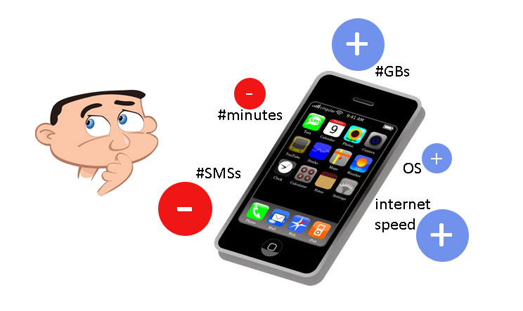
People Give Value to Products
People compare and „weigh” different aspects of each product and „calculate” product’s total value („utility”) for them

Slide 4
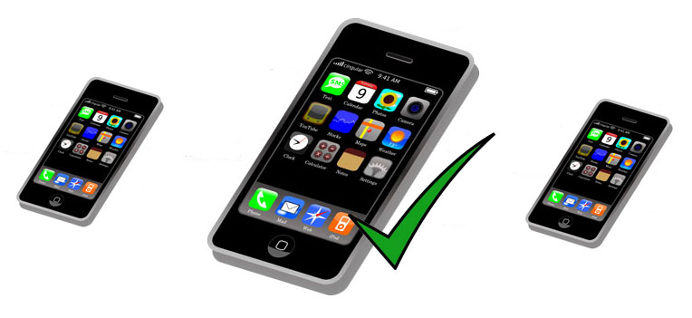
People Make Buying Decision
People will most probably buy a product that has the highest value (utility) for them
Buying decision is probabilistic and not exact because there are always additional influences not explained by the product attributes and the relations between them

Slide 5
MAXDIFF analysis
A Short Explanation of the MaxDiff Analysis

Slide 6
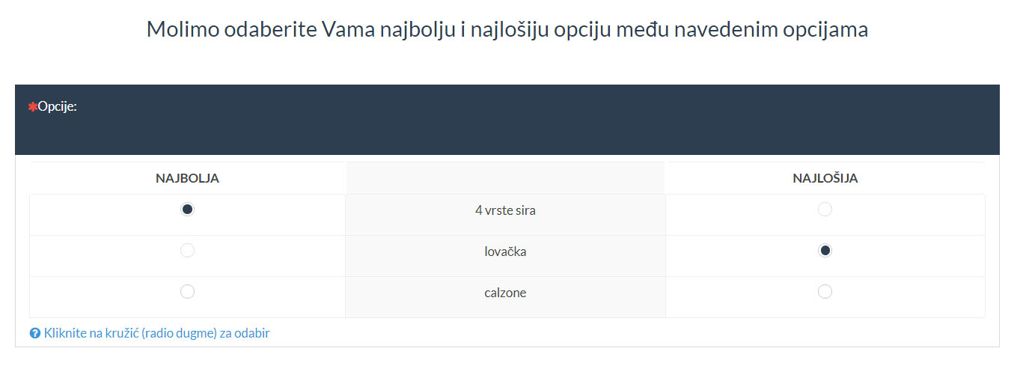
MaxDiff Analysis
Choice-based – respondents choose the best and the worst option between a few alternatives

Slide 7
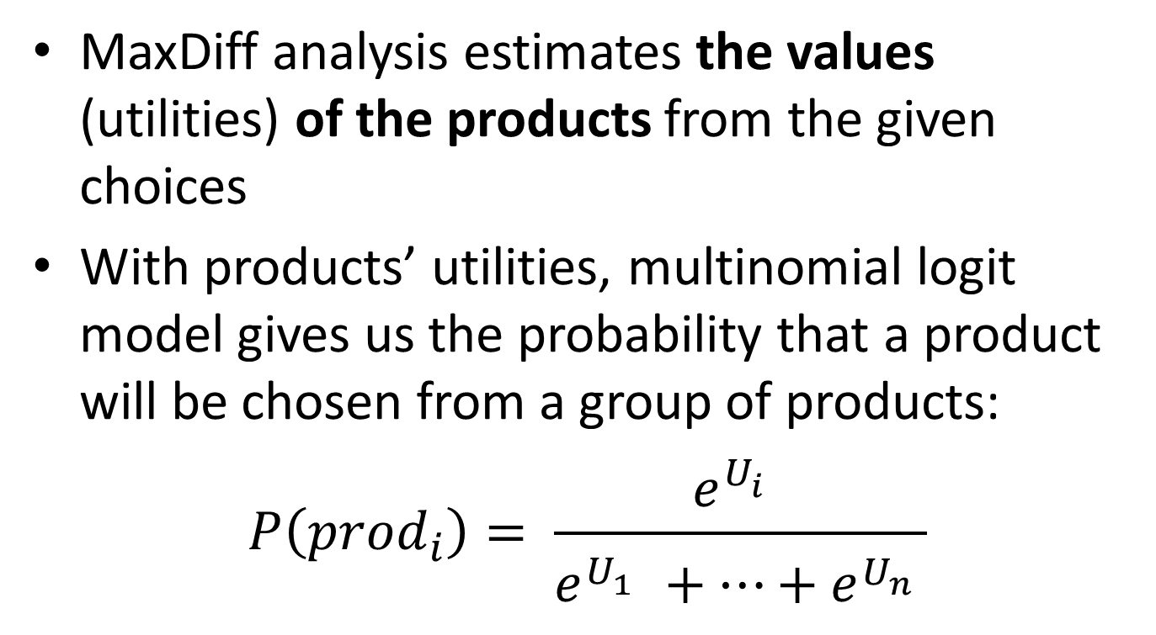
MaxDiff Analysis
MaxDiff analysis estimates the values (utilities) of the products from the given choices
With products’ utilities, multinomial logit model gives us the probability that a product will be chosen from a group of products:
$$P\left({prod}_{i}\right)= \frac{e^{U_{i}^{}}}{e^{U_{1}^{}}+…+e^{U_{n}^{}}}$$

Slide 8
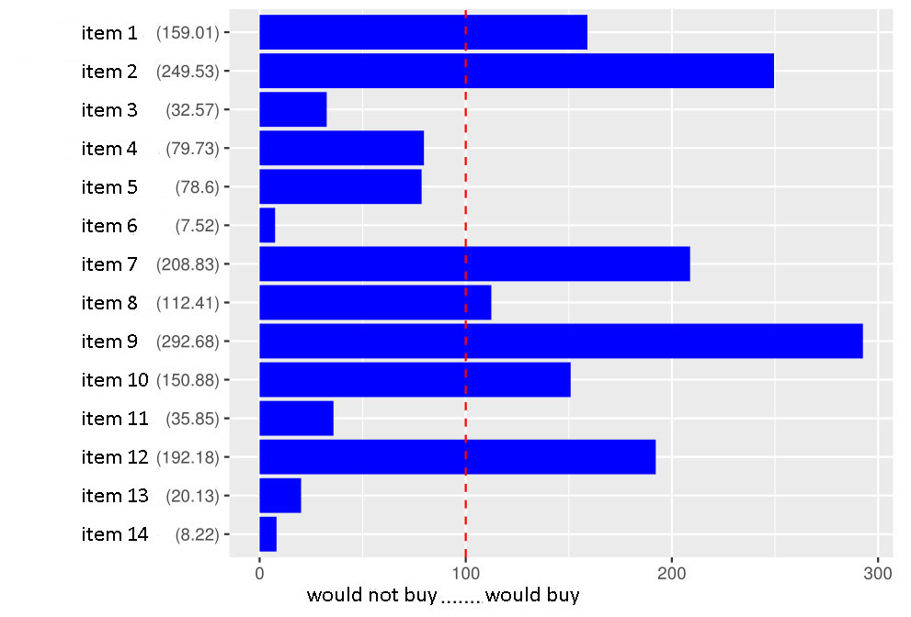
MaxDiff Analysis

Slide 9
MaxDiff Analysis
The best product (from a group) is the one with the highest probability of being chosen
The worst product (from a group) is the one with the least probability of being chosen
A simpler version of the CBC (Choice Based Conjoint) analysis

Slide 10
Some MaxDiff Usage Examples
Testing different:
Dishes from a restaurant menu
Tourist/travel packages
Cell-phones
Employees benefits packages
Mobile subscriptions
to find the most valued product/option

Slide 11
steps
Description of Steps in a MaxDiff Project Implementation

Slide 12
Step 1: Problem Definition
The first step is the problem definition, e.g.:
We are planning a few new products and we want to see which one would do the best in the market
We are interested in how do people value our products
We are interested in what do our people like and what they like less or dislike

Slide 13
Step 2: Products Definition
Definition of the products that we wish to analyse, e.g.:
Cars: Mercedes, Fiat, Opel
Pizzas: vegetarian, spicy, with mushrooms
Jeans: slim, regular, skinny fit
Mobile subscriptions: flat Internet, limited minutes, discounted international calls

Slide 14
Step 3: Design Definition
Design definition means building and combining alternatives (products) into questions and surveys
With respect to (typically) a large number of all possible combinations, we choose only a part of them, and this part has to be chosen so that we can calculate the products values

Slide 15
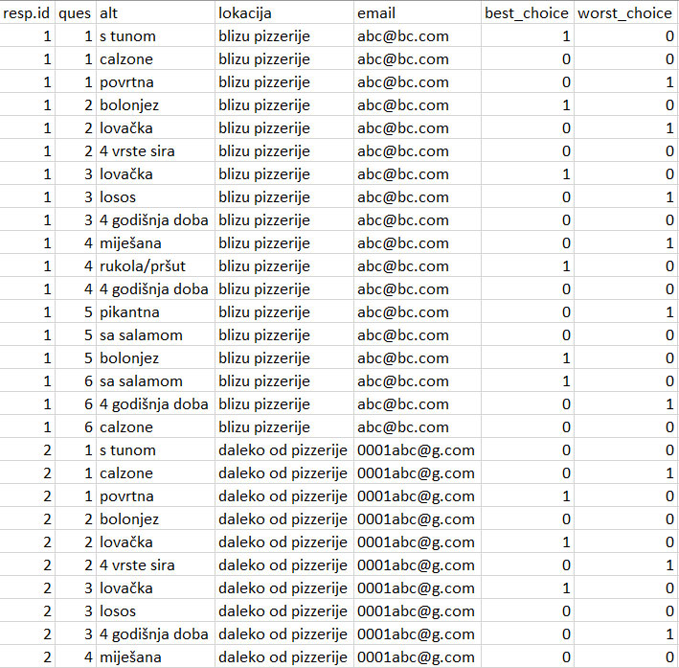
Step 4: Design Testing
Design has to be tested by simulating answers to check if there are any problems

Slide 16
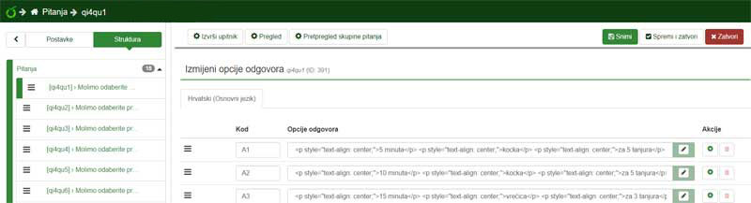
Step 5: Survey Implementation
The design, which is in a „code” form, has to be implemented as a survey in a tool/system for conducting surveys

Slide 17
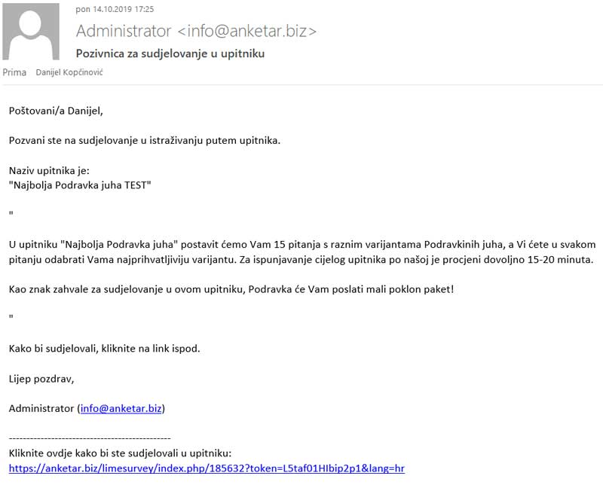
Step 6: Running the survey
By using a users database (newsletter subscribers, registered users, online pool – we can offer this too…), run the survey

Slide 18
Step 7: Checking the Answers
Check the answers and exclude from the analysis those that were e.g.:
always picking the same alternative (1st, 2nd…)
answering too quickly (less than a few seconds per question)
This is an important step because „ unrealistic” answers can significantly decrease the model quality, and sometimes event completely disable the model creation

Slide 19
Step 8: Results Analysis
Using the given answers, calculate the products values and with them calculate e.g.
the best and the worst product
value relationships between the products
predicted sales shares for some chosen group of products
find the best combination of products (TURF)
Respondents segmentation

Slide 20
Step 9: Using the Results
Using the results analysis, make the business decisions about new products, changing the existing or planned products, customer segmentation, marketing and sales adaptation…
With the MaxDiff methodology, business decisions will be aligned with the customers valuations and this will ensure the customer satisfaction and income/profit maximization

Slide 21
conclusion
Why Use the MaxDiff Analysis

Slide 22
Why Use the MaxDiff Analysis
Based on a reliably good model of making buying decisions (random utility model, used for more than 40 years in a few variants)
A very good simulation of the real purchase
Answers given by the buyers
Respondents find it easier to choose the best and the worst option instead of rating 5 or 6 (e.g. on Likert scales), thus giving more precise answers

Slide 23
Why Use the MaxDiff Analysis
More precise answers give better models and estimates of the future behaviour
Gives relative ratios between the products, not just the overall ranking
Positions products compared to the key point „buy - not buy”, „want – don’t want”, „like – don’t like”

Slide 24
Contact and Information
Danijel Kopčinović, IT Market
danijel.kopcinovic@itmarket.hr
+385956472127

