Slide 1
Themes 4 Fans
How to increase online community engagement using online surveys

Slide 2
Engagement
Why do some posts get much more engagement than others? One answer – people are much more interested in some themes than in some others.

Slide 3
Themes
Theme 1
Theme 2
Theme 3
There are many themes one can talk about with the fans. Which are the most interesting to them?

Slide 4
Ask the Fans
PLEASE CHOOSE THE MOST AND THE LEAST INTERESTING THEME IN THE LIST:
The best way to find out what are your fans the most and the least interested in is – to ask them!

Slide 5
MaxDiff Analysis
A method for comparing items and calculating the items values. Much better and more reliable than Likert scales or similar.

Slide 6
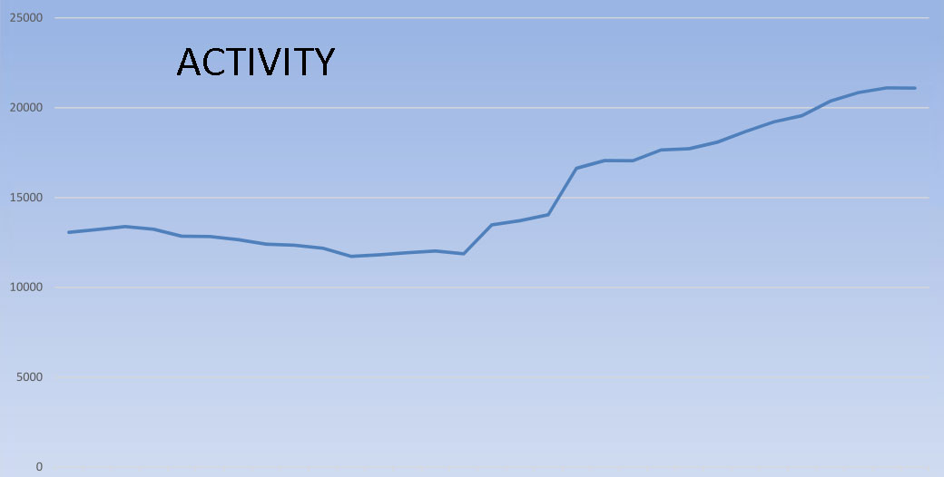
Adapt and Rise
Once you know which themes are the most interesting, adapt the communication and watch the engagement rise. ☺

Slide 7
More Info
https://anketar.biz/maxdiff-best-worst-analysis/
https://anketar.biz/maxdiff-best-worst-analysis-an-example/
https://anketar.biz/maxdiff-best-worst-project-steps/

Slide 8
Contact and Information
Danijel Kopčinović, IT Market
danijel.kopcinovic@itmarket.hr
+385956472127

