Slide 1
MaxDiff Analysis
MaxDiff market research and data analysis

Slide 2
introduction
Products and buying decisions

Slide 3
How do people buy products?
People buy products by „weighing” each product (its features) and „calculating” total benefit (utility) for them
Car: I prefer cars with known brands
Pizza: I prefer spicy pizzas
Jeans: I prefer blue regular fit jeans

Slide 4
Buying decision
People will most probably buy a product that has the highest benefit (utility) for them
Buying decision is not exact because there are always additional influences not explained by the attributes defined – that is why the decision is probabilistic, but based on the relations between the attribute values

Slide 5
MAXDIFF analysis
A short explanation of the MaxDiff analysis

Slide 6
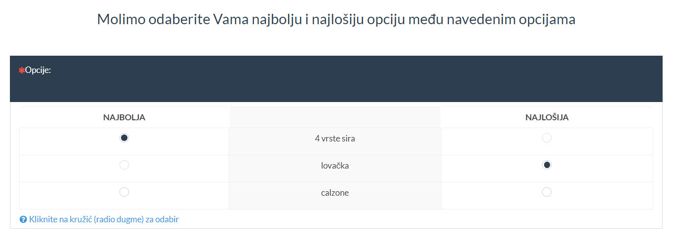
MaxDiff analysis
Choice-based – respondents choose the best and the worst option between a few alternatives – a good simulation of the buying process

Slide 7
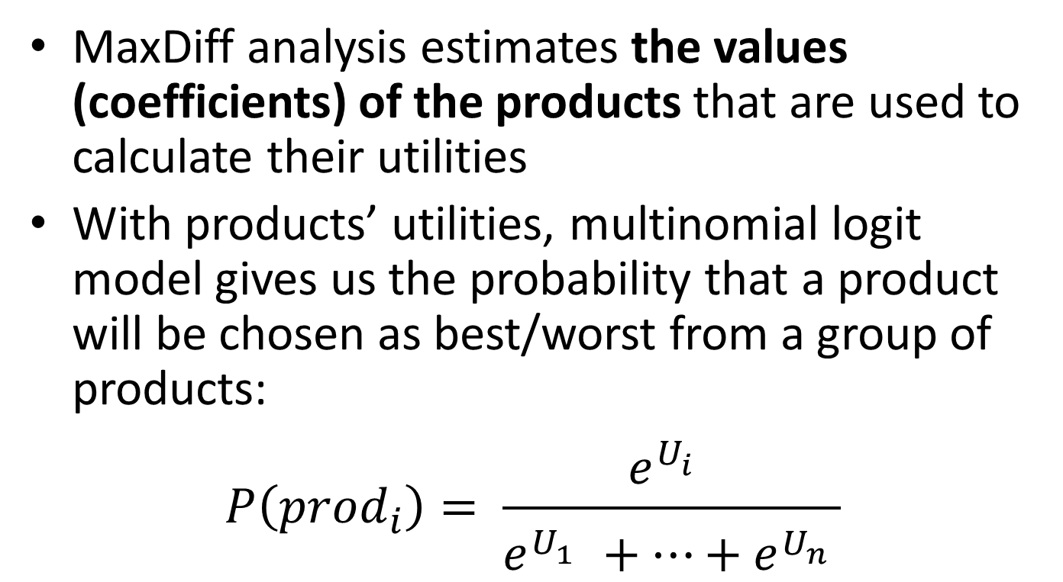
MaxDiff analysis
MaxDiff analysis estimates the values (coefficients) of the products that are used to calculate their utilities
With products’ utilities, multinomial logit model gives us the probability that a product will be chosen as best/worst from a group of products:
$$P\left({prod}_{i}\right)= \frac{e^{U_{i}^{}}}{e^{U_{1}^{}}+…+e^{U_{n}^{}}}$$

Slide 8
MaxDiff analysis
A simpler version of the CBC (Choice Based Conjoint) analysis
Easier for the respondents because they have less information to process (full products are shown, not their specific features)

Slide 9
steps
Description of steps in a MaxDiff project implementation

Slide 10
Step 1: problem definition
The first step is the problem definition, e.g.:
We are planning a new product and we want to see which one would do the best in the market
We are interested in how do people value our products
We are interested in what do our people like and what they like less or don’t like

Slide 11
Step 2: products definition
Definition of the products that we wish to analyse, e.g.:
Cars: Mercedes, Fiat, Opel
Pizzas: vegetarian, spicy, with mushrooms
Jeans: slim, regular, skinny fit

Slide 12
Step 3: design definition
Design definition means building and combining alternatives (products) into questions and surveys
With respect to (typically) a large number of all possible combinations, we choose only a part of them, and this part has to be chosen so that we can calculate the products coefficients

Slide 13
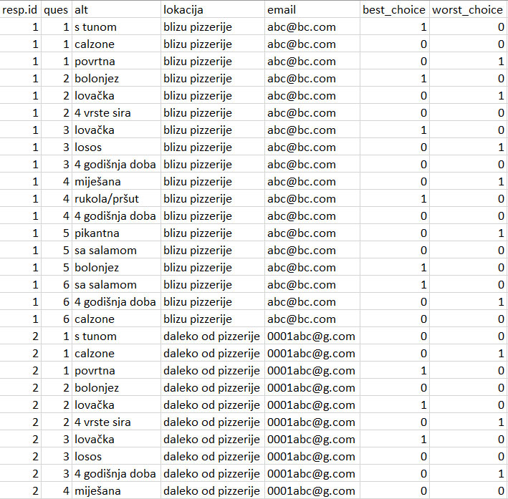
Step 4: design testing
Design has to be tested by simulating answers to check if there are any problems

Slide 14
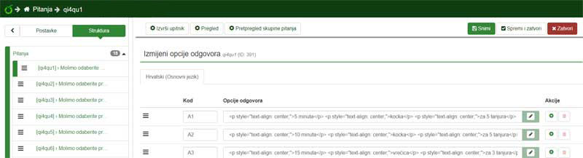
Step 5: survey implementation
The design, which is in a „code” form, has to be implemented as a survey in a tool/system for conducting surveys

Slide 15
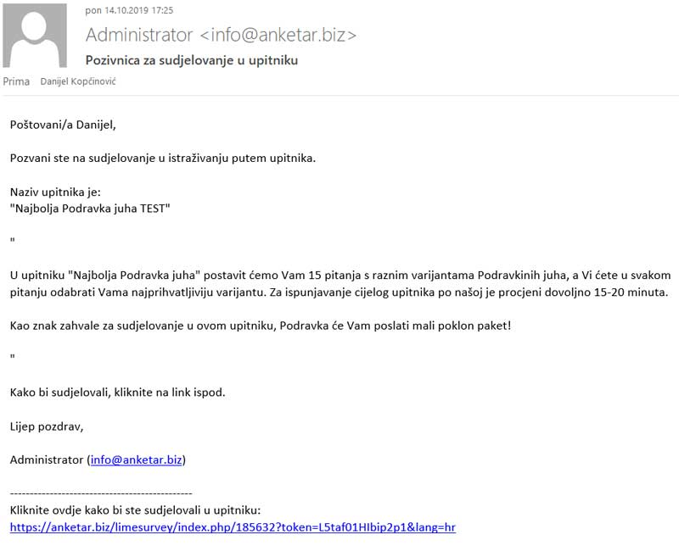
Step 6: initiating the survey
By using a users database (newsletter subscribers, registered users, online pool – we can offer this too…), initiate the survey

Slide 16
Step 7: checking the answers
Check the answers and exclude from the analysis those that were e.g.:
always picking the same alternative (1st, 2nd…)
answering too quickly (less than a few seconds per question)
This is an important step because „unreal” answers can significantly decrease the model quality, and sometimes event completely disable the model creation

Slide 17
Step 8: results analysis
Using the given answers, calculate the products coefficients and with them calculate e.g.
the best and the worst product
value ratios between the products
predicted sales share for some combinations of interest
the most benefitial combination/offer of products
Respondents segmentation

Slide 18
Step 9: using the results
Using the results analysis, make the business decisions about new products, changing the existing or planned products, customer segmentation, marketing and sales adaptation…
With the MaxDiff methodology, business decisions will be aligned with the customers valuations and this will ensure the customer satisfaction and income/profit maximization

Slide 19
conclusion
Why use the MaxDiff analysis

Slide 20
Why use the MaxDiff analysis
MaxDiff analysis is based on a reliably good model of making buying decisions (random utility model, used for more than 40 years in a few variants)
Answers are given by the buyers
A very good simulation of a real purchase
Relatively simple to implement
Improves business decisions

Slide 21
Contact and information
Danijel Kopčinović, IT Market
danijel.kopcinovic@itmarket.hr
+385956472127

