Slide 1
Coupling positive feedback loops with cell-cell signalling to overcome noise during developmental initiation in Dictyostelium
Daniel Kornai

Slide 2
Overview
Introduction to Dictyostelium
Noise and synchronization: Biological motivations of the model
Growth-Differentiation pathway: Overview and Boolean network model
Behaviour of the single cell model
Overview: 1D spatial model of the Dictyostelium colony
Behaviour of the 1D spatial model across a range of noise levels

Slide 3
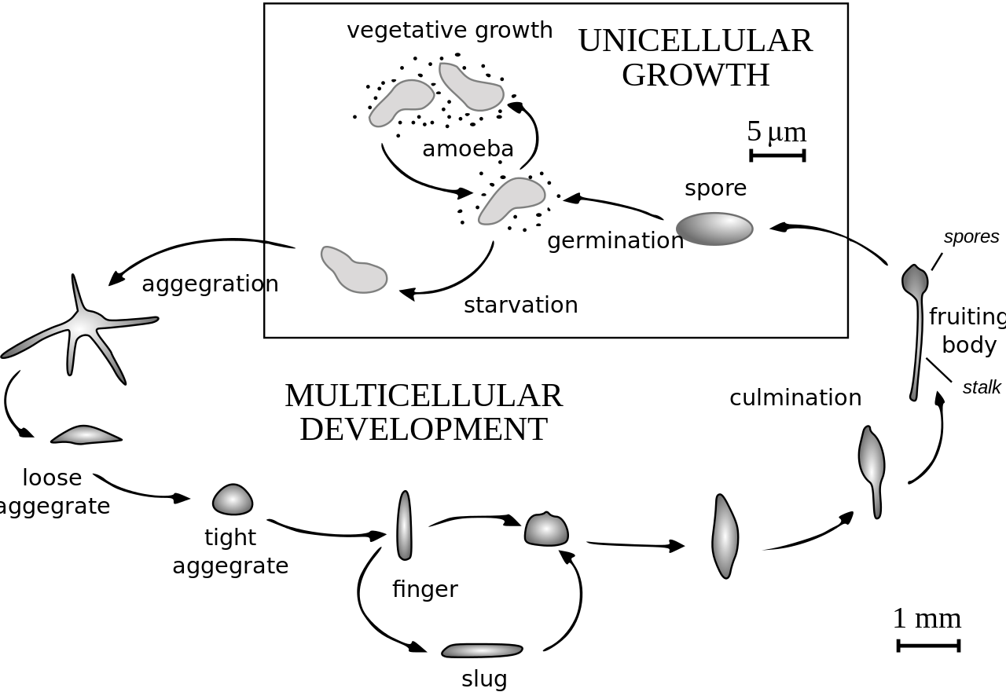
Dictyostelium lifecycle

Slide 4
Noise and synchronization:
Biological motivations of the model
A Dictyostelium colony can only aggregate successfully if the cell fate decisions of individual cells are synchronized
Synchronization is difficult due to two compounding factors:
  Variability in the environment cells are exposed to
→ cells receive different signals
  Intrinsic noise from the stochastic dynamics of gene expression
  → cells have different responses to identical signals
How can Dictyostelium guarantee that cells choose to enter the social-developmental cycle synchronously?

Slide 5
Dictyostelium phylogeny and the biological motivations of the model
Dictyostelid phylogeny can be subdivided into two branches each containing two major groups.
Colony sizes vary across groups, with Group 4 species having much larger colony sizes than groups 1-3
Larger colonies are more difficult to synchronize:
  Larger colonies inhabit larger areas, which implies that cells are subjected to a wider range of microenvironments.
  A higher number of cells are distributed across a larger area, meaning that any cell-cell communication that relies on the diffusion of signaling molecules is less efficient at transferring information between the most distant cells
This suggests that the synchronization mechanisms utilized by group 4 species are more robust. Why?
Group 4 species export a signalling molecule (cAMP) which is involved in a positive feedback loop to coordinate aggregation, while groups 1-3 only utilize cAMP as an intracellular signal during early development
How did the coupling of cell-cell signalling to a positive feedback loop enable group 4 Dictyostelia to lower the amount of stochastic variation in the timing of the onset of aggregation, thereby allowing larger groups to collaborate successfully?

Slide 6
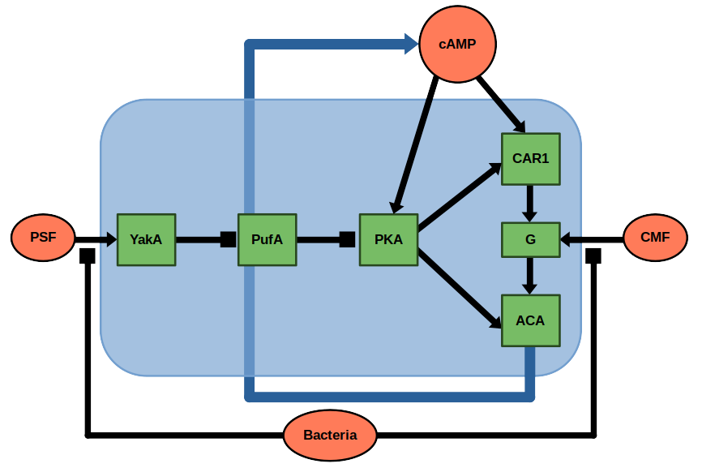
The growth-differentiation pathway: controlling the transition from unicellular growth to aggregation
Well-fed cells secrete the PSF (Pre-starvation Factor)
  PSF receptors are only produced by starving cells.
  Thus, well fed cells will not respond to PSF
  PSF concentrations increase with cell density, allowing cells to estimate the density of kin
Starving cells secrete CMF (Conditioned Medium Factor)
  Starving cells make CMF receptors, and secrete CMF.
  CMF concentrations indicate the density of starving kin.
PSF indirectly activates PKA
PKA activates CAR1 (a cAMP receptor) and ACA (the cAMP synthase). Most cAMP is exported outside the cell
CMF activates G proteins which enable the activation of ACA by CAR1
This completes a positive feedback loop, as cAMP exposure activates PKA and CAR1, leading to further cAMP production
Exposure to cAMP induces the expression of aggregation competence genes (such as the cell adhesion genes csA, tgrB1, and tgrC1), allowing these cells to start multicellular development

Slide 7
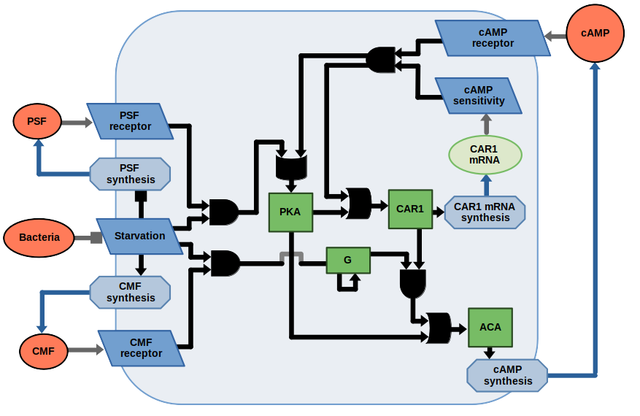
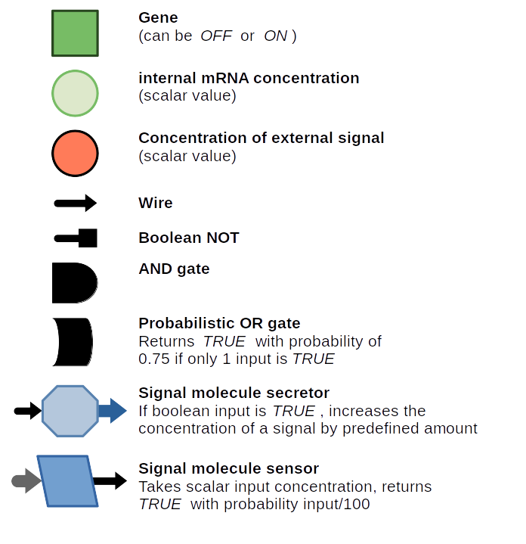
Boolean network model of the growth-differentiation pathway
Scalar input in the form of signal concentrations
Boolean circuit representing internal elements
Signals are secreted according to the internal state

Slide 8
Single cell model
Given the boolean network, the production (and consumption) rates of signals impact the time domain behaviour of the model.
Production rate parameters set to match timescales established in the literature
  PSF production starts 2-3 hours before starvation
  CMF production is significant after 1-2 hours of starvation
  cAMP production following 4-5 hours of starvation
  CAR1 mRNA accumulates 2 hours following starvation
  Aggregation competence genes are expressed at 5-6 hours following starvation
Internal cell state, the level of extracellular signals (Bacteria, PSF, CMF, cAMP) and internal signals (CAR1 mRNA) are tracked over time
Aggregation genes
CAR1 mRNA
PSF
CMF
cAMP
quorum sensing
starvation
aggregation
-5 h
0 h
5 h

Slide 9
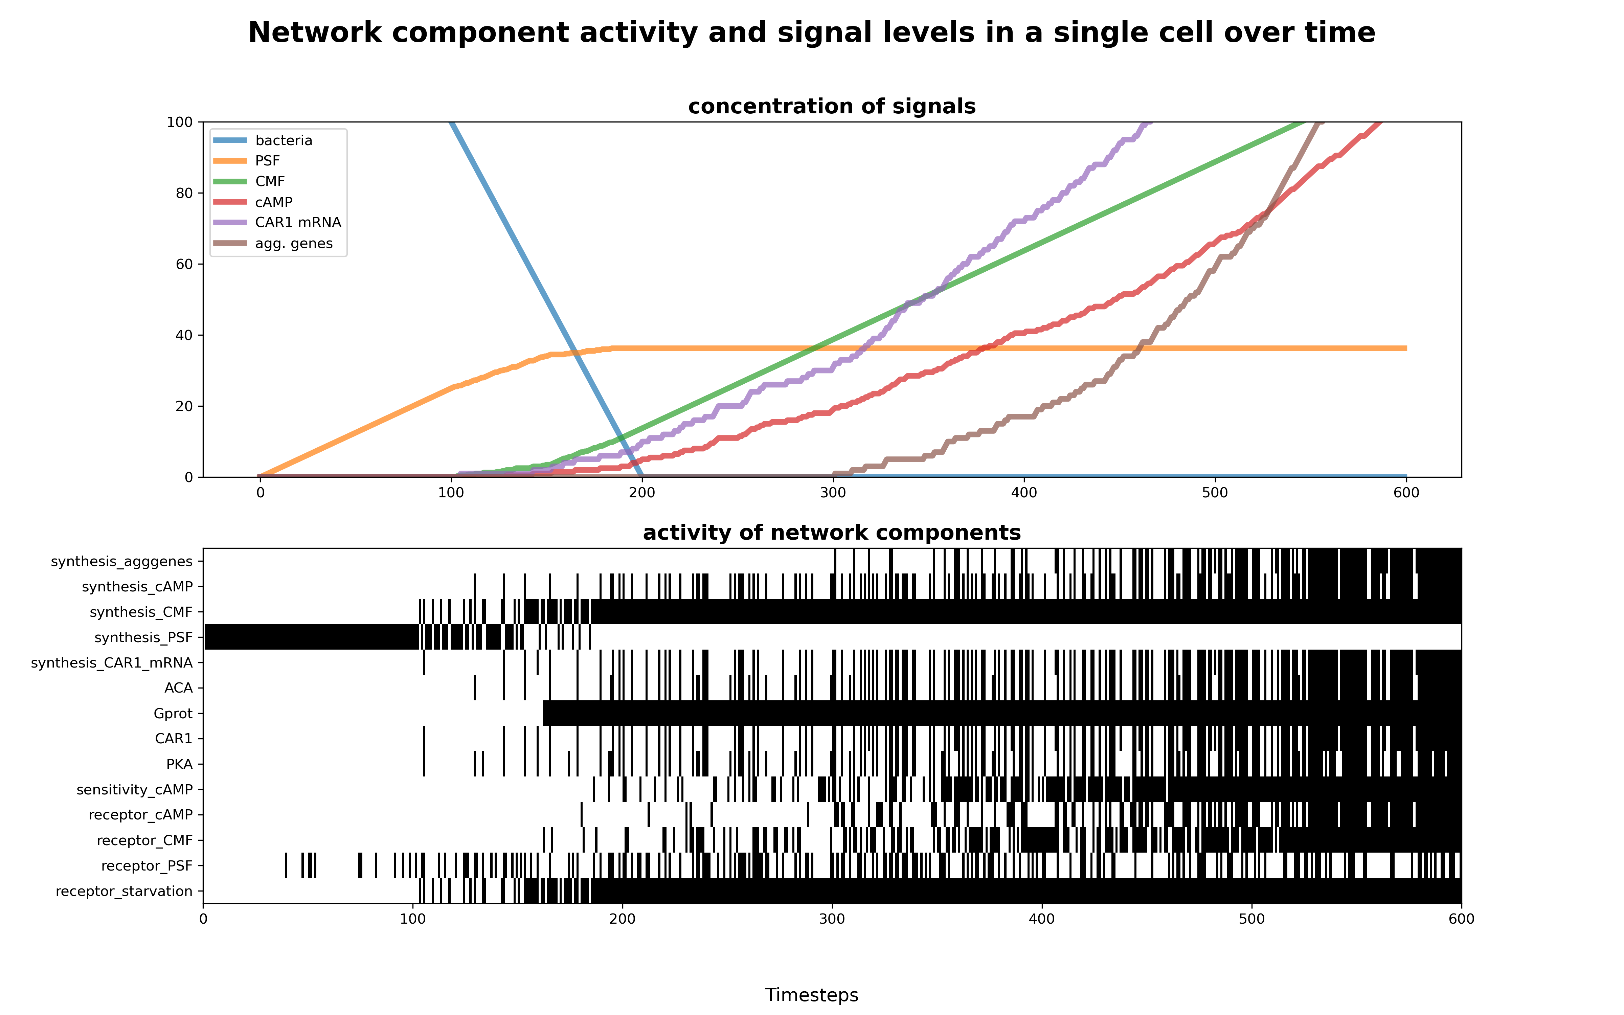
Single cell model reproduces expected temporal behaviour, and the inherent stochasticity of transcription

Slide 10
1D spatial model
Single cell model is extended by allowing extracellular signals
(PSF, CMF, cAMP) to diffuse between neighbouring grid cells arranged in a line
  Diffusion rates for the signals depend on the size of the molecule
The collective behaviour of cells in a grid unit is modelled via a single cell. However, grid units now have a cell density parameter, which multiplies the rate at which signals are produced
The starting cell density, and starting bacterial concentrations are drawn from truncated normal distributions with variable standard deviation
  Truncation is to avoid ≈0 cell densities or bacterial concentrations
Internal cell state, the level of extracellular signals (Bacteria, PSF, CMF, cAMP) and internal signals (CAR1 mRNA) are tracked over time
The lack of cAMP export by Dictyostelia in groups 1-3 is modelled by setting the diffusion rate of cAMP to 0, thereby making it an intracellular signal

Slide 11
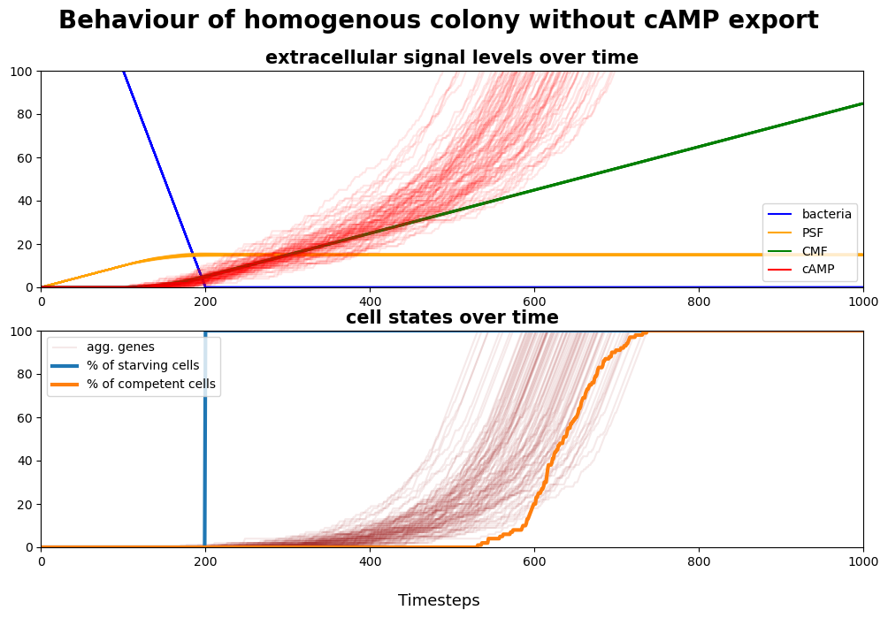
1D model: Colony behaviour in groups 1-3 without cAMP export
When starvation is synchronous, the moderate de-synchronization in the timing of aggregation competence is due to intracellular stochasticity alone.

Slide 12
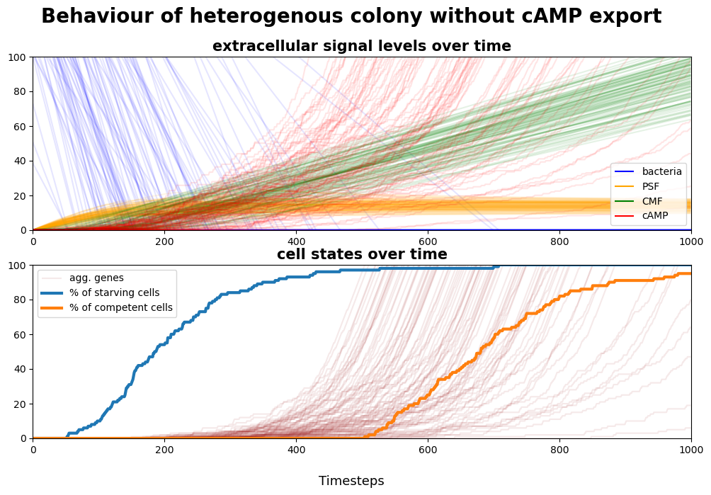
1D model: Colony behaviour in groups 1-3 without cAMP export
When starvation is synchronous, the moderate de-synchronization in the timing of aggregation competence is due to intracellular stochasticity alone.
When starvation is asynchronous due to variability in cell densities and starting bacterial concentrations, intracellular stochasticity and environmental heterogeneity compound to increase the spread in the timing of aggregation competence
Despite PSF and CMF signals diffusing across the colony, cell-cell communication alone is not able to synchronize the population

Slide 13
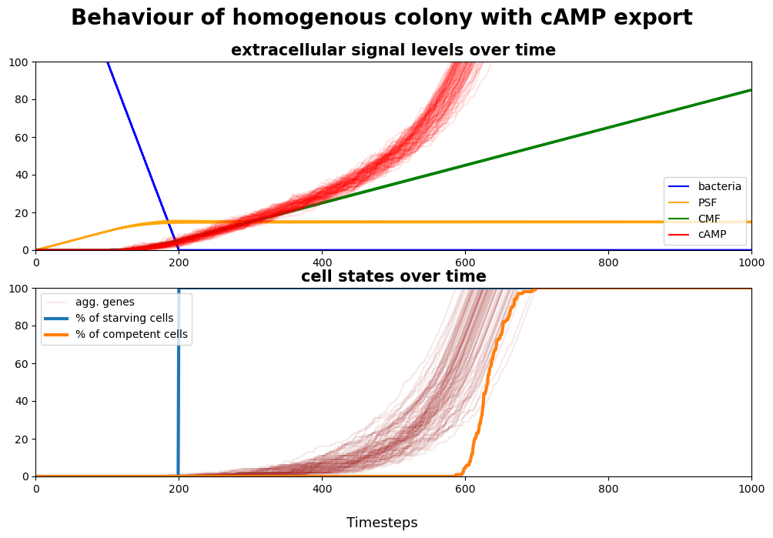
1D model: Colony behaviour in group 4 with cAMP export
When starvation is synchronous, diffusing cAMP signals can overcome intracellular stochasticity to synchronize aggregation

Slide 14
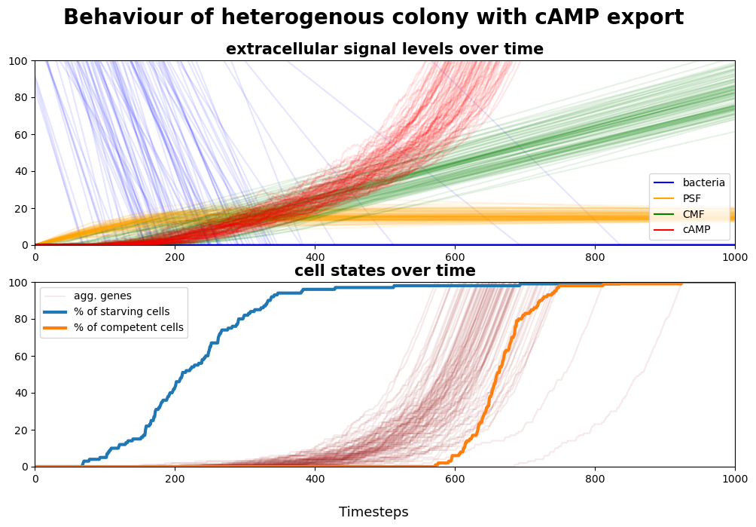
1D model: Colony behaviour in group 4 with cAMP export
When starvation is synchronous, diffusing cAMP signals can overcome intracellular stochasticity to synchronize aggregation
When starvation is asynchronous due to variability in cell densities and starting bacterial concentrations, the positive feedback loop induced by cAMP signals synchronize aggregation competence, despite varying PSF and CMF levels
cell-cell communication coupled with positive feedback loops can maintain colony synchronicity, even in the face of significant noise

Slide 15
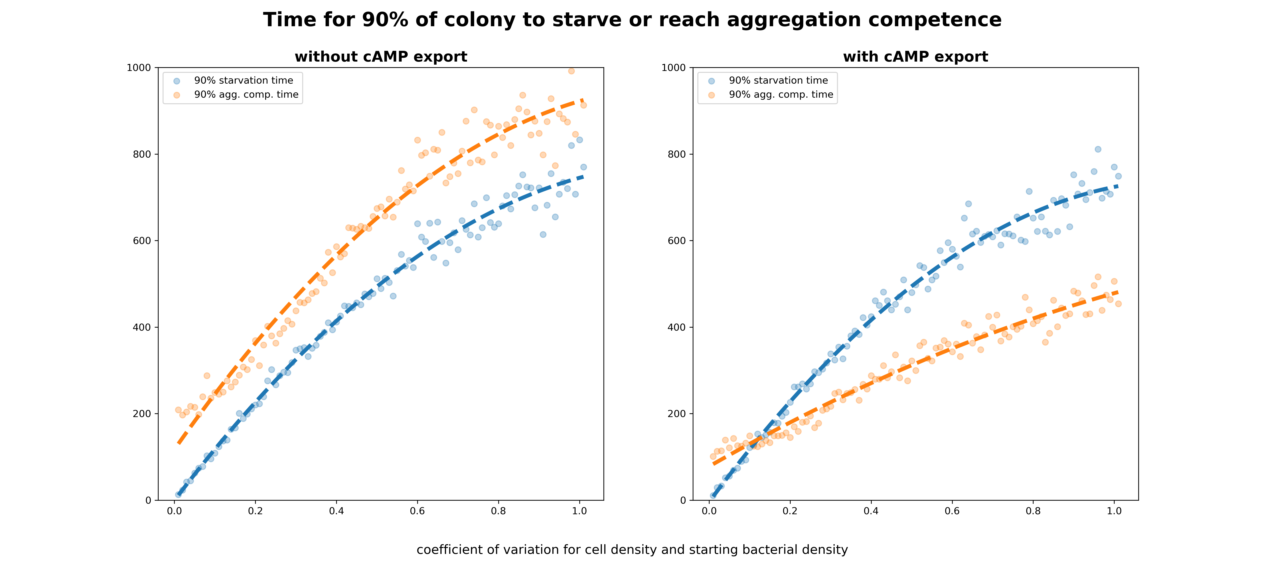
Comparison of predicted colony behaviour in groups 1-3 vs group 4 across a range of heterogeneity levels using the 1D model

Slide 16
Comparison of predicted colony behaviour in groups 1-3 vs group 4 across a range of heterogeneity levels using the 1D model

Slide 17
Conclusions
Dictyostelium groups must synchronize cell fate decisions to succeed in their multicellular development
The synchronization of autonomous cell fate decisions is made difficult by the intrinsic stochasticity of cells, and variability in their environment
Phylogenetic analysis suggests that the increased colony sizes of group 4 Dictyostelia are due to the export of cAMP, a signalling molecule involved in a positive feedback loop.
The 1D spatial model suggests that when cell-cell signalling is coupled with a positive feedback loop, noise arising from environmental heterogeneity and intracellular stochasticity can be effectively buffered, allowing the population to make collective deterministic cell fate choices

Slide 18
Limitations
A boolean circuit model represents a significant simplification of the intracellular processes driving decision-making
Precise measurements for the level of extracellular signals over time are not available in the literature
Time domain RNAseq data used to calibrate transcription levels only has a resolution of 1-2 h
Other signalling molecules are known to be involved in the initiation of aggregation, but their regulatory networks are not currently known

Slide 19
Thank you for your attention!
Any questions?

