Slide 1
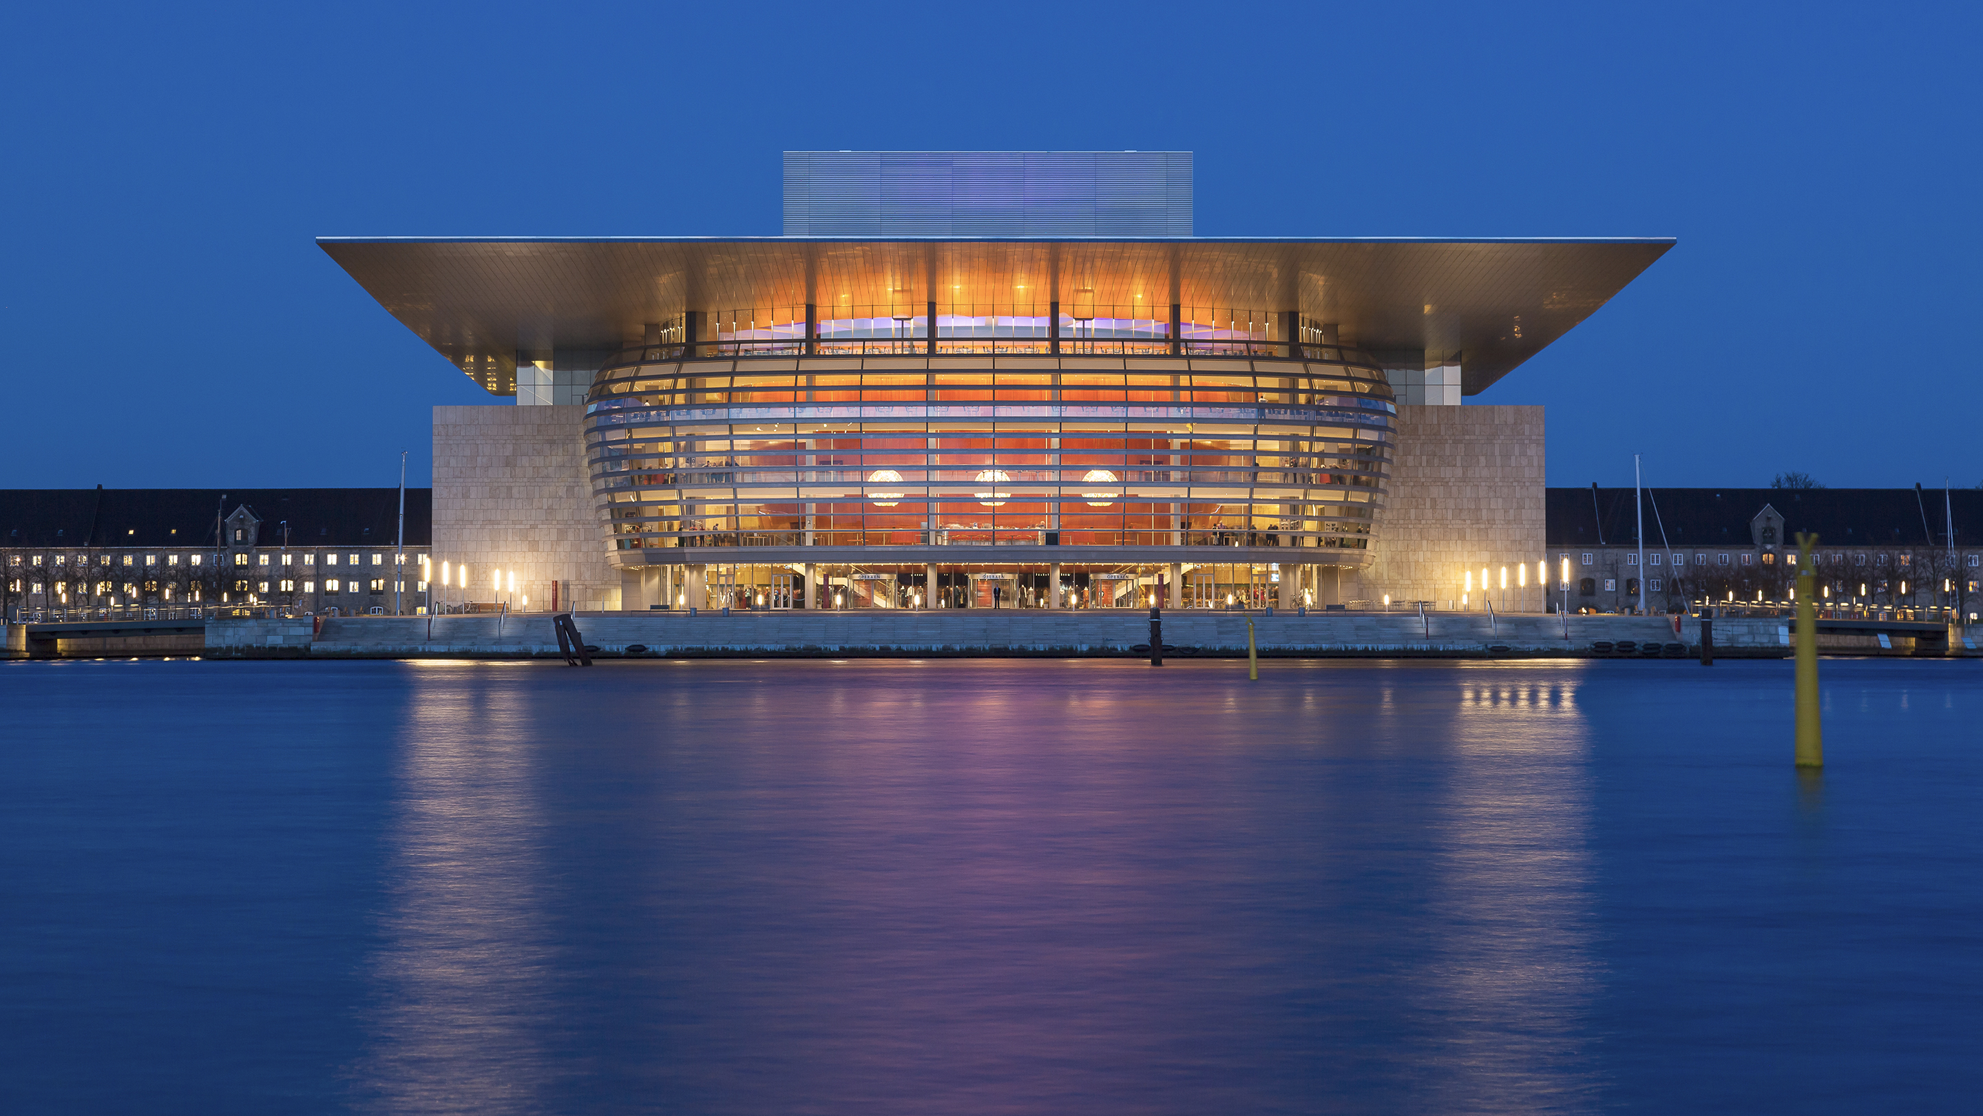
The Battle of Neighborhoods
D K , Toronto 2020
Capstone Project

Slide 2
Agenda
1. Introduction: Business Problem
2. Data Section
3. Methodology
4. Results
5. Discussion and Conclusion

Slide 3
Introduction: Business Problem
The purpose of this project is to help people in exploring housing options in close neighborhood of hockey arena in Toronto.
Vast majority of families in Toronto have children who practice professional hokey. In a busy and traffic-congested city like Toronto, it is important to have a good connection with hokey arena to save time for traveling between home and practice numerous times a week. Having a hockey arena in a close neighborhood provides opportunity for families with college or professional players to save time and money.
This project will help people to get awareness of the area and neighborhood before moving to a new city or relocating to a new neighborhood, knowing that it meets their requirement.

Slide 4
Data
Fundamental data for the project consisting of Postal Code, Borough, and Neighborhood will be scrapped from wikipedia.
Data Link: https://en.wikipedia.org/wiki/List_of_postal_codes_of_Canada:_M Will use Toronto dataset which we scrapped from wikipedia on Week 3. Dataset consisting of latitude and longitude, zip codes.
Foursquare API Data: The cleansed data will then be used alongside Foursquare data, which is readily available. Foursquare is a location data provider with information about all manner of venues and events within an area of interest. Such information includes venue names, locations, menus and even photos. As such, the foursquare location platform will be used as the sole data source since all the stated required information can be obtained through the API.
Foursquare location data will be leveraged to compare neighborhoods in Toronto with close access to hockey area.

Slide 5
Methodology
Data Analysis and Location Data:
Foursquare location data will be leveraged to explore or compare districts around Paris.
Data manipulation and analysis to derive subsets of the initial data.
Identifying the high traffic areas using data visualisation and tatistical nalysis.
Visualization:
Analysis and plotting visualizations.
Data visualization using various mapping libraries.
Clustering Approach:
To compare the similarities of two cities, we decided to explore neighborhoods, segment them, and group them into clusters to find similar neighborhoods in a big city like New York and Toronto. To be able to do that, we need to cluster data which is a form of unsupervised machine learning: k-means clustering algorithm.

Slide 6
Results
Comparing the maps we can notice the neigborhoods in Toronto which are close to hockey arena are Victoria Village and Humewood-Cedarvale lockated on the north side of the city.
Recommended zones should therefore be considered only as a starting point for more detailed analysis which could eventually result in location which has not only no nearby competition but also other factors taken into account and all other relevant conditions met.

Slide 7

Neigborhoods in Toronto with hockey arena

Slide 8
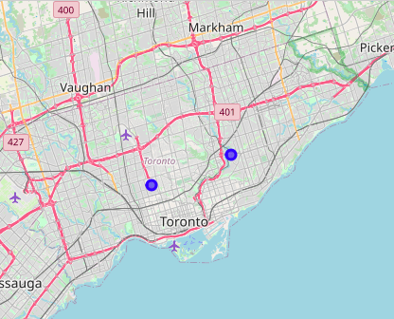
Location of hockey arenas in
Victoria Village (left) and
Humewood-Cedarvale (right)

Slide 9
Discussion and Conclussion
Results of the project shows clearly that the neighborhoods with the close coonection to the hockey arenas are located on the suberbs of the city of Toronto. It might be assisiated with the high trafffic demands during sport events. The suburb home location are more popular among families, thus the requirement for hockey facilities might be linked to the advantage of living away from the downtown.
Purpose of this project was to identify Toronto neighborhoods close to hockey arena for people who are connected to the intense schedule of practicing. By calculating hockey arenas in the city this reports aims to aid stakeholders in narrowing down the search for optimal location for a new home.
Clustering of those locations was then performed in order to create major zones of interest (containing greatest number of potential locations) and addresses of those zone centers were created to be used as starting points for final exploration by stakeholders.

