Slide 1
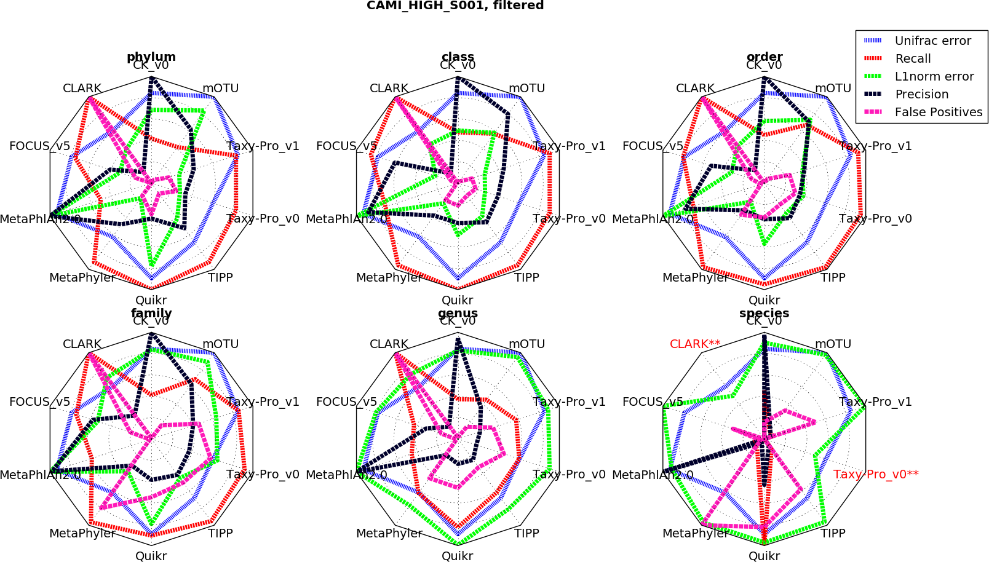
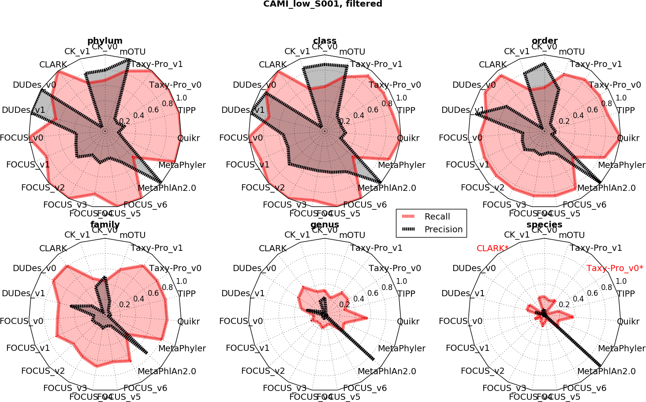

Slide 2
Metric | Best method (score) | Second best method (score) | Third best method (score)
Recall | Quikr (43) | TIPP (61) | Taxy Pro v1 (66)
Precision | MetaPhlAn 2.0 (16) | Common Kmers v0 (29) | mOTU (54)
L1 Norm | MetaPhyler (42) | FOCUS v5 (71) | TIPP (78)
Unifrac | MetaPhyler (4) | Taxy-Pro v0 (4) | CLARK (5)

Slide 3
a)
b)
Metric | Best method (score) | Second best method (score) | Third best method (score)
Recall | Quikr (43) | TIPP (61) | Taxy Pro v1 (66)
Precision | MetaPhlAn 2.0 (16) | Common Kmers v0 (29) | mOTU (54)
L1 Norm | MetaPhyler (42) | FOCUS v5 (71) | TIPP (78)
Unifrac | MetaPhyler (4) | Taxy-Pro v0 (4) | CLARK (5)
c)

