Slide 1
Donkeylift
A relational data store with the data owner in mind.

Slide 2
Objectives
Provide user-friendly, feature-rich Data-as-a-Service.
Provide a platform for application developers.
Leverage the relational data model.
Reduce implementation times of new databases.
Share data management with content administrators.
Improve overall data integrity, quality and transparency.

Slide 3
Scope
Schema Editor - web app.
Data Browser - web app.
Data Editor - Excel plugin.
Data Access Layer – web service.
Data storage –relational database (sqlite).

Slide 4
Architecture

Slide 5
Data Browser
Leverage, don’t suffer the relational data model

Slide 6
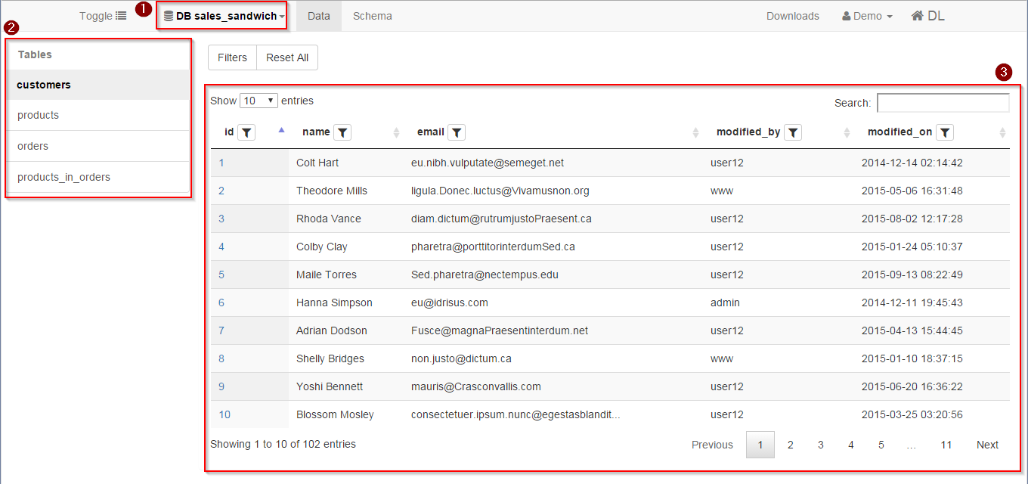
Data Browser –Navigation

Slide 7
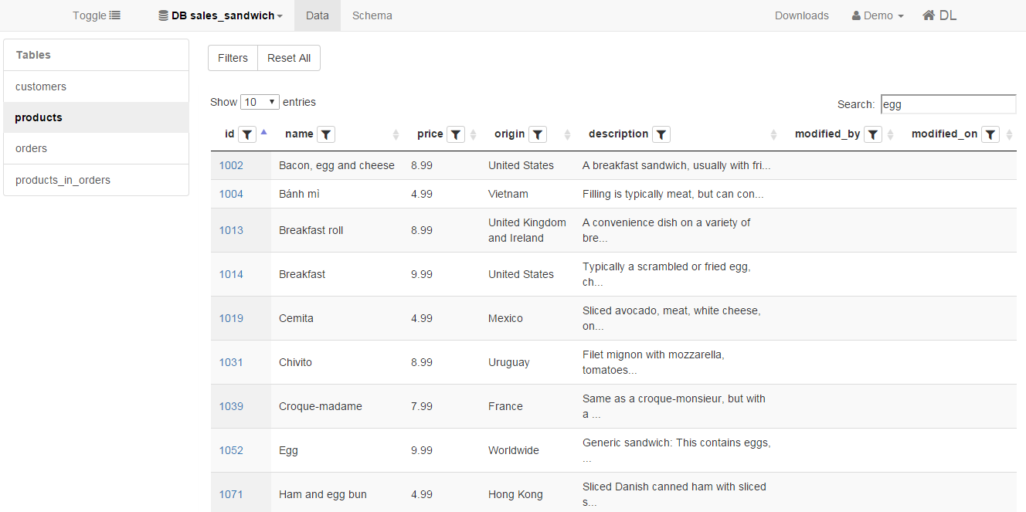
Data Browser –Full text search

Slide 8
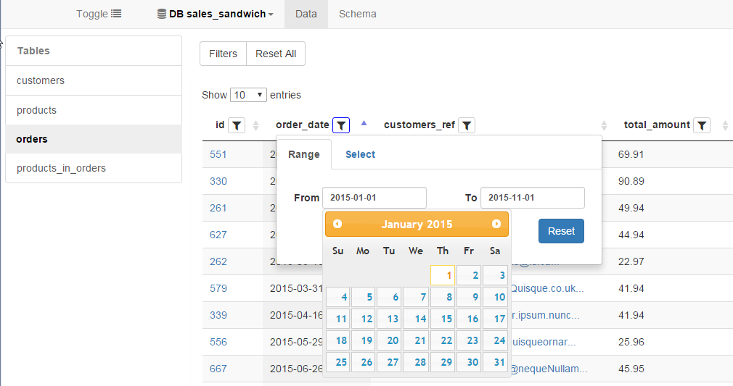
Data Browser – Filter by Range

Slide 9
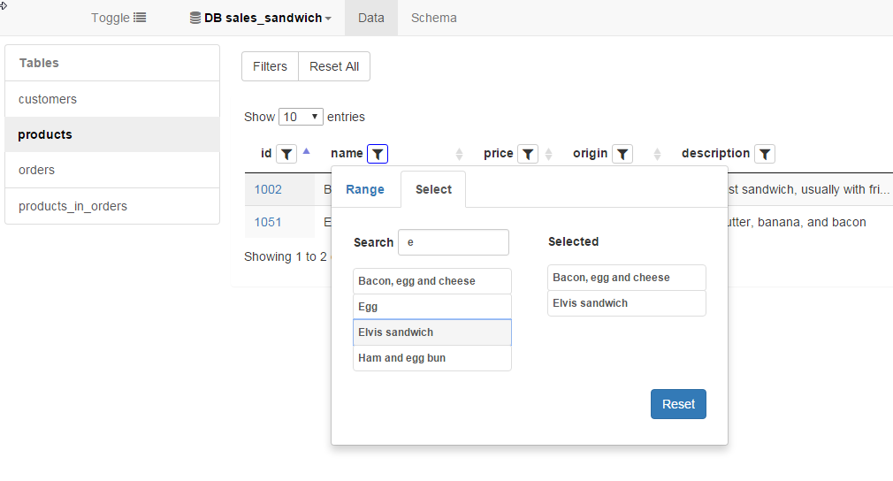
Data Browser – Filter by Item Selection

Slide 10
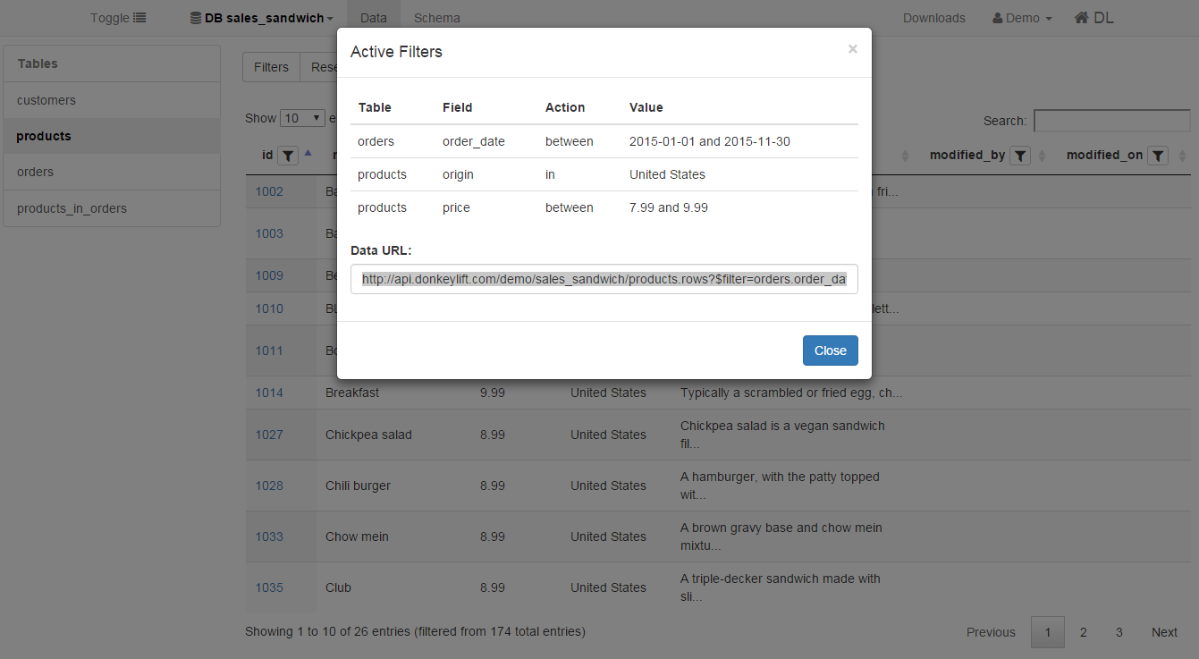
Data Browser – Filter Composition

Slide 11
MSocias
Start with USE CASE
Why relational? ACID
How many customers in:
small online shops
Event orgs.
Etc.
Who provides similar services?

Slide 12
MSocias
Gather immediate feedback. Simple PPT, interview potential clients.
Fixed Questionnaire, few questions to get comparable answers.

